Slide 1
GM#2
유티 오스틴 한인 학생회
texasuka.org

Slide 2
Administration
Dongari Updates
Workshop Plans

Slide 3
Dongari Updates
We are going to hold Dongari Fair today!
Good looking leaders are waiting for you to come to their tabling and talk about their plan for this semester!

Slide 4
Table Tennis
Book Club
Weight Training
Board Game
Existing Dongaries
Basketball
Volleyball
Band
Stock Discussion
Tennis
Gaming

Slide 5
New Dongaries
Table Tennis
Book Club
Weight Training
Board Game
Basketball
Volleyball
Band
Stock Discussion
Tennis
Gaming

Slide 6
New Dongaries
These Dongaries are not created yet, please help us to plan and participate as a leader, today!

Slide 7
Last Workshop
Resume / Career fair

Slide 8
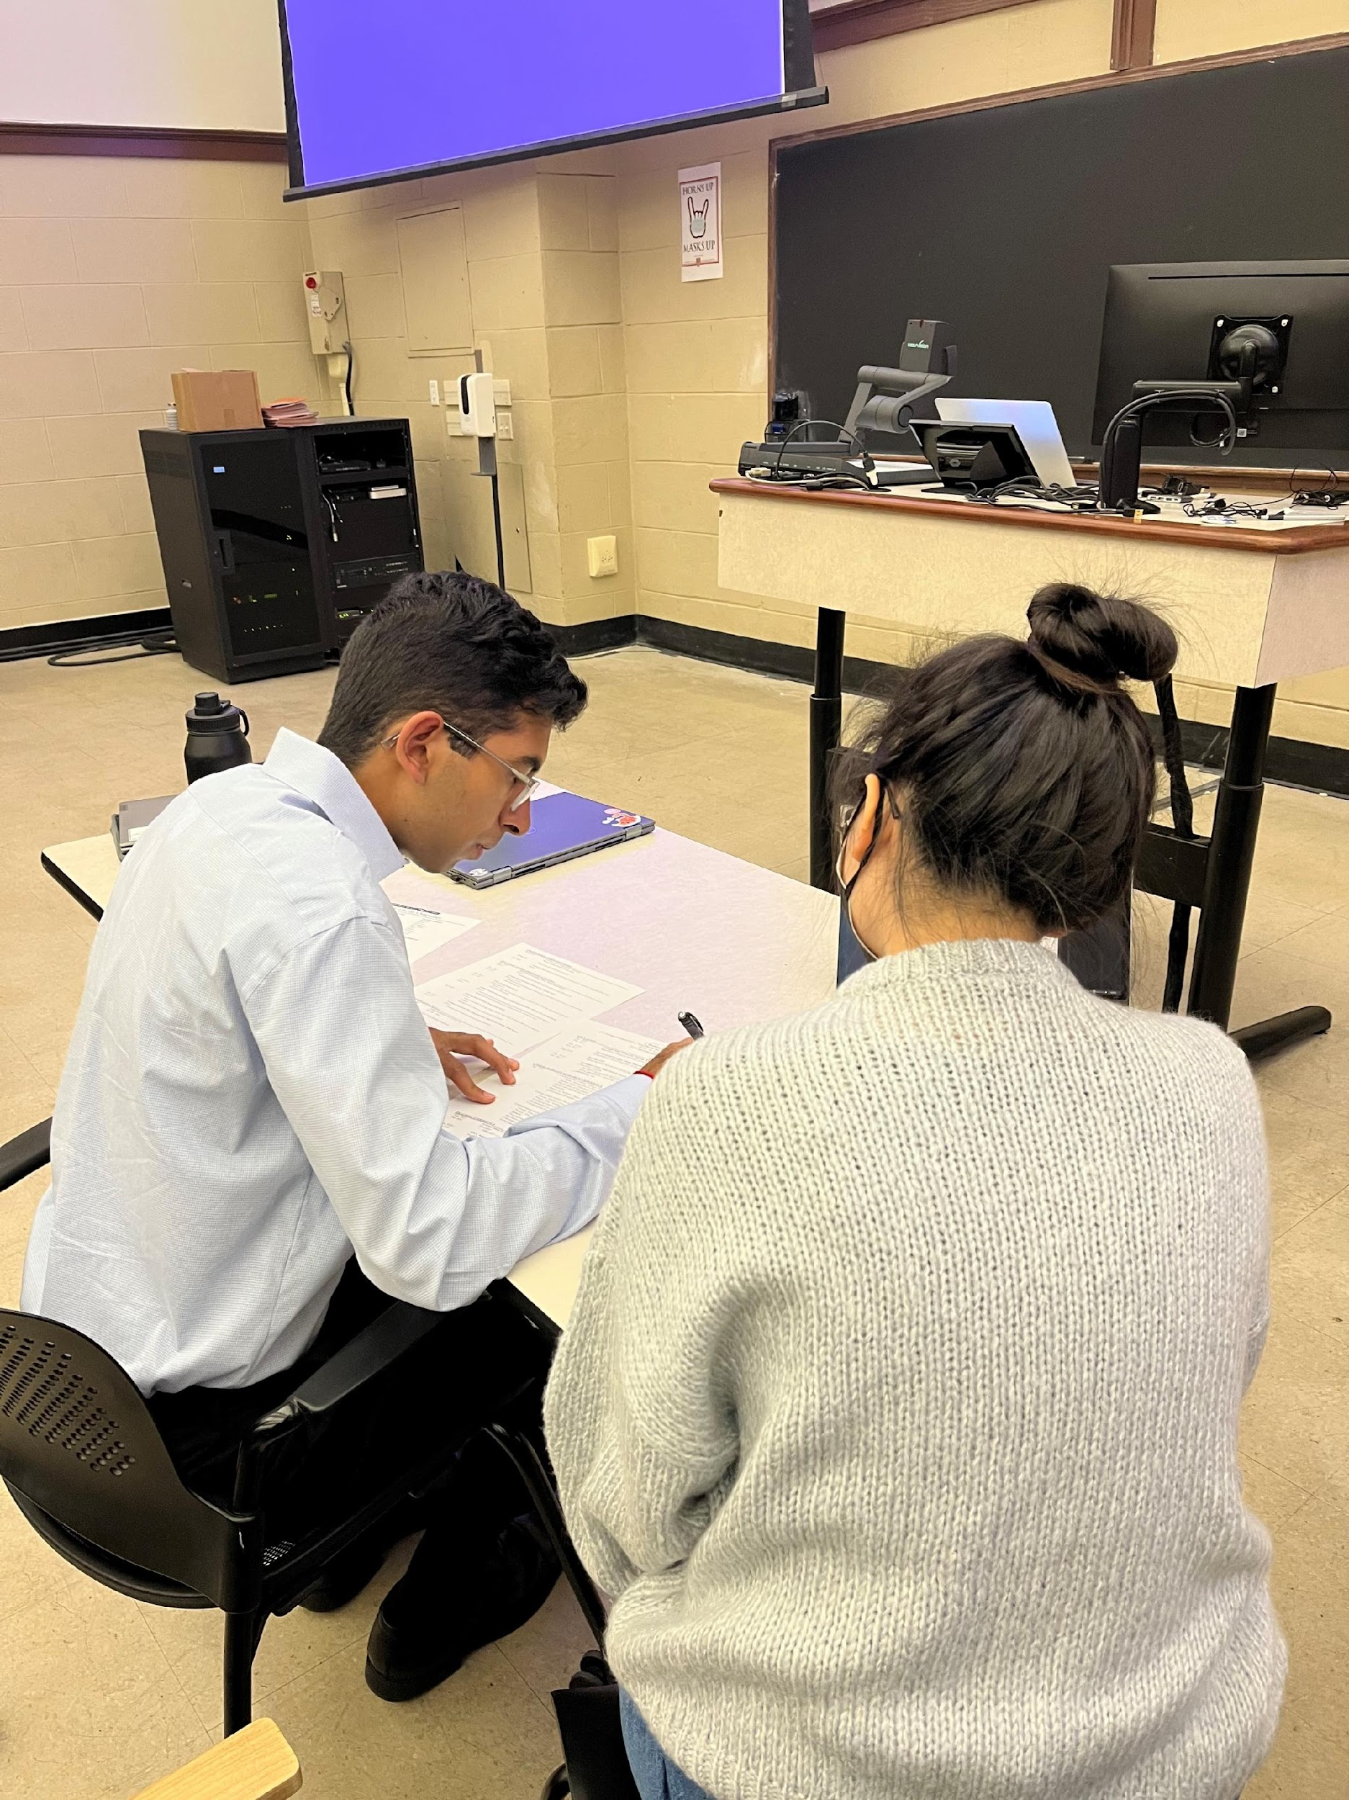
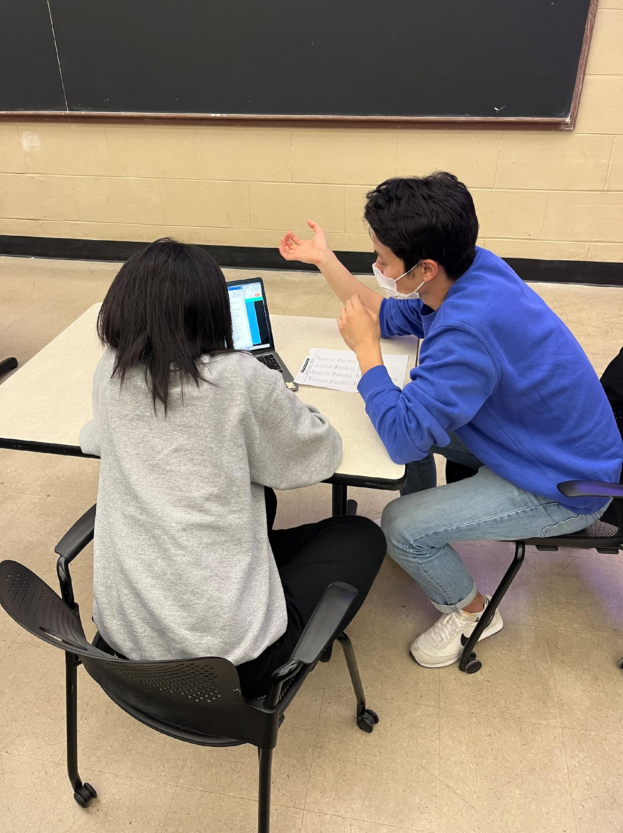
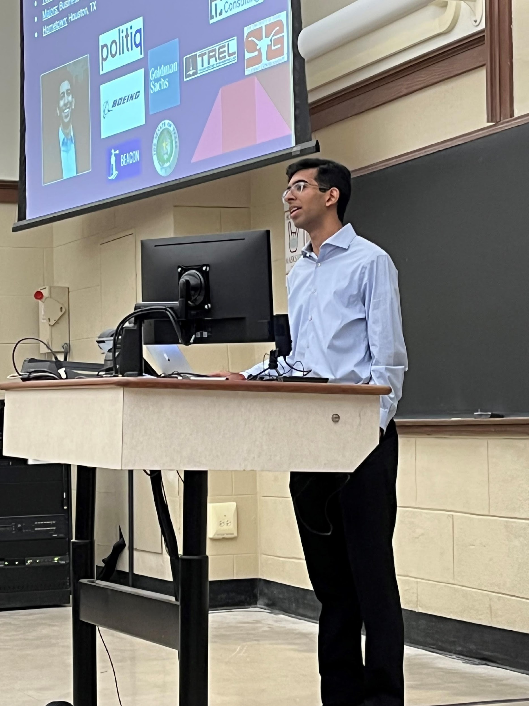
Last Workshop
Resume / Career fair

Slide 9
Next Workshop
Interview Workshop

Slide 10
Next Workshop
When: 2/24 Thursday
Where: Here!
Interview Workshop

Slide 11
Marketing
YouTube
Calendar

Slide 12
YouTube
A YouTube short is coming to our channel this Friday so please subscribe and watch!

Slide 13
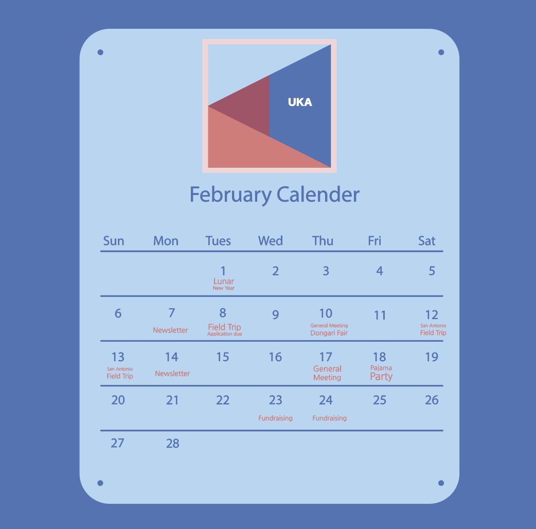
Calendar
Here is our UKA Calendar for February!

Slide 15
Finance
UKA T-Shirts
Scholarships
Membership Fees

Slide 16
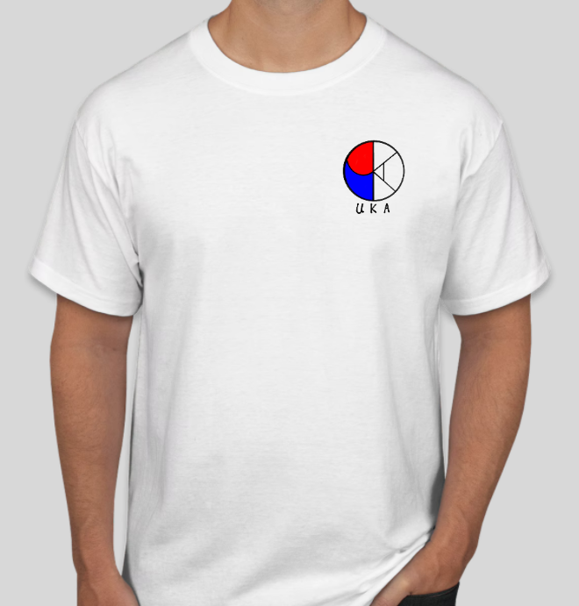
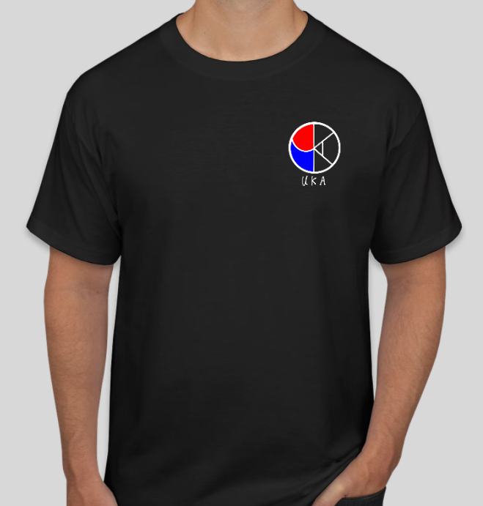
UKA T-Shirt
Orders have been placed!
Receive them by GM3 or GM4
If there is enough stock of shirt available for the second order.

Slide 17
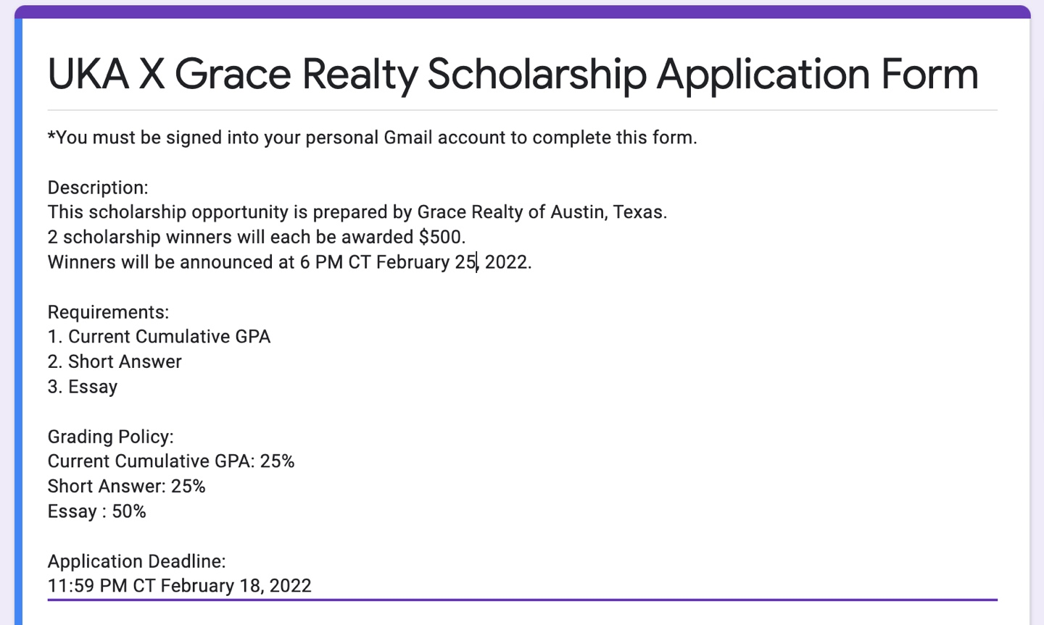
UKA X Grace Realty Scholarship
Chance to win $500
Applications due by 11:59 CT February 18, 2022
Only one short essay and short answer required

Slide 18
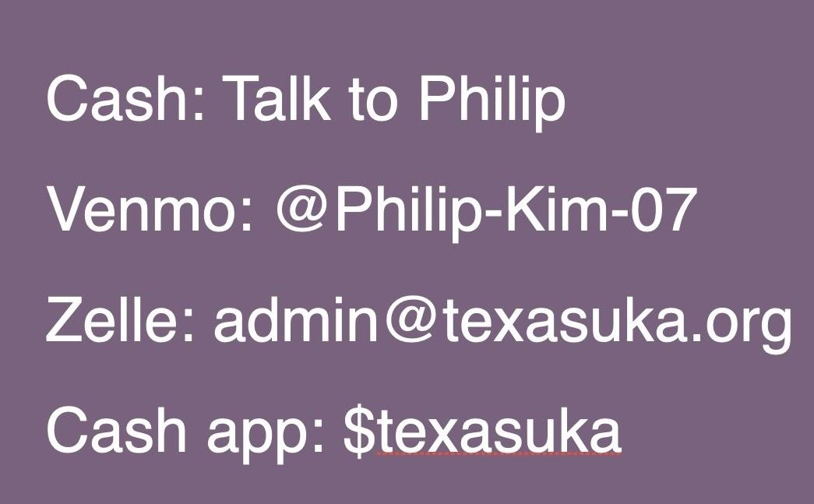
Membership Fees
Only $30 for the Spring Semester!
Pay to enjoy all the benefits of UKA!

Slide 19
Operation
UKA Field Trip
K-Festival
Fam-Fam Update

Slide 20
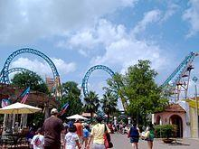
UKA Field Trip
Date: 2/12 – 2/13
Plans
First day: Downtown/Riverwalk
Second day: Six Flags Fiesta Texas

Slide 21
UKA Field Trip
No dues, but you will be accountable for your own spending during the trip.
Hotel rooms are provided.
Incentives for drivers:
Money for gas
Free dinner

Slide 22
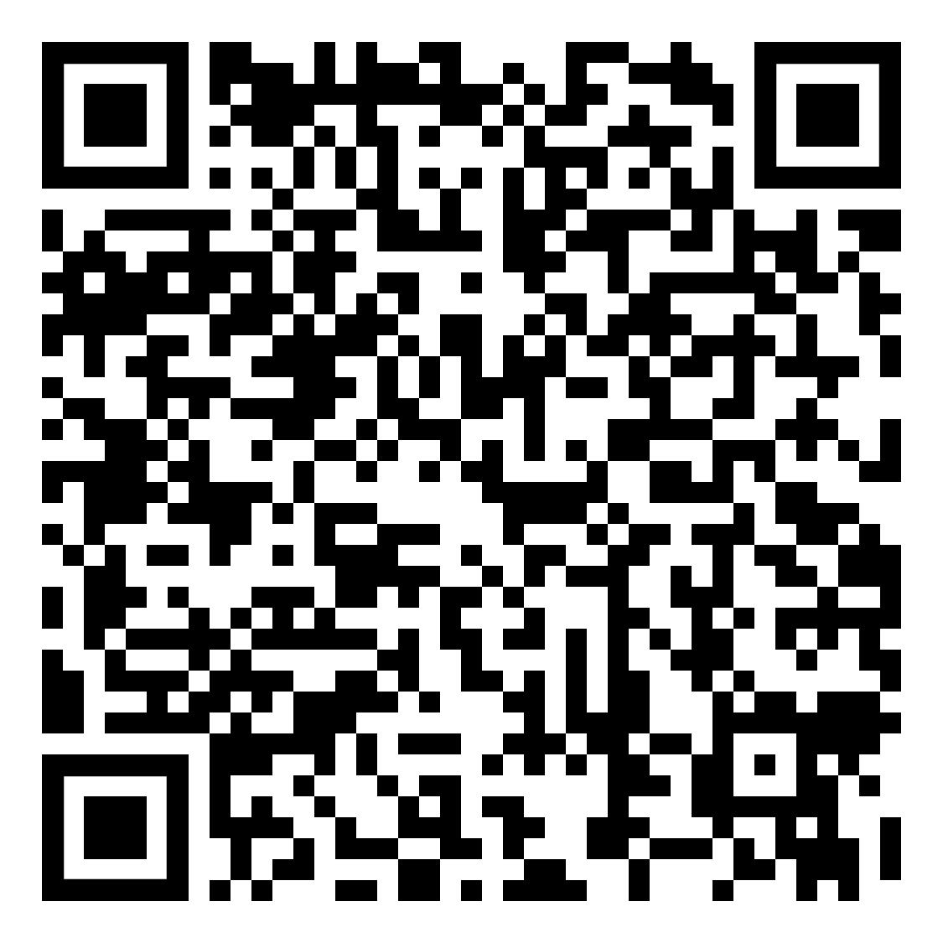
UKA Field Trip
<Sign Up>
Submit the Google Form by 2/10
(Find through Instagram/Group Chat)

Slide 23
K-Festival
If you have any performance/activity suggestions, please let us know!

Slide 24
Fam-Fam Update
New Fam-Fams have been finalized!
Let us know if you want to join one

Slide 25
Informatics
UT Bamboo
YouTube

Slide 26
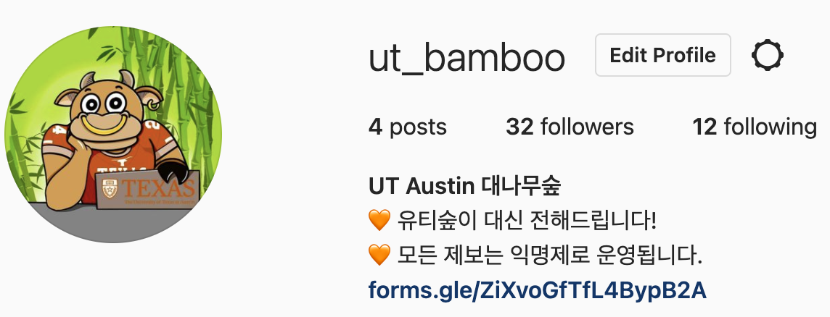
UT Bamboo
Please Follow!!!
We made an Instagram account!
@ut_bamboo

Slide 27
YouTube
UKA TV
Dorm Tour Video Coming Soon!

Slide 28
Dongari Fair

Slide 29
Basketball

Slide 30
Volleyball

Slide 31
Band

Slide 32
Gaming

Slide 33
Stock Discussion

Slide 34
Tennis

