Slide 1
GM 4

Slide 2
Administration
Dongari
Workshop
Major Group Chat

Slide 3
Dongari Update
We give $200 to each Dongari this year!!

Slide 4
Financial support will be provided in the form of REIMBURSEMENT.
Leaders will show us the RECEIPT of the expenses.
There are several PROHIBITED ITEMS we cannot reimburse. Ex) Alcohol

Slide 5
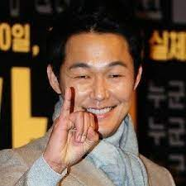
약속 지키자?
More specific criteria will be given to Dongari leaders!!

Slide 6
Workshop Announcement
Our Course Registration for 2022 spring semester starts on October 25th
Course Registration Workshop

Slide 7
Course Registration Workshop
Upperclassmen
(Mentor)
Underclassmen
(Mentee)
One Mentor and several Mentees are going to be matched to share some tips and recommend courses

Slide 8
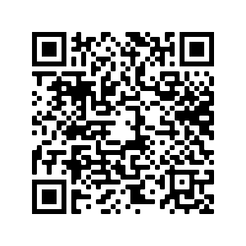
Course Registration Workshop
Therefore, we need to take a SURVEY to estimate the # of participants of Course Registration Workshop.

Slide 9
Major Group Chats
We are planning to create a KAKAOTALK open chat where we can talk about STUDIES or CAREERS and share some tips with the same MAJOR students.
MAJOR

Slide 10
Major Group Chats
Only requested major group chats will be created
The one who requested a major group chat has to be an ADMIN of it.
When the major open chat is created, we will notice others who has the same major to join there.
MAJOR

Slide 11
Informatics
Newsletter
YouTube Crew

Slide 12
Newsletter
Sent out on Tuesday 10/12
Bi-monthly newsletter has begun!

Slide 13
YouTube Crew Application
We need more YouTube Crew!!

Slide 14
YouTube Crew Application
Please Apply!! Be one of us!

Slide 15
Marketing
Squid Game Fundraiser

Slide 16
Marketing
Squid Game Fundraiser

Slide 17
When?
Wednesday, October 20th Thursday, October 21st
10 AM – 4 PM

Slide 18
Where?
Speedway in front of Gregory Gymnasium

Slide 19
What?
Put your life on the line to pick DALGONA :)

Slide 20
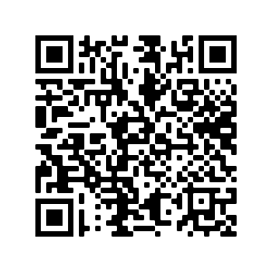
Squid Game Fundraiser Volunteer
Want to help us?
Sign up here!

Slide 21
Squid Game Fundraiser Volunteer
You can be one of us!!

Slide 22
Finance
UKA X KAAGA Scholarship
UKA T-Shirt

Slide 23
UKA X KAAGA Scholarship
Sponsored by Korean American Association of Greater Austin
Application Deadline: 11:59 PM, Sunday, October 31
Winners will be announced on November 7th.

Slide 24
UKA X KAAGA Scholarship
Two recipients will be selected from UKA members

Slide 25
UKA X KAAGA Scholarship
Each will receive $500!

Slide 26
How to Apply:
Fill out personal information form
Proof of Financial Need
1 page essay

Slide 27
UKA T-Shirt
$5 per each shirt!!

Slide 28
UKA T-Shirt
The color of T-shirt will be different between General Member and Director

Slide 29
UKA T-Shirt
Ex)
Any member can DESIGN for UKA T-shirt!
The COOLEST design will be selected

Slide 30
UKA T-Shirt
If your design is selected,
T-shirt is free!!
Your name will be on the designed by on the UKA website

Slide 31
Operation
FAM-FAM Updates
Picnic
Other Upcoming Events

Slide 32
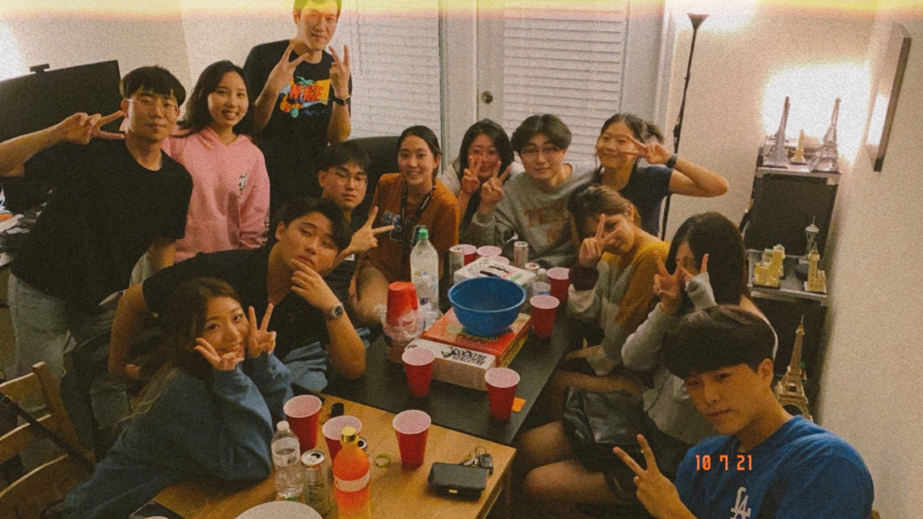
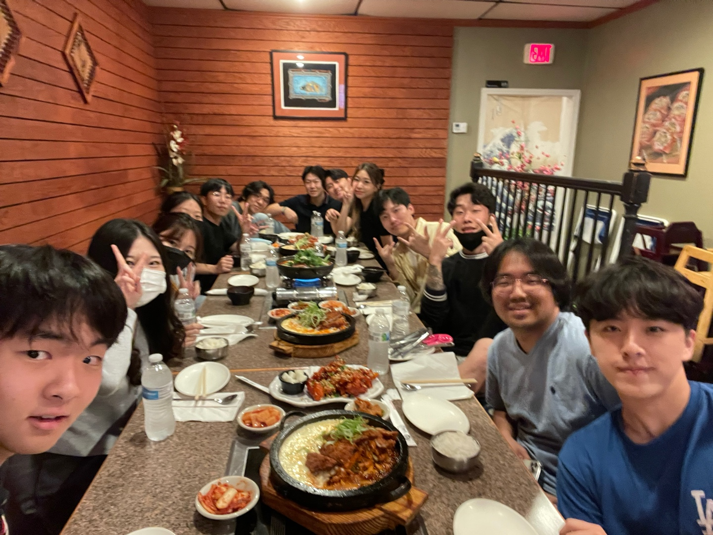
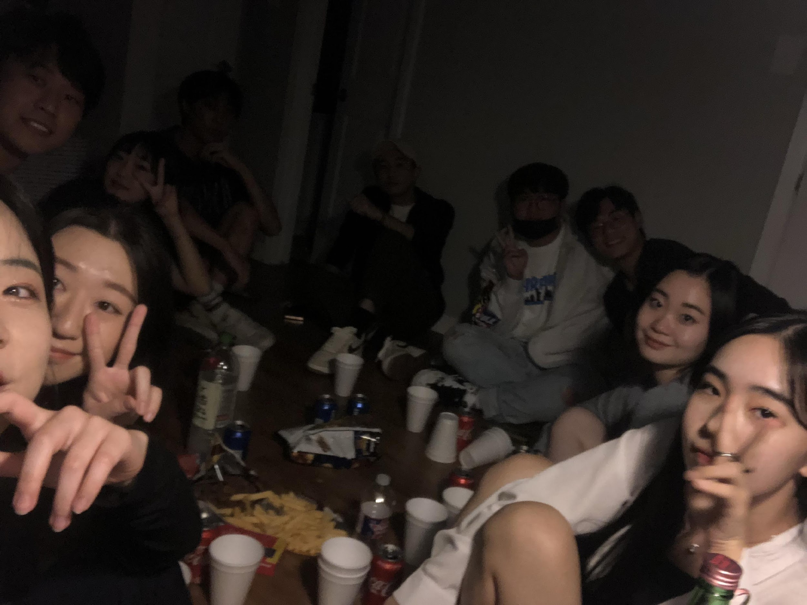
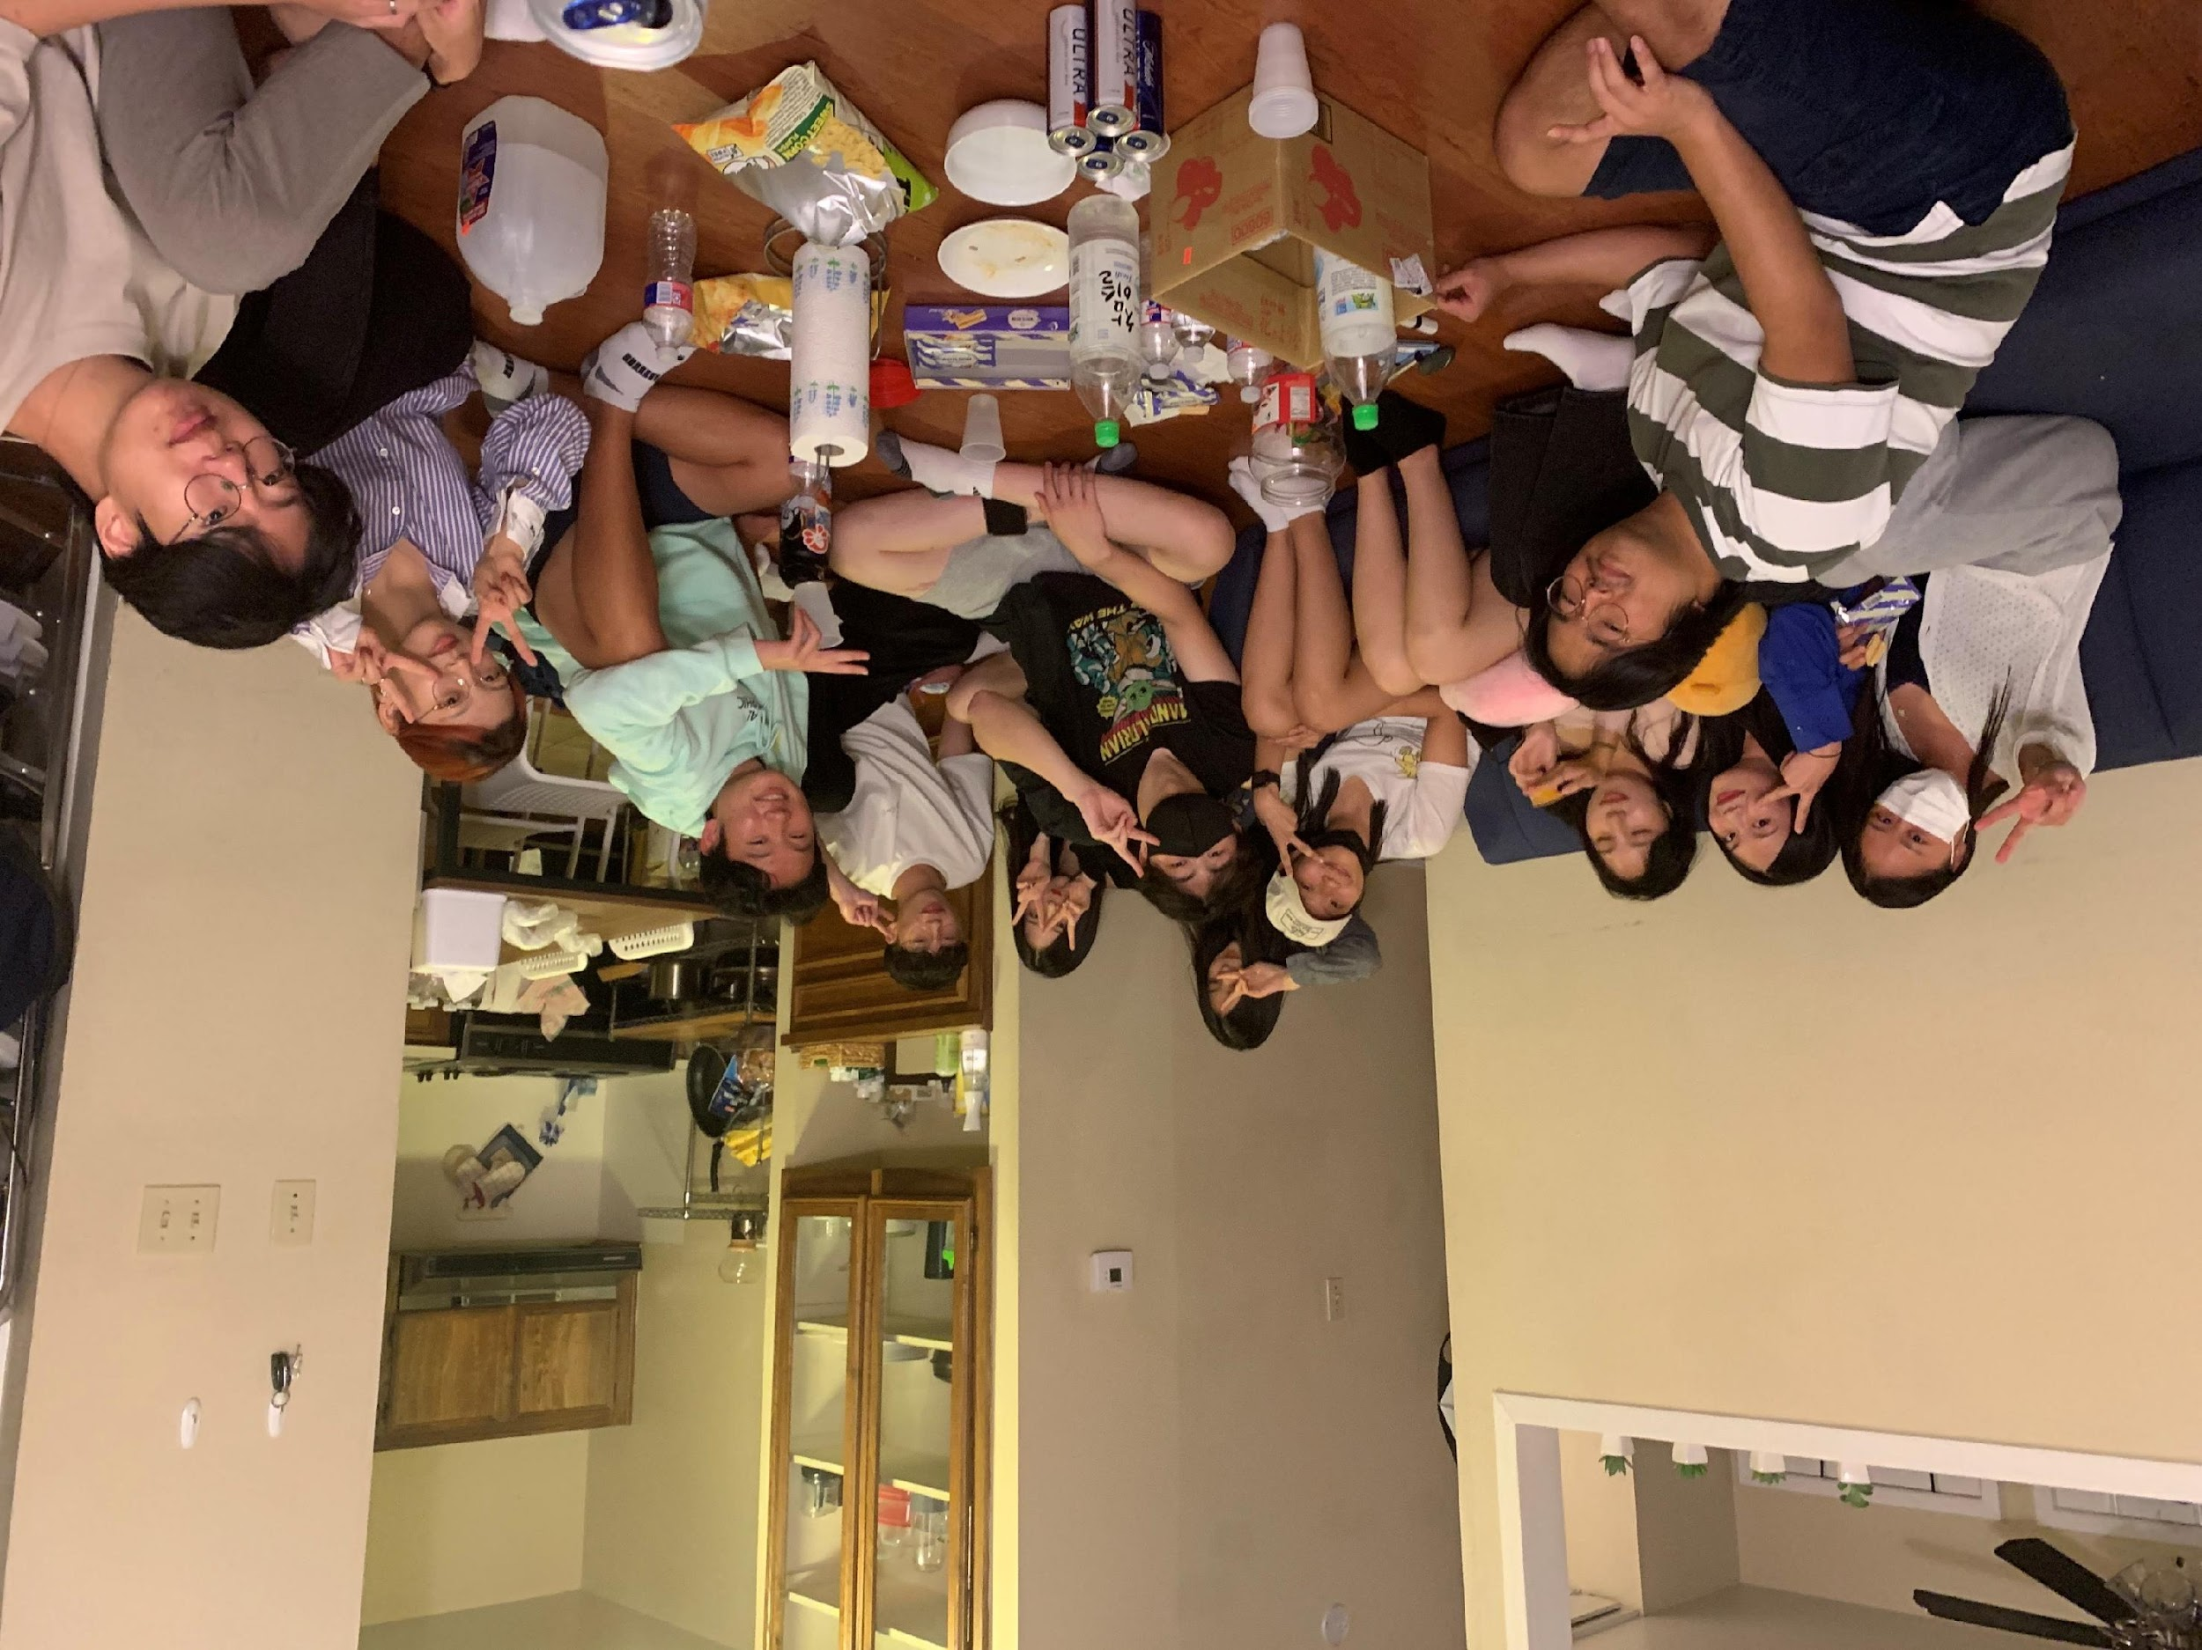
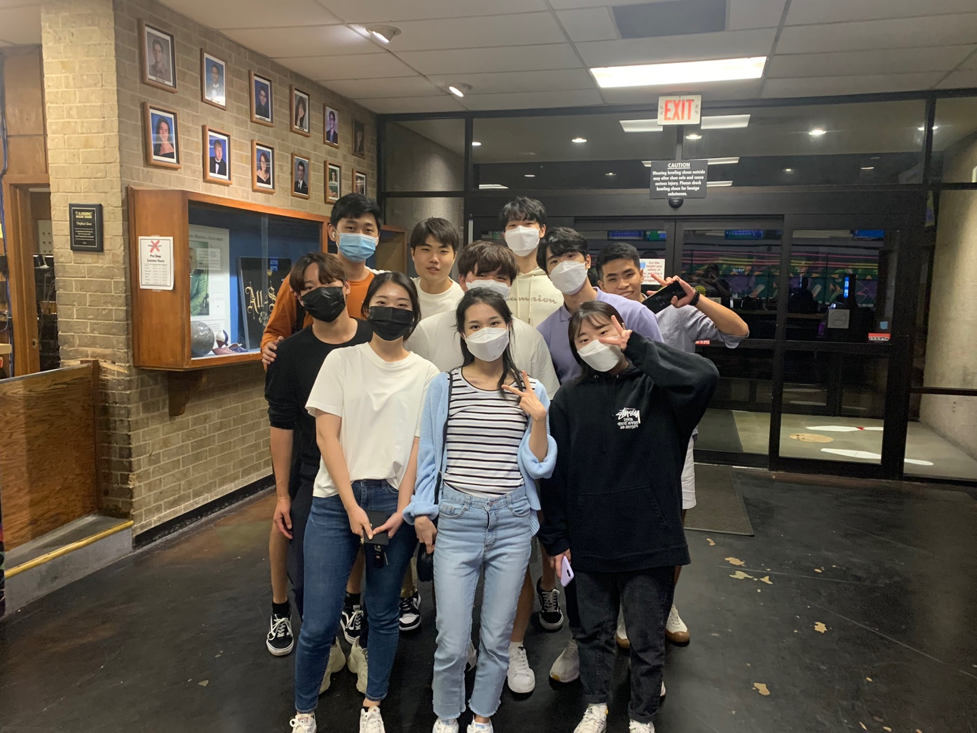
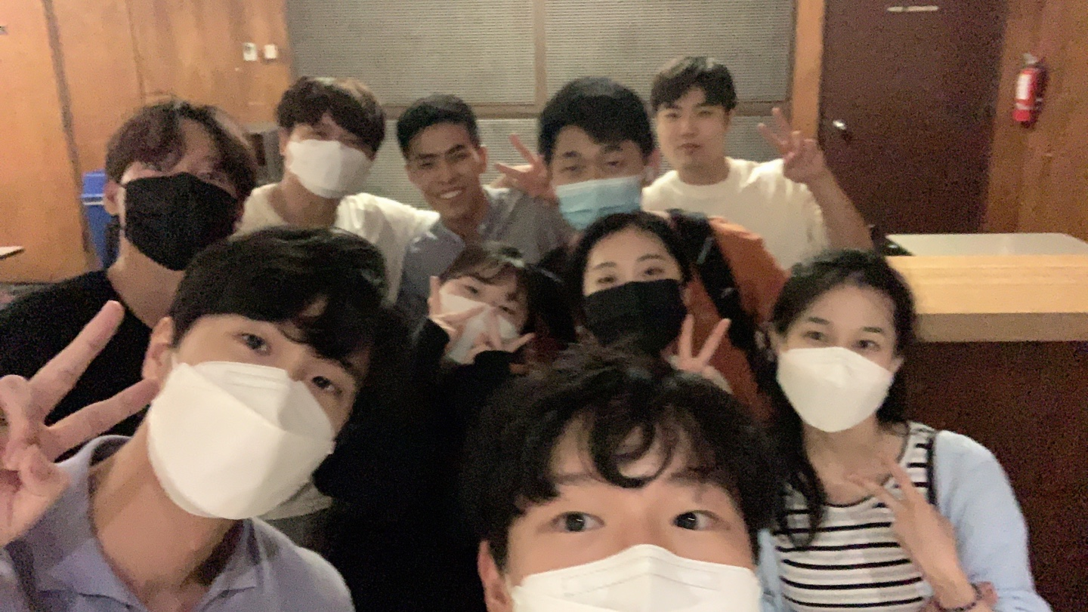
FAM-FAM Updates

Slide 33
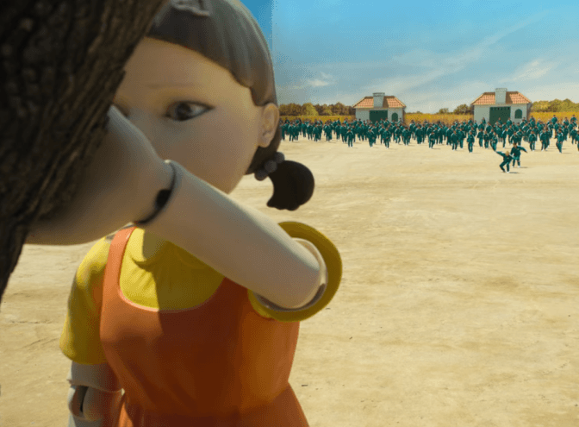
Picnic on Oct. 23!
4:30-7pm!
Good Music!
Fun Games!

Slide 34
Bring your own Food!
Prepare your food with your FAM-FAM members!

Slide 35
You can bring anything to play!

Slide 36
There are games that FAM-FAMs will compete each other.
The winning FAM-FAM will receive $200 as a reward!

Slide 37
Upcoming Events
Bowling Night @Union
11/12, 6 - 8pm
FAM FAMS COMPETING!!!
Friendsgiving
11/20
Christmas Party
12/4, 7:30-10pm
Talent Show!

Slide 38
Internship Panels

Slide 39
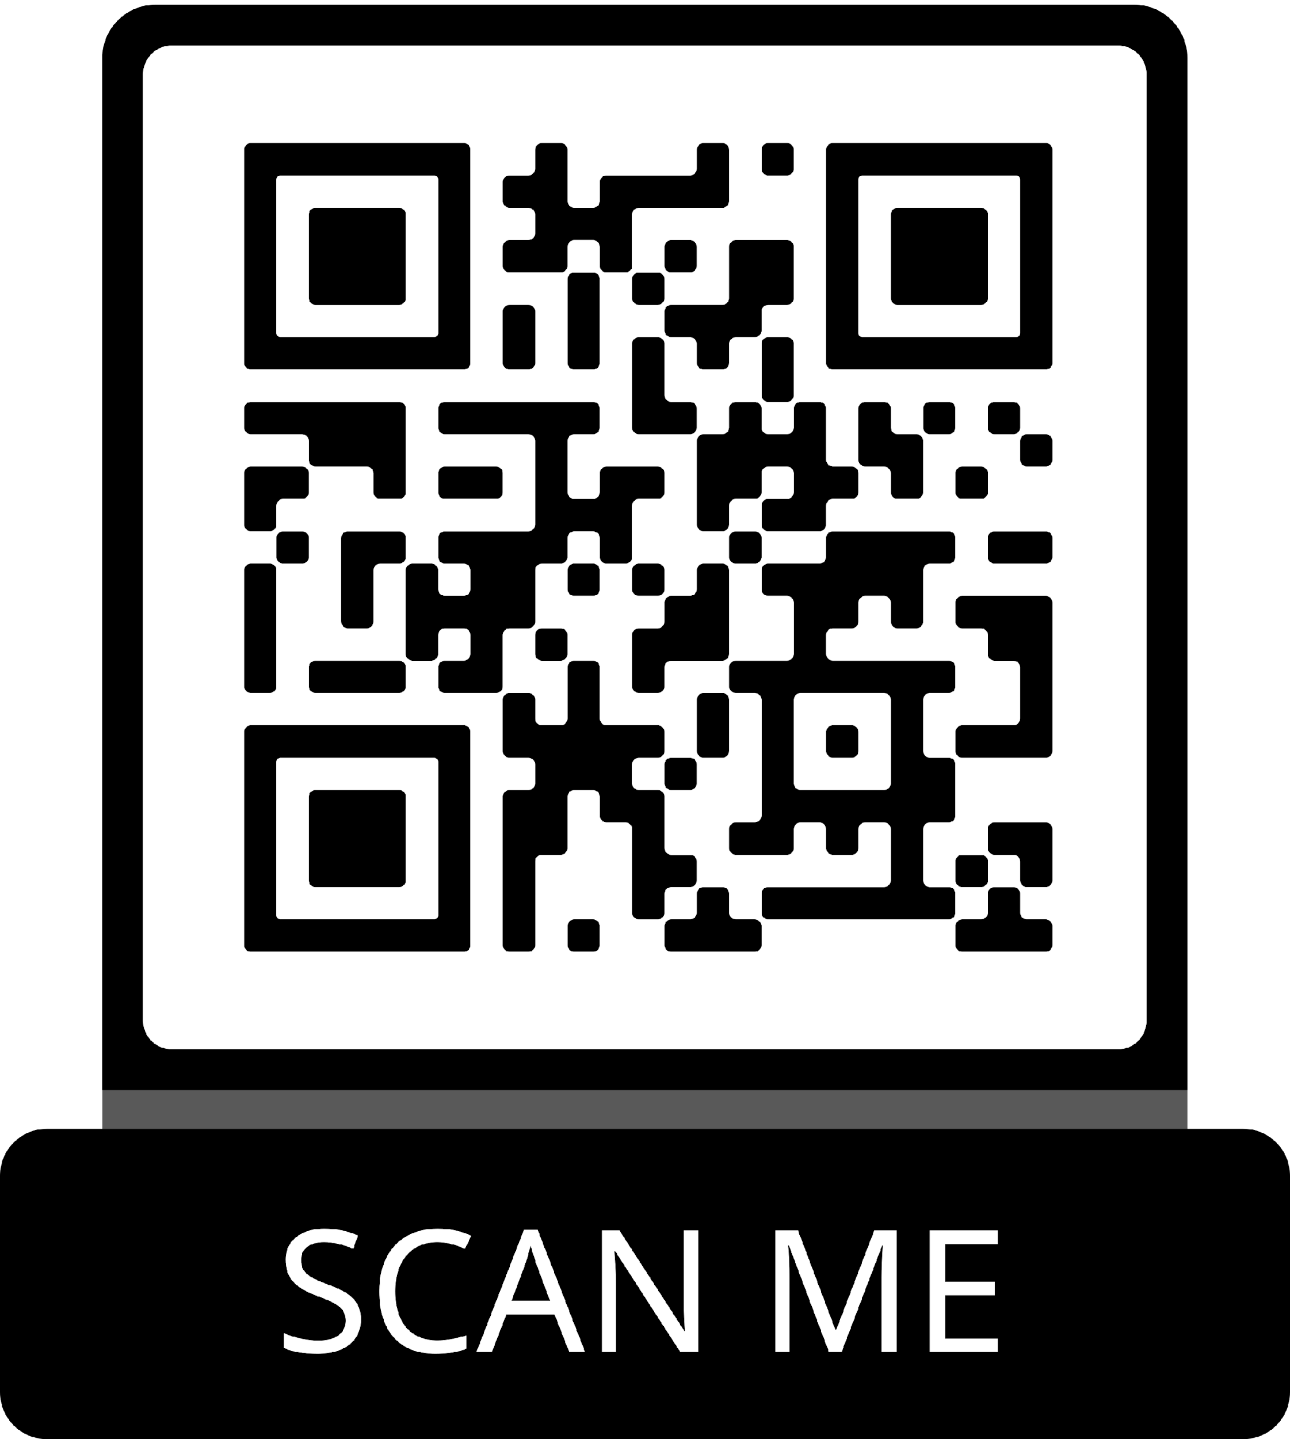
Feedback Form

