Slide 1
21FA
UKA
Recap

Slide 2
Ready for Time Travel?

Slide 4
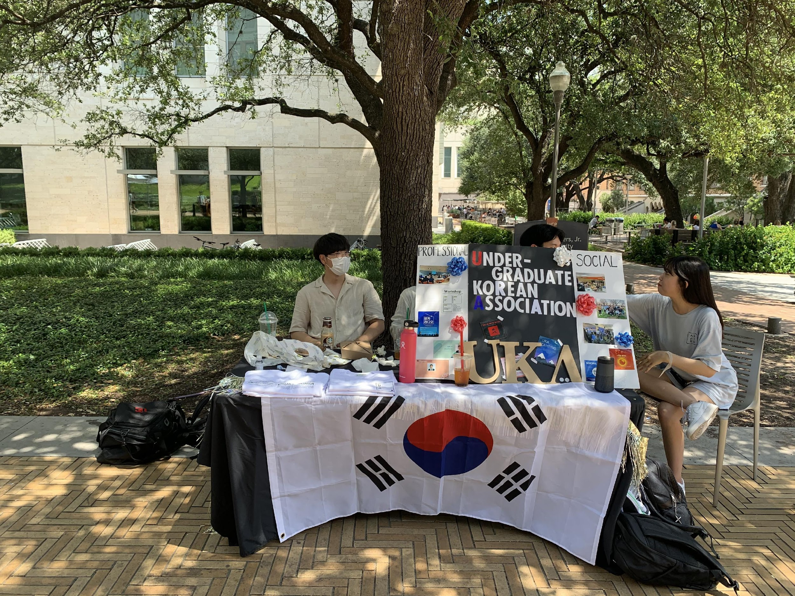
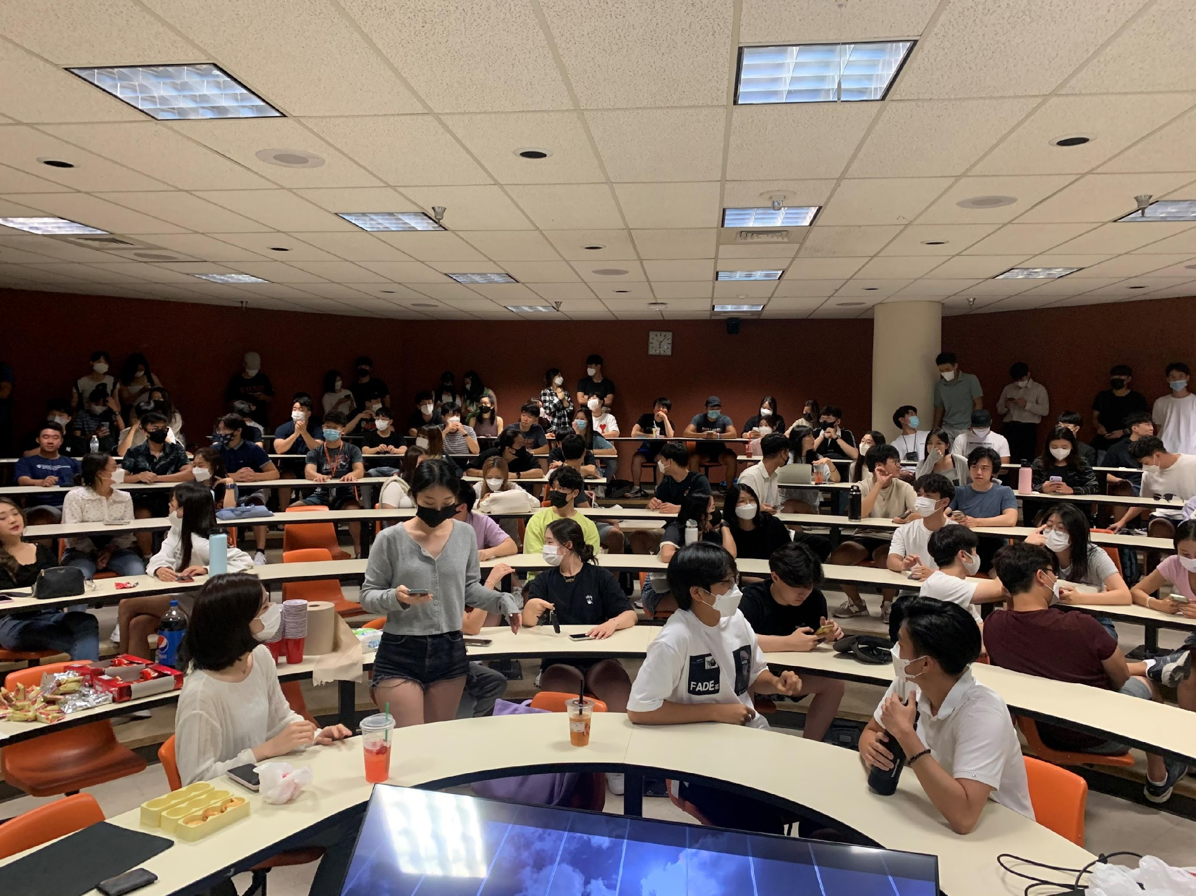
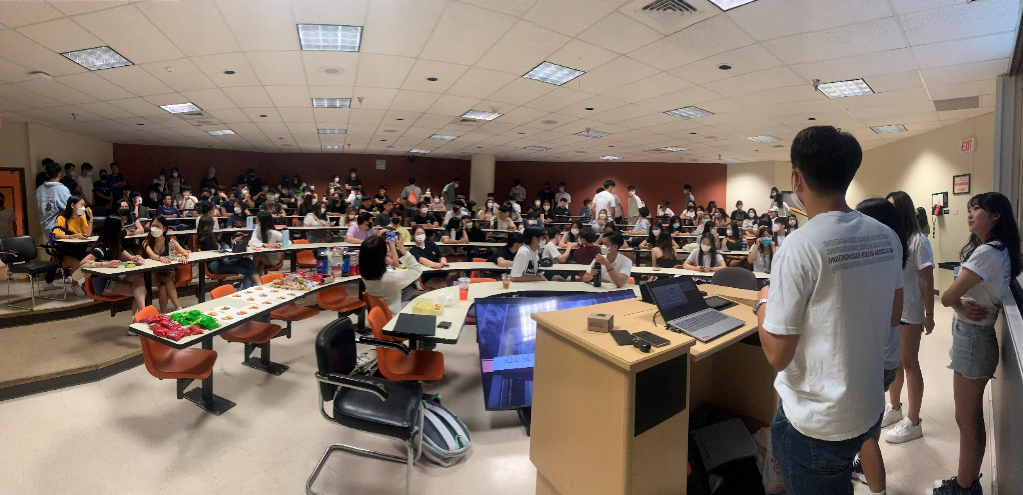
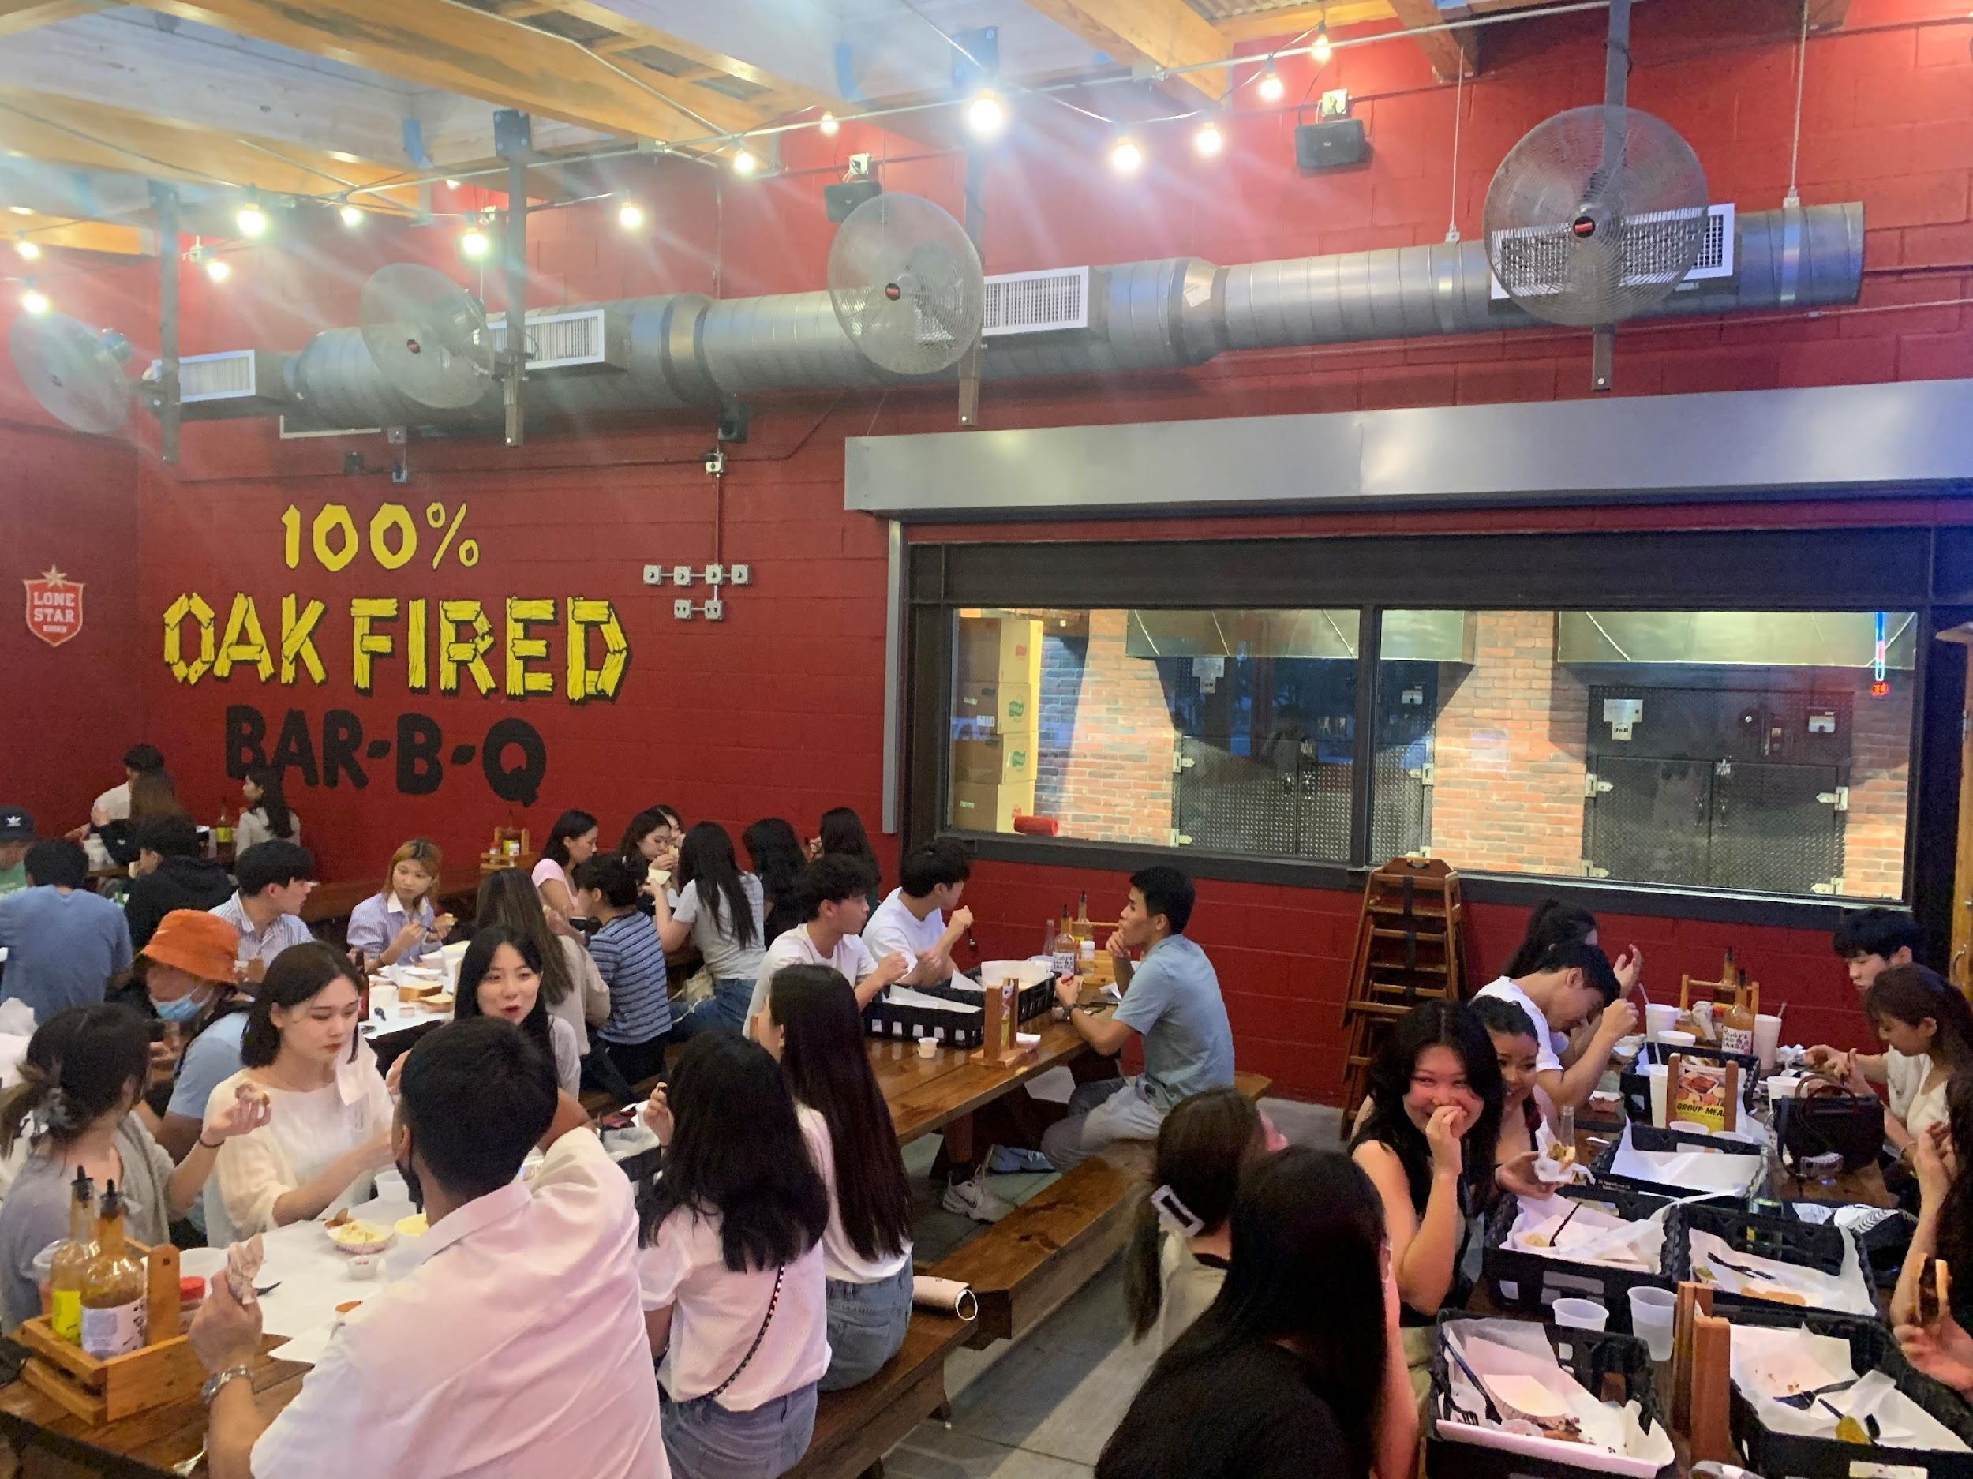
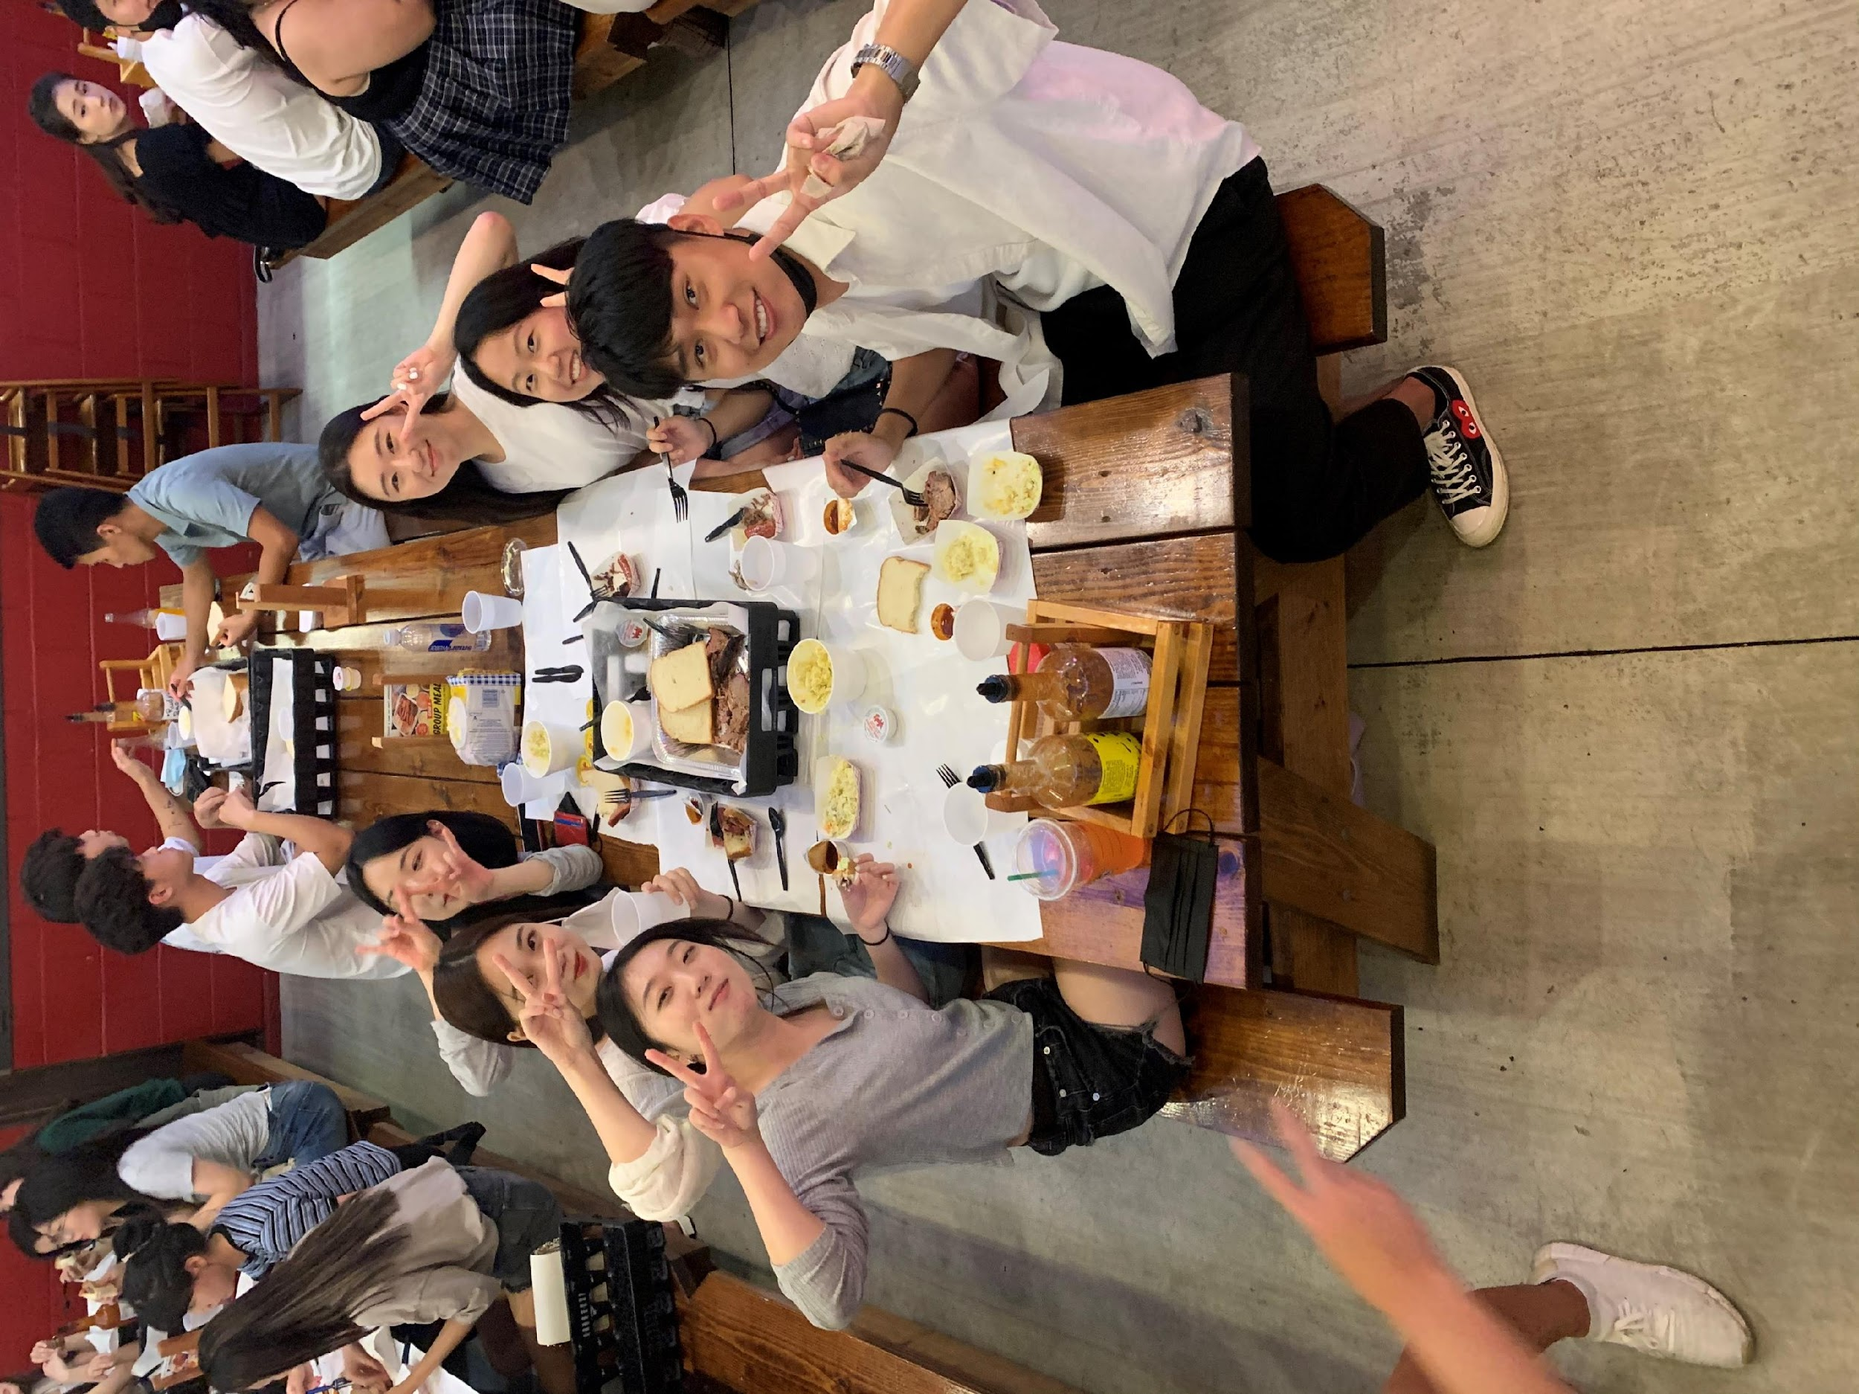
August,
the Beginning of 21FA UKA
First Tabling
Open House
Rudy’s Social

Slide 5
August,
the Beginning of 21FA UKA
First Tabling
Open House
Rudy’s Social

Slide 6
August,
the Beginning of 21FA UKA
Open House
Rudy’s Social

Slide 7
August,
the Beginning of 21FA UKA
Rudy’s Social

Slide 8
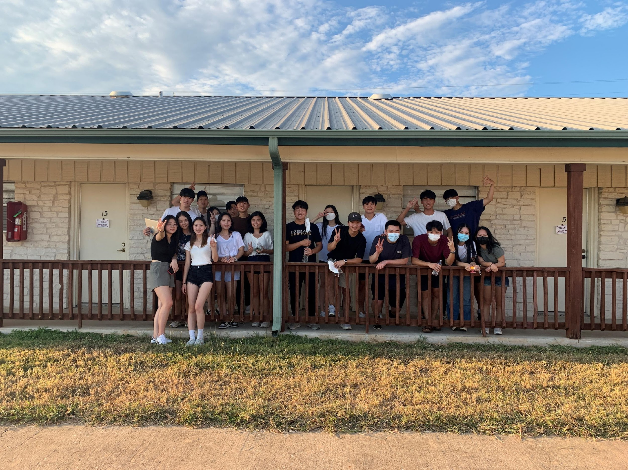
September,
No MT in the U.S.? Wrong!
First GM
MT

Slide 9
September,
No MT in the U.S.? Wrong!
First GM
MT

Slide 10
September,
No MT in the U.S.? Wrong!
MT

Slide 11
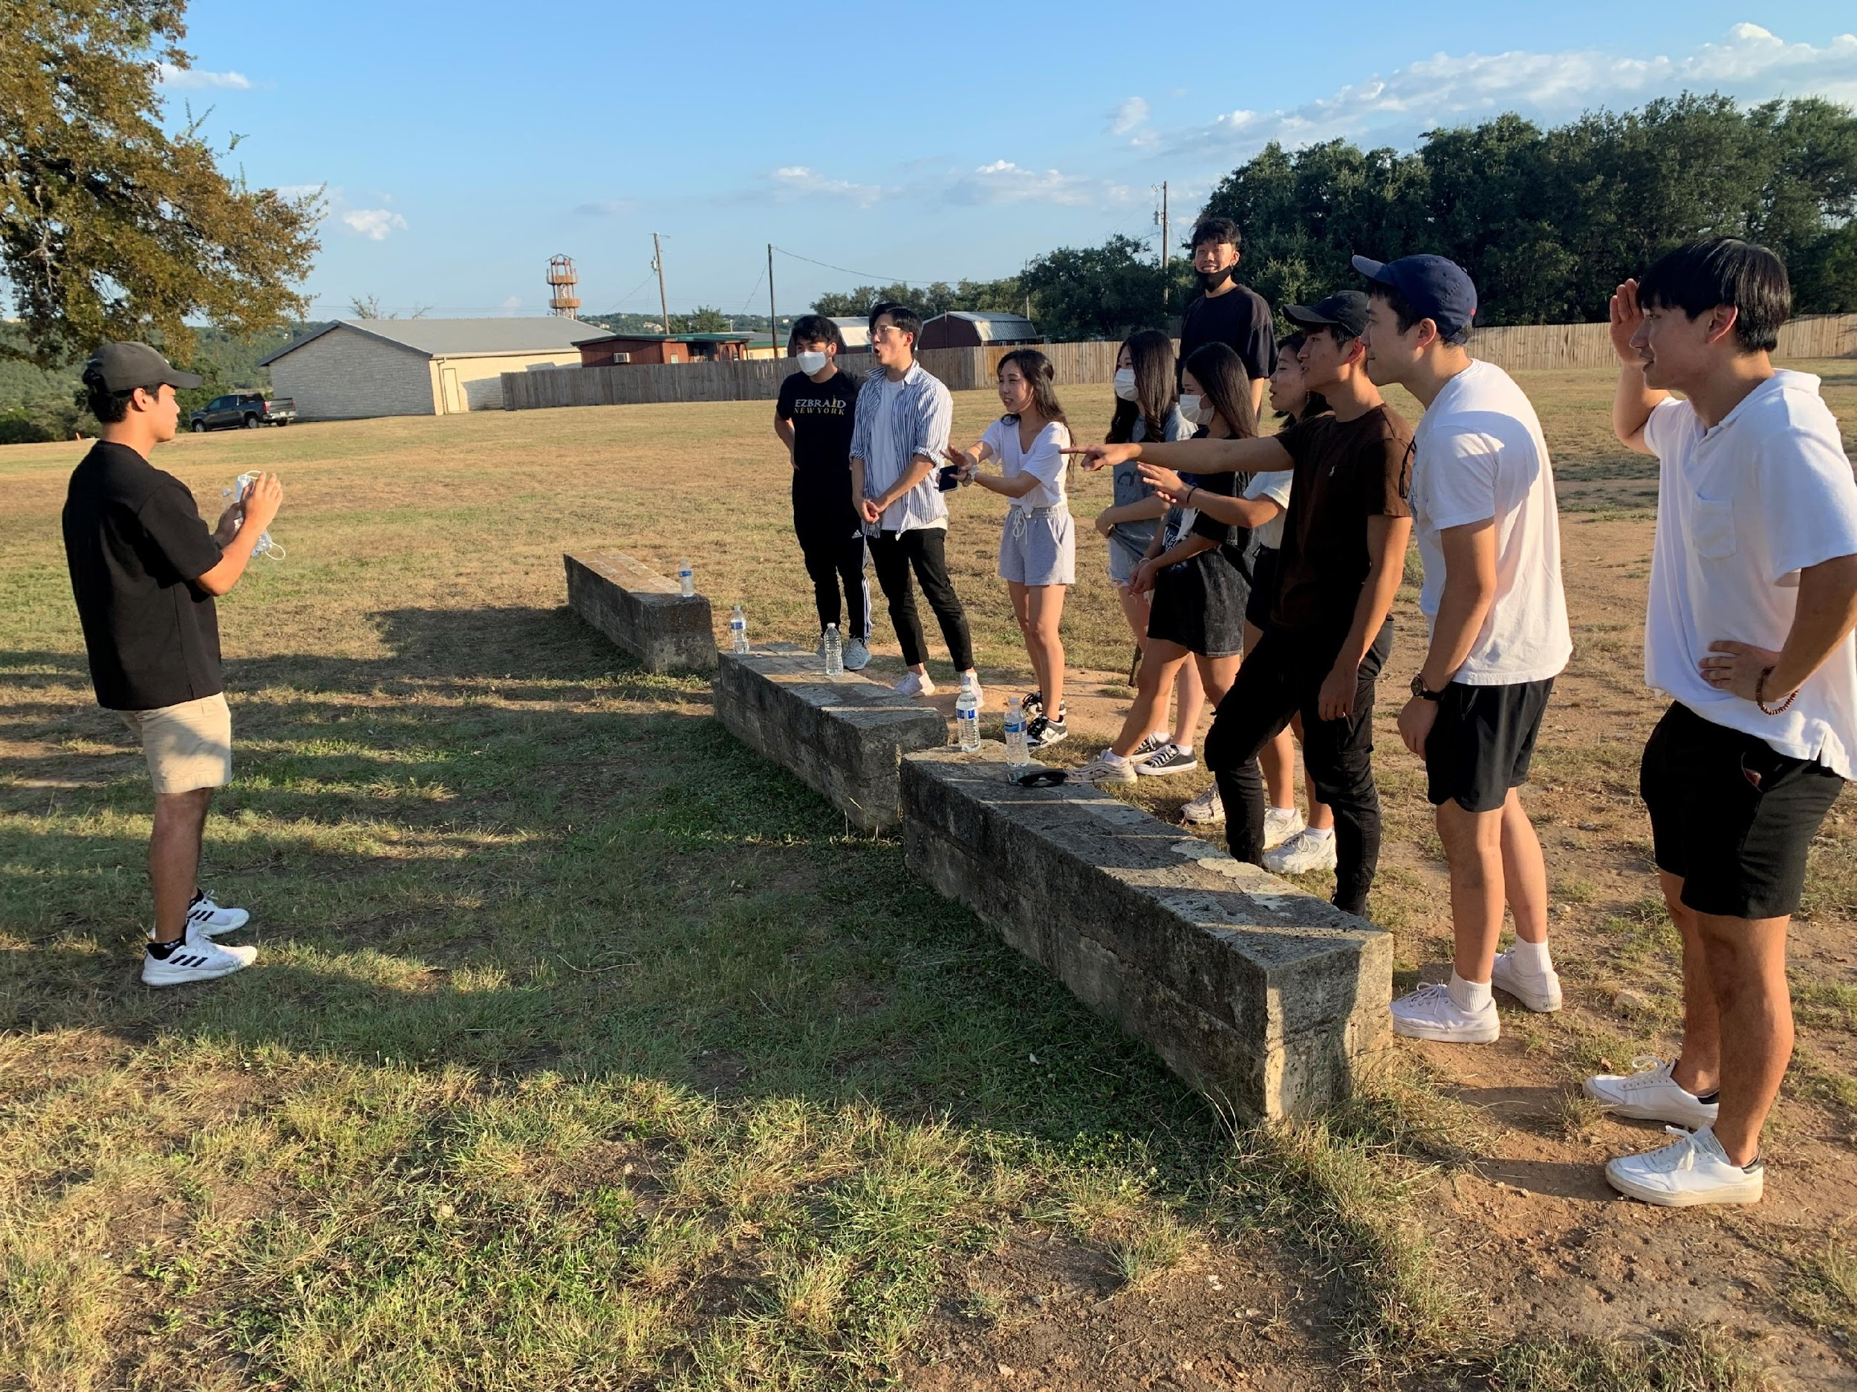
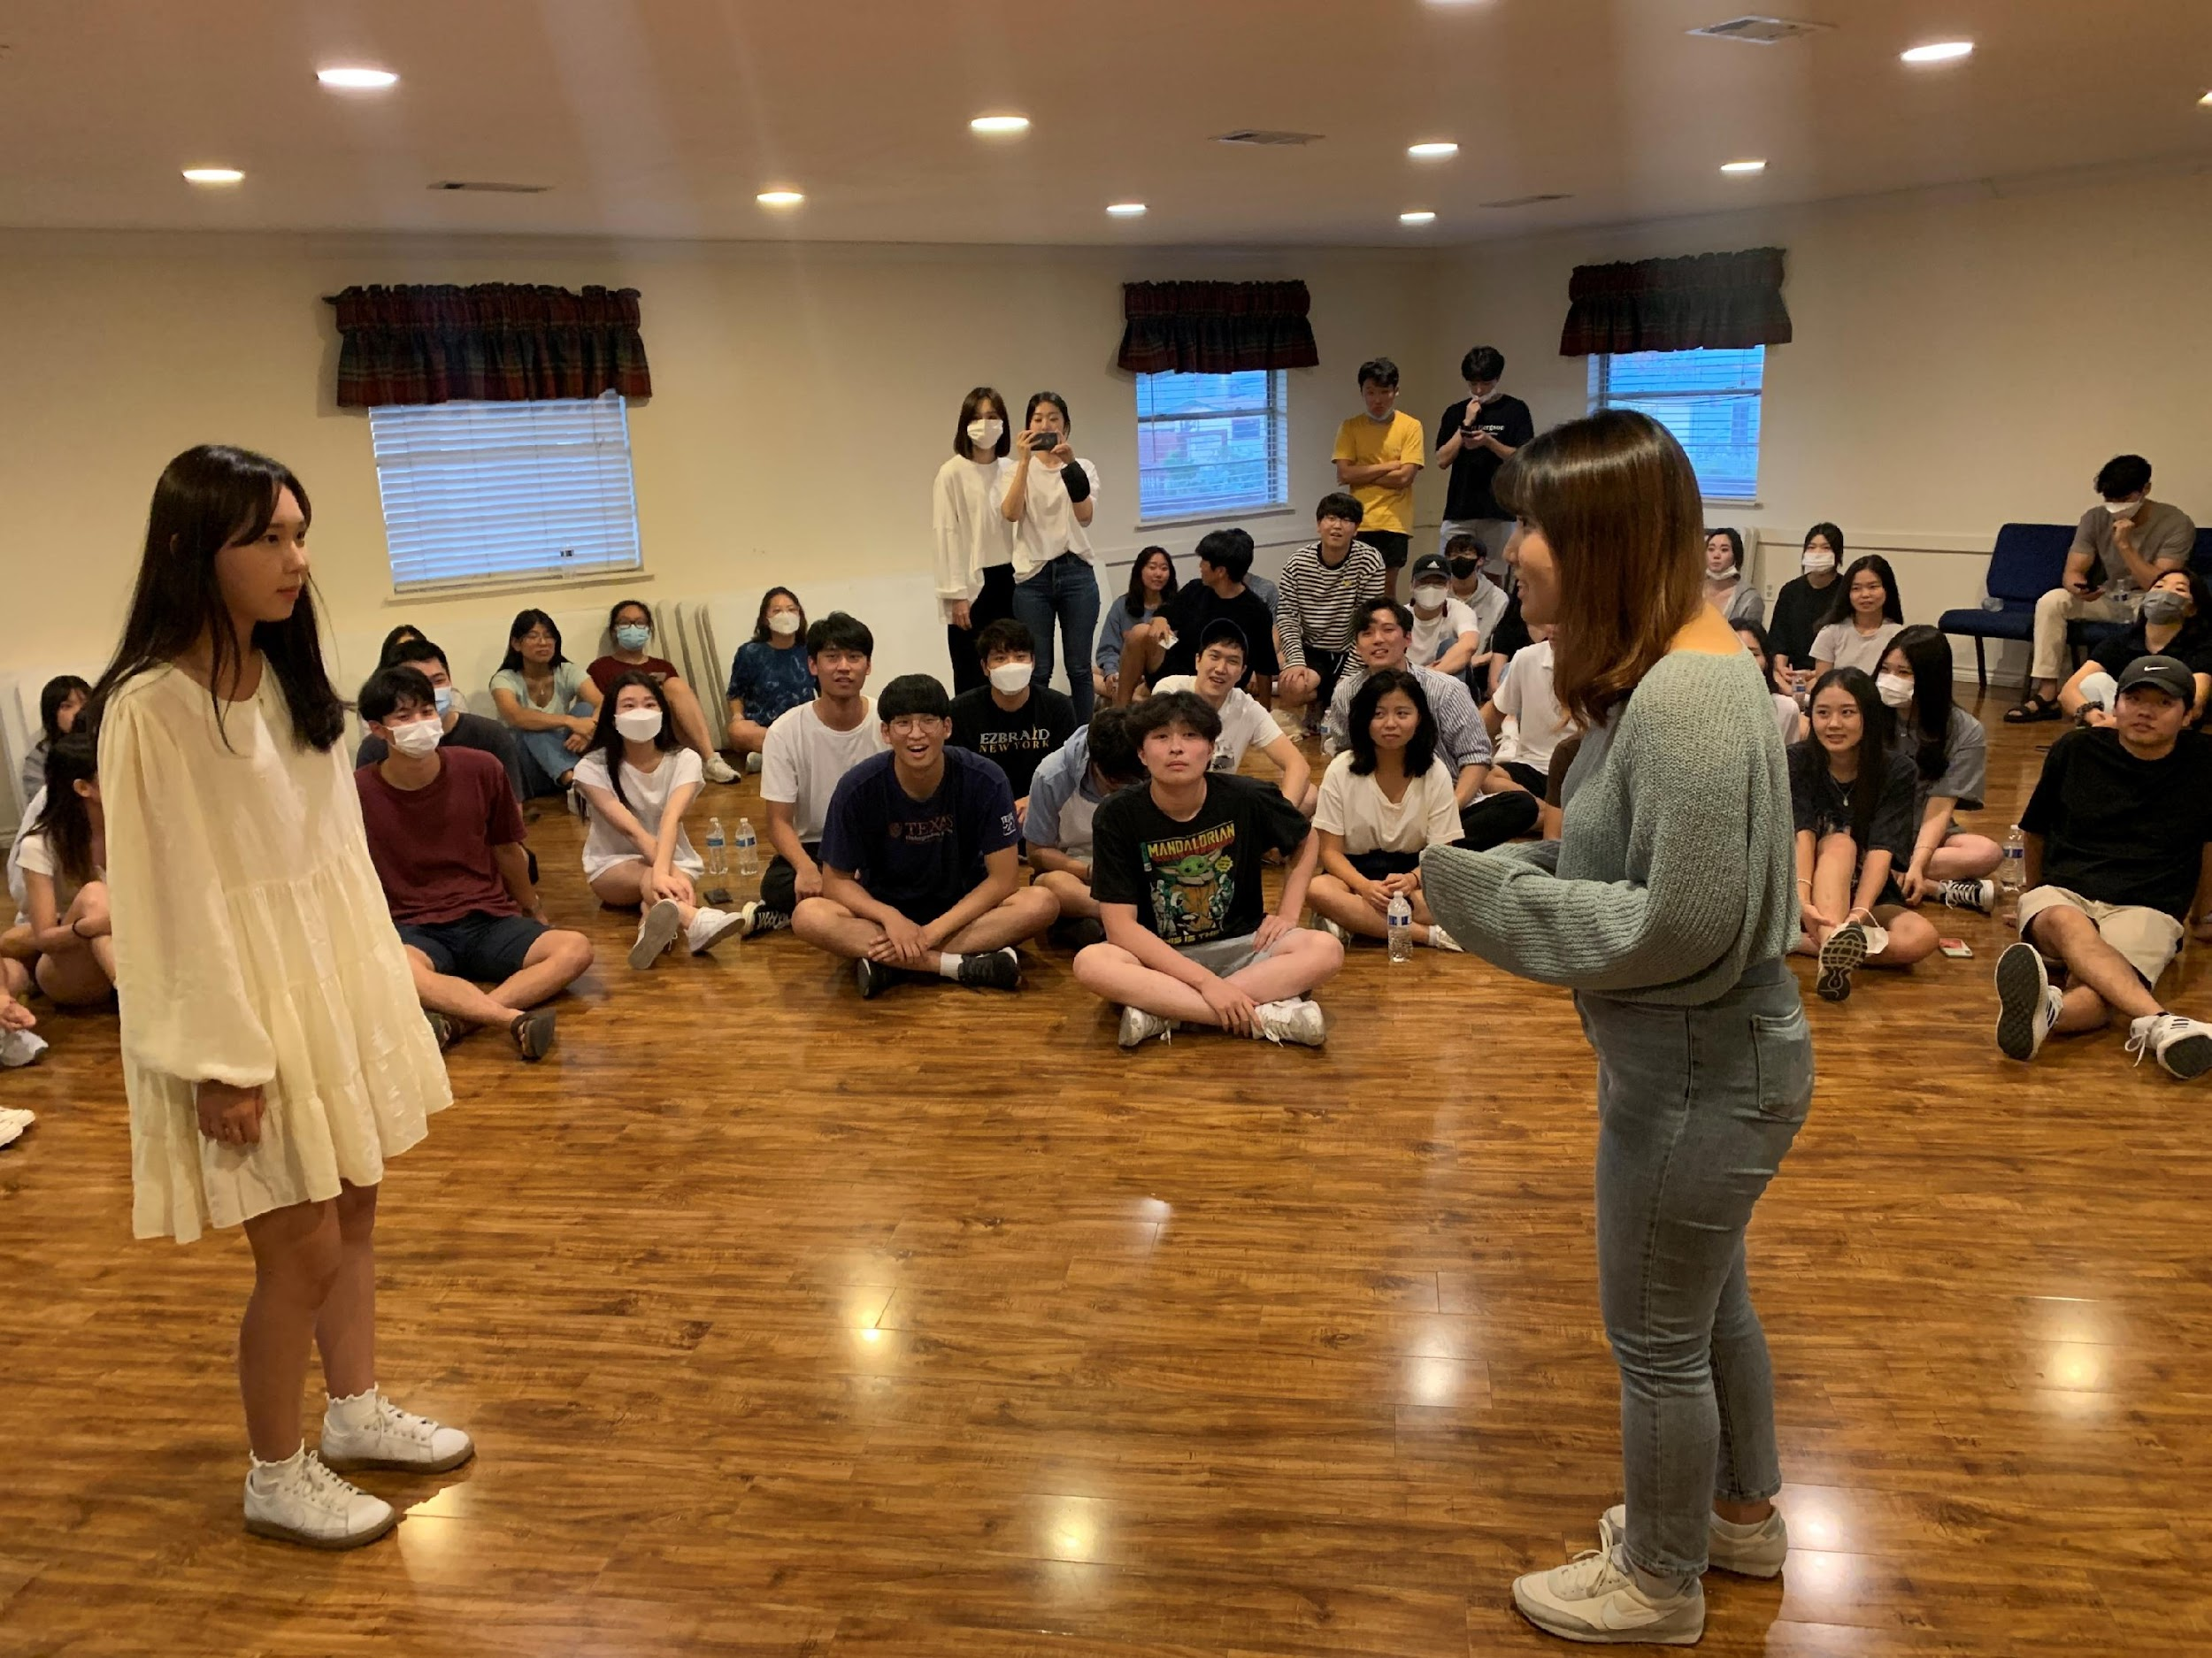
September,
No MT in the U.S.? Wrong!
Mini Games

Slide 12
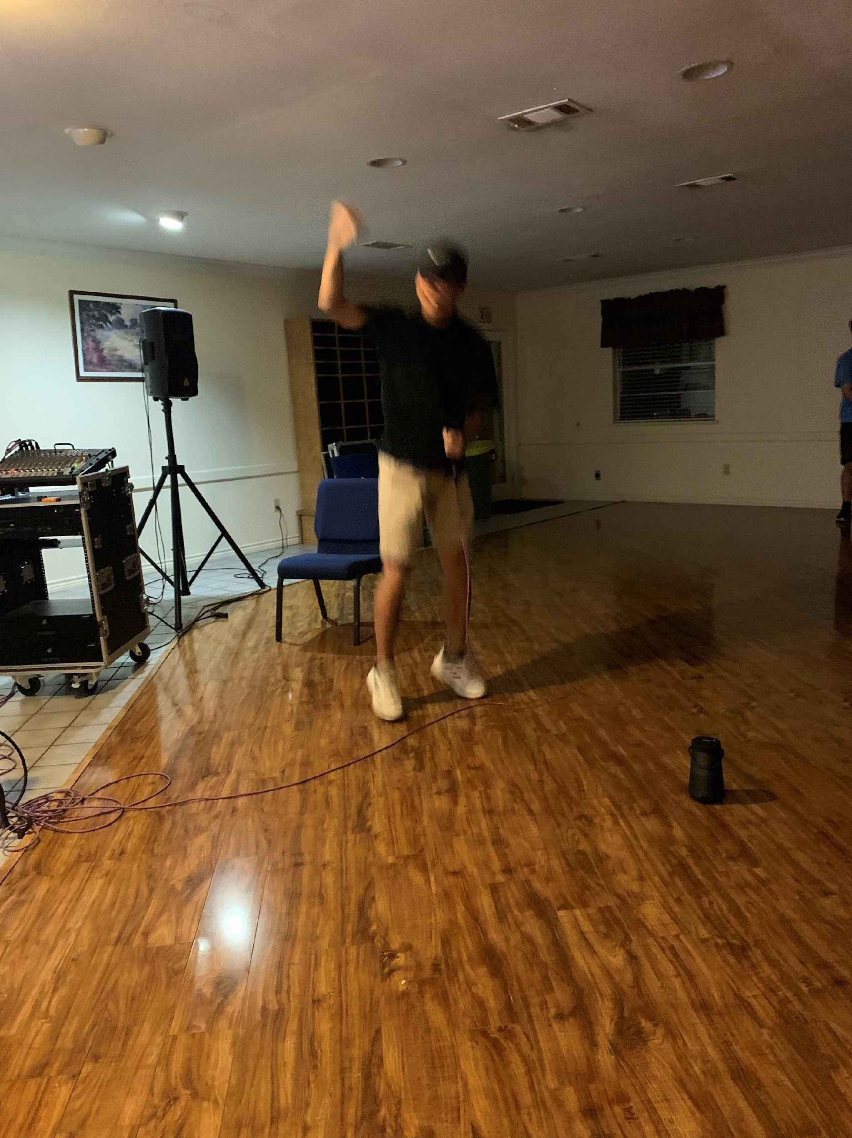
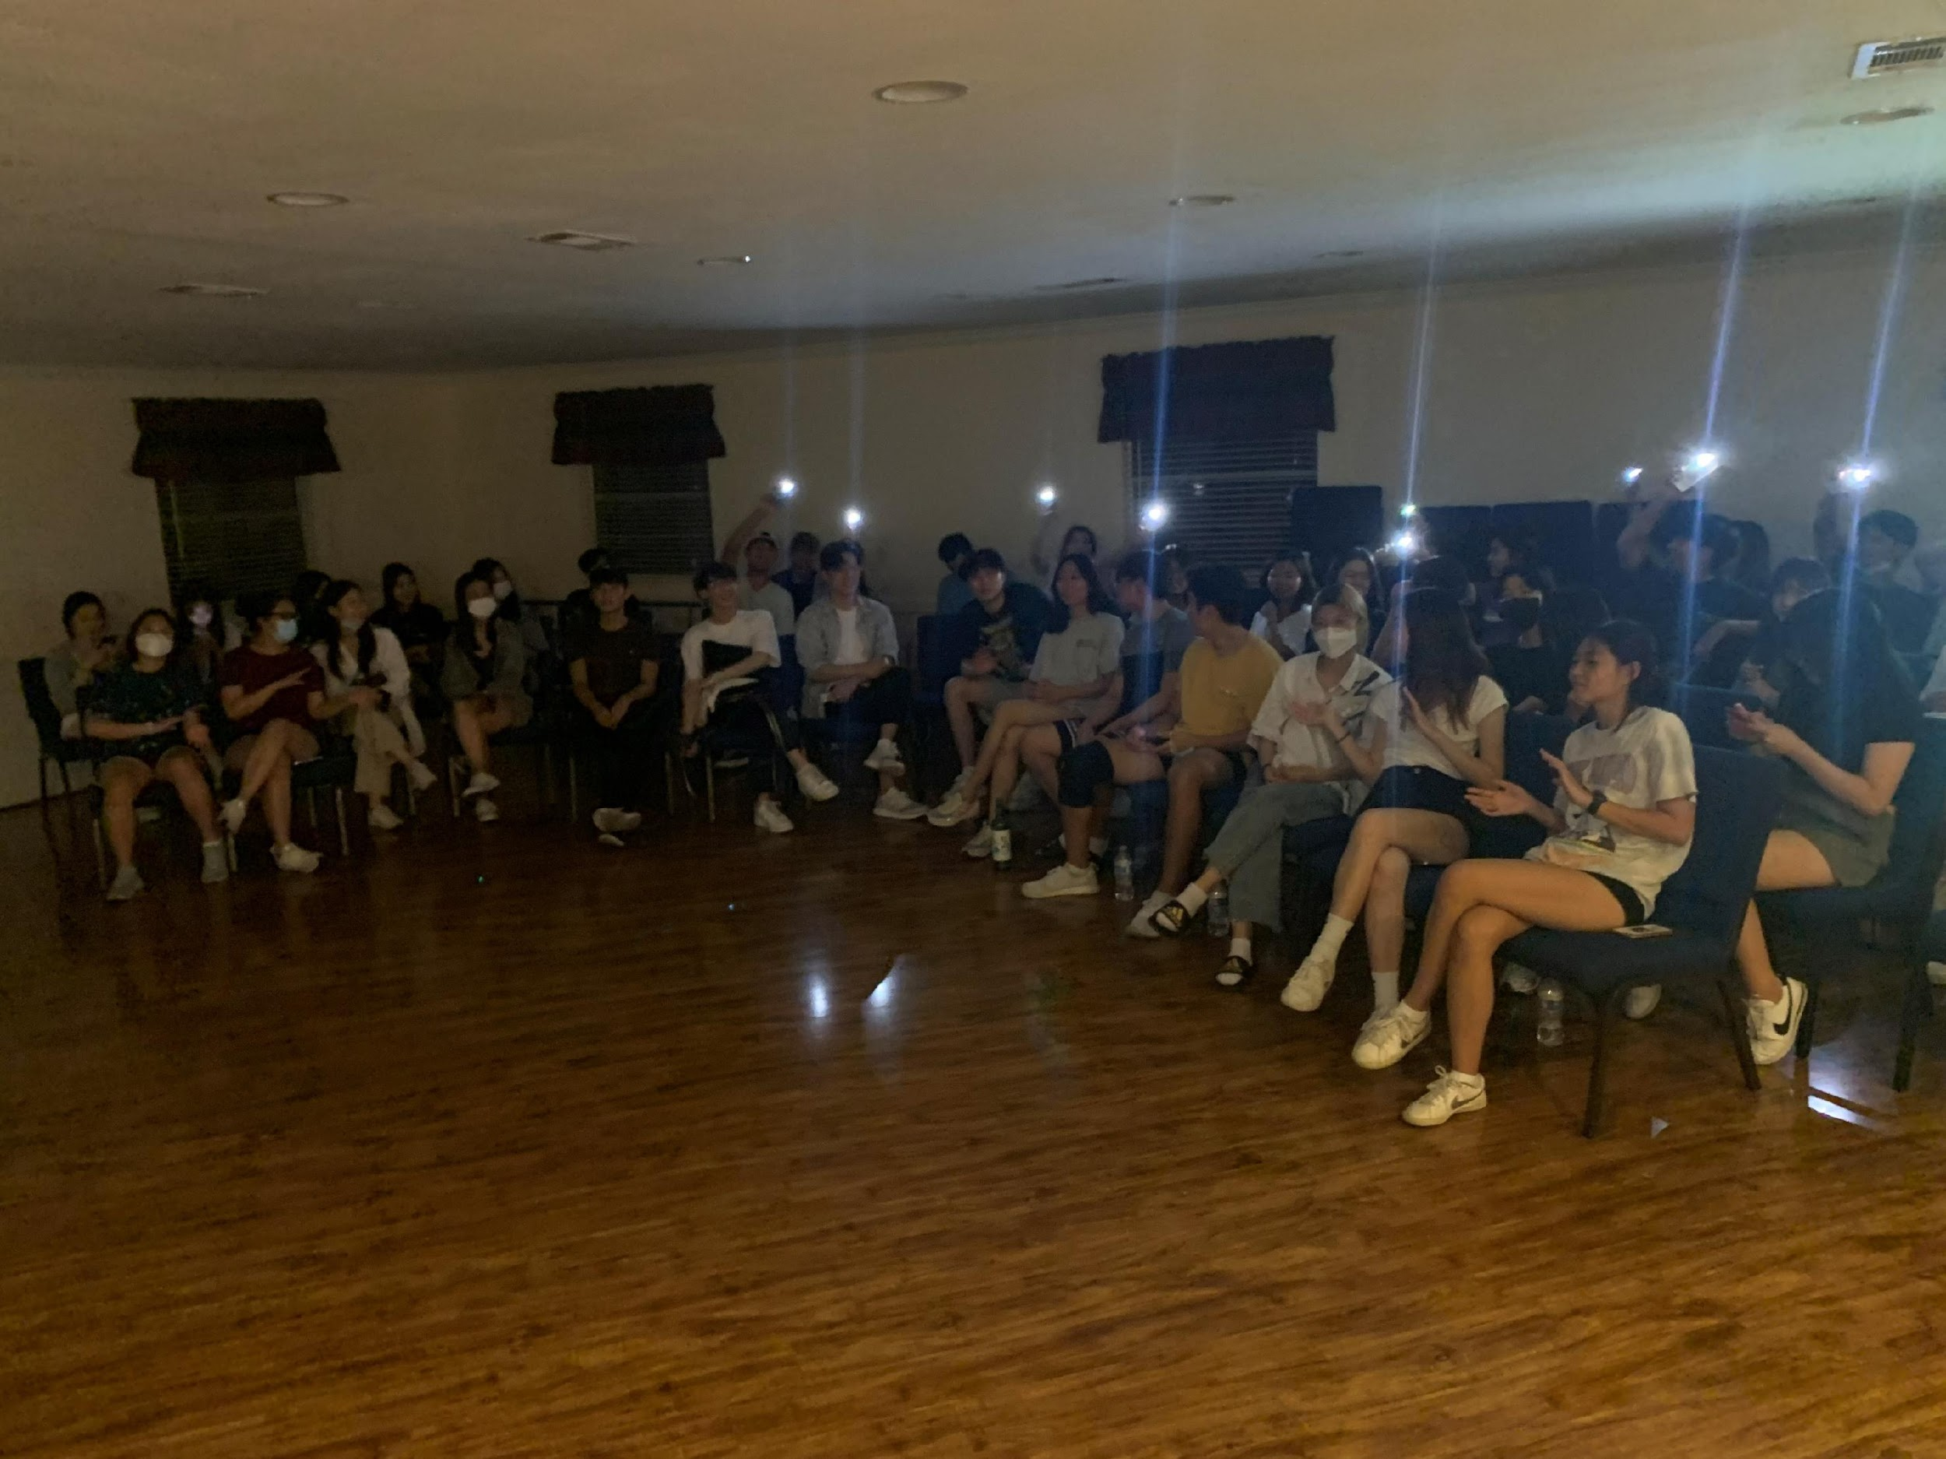
September,
No MT in the U.S.? Wrong!
Talent Show

Slide 13
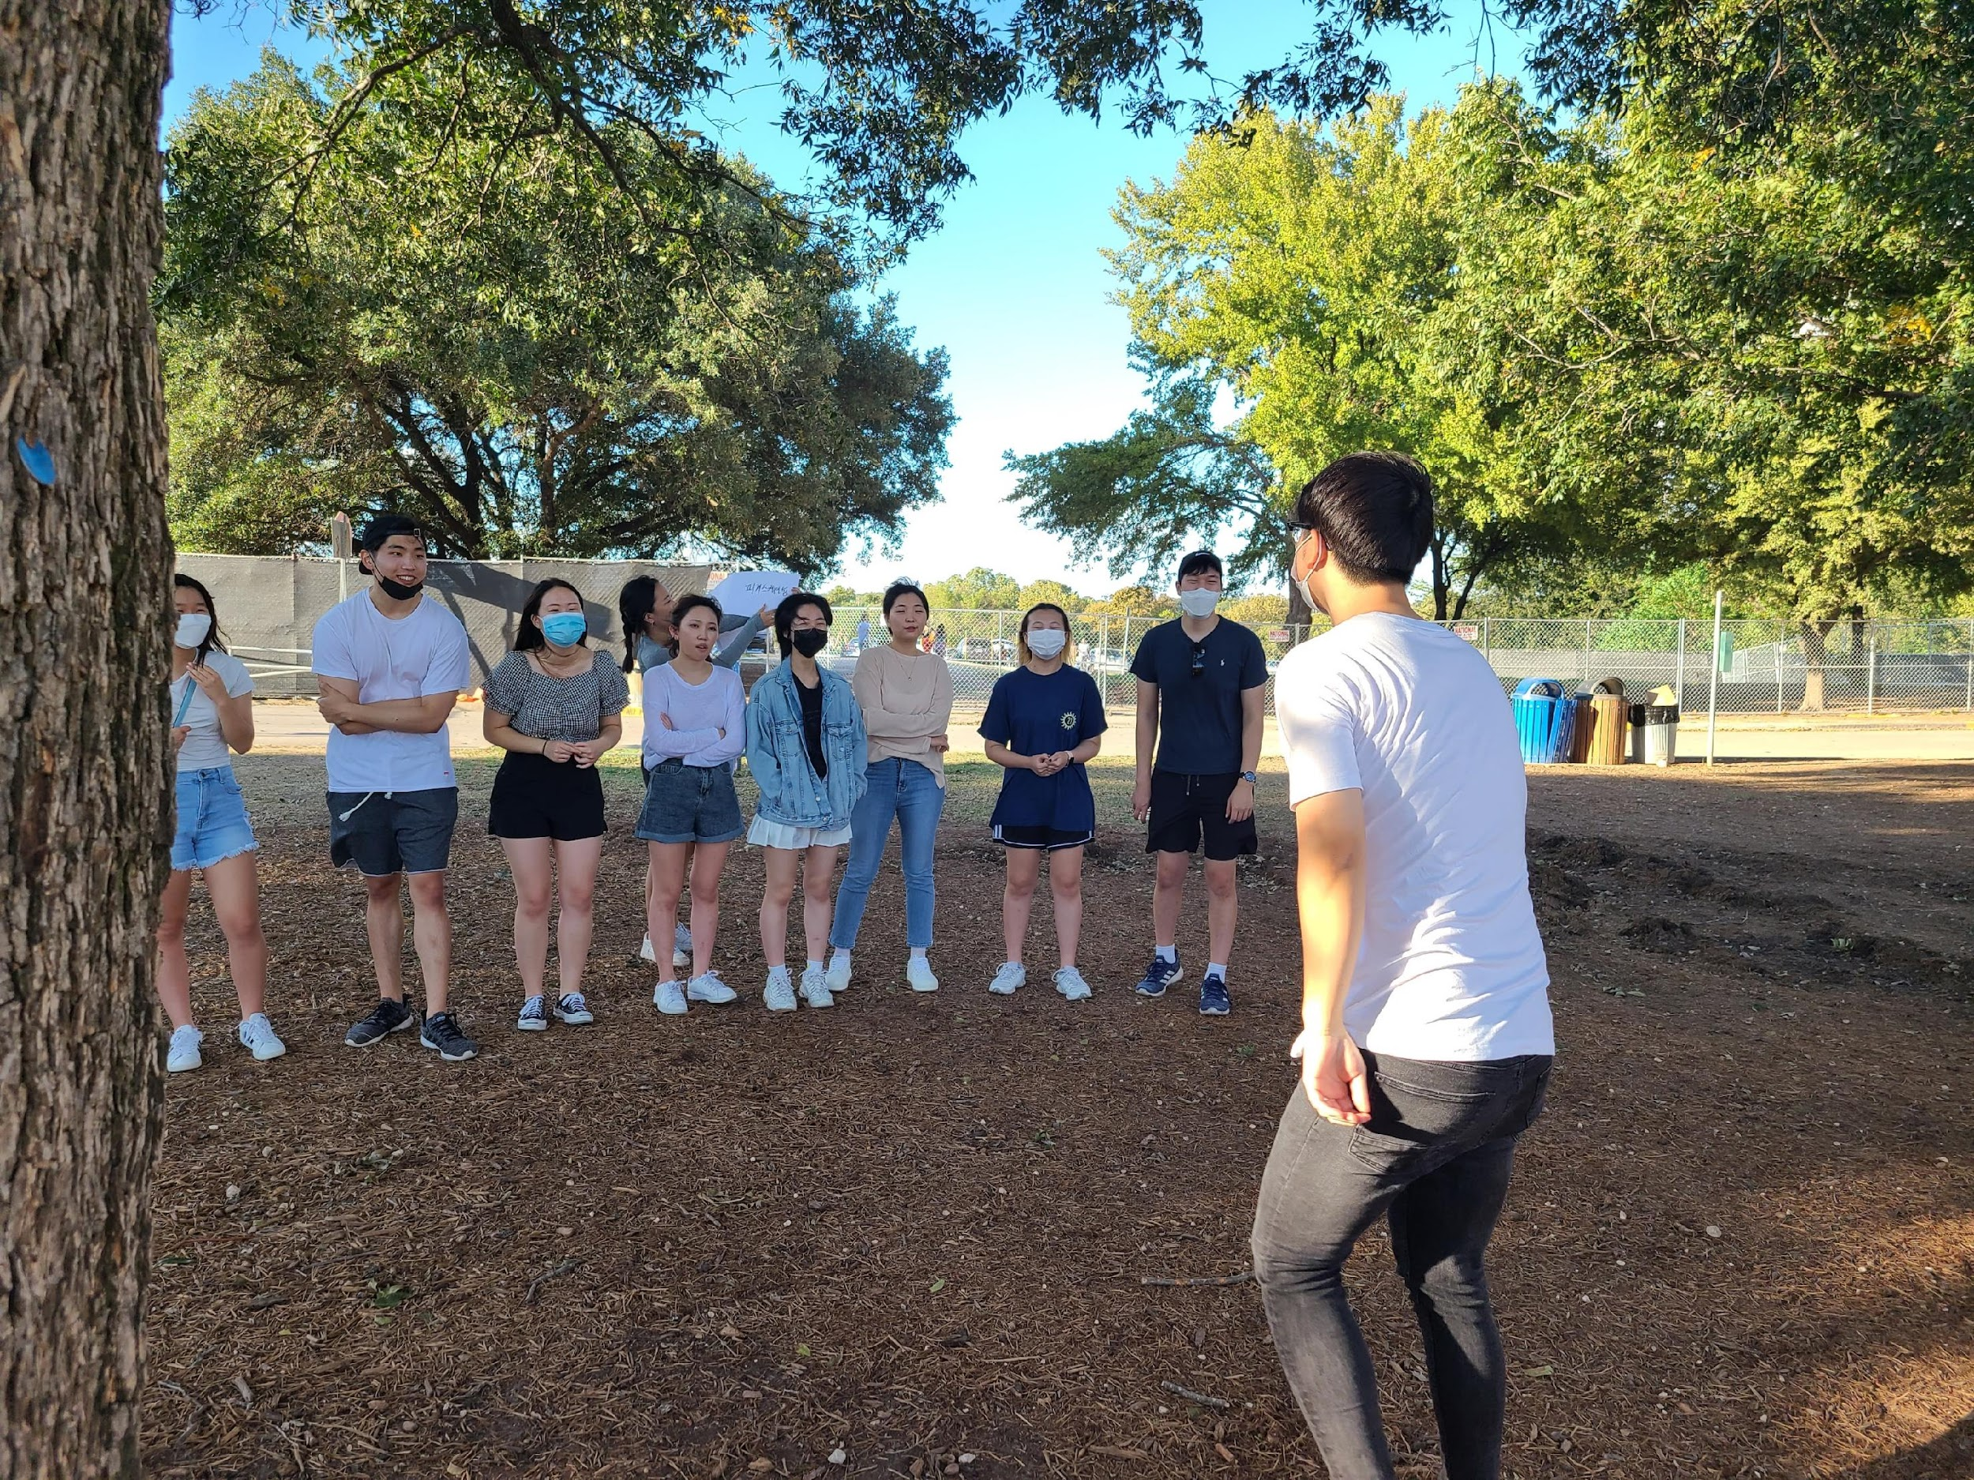
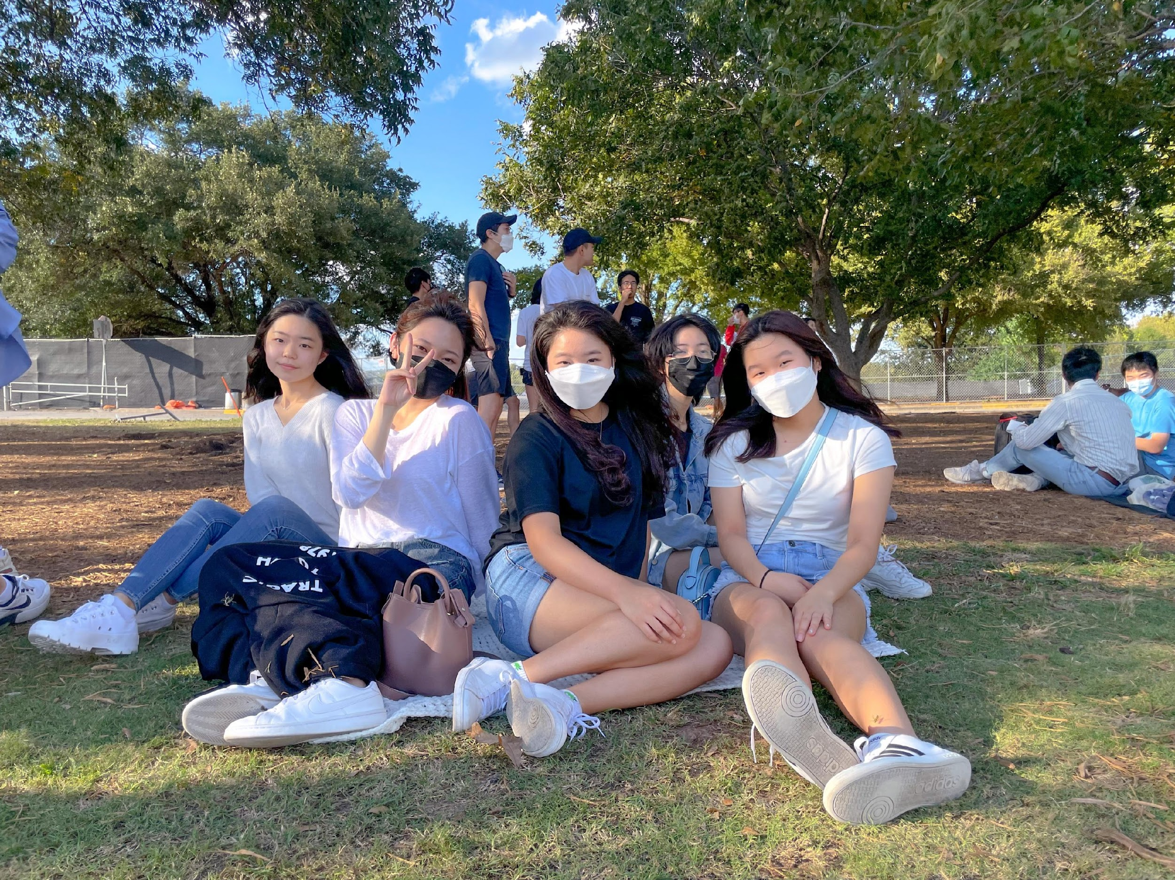
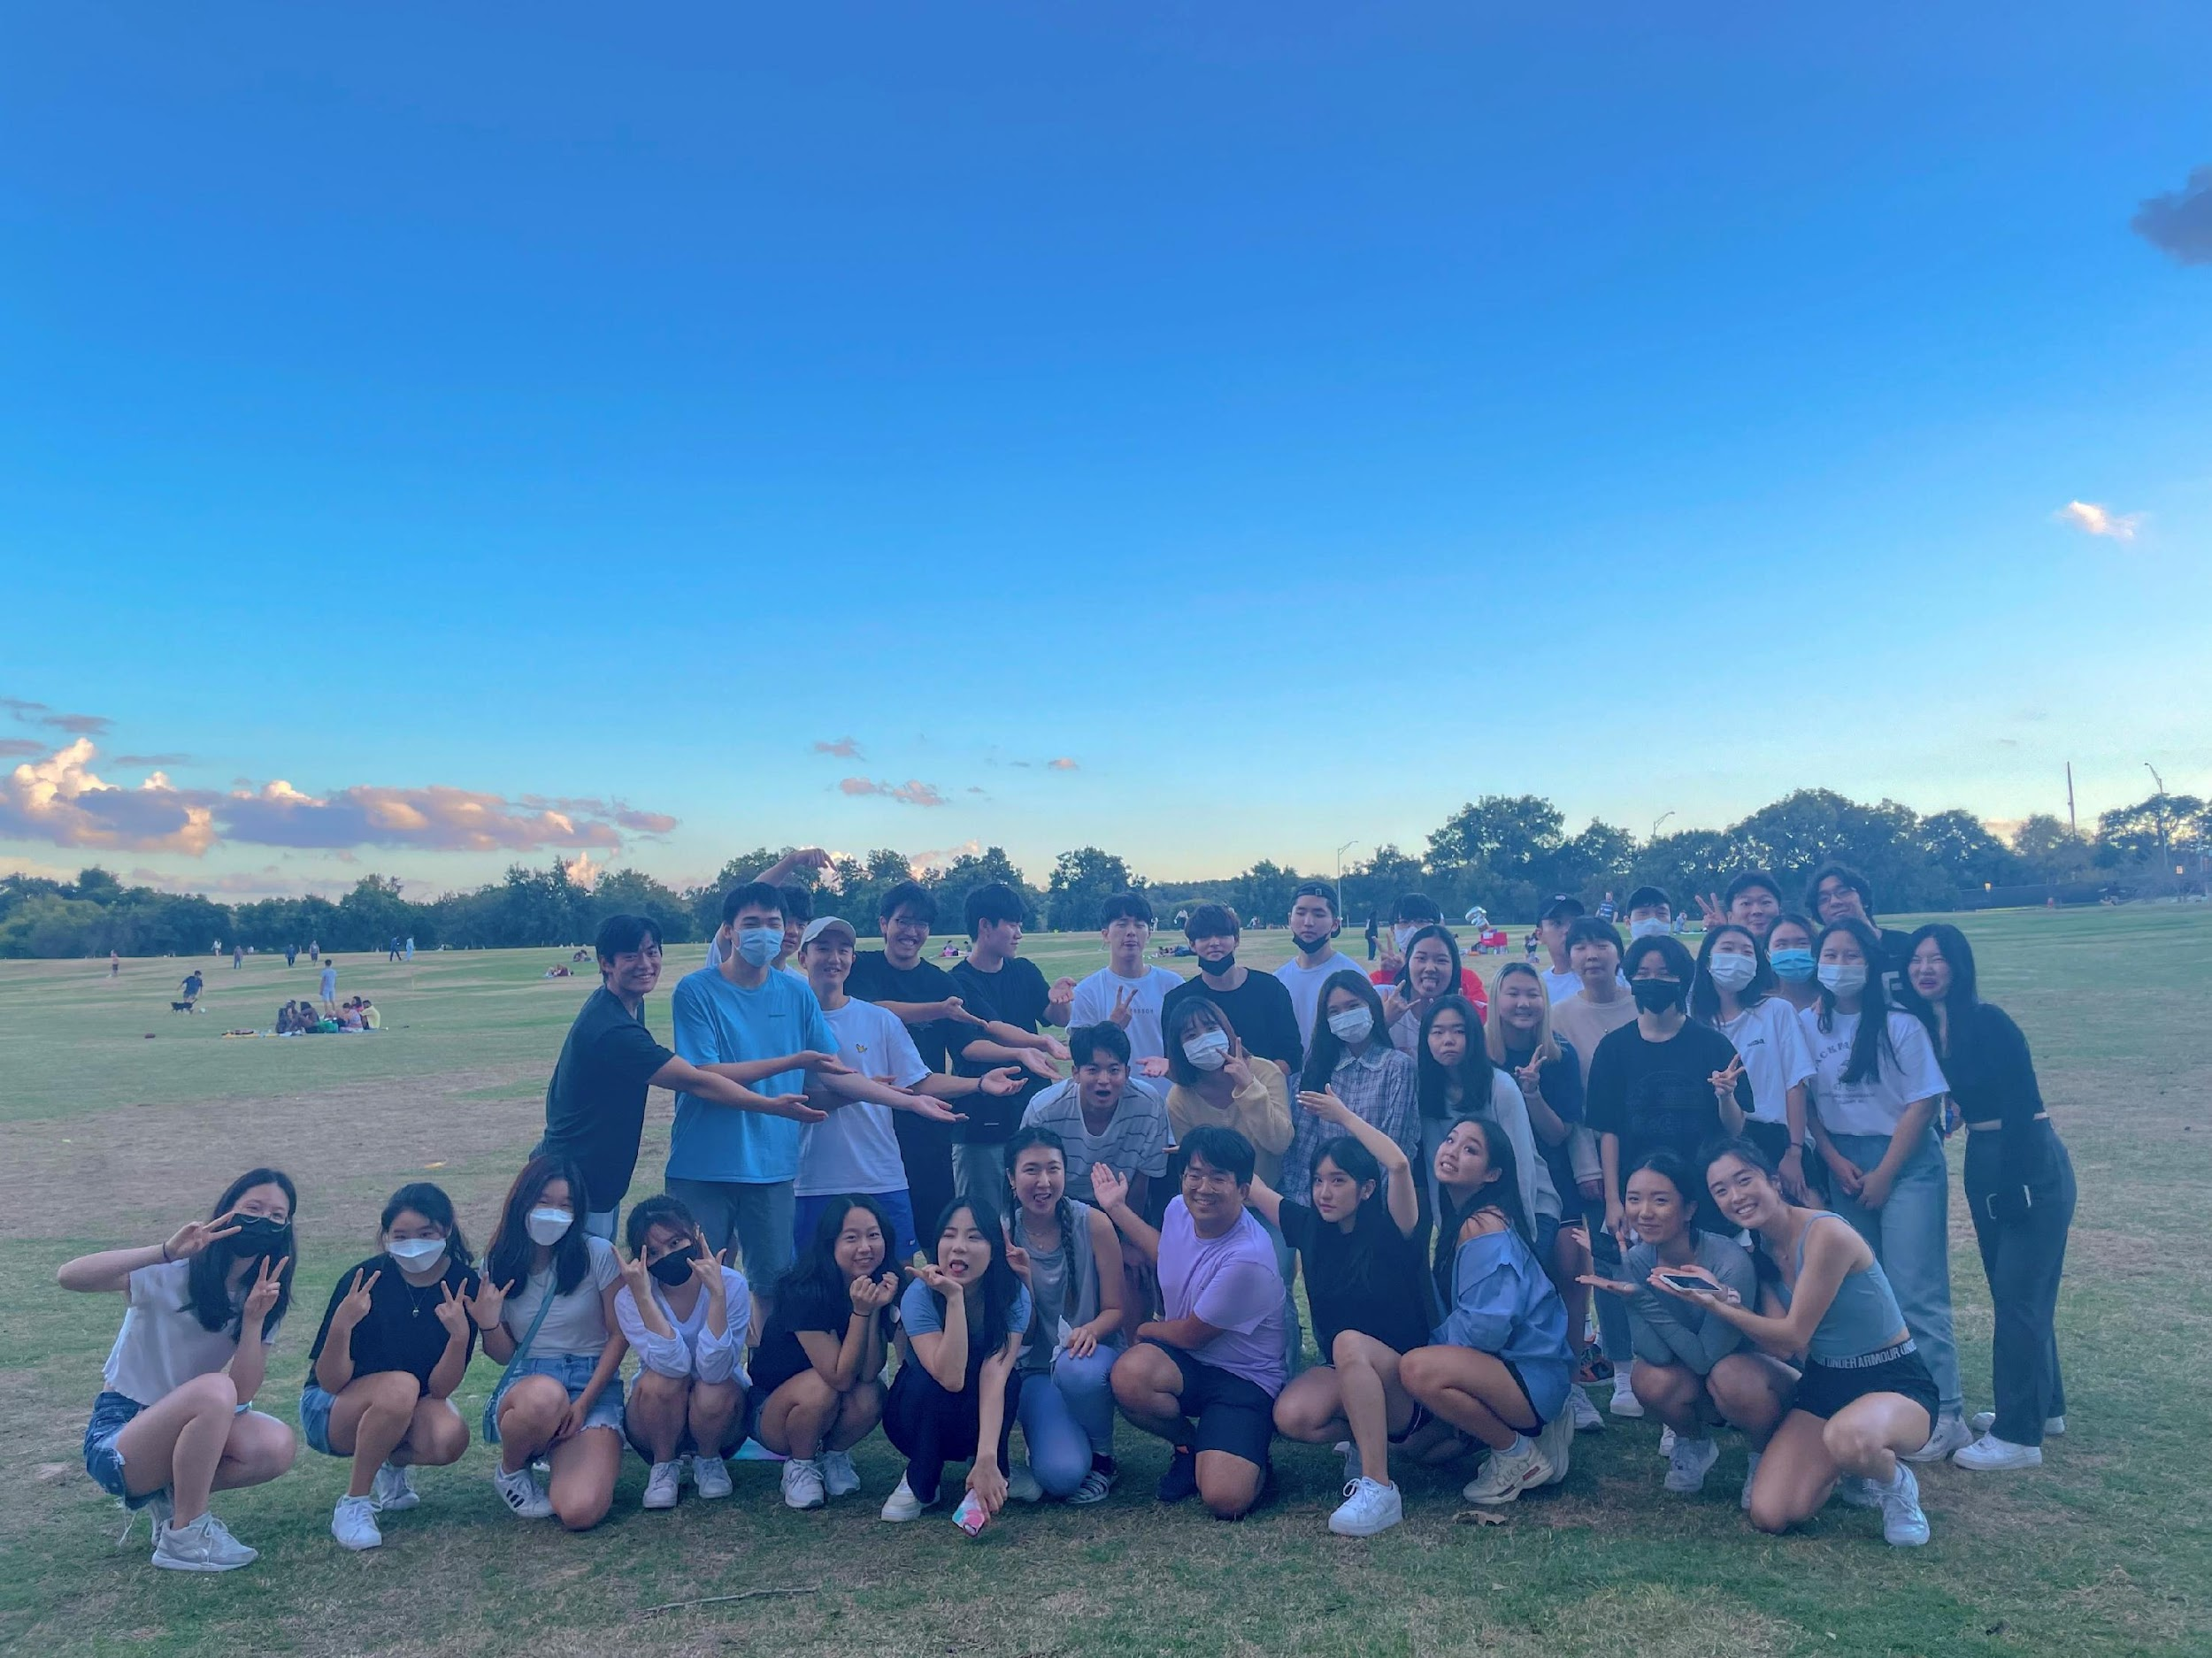
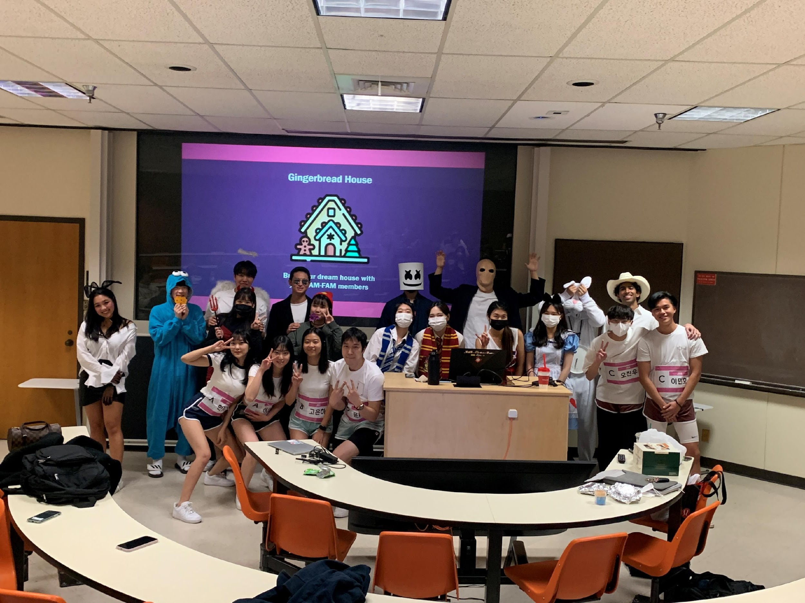
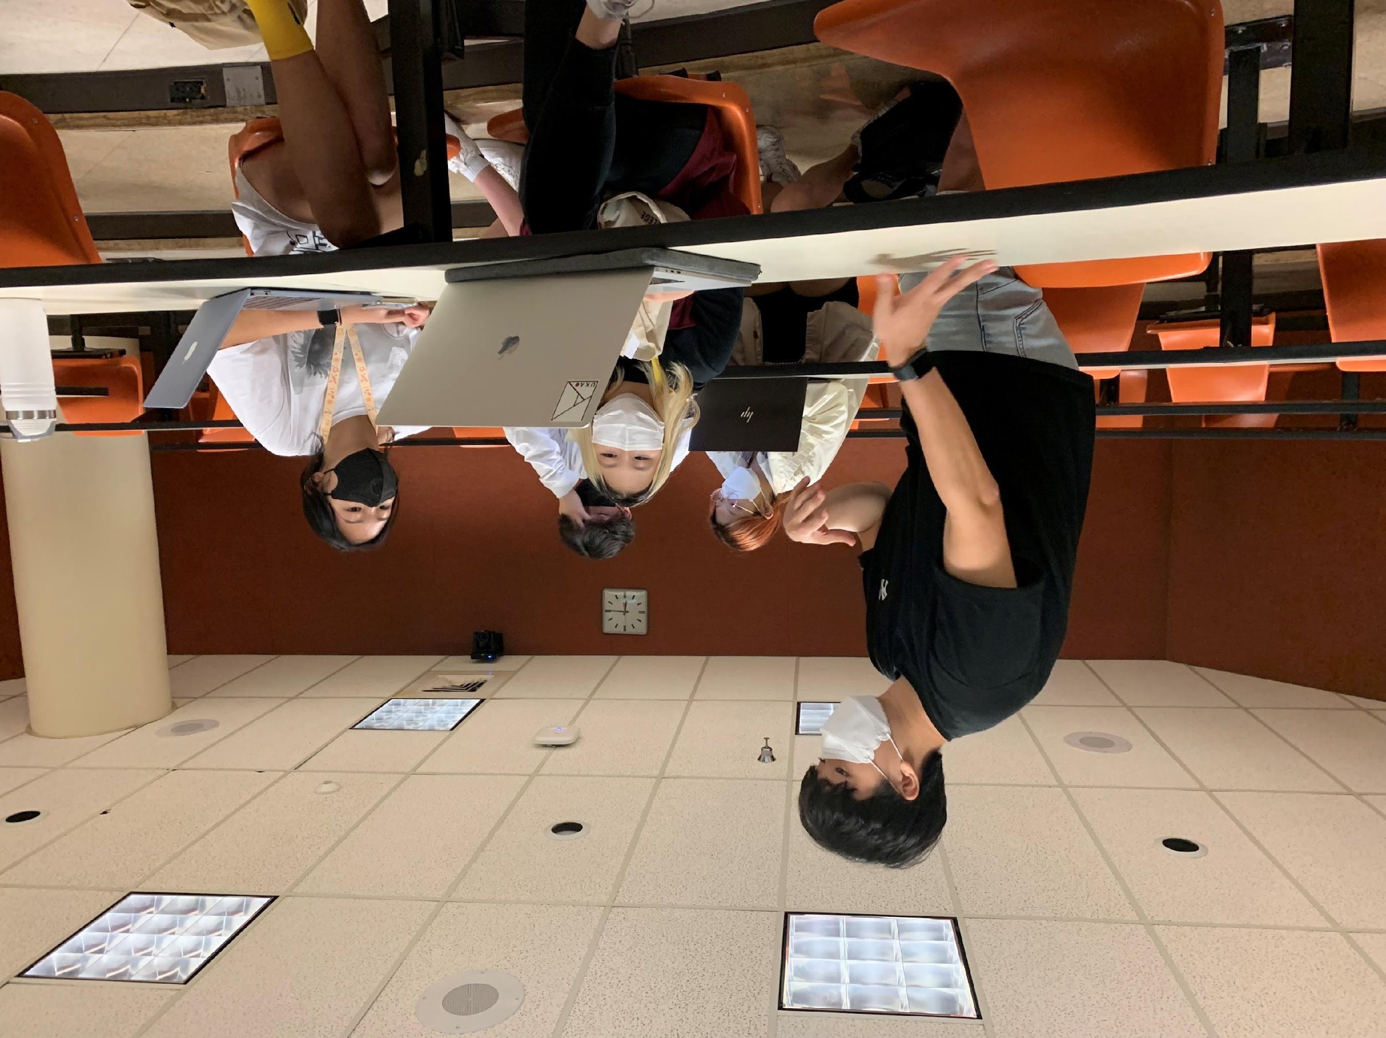
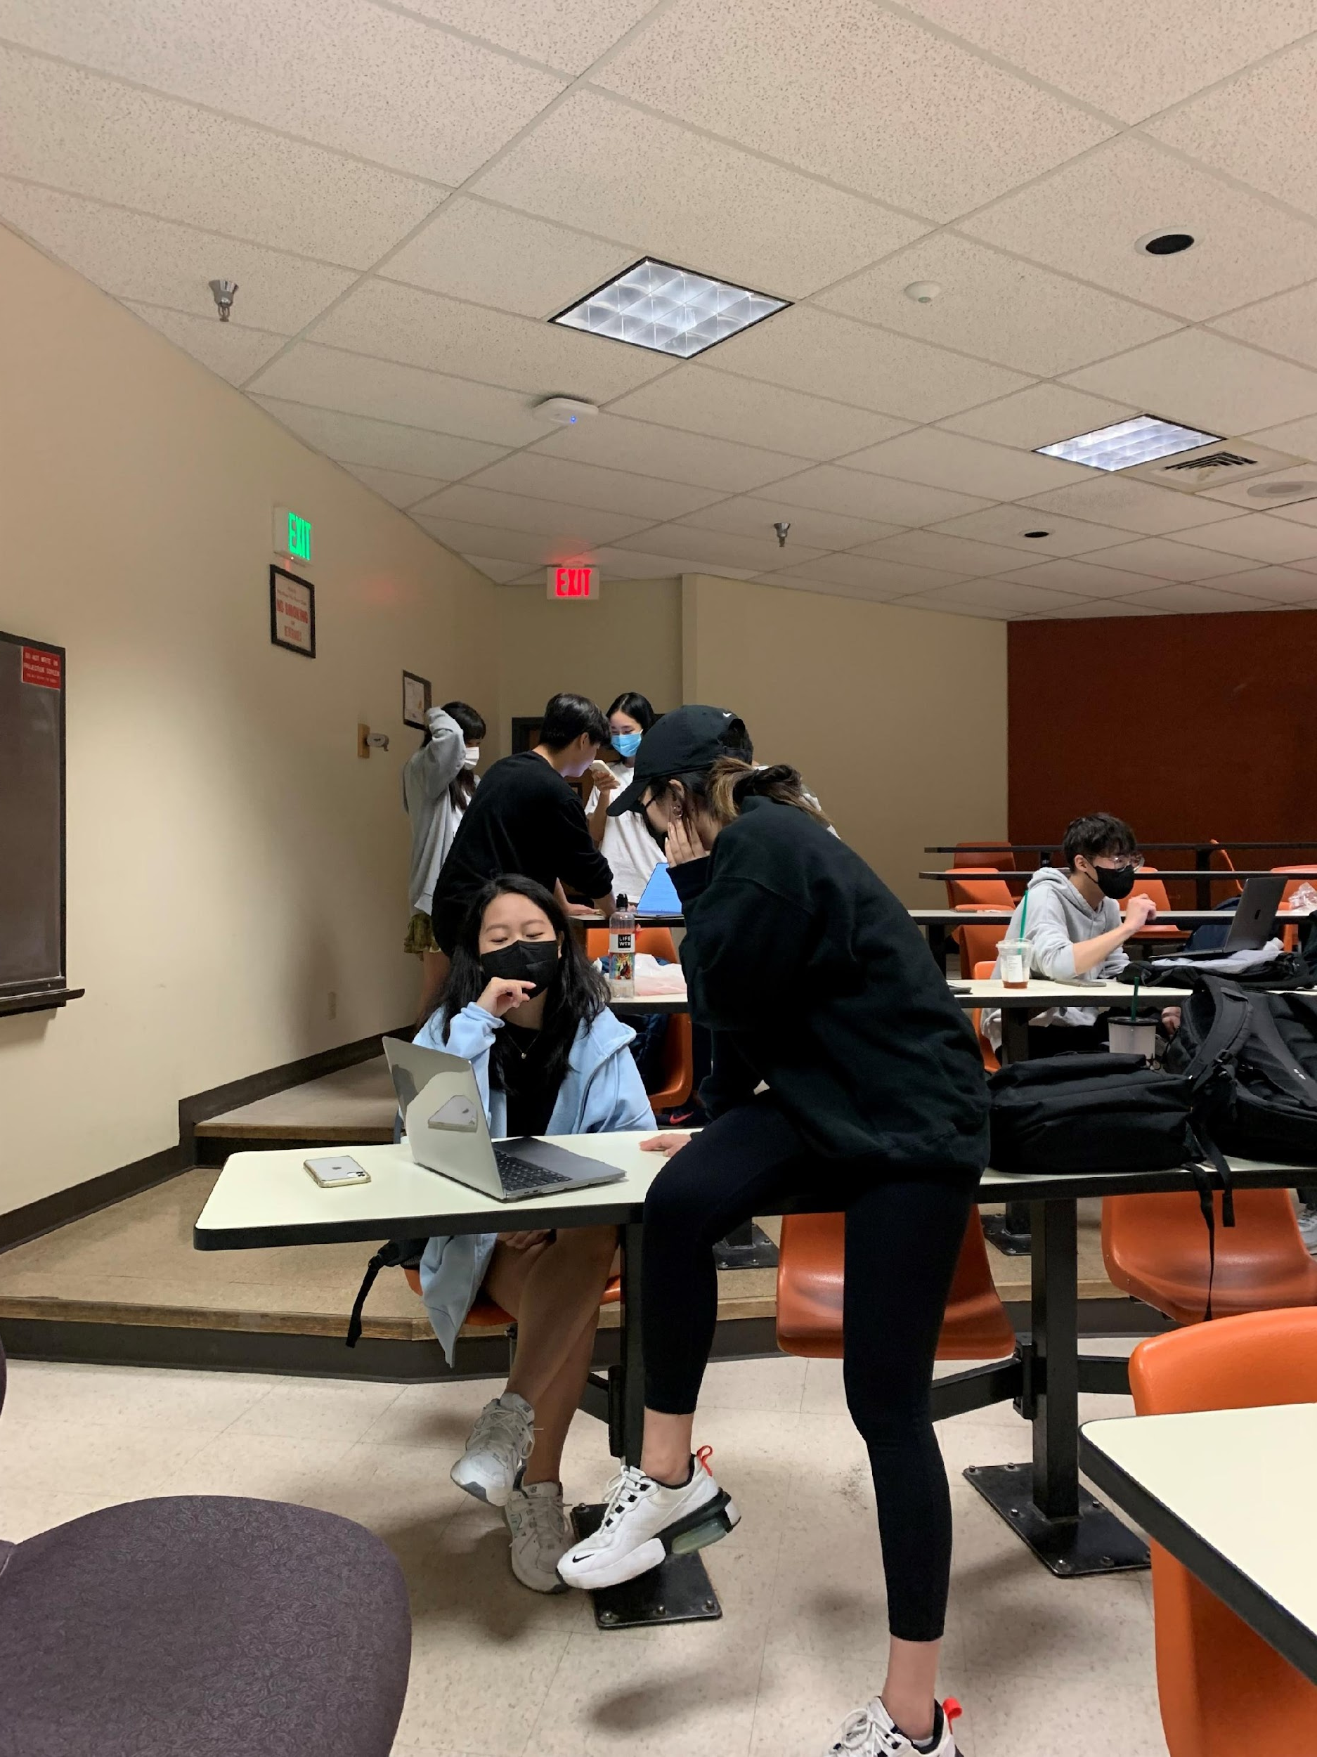
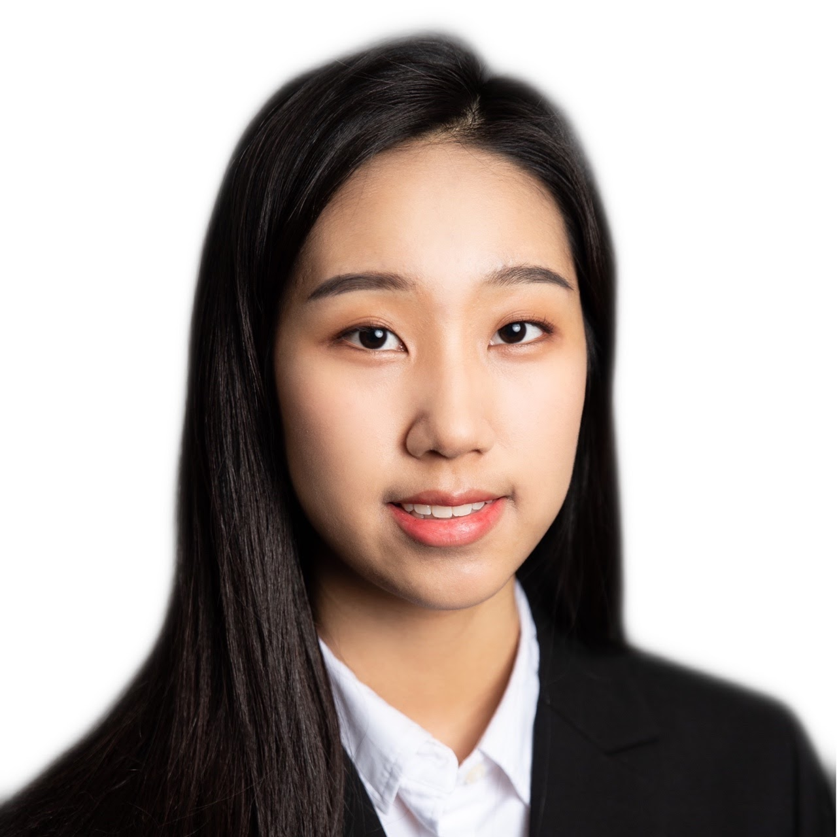
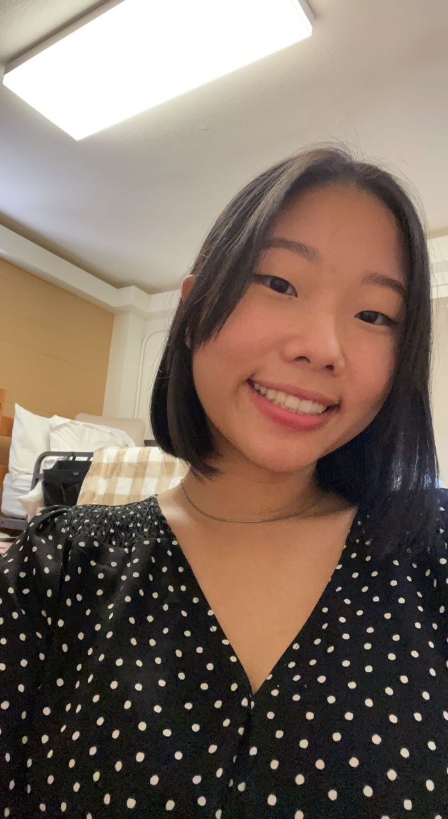
October,
Trick or Treat me Dalgona!
Picnic
Dalgona Fundrasing
Halloween GM
Course Regi. Workshop
Scholarship

Slide 14
October,
Trick or Treat me Dalgona!
Picnic
Dalgona Fundrasing
Halloween GM
Course Regi. Workshop
Scholarship

Slide 15
October,
Trick or Treat me Dalgona!
Dalgona Fundrasing
Halloween GM
Course Regi. Workshop
Scholarship

Slide 16
October,
Trick or Treat me Dalgona!
Halloween GM
Course Regi. Workshop
Scholarship

Slide 17
October,
Trick or Treat me Dalgona!
Course Regi. Workshop
Scholarship

Slide 18
October,
Trick or Treat me Dalgona!
UKA X KAAGA Scholarship
Scholarship
Esther Goh
Rachael Park

Slide 19
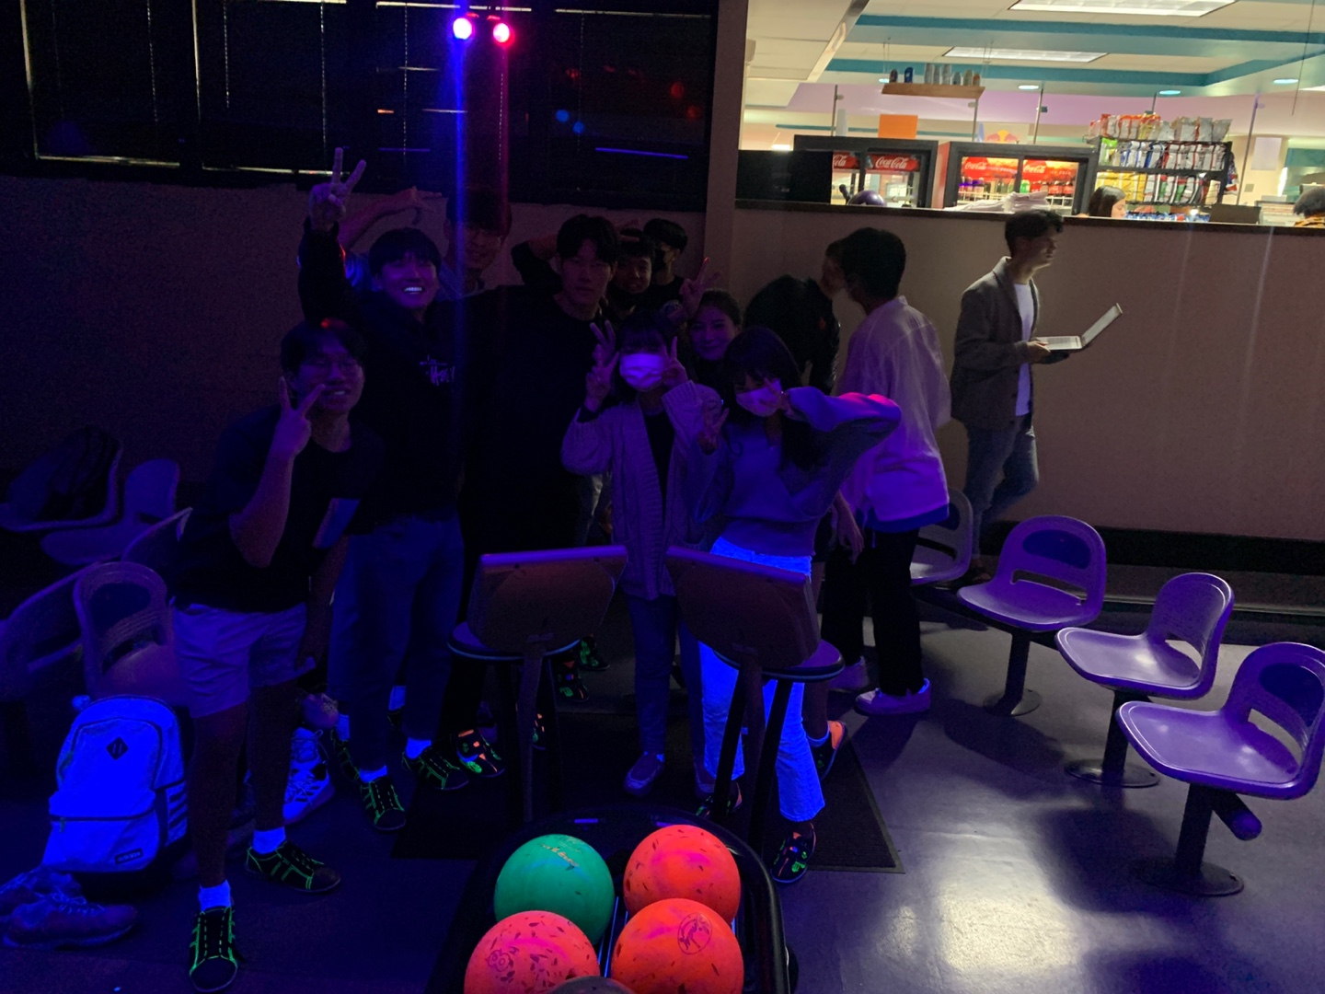
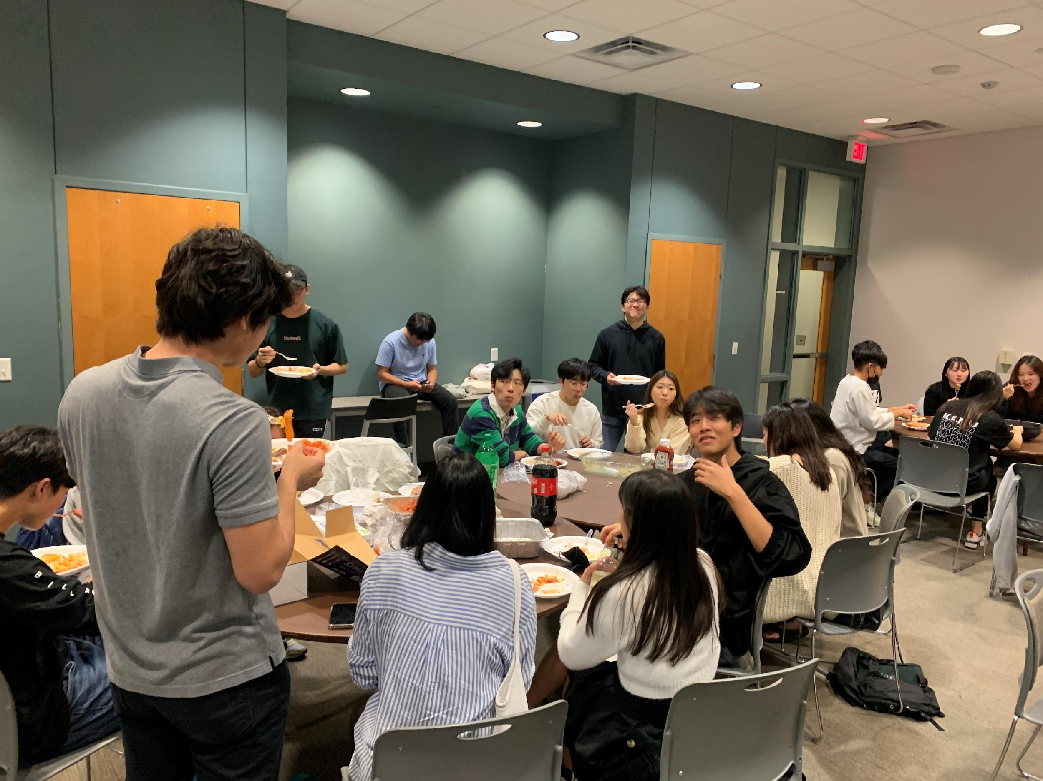
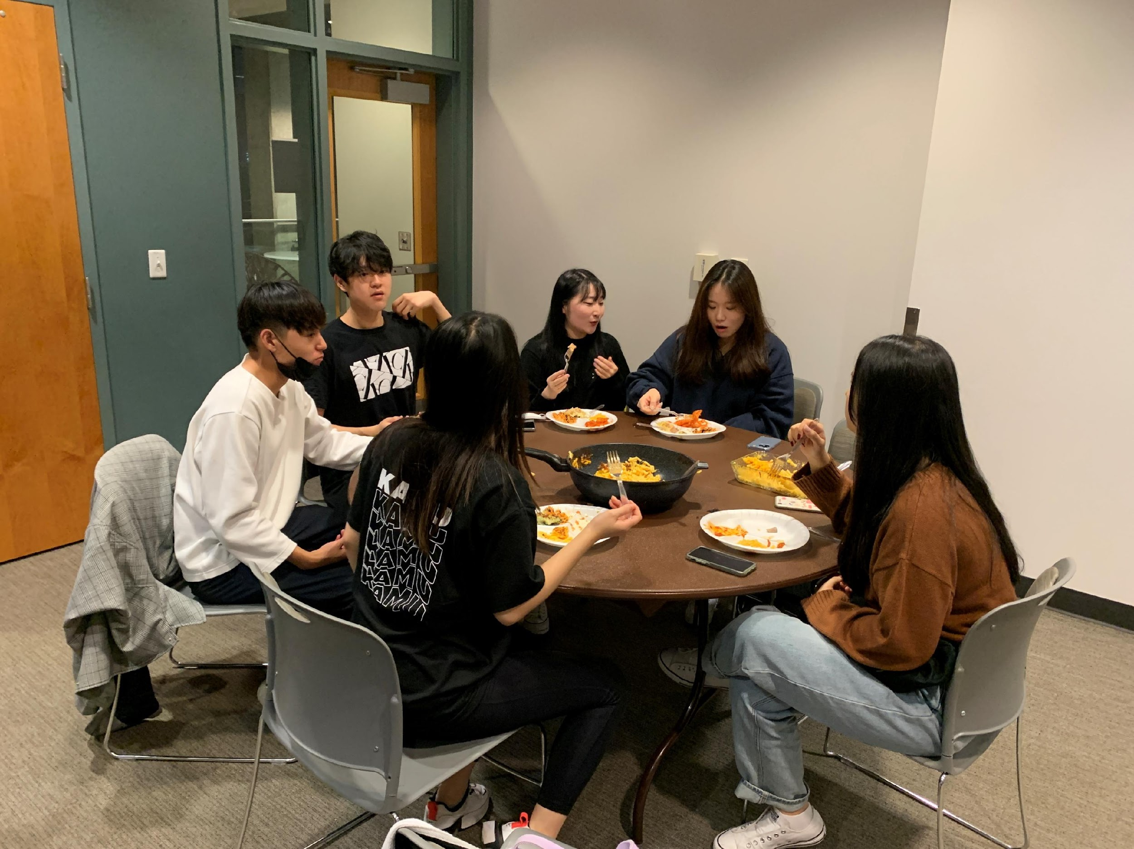
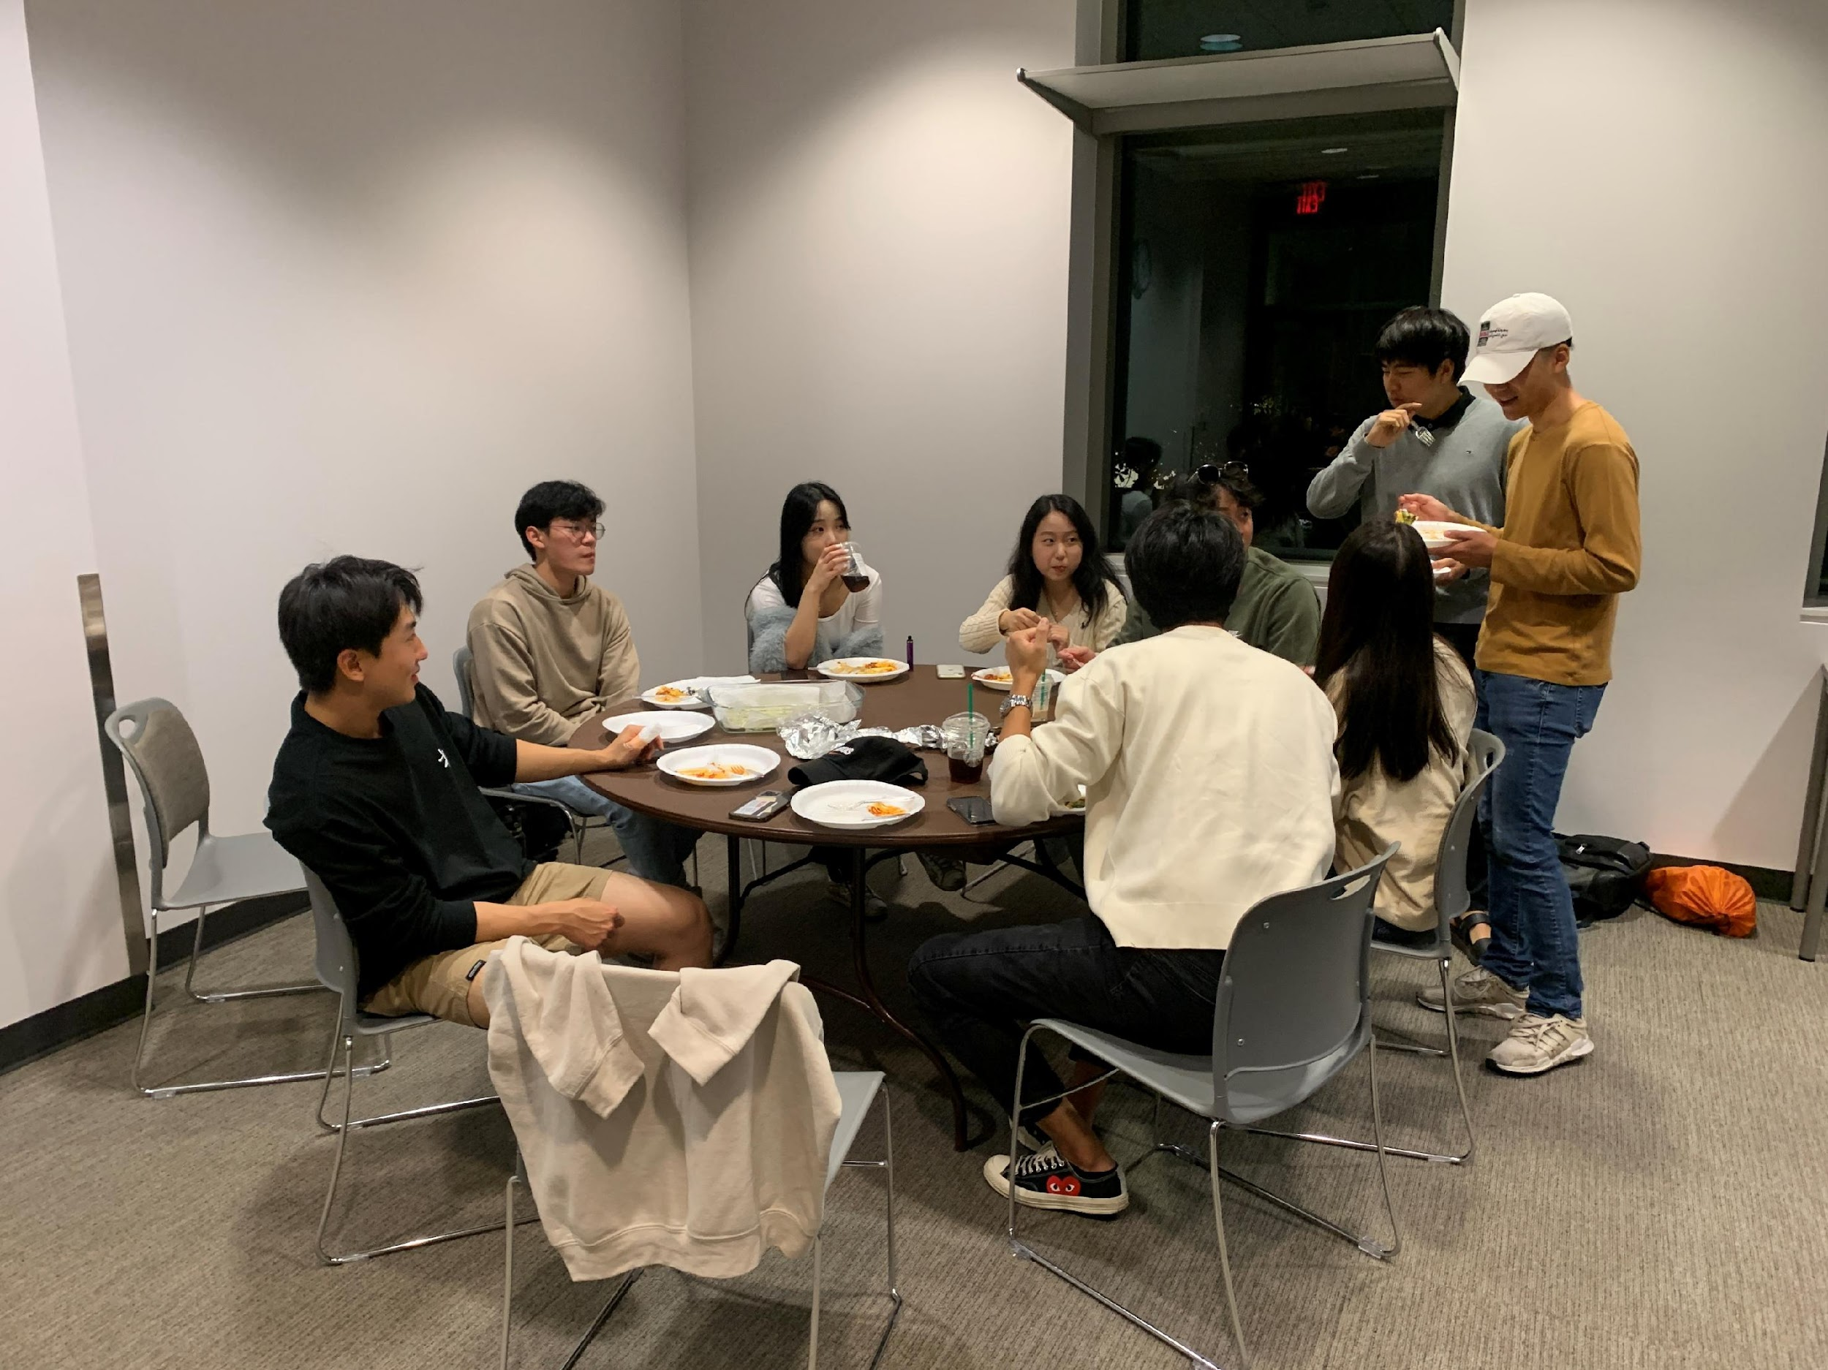
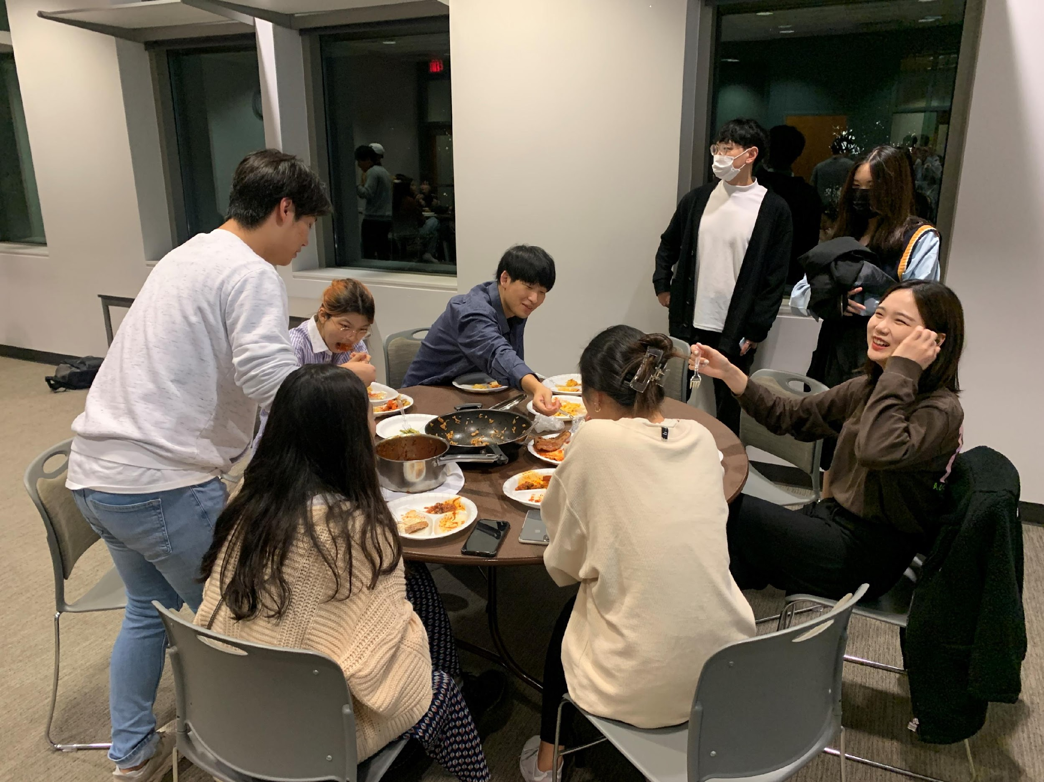
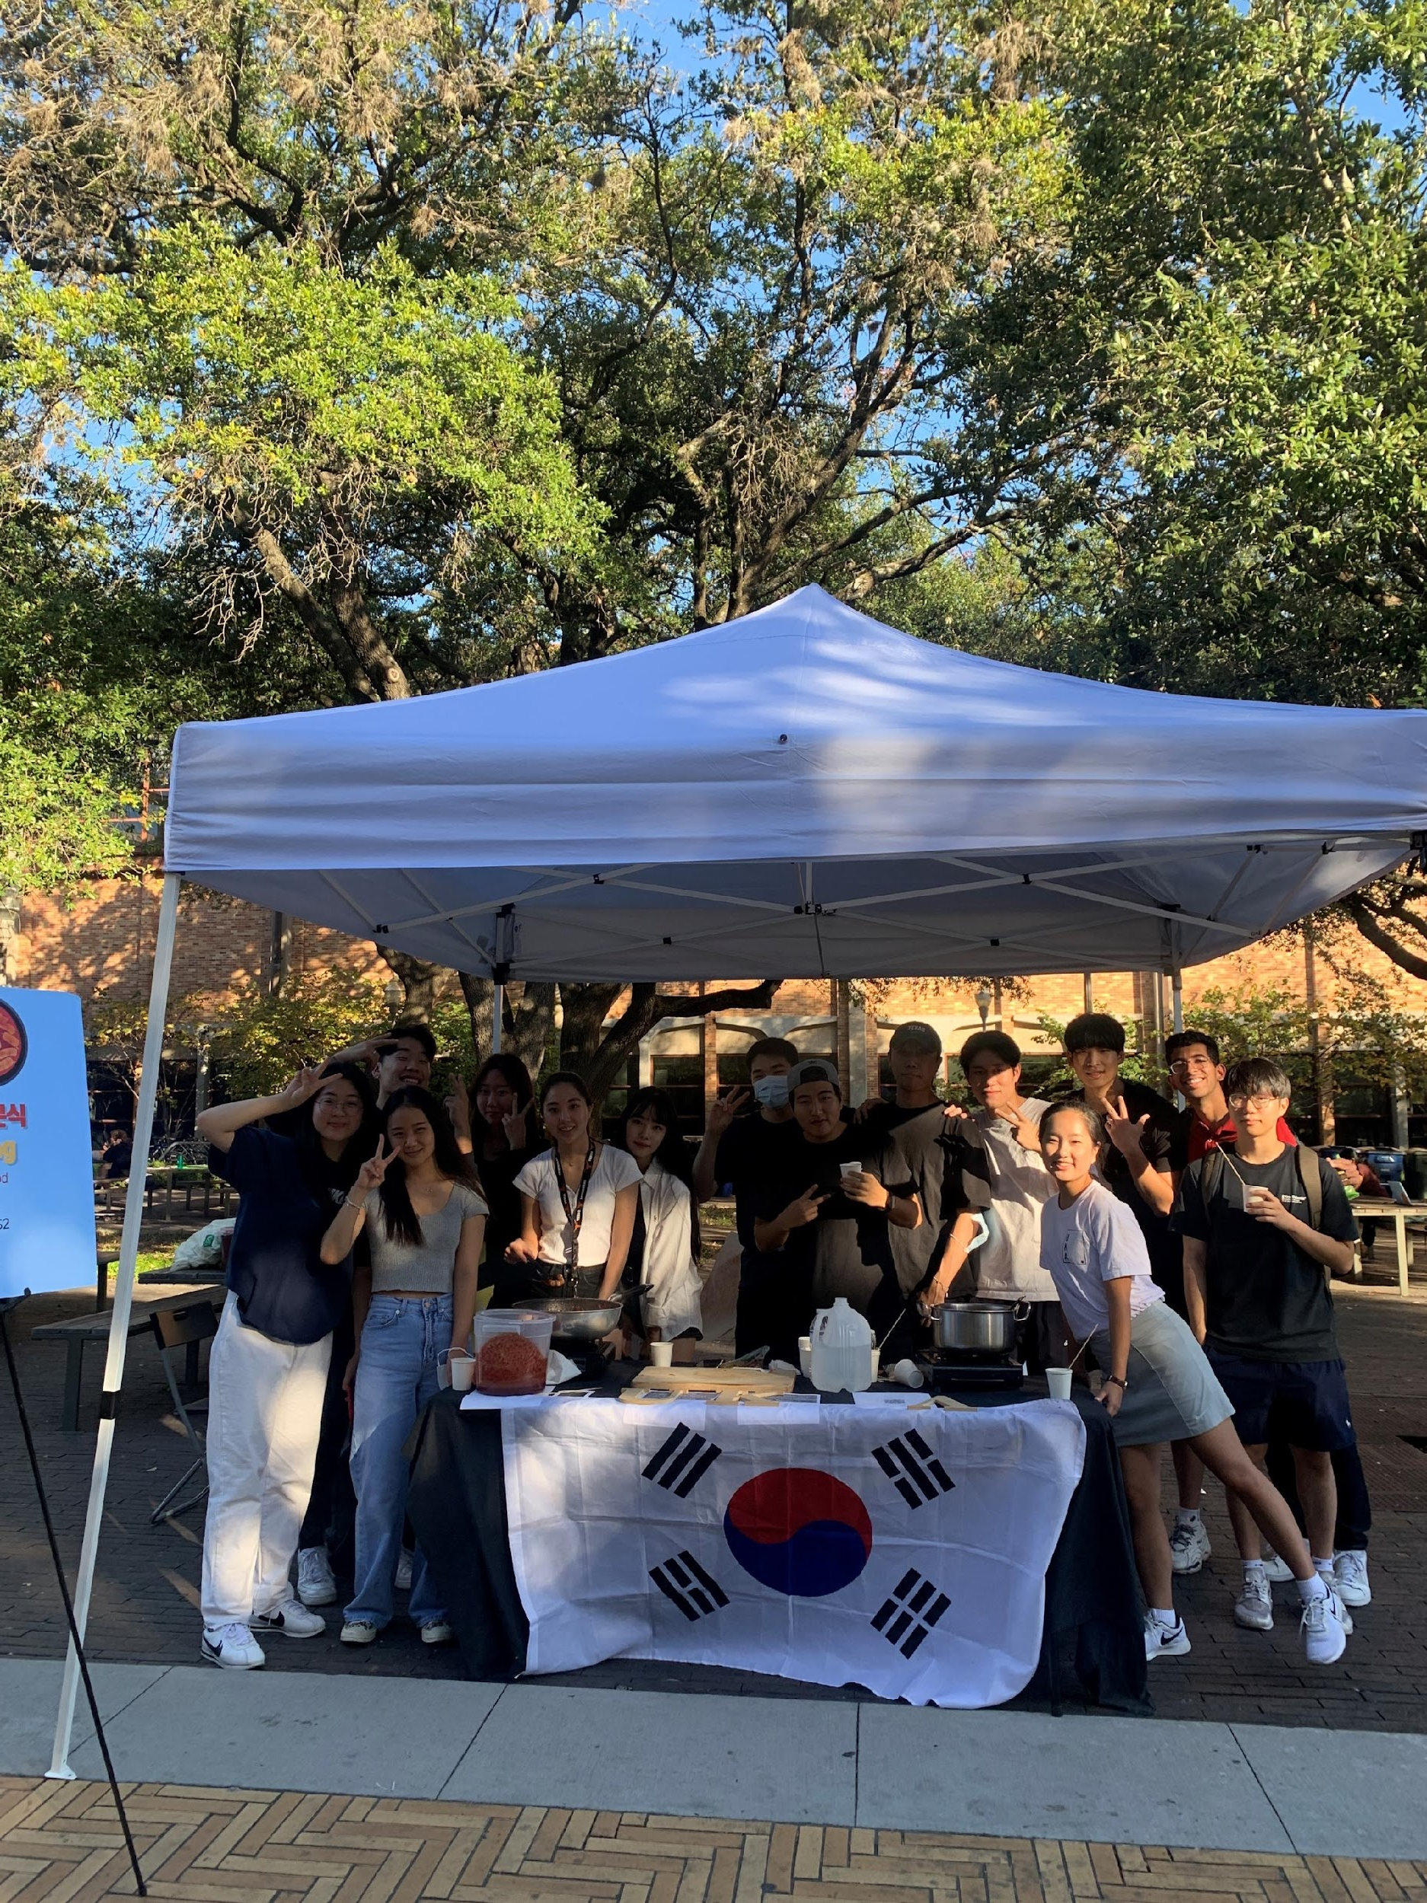
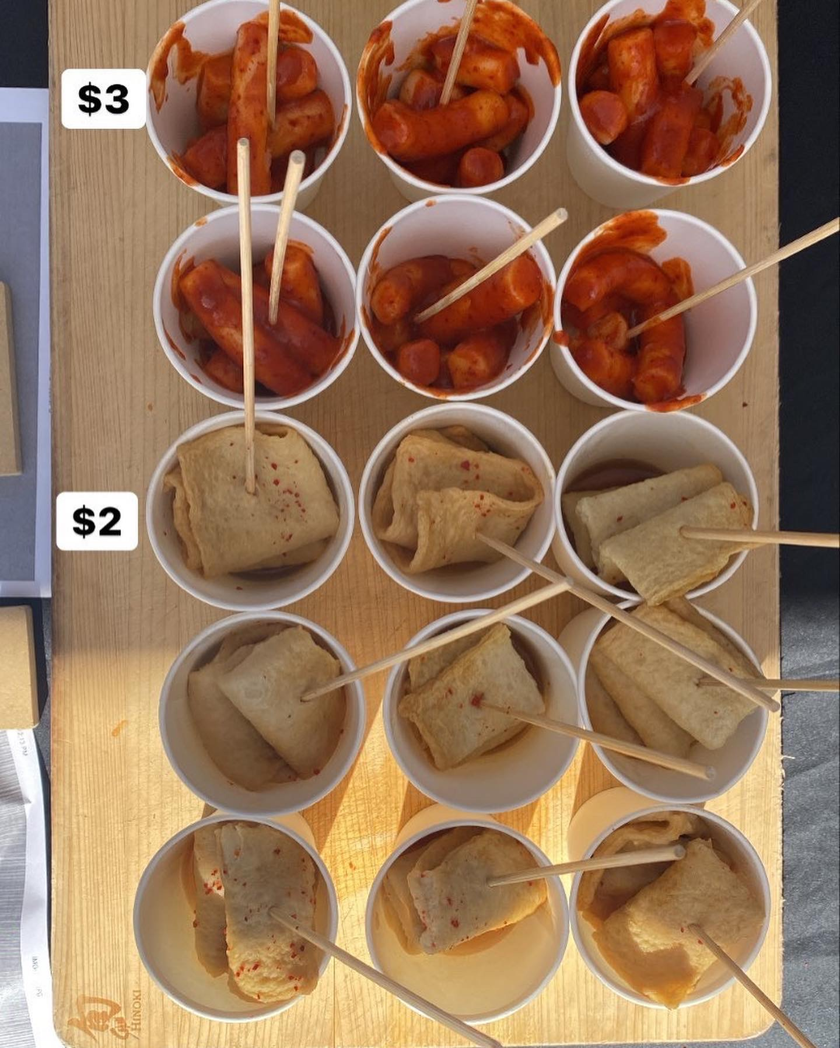
November,
Sharing is Caring, especially FOOD!
Bowling Competition
Friendsgiving
Ddeokbokki Fundraising

Slide 20
November,
Sharing is Caring, especially FOOD!
Bowling Competition
Friendsgiving
Ddeokbokki Fundraising

Slide 21
November,
Sharing is Caring, especially FOOD!
Friendsgiving
Ddeokbokki Fundraising

Slide 22
November,
Sharing is Caring, especially FOOD!
Ddeokbokki Fundraising

Slide 23
We can’t time travel to the FUTURE !!
YOU are the one who make UKA’s FUTURE!!

Slide 25
Other Contents

Slide 26
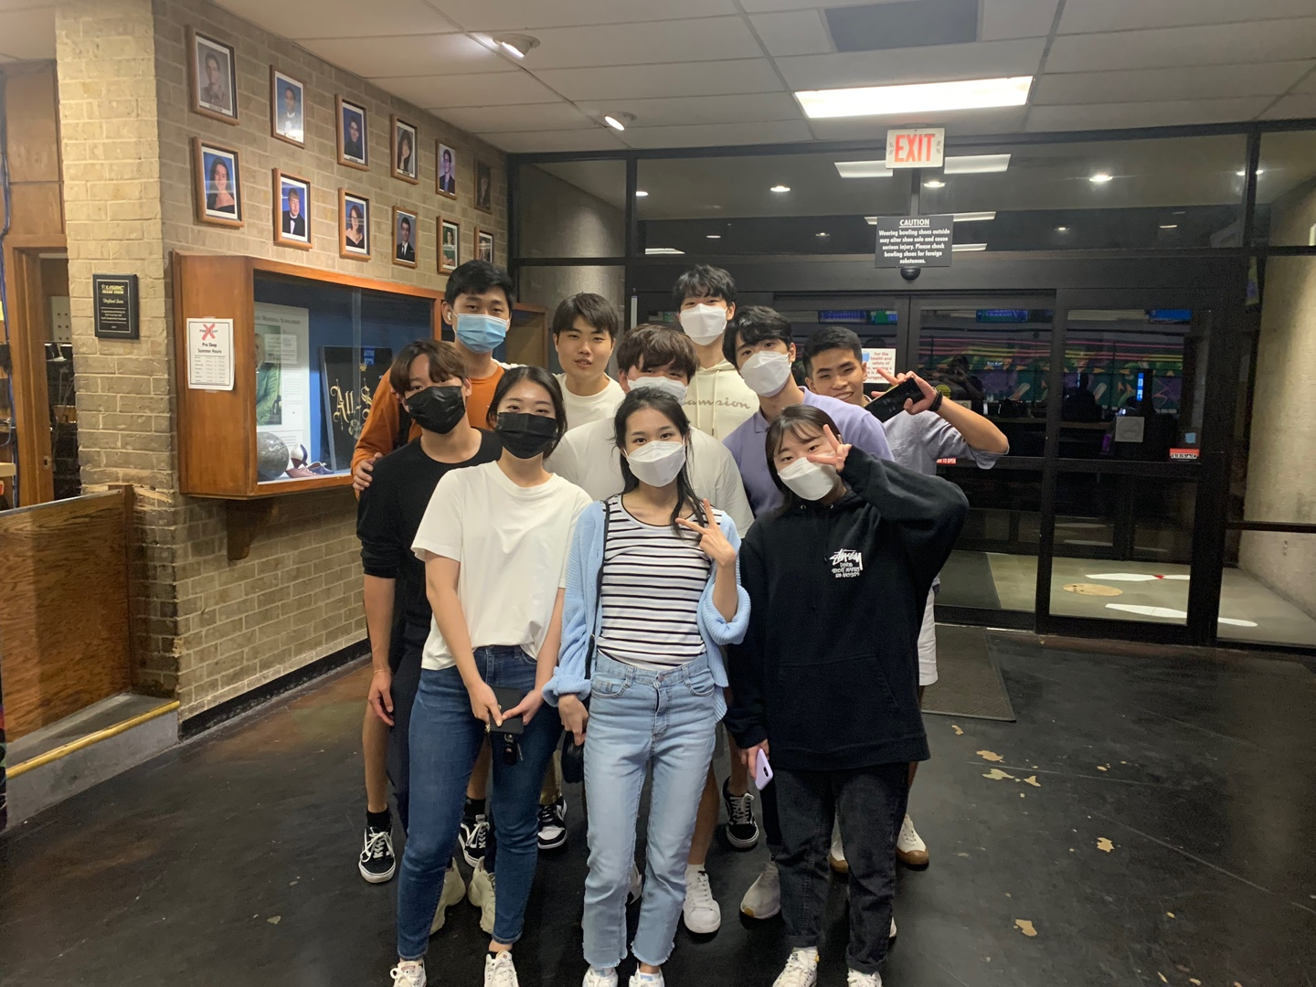
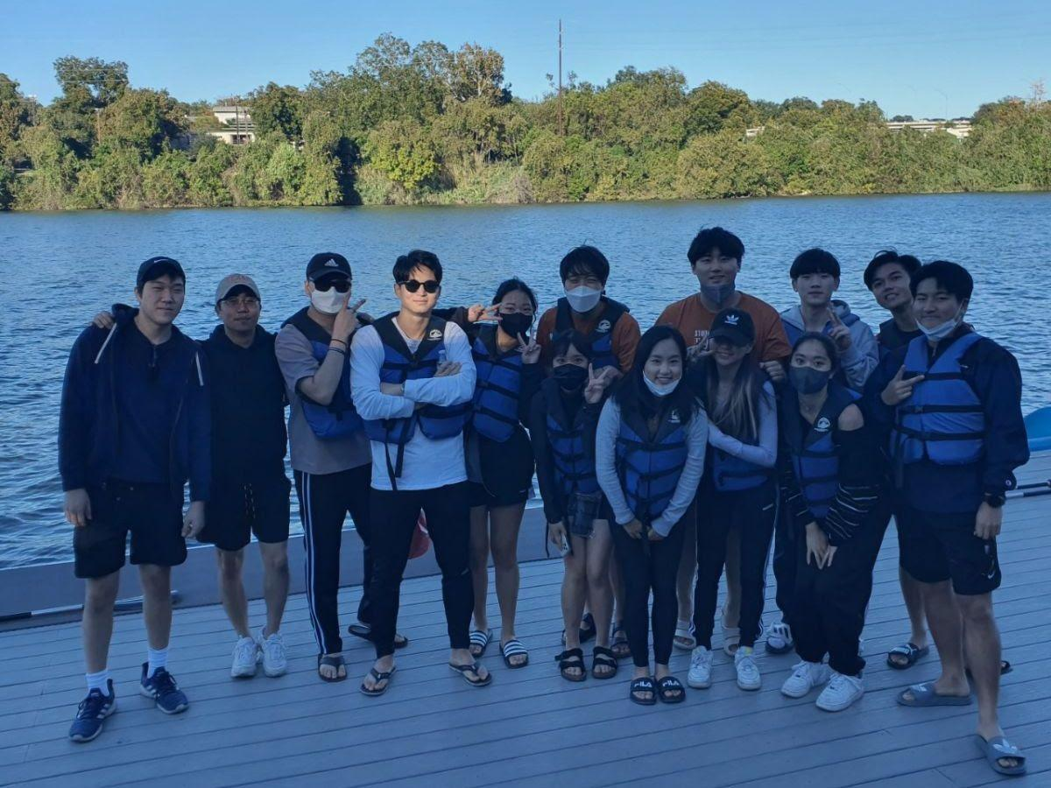
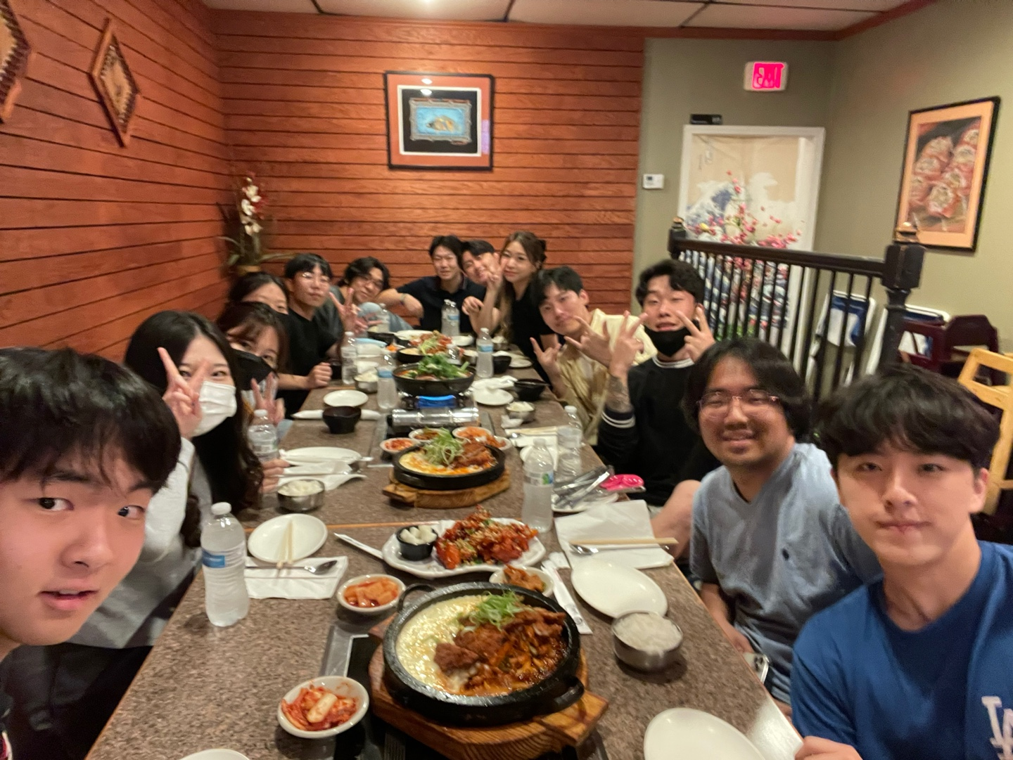
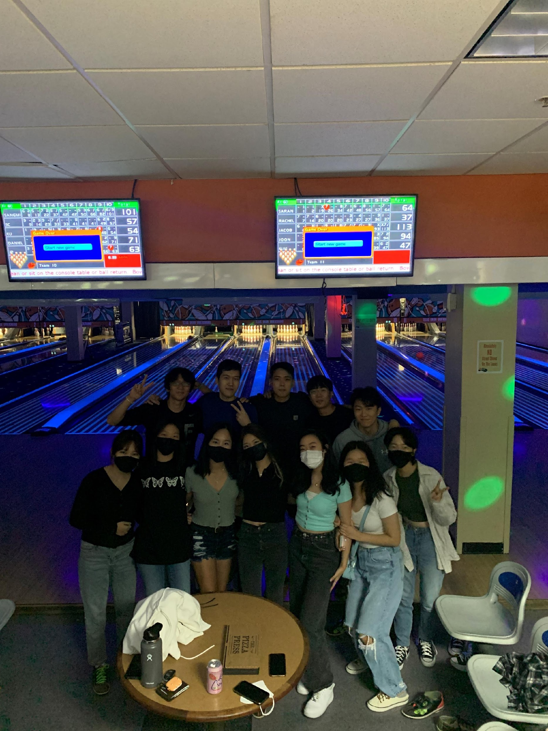
Each FAM FAM group had a lot of fun this semester!!
FAM FAM

Slide 27
Please shout out to your MOM and DAD who cared you
FAM FAM

Slide 28
FAM FAM
Basketball
Movie
Golf
Dongari
Stock Discussion
Tennis
Gaming
Volleyball
Band
Karaoke

Slide 29
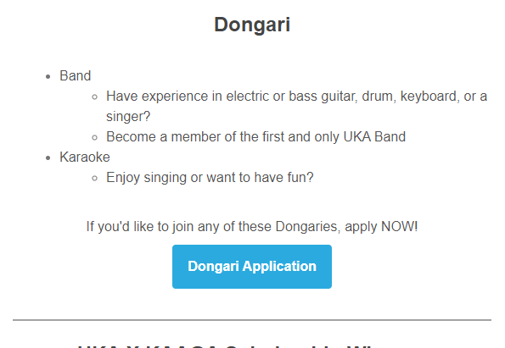
Our Newsletter team send you every UKA info quickly and precisely!!
Please check your email!!
FAM FAM
Dongari
Newsletter

Slide 30
Subscribe and Like!!
more videos coming soon!
FAM FAM
Dongari
Newsletter
UKA TV

Slide 31
UKA Planner
Camping
UKA Mini-Olympics
UT Korean Symposium
Career Workshop
More Guest Speakers
More scholarship
UT Korean Festival
UKA Election
End of Year Banquet
Next Semester Events

Slide 32
! Important Anouncement !
대선 투표 기간: 2/23/2022-2/28/2022
신청 마감: 1/8/2022
신청방법:
1.홈페이지 접속 후(http://ova.nec.go.kr)
2.홈 > 국외부재자/재외선거인 > 신고·등록신청 메뉴로 접속
3.주민등록번호 유무 확인
4.전자우편(E-mail) 및 자동입력방지 문자 입력 후 유효성 검증 체크
5.이메일 수신 및 유효성 검증 완료 후 신고서·등록신청서 작성
6.신고·등록신청 완료
Next Semester Events

Slide 33
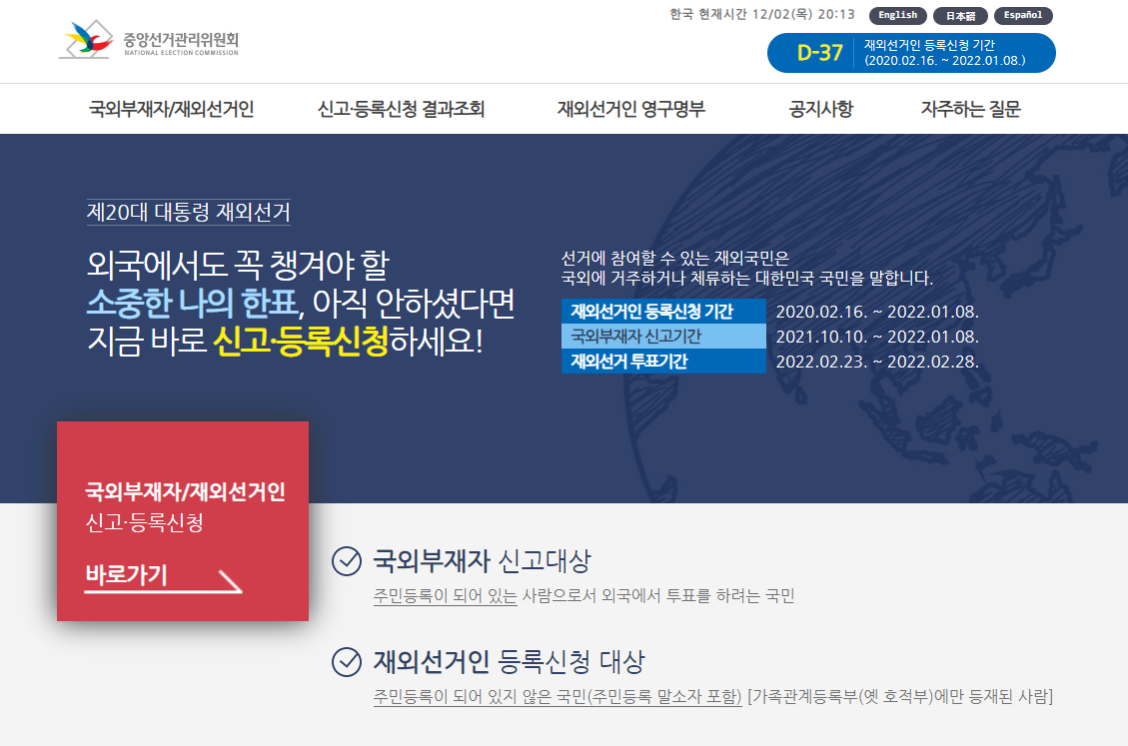
! Important Anouncement !
대선 투표 기간: 2/23/2022-2/28/2022
신청 마감: 1/8/2022
신청방법:
1.홈페이지 접속 후(http://ova.nec.go.kr)
2.홈 > 국외부재자/재외선거인 > 신고·등록신청 메뉴로 접속
3.주민등록번호 유무 확인
4.전자우편(E-mail) 및 자동입력방지 문자 입력 후 유효성 검증 체크
5.이메일 수신 및 유효성 검증 완료 후 신고서·등록신청서 작성
6.신고·등록신청 완료
Next Semester Events

