Slide 1
Interview Workshop
With Mentors in Various Fields

Slide 3
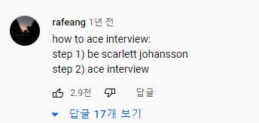

Slide 4
How to Ace Interview?
Head-up
Shoulders pulled back
No slouching
No laid-backness
Posture

Slide 5
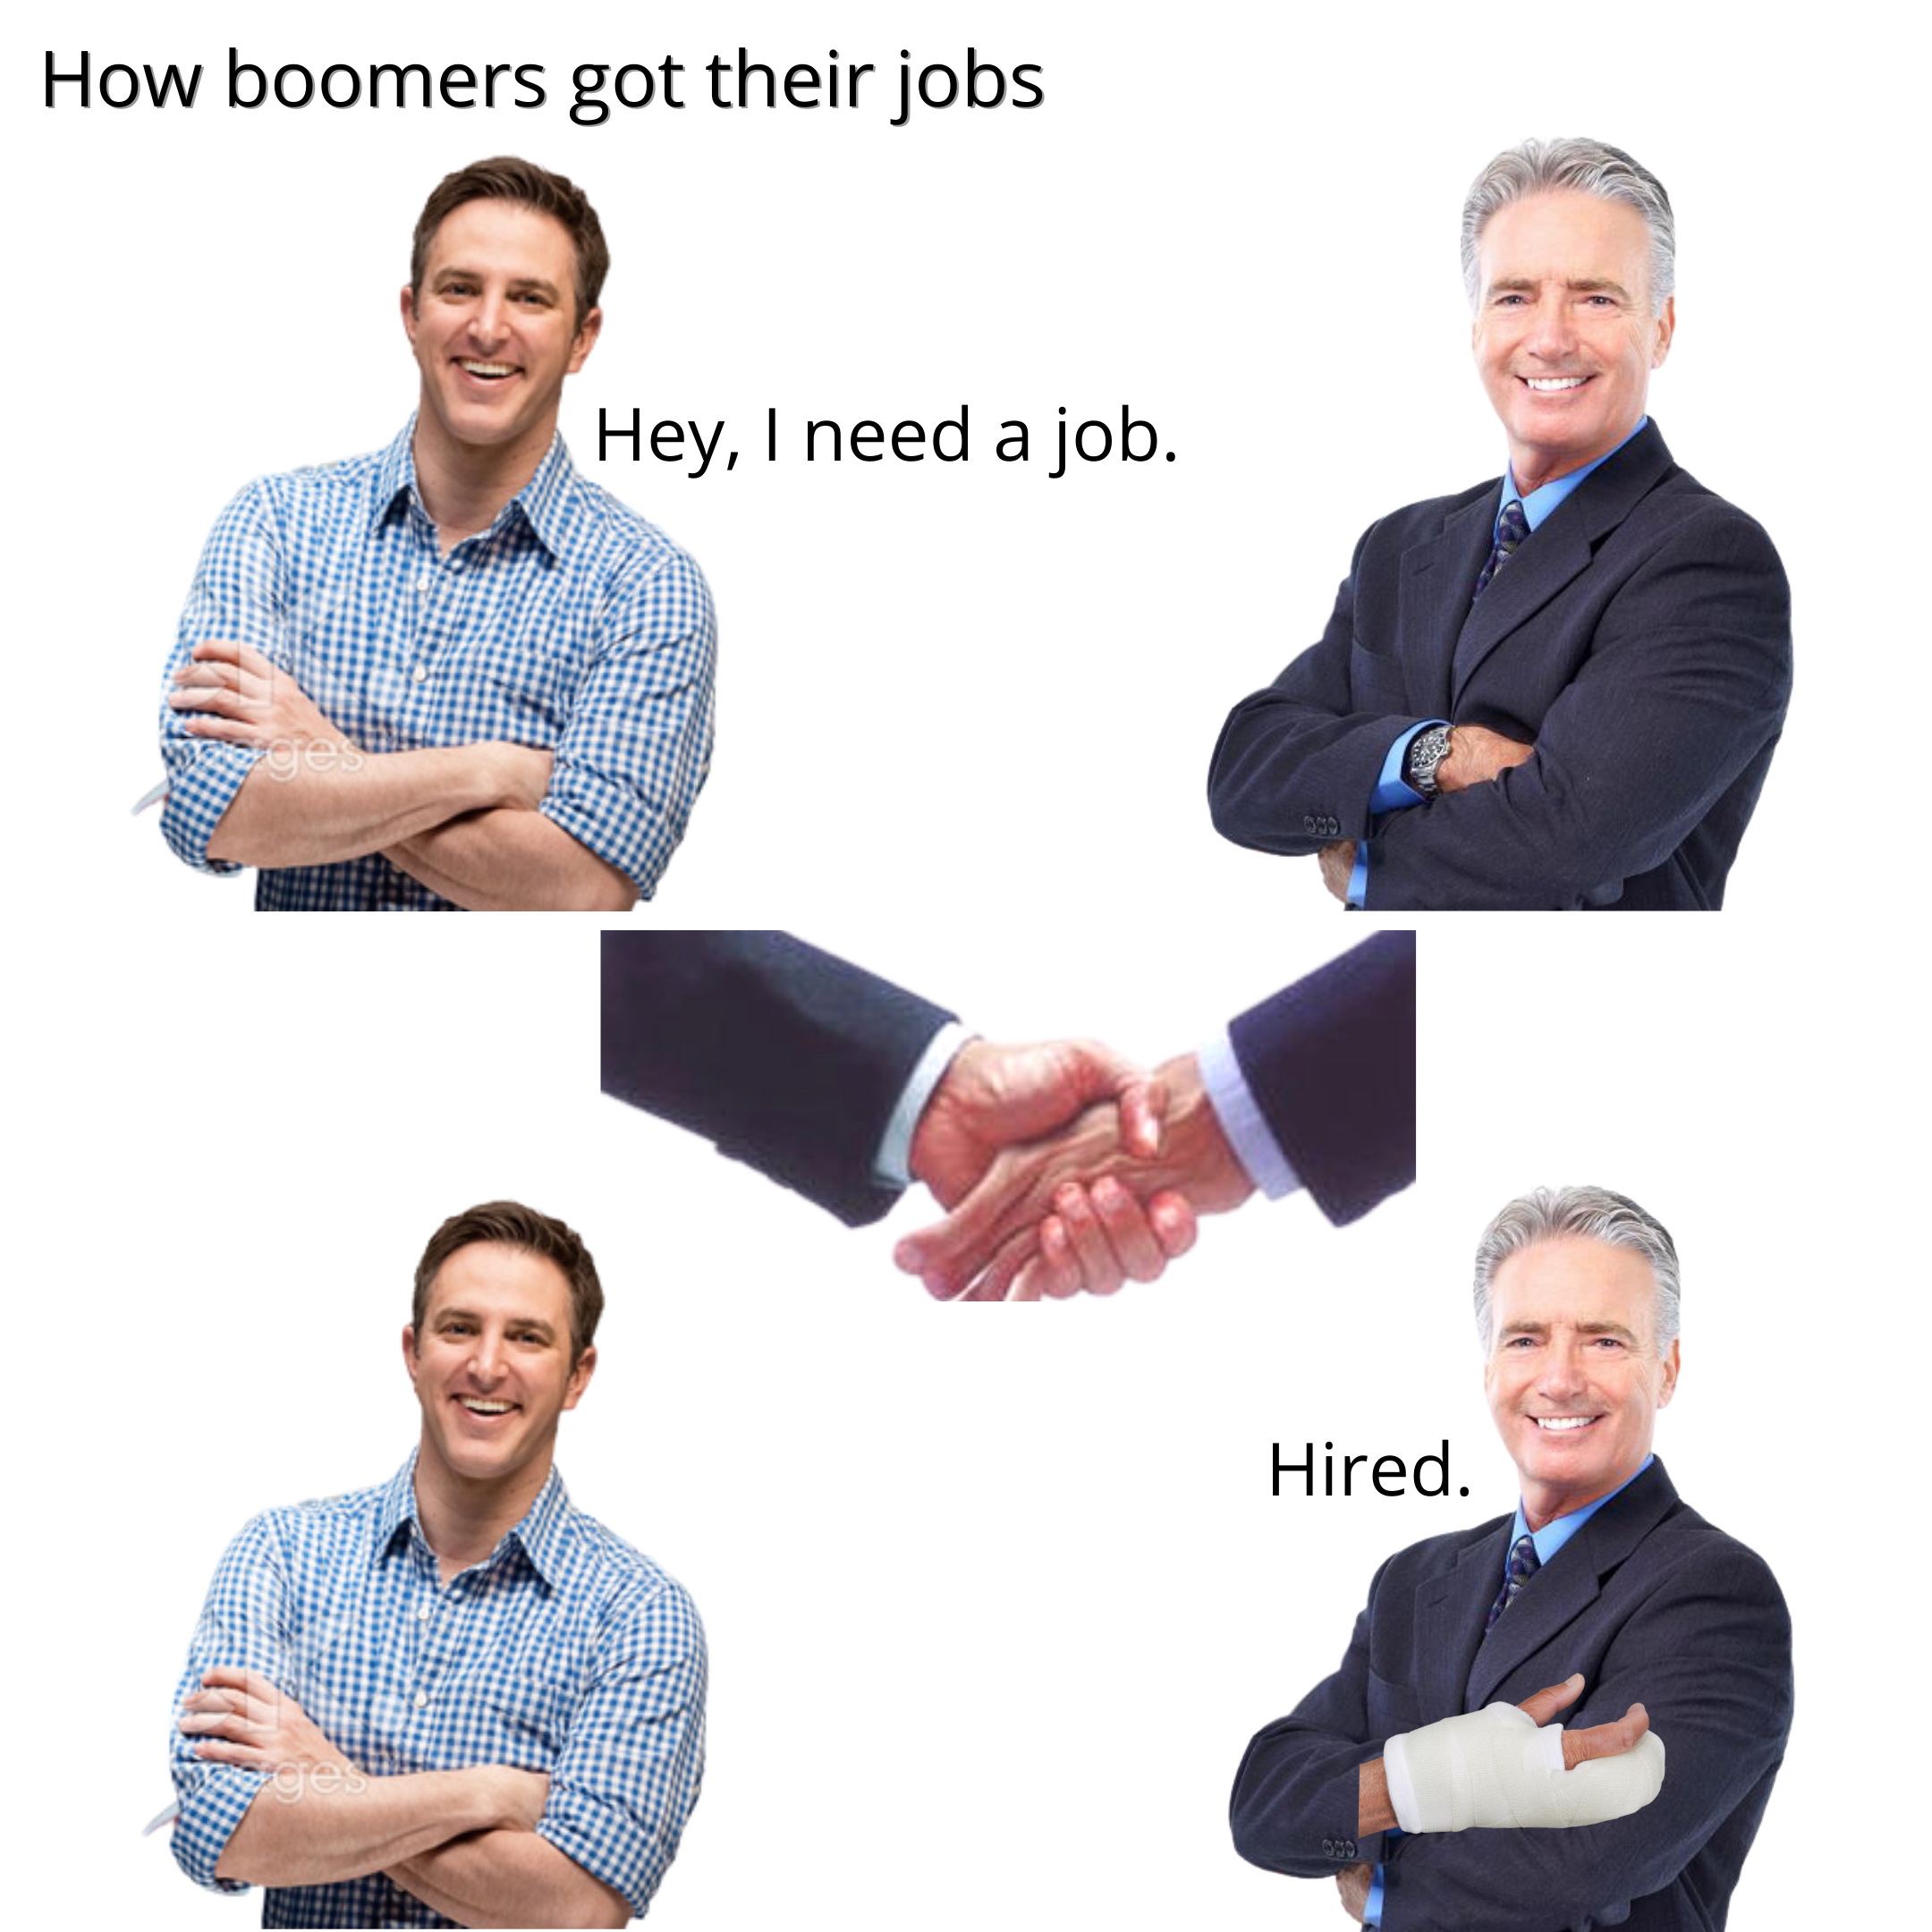
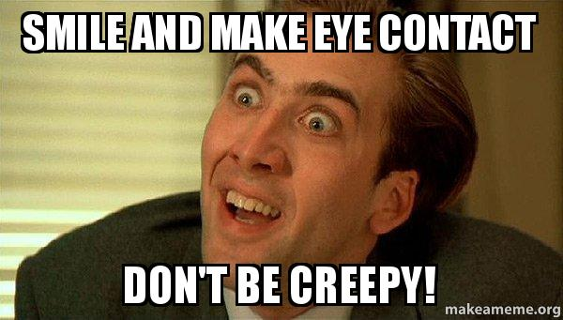
How to Ace Interview?
Eye Contact
Firm Handshake
Make a good first impression!!

Slide 6
Staring Game

Slide 7
How to Ace Interview?
A lot of the time, small talk comes up before any questions. It’s good to have a few current events or topics in mind.
Small Talk

Slide 8
Small Talk

Slide 9
How to Ace Interview?
Examples:
What are your biggest weaknesses/strengths?
What do you see yourself in five years?
Out of all the candidates, why should we hire you?
Why do want this Job/school?
Common Questions

Slide 10
How to Ace Interview?
Don’t rush to answer the question!
It is fine to take your time to think
deeply enough about the question!
Common Questions

Slide 11
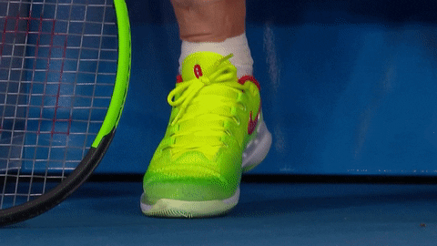
How to Ace Interview?
Avoid Unnecessary Movements

Slide 12
How to Ace Interview?
Interviewers will ask you if there are any questions for them.
Please!! Make sure to have a short list of questions for your employer or interviewer.

Slide 13
How to Ace Interview?
Always follow up within 24 hours with the Thank You Email. This can be a quick note simply thanking them for their time or a longer one that elaborates on some of the things you talked about.
It’s key to leaving a lasting impression
Thank You Email

Slide 14
Time with Mentors

