Slide 1
UT-Austin UKA Resume Workshop
Presentation by: Ashish Davé (아시스 다베)
January 2022

Slide 2
About Me
Year: Senior
Majors: Business Honors, Plan II Honors, Finance, Certificate in Business Spanish
Hometown: Houston, TX

Slide 3
Introduction

Slide 4
What is networking?
Series of direct and indirect interactions with people in order to build rapport and goodwill

Slide 5
What is networking?
Series of direct and indirect interactions with people in order to build rapport and goodwill
Direct Interactions:
Conversations and emails with recruiters, employees, or staff
Informational interviews with employees or staff
Applications for positions with the firm
Indirect Interactions:
Online content (your LinkedIn profile, articles written about you, publications)
Referrals by other staff members—your reputation, good or bad

Slide 6
Preparing your online presence

Slide 7
Preparing your online presence
LinkedIn
Especially important for: McCombs, COLA, Cockrell, CNS (computer/data science)
Less important for: Pre-Med, Social Work/Education

Slide 8
Preparing your online presence
LinkedIn
Especially important for: McCombs, COLA, Cockrell, CNS (computer/data science)
Less important for: Pre-Med, Social Work/Education
Earned Media
Positive online content by a credible third party, such as a news organization, academic journal, or school
Importance of being “searchable”

Slide 9
Recruiting resources at UT-Austin
RecruitMcCombs
HandShake
UT Career Fairs
Direct applications on employers’ websites

Slide 10
Career Fair

Slide 11
Career fair: what to expect?
Prepare your…
Story (i.e. elevator pitch)
30-60 second introduction of yourself:
Name
Major
Why you are interested in the company
Demonstrated knowledge/experience of the firm/industry)
A+ pitch: reference a point of contact at the organization

Slide 12
Career fair: what to expect?
Prepare your…
Story (i.e. elevator pitch)
30-60 second introduction of yourself:
Name
Major
Why you are interested in the company
Demonstrated knowledge/experience of the firm/industry)
A+ pitch: reference a point of contact at the organization
Materials
Resume, padfolio, pen and paper
Notes on company/organization

Slide 13
Career fair: what to expect?
Prepare your…
Story (i.e. elevator pitch)
30-60 second introduction of yourself:
Name
Major
Why you are interested in the company
Demonstrated knowledge/experience of the firm/industry)
A+ pitch: reference a point of contact at the organization
Materials
Resume, padfolio, pen and paper
Notes on company/organization
Objectives
Typically twofold: a) learn more about the organization, b) make name known to recruiter
Always ask for the representative’s email and follow up after the fair

Slide 14
LinkedIn Interactive Walkthrough

Slide 15
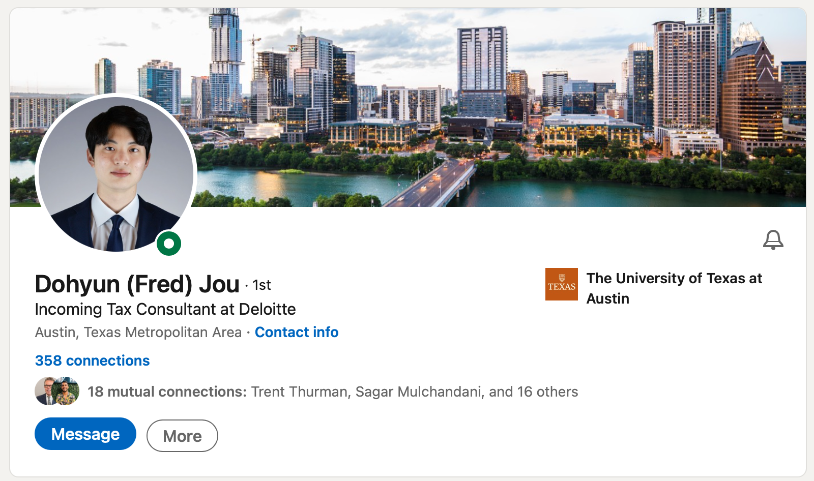
Step #1: Header
Professional Profile Photo
Header Photo (cityscape or appropriate landscape preferred)
Current or Expected Occupation
University Logo

Slide 16
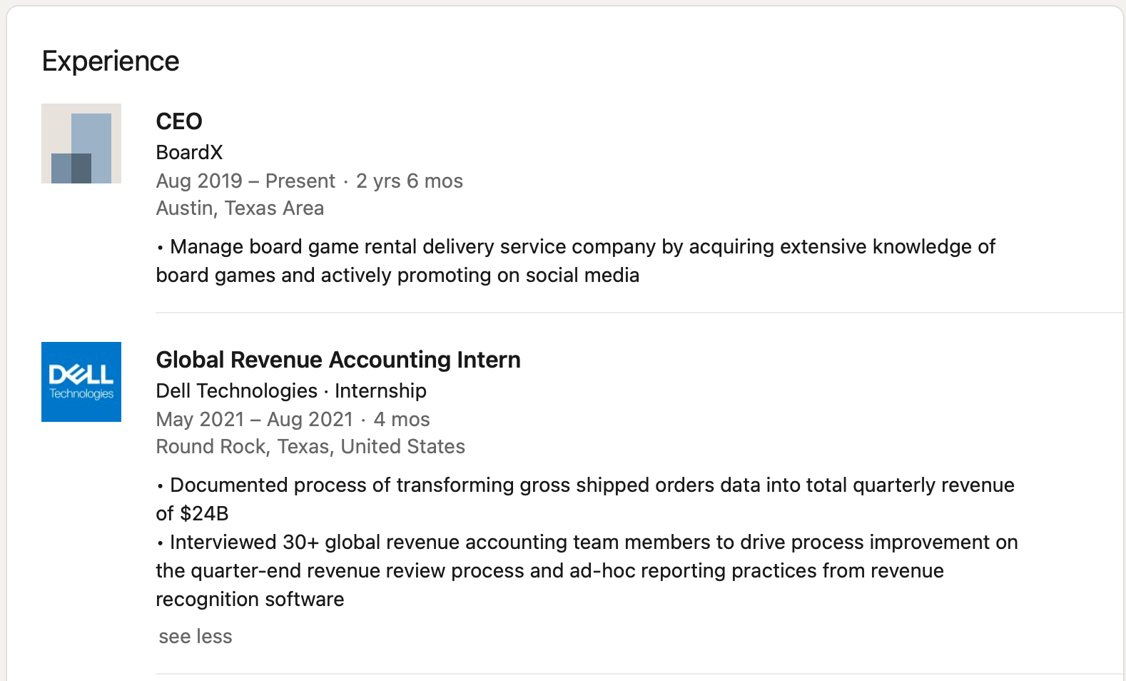
Step #2: Experience
Position Title
Company/Organization
Dates of Occupation
Description of Impact (can reuse resume bullets here; focus on quantification of impact)

Slide 17
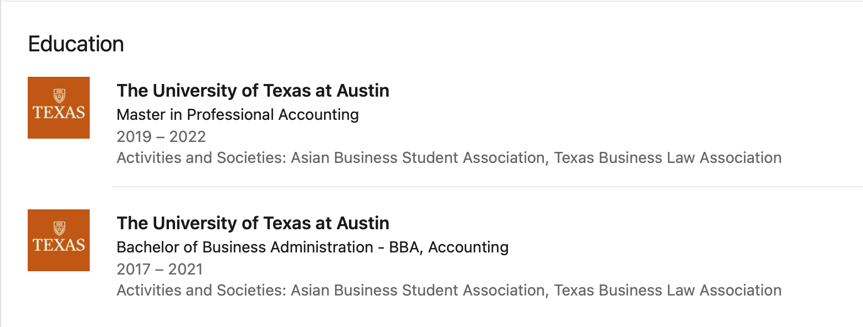
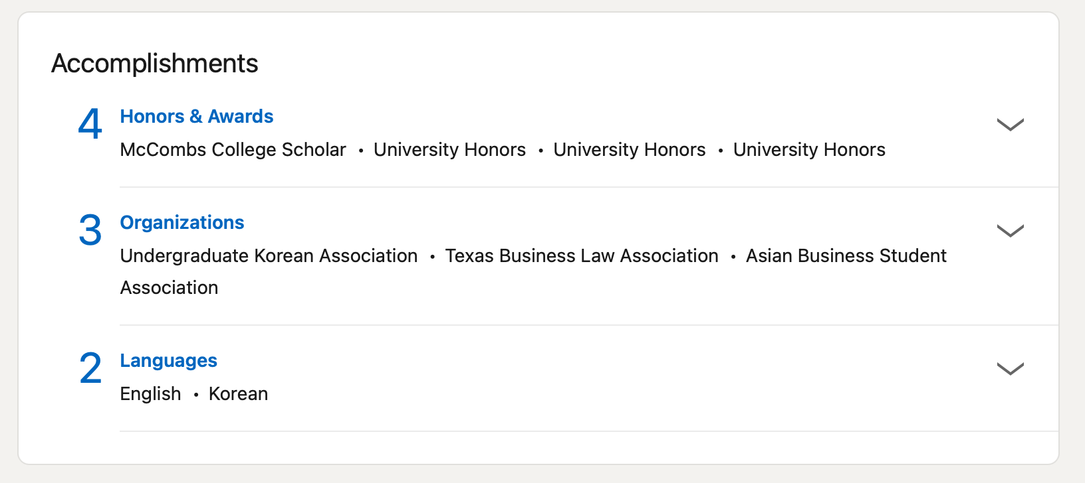
Step #3: Education & Extras
UT-Austin!
Major
Dates of Study
Clubs/Organizations + Leadership Positions
Honors and Awards (max of 10!)
Organizations (if not listed above)
Languages
Test Scores (if good)

Slide 18
Resume Walkthrough

Slide 19
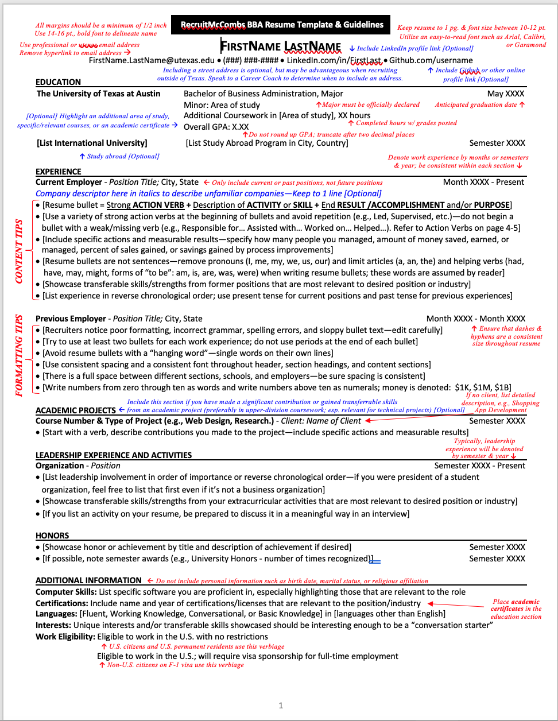
Elements of a good resume
Google “UT Austin McCombs BBA Resume Template”
Core sections:
Name and contact information
Education (include GPA and test scores if high)
Work Experience – jobs, internships
Leadership Experience and Activities– student orgs/extracurriculars (limit to college)
Honors – awards, Dean’s Lists, competitions
Additional Information – language, skills, certifications, work eligibility (only if international student)
**Science/pre-med and Moody will have modified resumes**
Science: add “Research Experience” section below Work Experience
Moody’s: Google “UT Moody’s Resume Writing Guide,” go to “Career Materials” page

Slide 20
Resume Do’s and Don’ts
DO:
Always quantify your impact. Use phrases like “Analyzed 35 datasets to achieve ~$5K in cost savings” or “Treated 100+ patients as head clinical volunteer through vitals screenings.”

Slide 21
Resume Do’s and Don’ts
DO:
Always quantify your impact. Phrases like “Analyzed 35 datasets to achieve ~$5K in cost savings” or “Treated 100+ patients as head clinical volunteer through vitals screenings” communicate impact in a meaningful way to recruiters.
Spend time reworking your bullets. Think critically about the most valuable 3-6 features of your experience. Aim for max description in least number of words.

Slide 22
Resume Do’s and Don’ts
DO:
Always quantify your impact. Use phrases like “Analyzed 35 datasets to achieve ~$5K in cost savings” or “Treated 100+ patients as head clinical volunteer through vitals screenings” communicate impact in a meaningful way to recruiters.
Spend time reworking your bullets. Think critically about the most valuable 3-6 features of your experience. Aim for max description in least number of words.
Use action verbs when starting your bullets. Vary your action verbs and avoid passive verbs, like “participated” and “completed.”

Slide 23
Resume Do’s and Don’ts
DO:
Always quantify your impact. Use phrases like “Analyzed 35 datasets to achieve ~$5K in cost savings” or “Treated 100+ patients as head clinical volunteer through vitals screenings” communicate impact in a meaningful way to recruiters.
Spend time reworking your bullets. Think critically about the most valuable 3-6 features of your experience. Aim for max description in least number of words.
Use action verbs when starting your bullets. Vary your action verbs and avoid passive verbs, like “participated” and “completed.”
Have a minimum of 2 bullets per experience but no more than 5 total. Diversify bullet content and focus.

Slide 24
Resume Do’s and Don’ts
DO:
Always quantify your impact. Use phrases like “Analyzed 35 datasets to achieve ~$5K in cost savings” or “Treated 100+ patients as head clinical volunteer through vitals screenings” communicate impact in a meaningful way to recruiters.
Spend time reworking your bullets. Think critically about the most valuable 3-6 features of your experience. Aim for max description in least number of words.
Use action verbs when starting your bullets. Vary your action verbs and avoid passive verbs, like “participated” and “completed.”
Have a minimum of 2 bullets per experience but no more than 5 total. Diversify bullet content and focus.
Be space possessive. Every inch of your resume is valuable real estate.

Slide 25
Resume Do’s and Don’ts
DON’T:
Exceed one page. For undergraduates, resumes should not exceed one page except for exceptional circumstances or explicitly requested.

Slide 26
Resume Do’s and Don’ts
DON’T:
Exceed one page. For undergraduates, resumes should not exceed one page except for exceptional circumstances or explicitly requested.
Have typos or grammar errors in bullets.

Slide 27
Resume Do’s and Don’ts
DON’T:
Exceed one page. For undergraduates, resumes should not exceed one page except for exceptional circumstances or explicitly requested.
Have typos or grammar errors in bullets.
Leave white space at the end of lines or between sections. This indicates an incomplete/insubstantial idea. Dig deeper or combine similar actions.

Slide 28
Resume Do’s and Don’ts
DON’T:
Exceed one page. For undergraduates, resumes should not exceed one page except for exceptional circumstances or explicitly requested.
Have typos or grammar errors in bullets.
Leave white space at the end of lines or between sections. This indicates an incomplete/insubstantial idea. Dig deeper or combine similar actions.
Include experiences from high school unless it has continued through college. Notable honors are acceptable.

Slide 29
Resume Do’s and Don’ts
DON’T:
Exceed one page. For undergraduates, resumes should not exceed one page except for exceptional circumstances or explicitly requested.
Have typos or grammar errors in bullets.
Leave white space at the end of lines or between sections. This indicates an incomplete/insubstantial idea. Dig deeper or combine similar actions.
Include experiences from high school unless it has continued through college. Notable honors are acceptable.
Repeat action verbs from line to line. Use a thesaurus!

Slide 30
Questions?

Slide 31
Resume Open Workshop

Slide 32
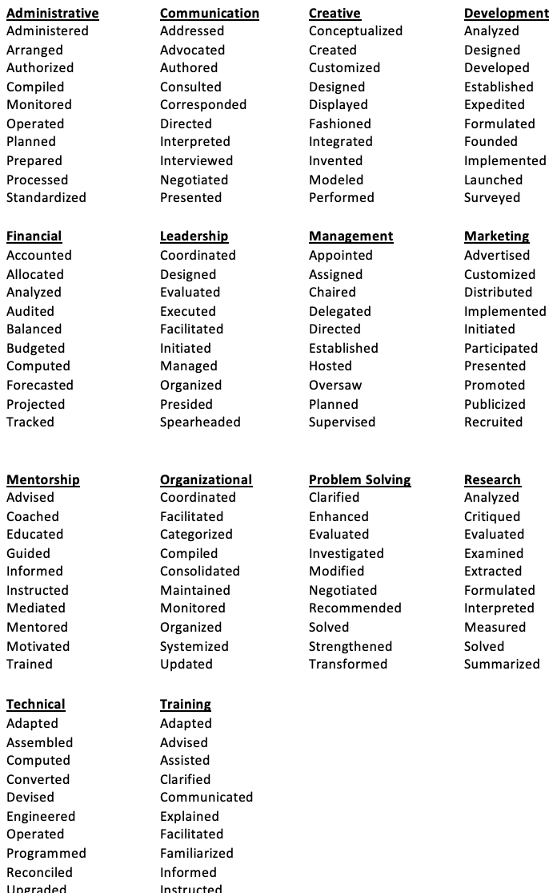
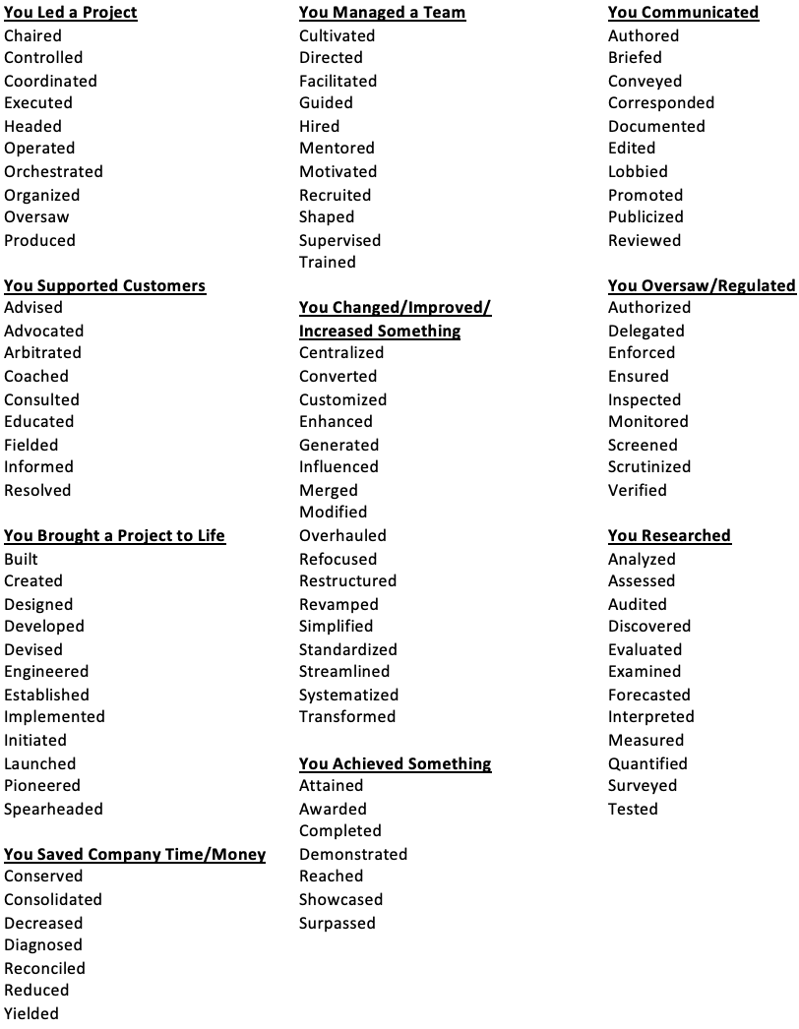
Resume Workshop

