Slide 1
GM#3
유티 어스틴 한인 학생회
texasuka.org

Slide 2
Finance
UKA X Grace Realty Scholarship
Fundraising

Slide 3
Finance
Scholarships are due this Friday, February 18th at Midnight!

Slide 4
Finance
One essay
And
are required!
One short answer

Slide 5
Finance
Win $500 towards tuition!

Slide 6
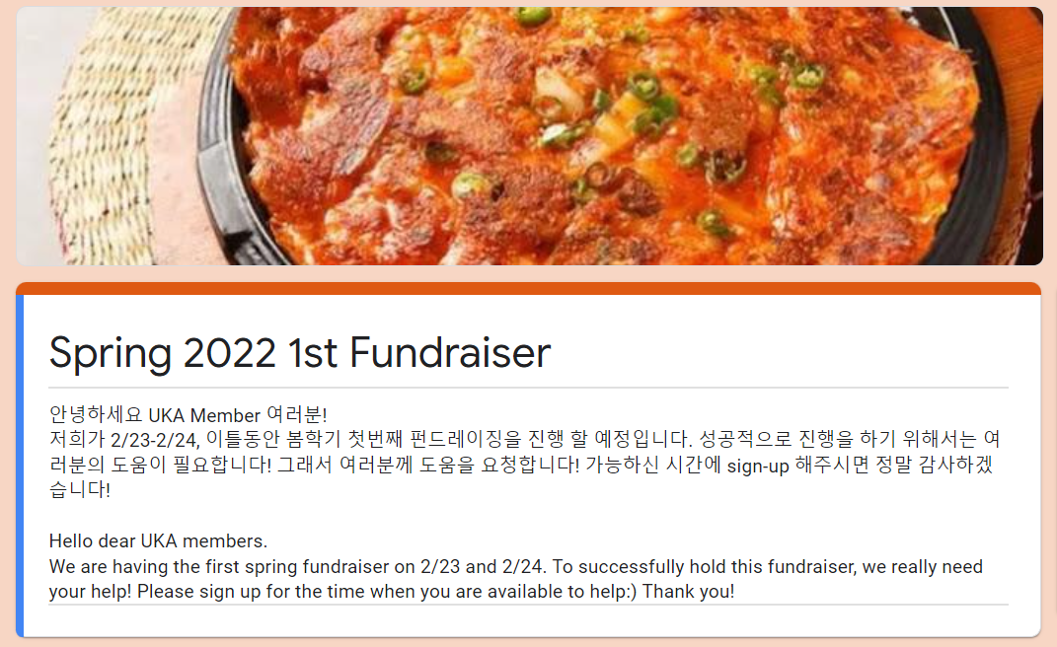
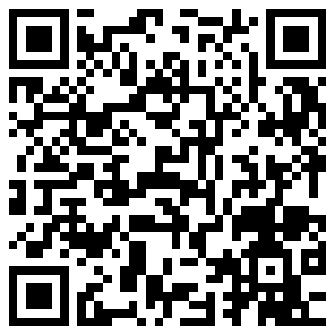
Korean Pancakes Fundraiser
Next Wednesday – Thursday
(February 23 – 24) from 11 AM – 4 PM

Slide 7
Informatics
Website Update
YouTube Video

Slide 8
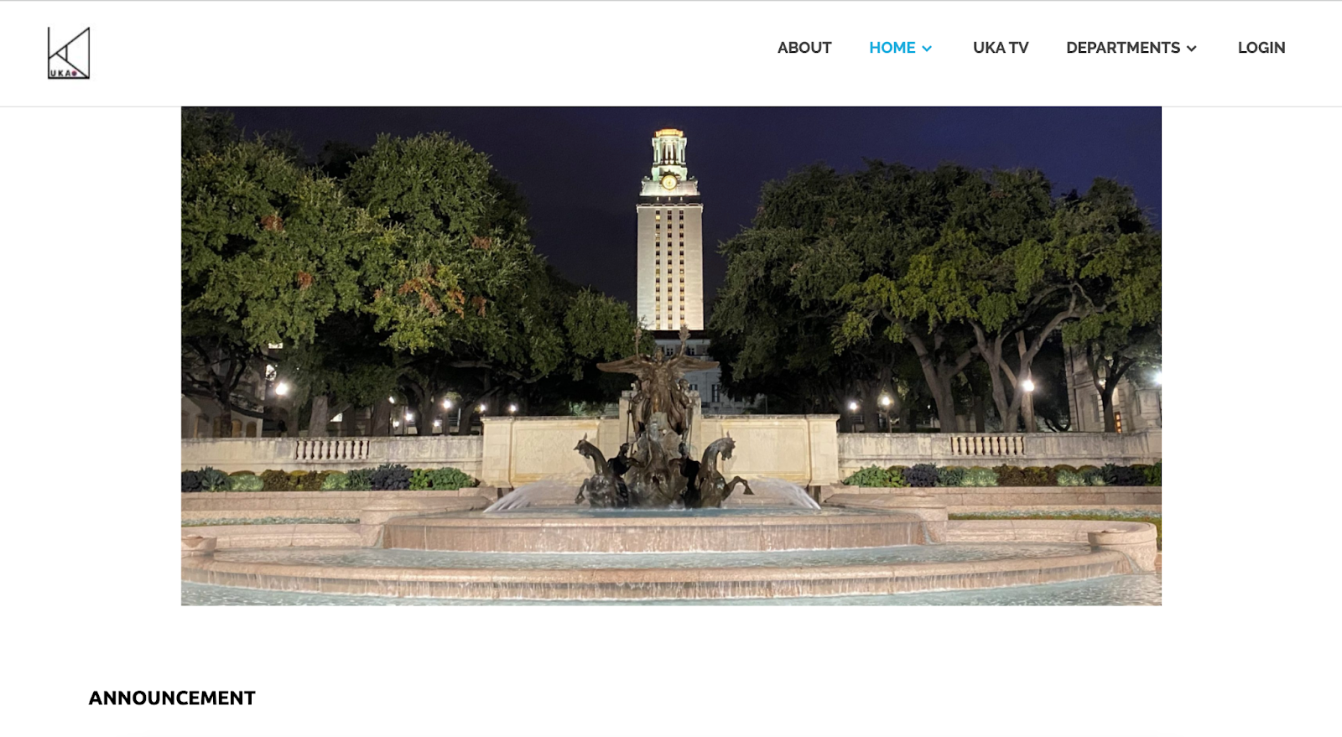
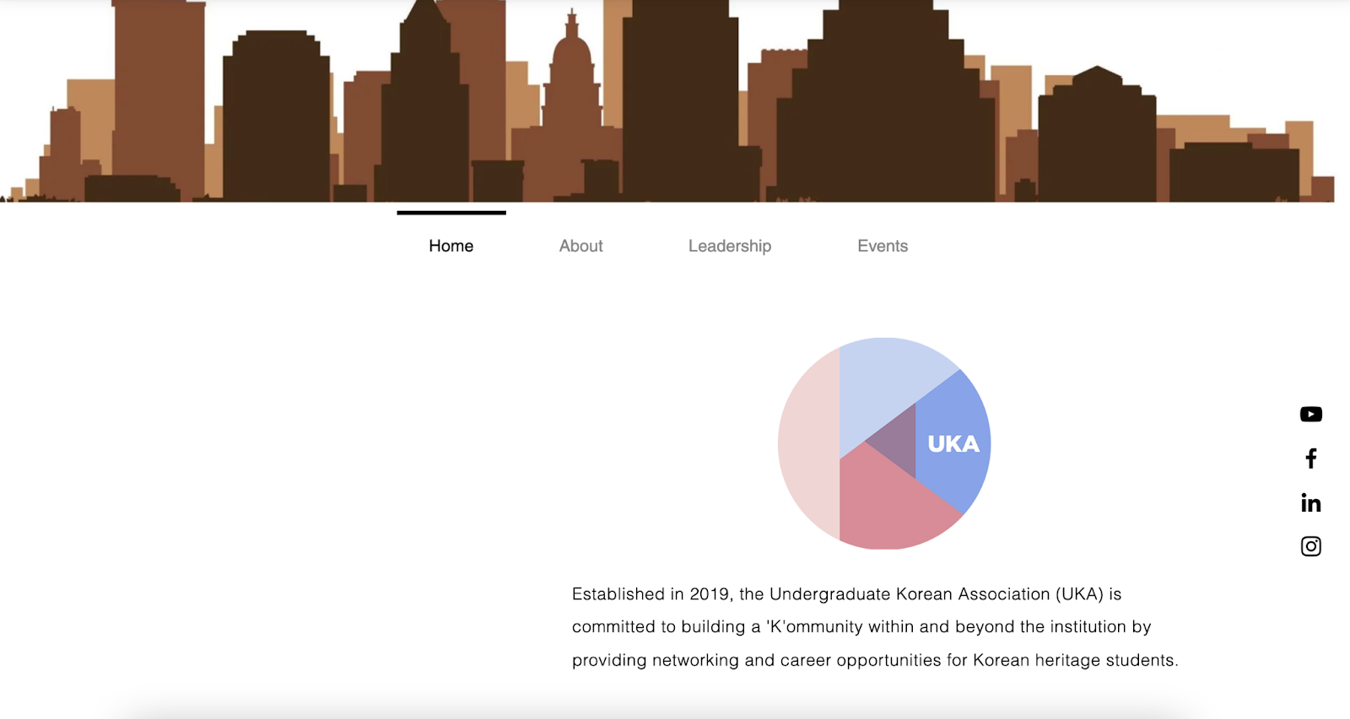
Website Update
BEFORE:

Slide 9
Website Update
AFTER:
A preview of our new website!! Will soon be published and shared in Kakao group chat

Slide 10
YouTube Video
We are currently working on a dorm tour video! We plan to publish by February so please subscribe!

Slide 11
Marketing
Internship Opportunity

Slide 12
Internship Opportunity
Samsung Bioepis Global Internship
Major
Biology, Chemical Engineering, Chemistry, 의약학
Requirements
2022년 12월 또는 2023년 5월 졸업 예정자 (학/석)
군필/면제자
해외여행 결격사유 없는 자

Slide 13
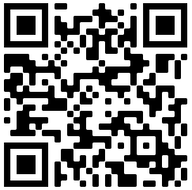
Internship Opportunity
Application
Feb 17th – Feb 28th 5PM (KST)

Slide 14
Operation
UKA Field Trip Recap
Upcoming Events
Fam-Fam Update

Slide 15
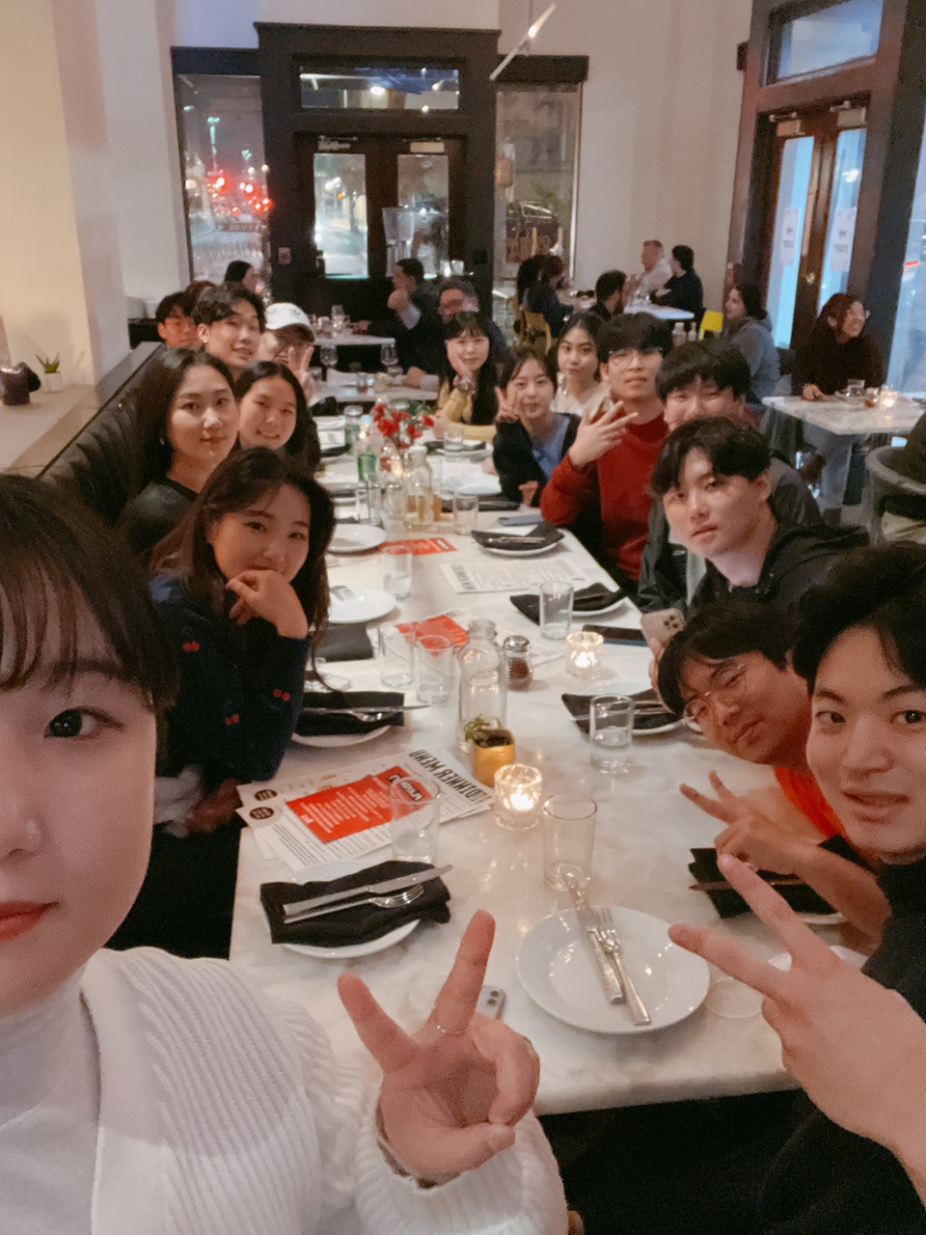
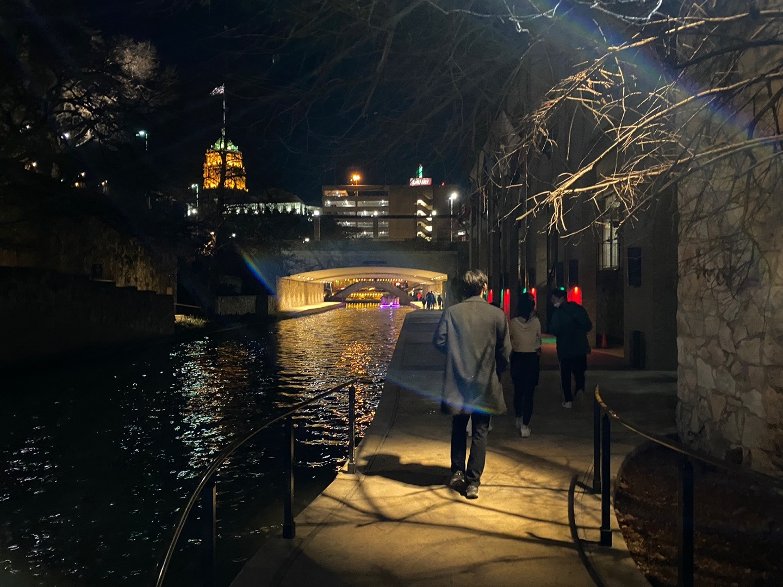
San Antonio Field Trip
Night at Riverwalk!

Slide 16
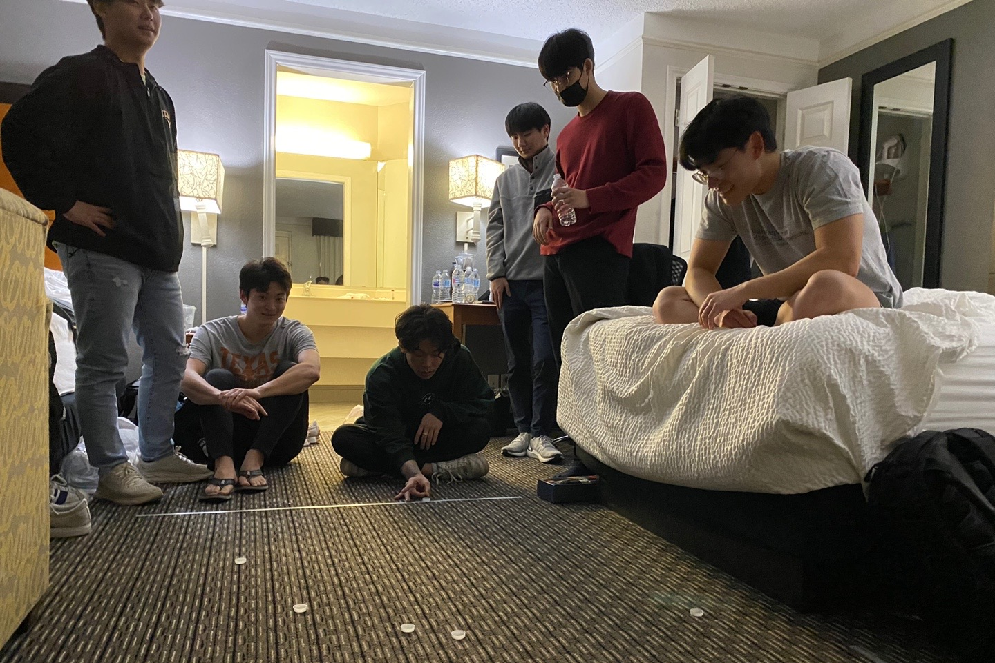
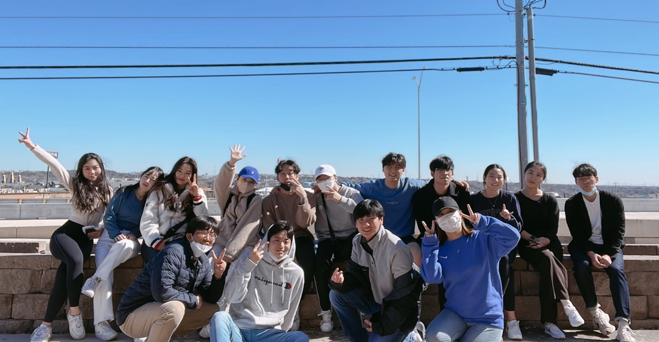
San Antonio Field Trip

Slide 17
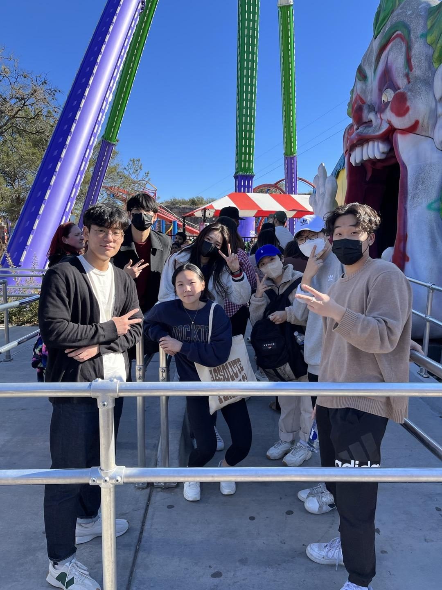
San Antonio Field Trip
Six Flags!

Slide 18
Pajama Party
Come join the Fun!
When: February 26th (Sat) at the Union
Free Pizza and Fun Games!!

Slide 19
K-Festival
Be part of the Grand Festival!
Where: Gregory Plaza
When: March 22nd (Tuesday)
Time: 5-10PM

Slide 20
FAM FAM Adjustments
New Members have been Added!
You must pay your fee to join
Fill out the membership form to join

Slide 21
Administration
Dongari Updates
Workshop Plans
Guest Speaker

Slide 22
Dongari Update
UKA Basketball team won the last game!!
The next game is scheduled for next Tuesday at 7pm. Please come and cheer for them!!
UKA B-Ball

Slide 23
Dongari Update
League of Legend UKA Competition
Prize: Champion Skin
When: 2/26 Sat
Where: Summoner’s Rift
UKA Gaming

Slide 24
Dongari Update
Red Devil FC is going to play in the IM League today!! Please come and cheer for them!!
When: Today at 8 pm
Where: Charles Alan Wright Fields
Red Devil FC

Slide 25
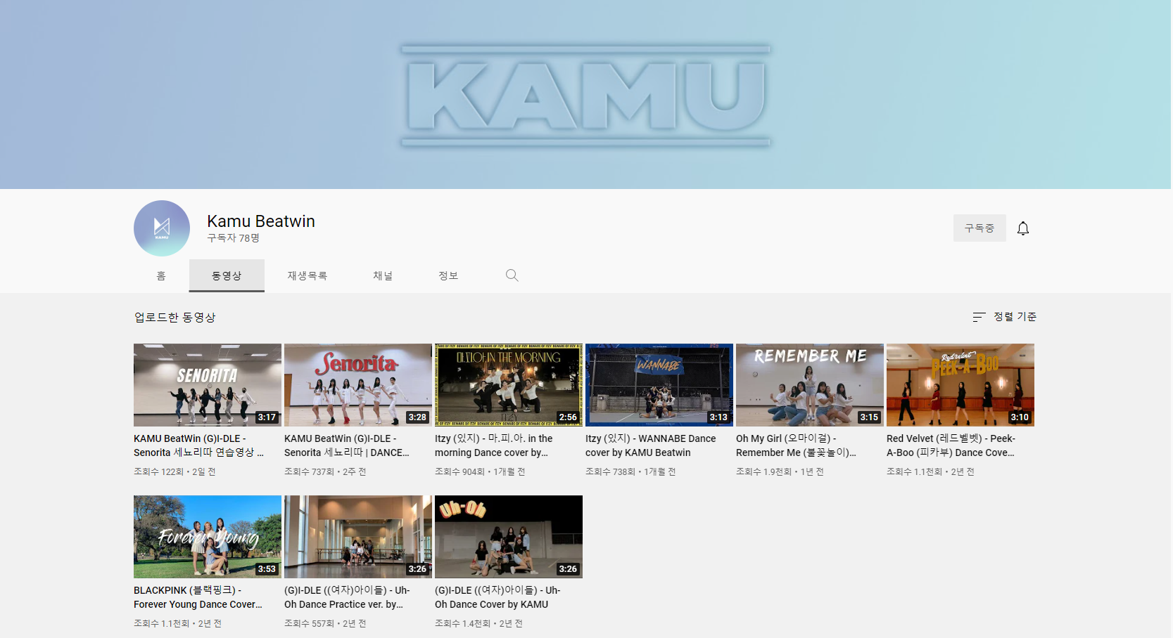
Dongari Update
KAMU Beatwin is a dance group who mainly covers K-pop dance.
Please go visit KAMU youtube and subscribe to watch their amazing performance!!
KAMU Beatwin

Slide 26
Workshop Reminder
When
Where
Interview Workshop

Slide 27
Workshop Reminder
2/24 Thu
Where
Interview Workshop

Slide 28
Workshop Reminder
2/24 Thu
GAR 0.102
Interview Workshop

Slide 29
Guest Speaker
Chef Choo

Slide 30
Chef Choo

Slide 31
GAME TIME

Slide 32
Team Name
Before we start, please create team name
(5 minutes)

Slide 33
Guessing Movie Quote
Rule:
Guess the line of the movie scene with voice imitation and acting.
You pass only when I like your acting and voice imitation.
The same person cannot get it right more than once.
The team with the most people who said the right answer is the winner!!

Slide 34
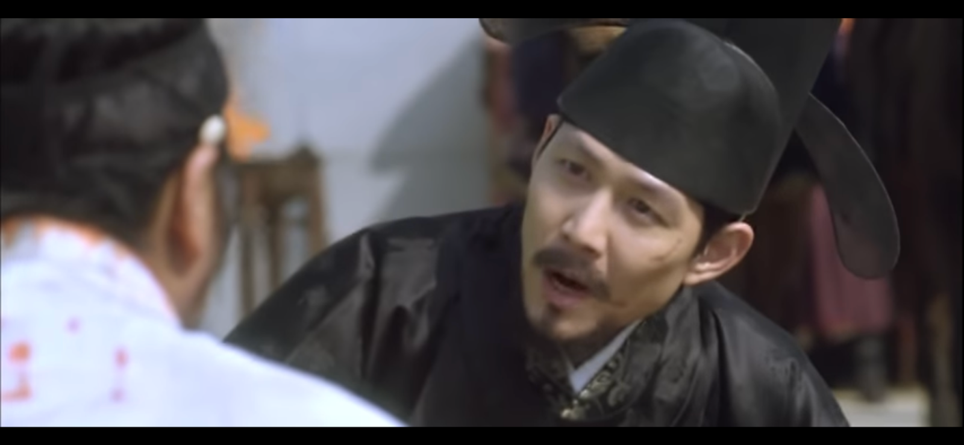
관상

Slide 35
관상 – 내가 왕이 될 상인가?

Slide 36
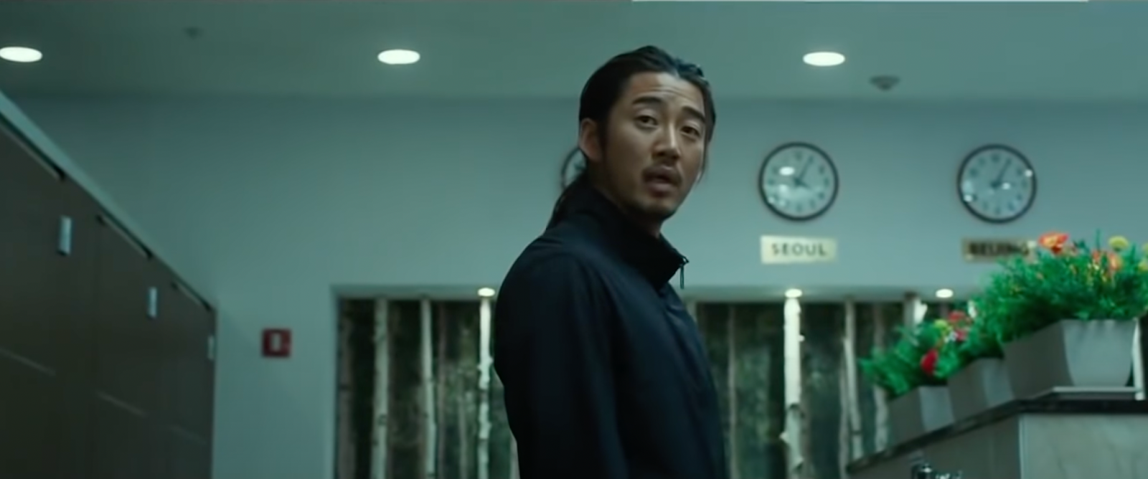
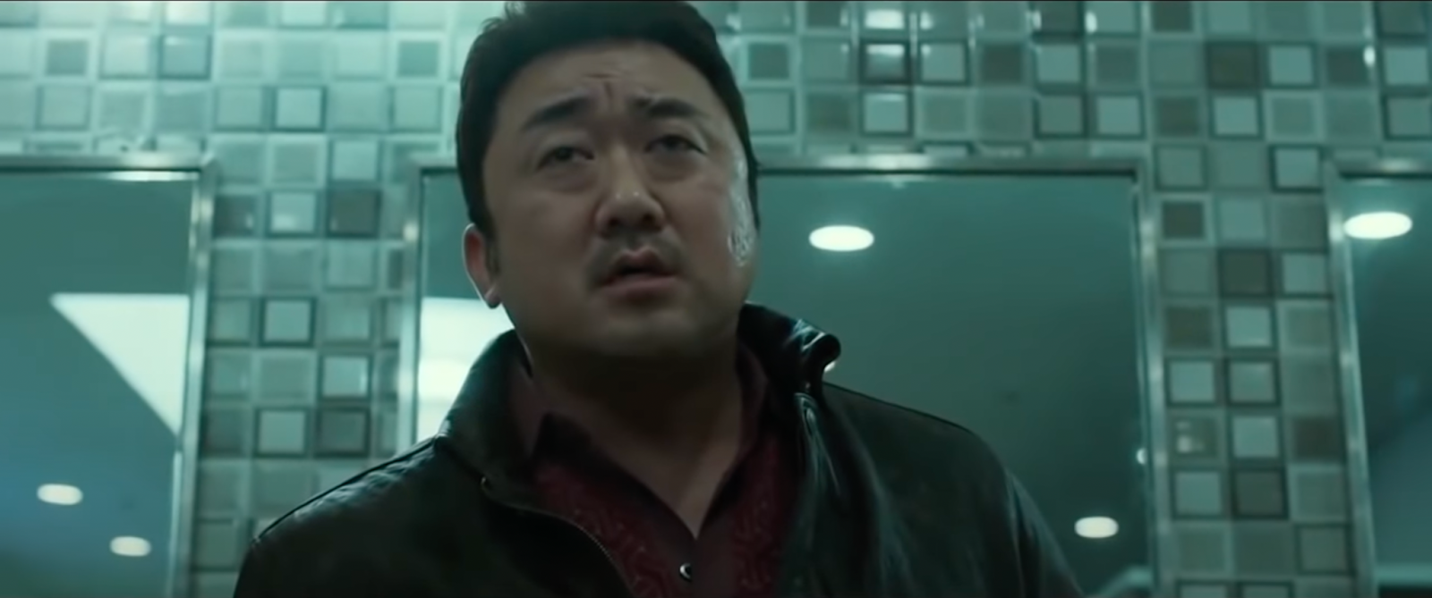
범죄도시

Slide 37
범죄도시 – 혼자야? 어 아직 싱글이야

Slide 38
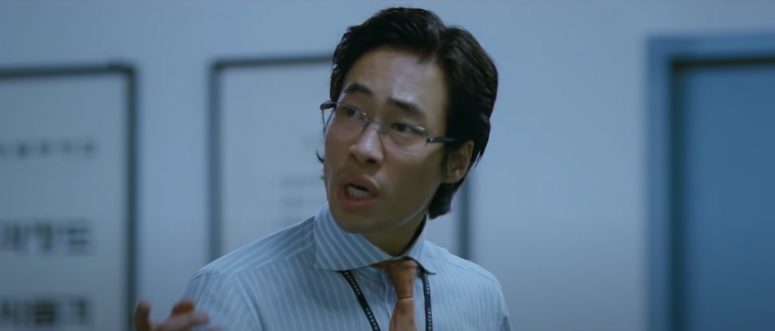
부당거래

Slide 39
부당거래 – 호의가 계속되면 그게 권리인 줄 알아

Slide 40
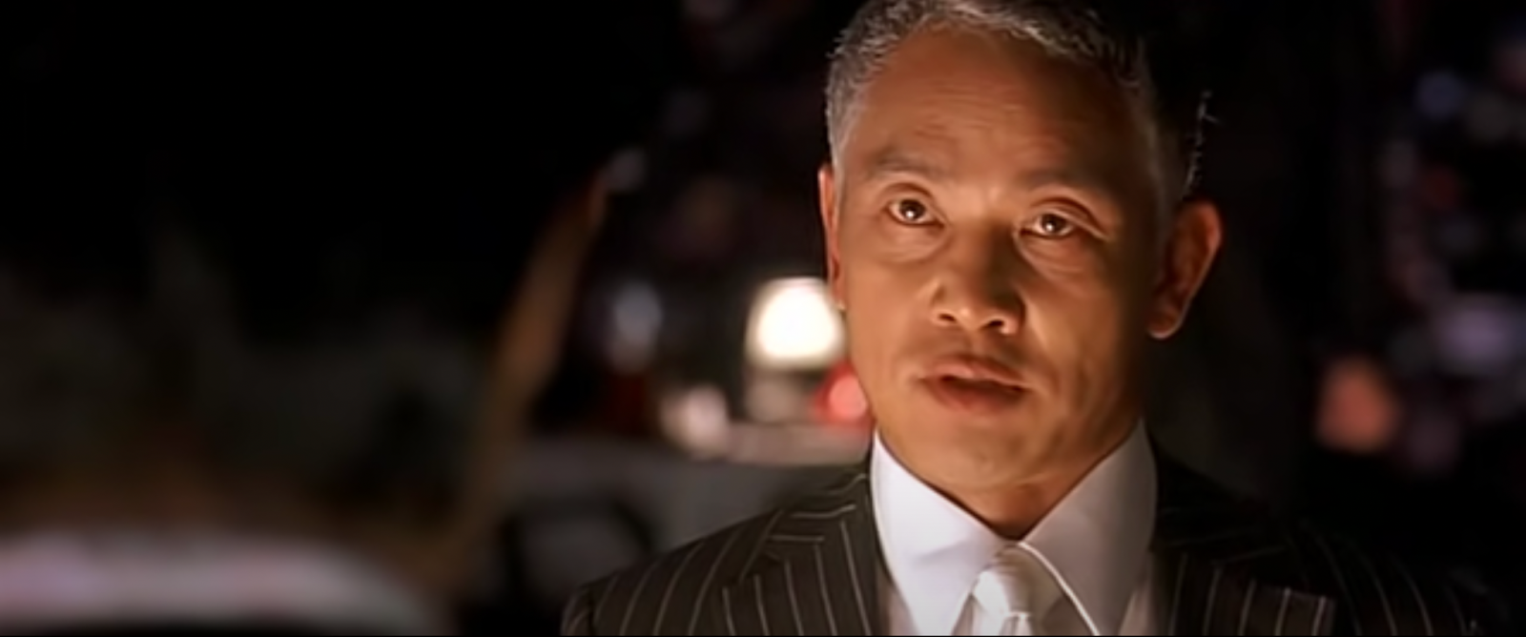
달콤한 인생

Slide 41
달콤한 인생 – 넌 나에게 모욕감을 줬어

Slide 42
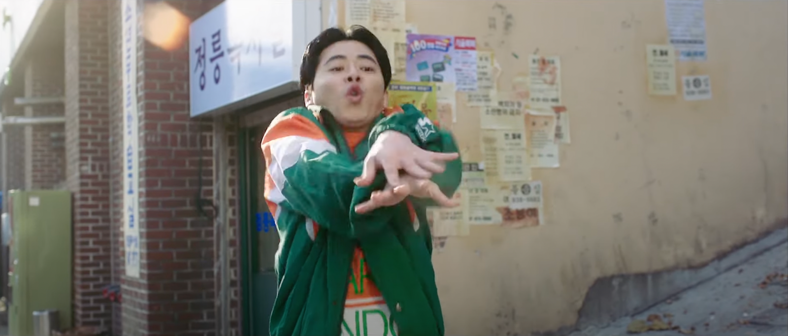
건축학개론

Slide 43
건축학개론 – 비벼, 막 비벼, 일로 갔다가 절로 갔다가 앞으로 갔다가 뒤로 갔다가 겁나 비벼!!

Slide 44
베테랑

Slide 45
베테랑 – 지금 내 기분이 그래, 어이가 없네?

Slide 46
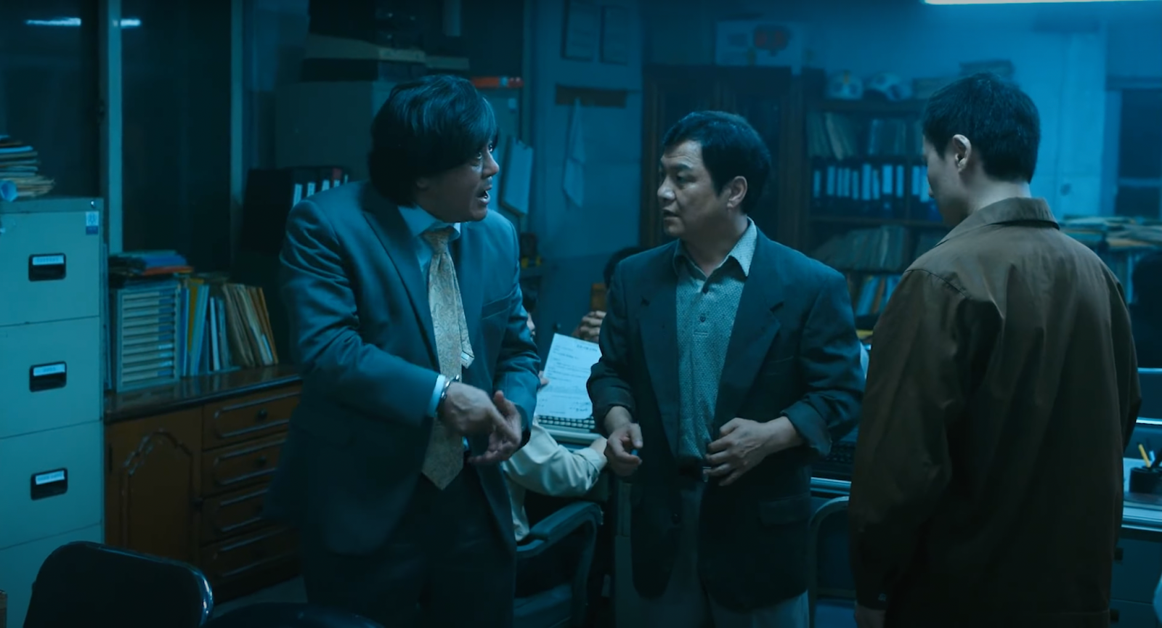
범죄와의 전쟁

Slide 47
범죄와의 전쟁 – 느그 서장 남천동 살재? 내가 임마! 느그 서장이랑 임마! 밥 먹고! 싸우나도 가고! 다했어 임마!

Slide 48
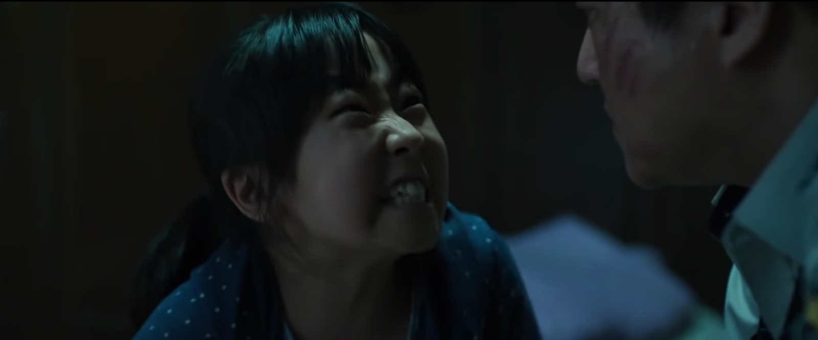
곡성

Slide 49
곡성 – 뭣이 중헌디, 뭣이 중허냐고!!

Slide 50
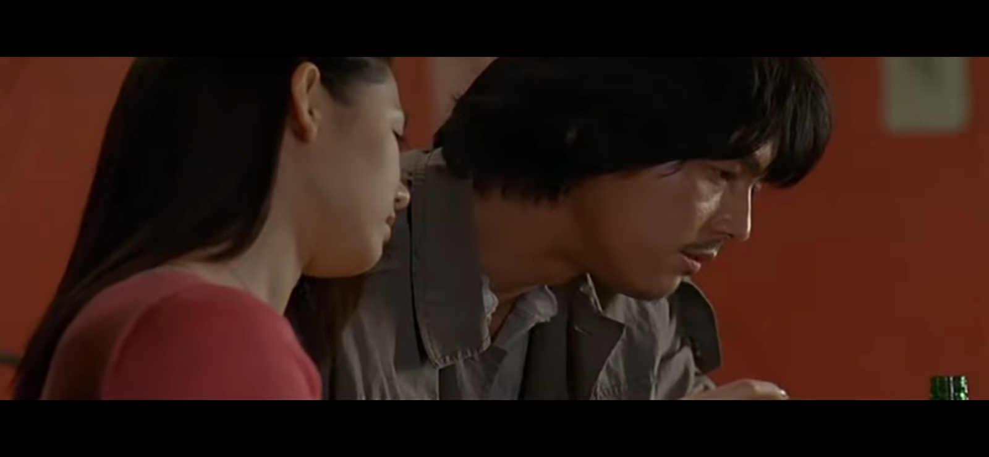
내 머릿속의 지우개

Slide 51
내 머릿속의 지우개 – 이거 마시면 나랑 사귀는거다?

Slide 52
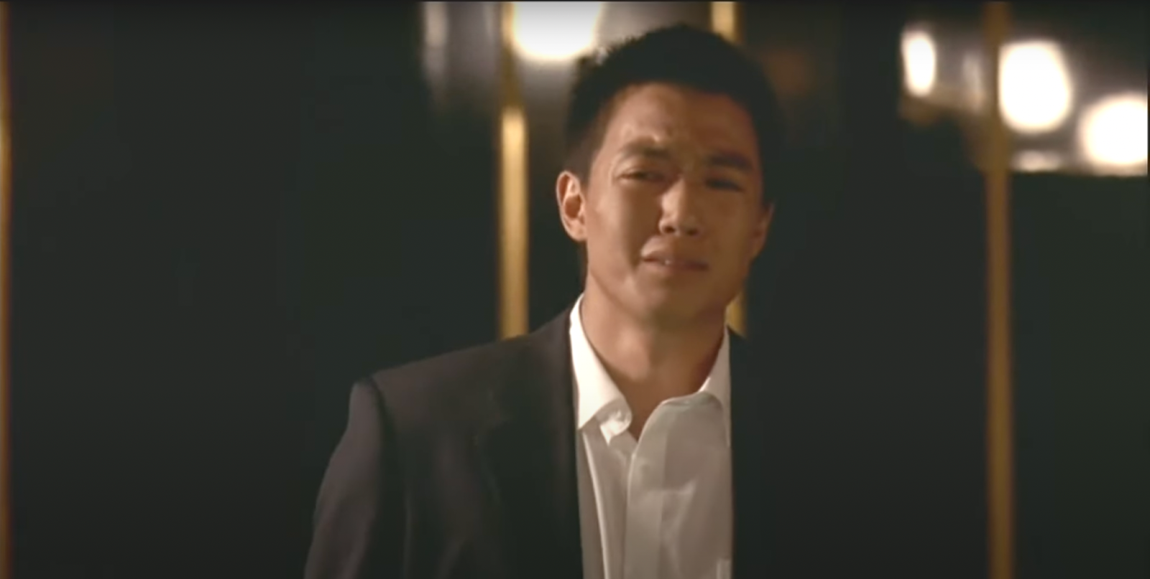
해바라기

Slide 53
해바라기 – 꼭 그렇게 다 가져가야만.. 속이 후련했냐!!

