Slide 1
GM#1
유티 어스틴 한인 학생회
texasuka.org

Slide 2
Administration
Dongari Updates
Workshop Plans
Volunteering Plans

Slide 3
Dongari Updates
Basketball
Volleyball
Band
Stock Discussion
Tennis
Gaming
Golf
Movie
Karaoke

Slide 4
Dongari Updates
Basketball
Volleyball
Band
Stock Discussion
Tennis
Gaming
Several Dongaries were abolished due to the difficulty of contents planning
Golf
Movie
Karaoke

Slide 5
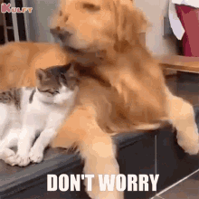
Dongari Updates
Don’t Worry! You always have a chance to create a NEW Dongari!
Golf
Movie
Karaoke

Slide 6
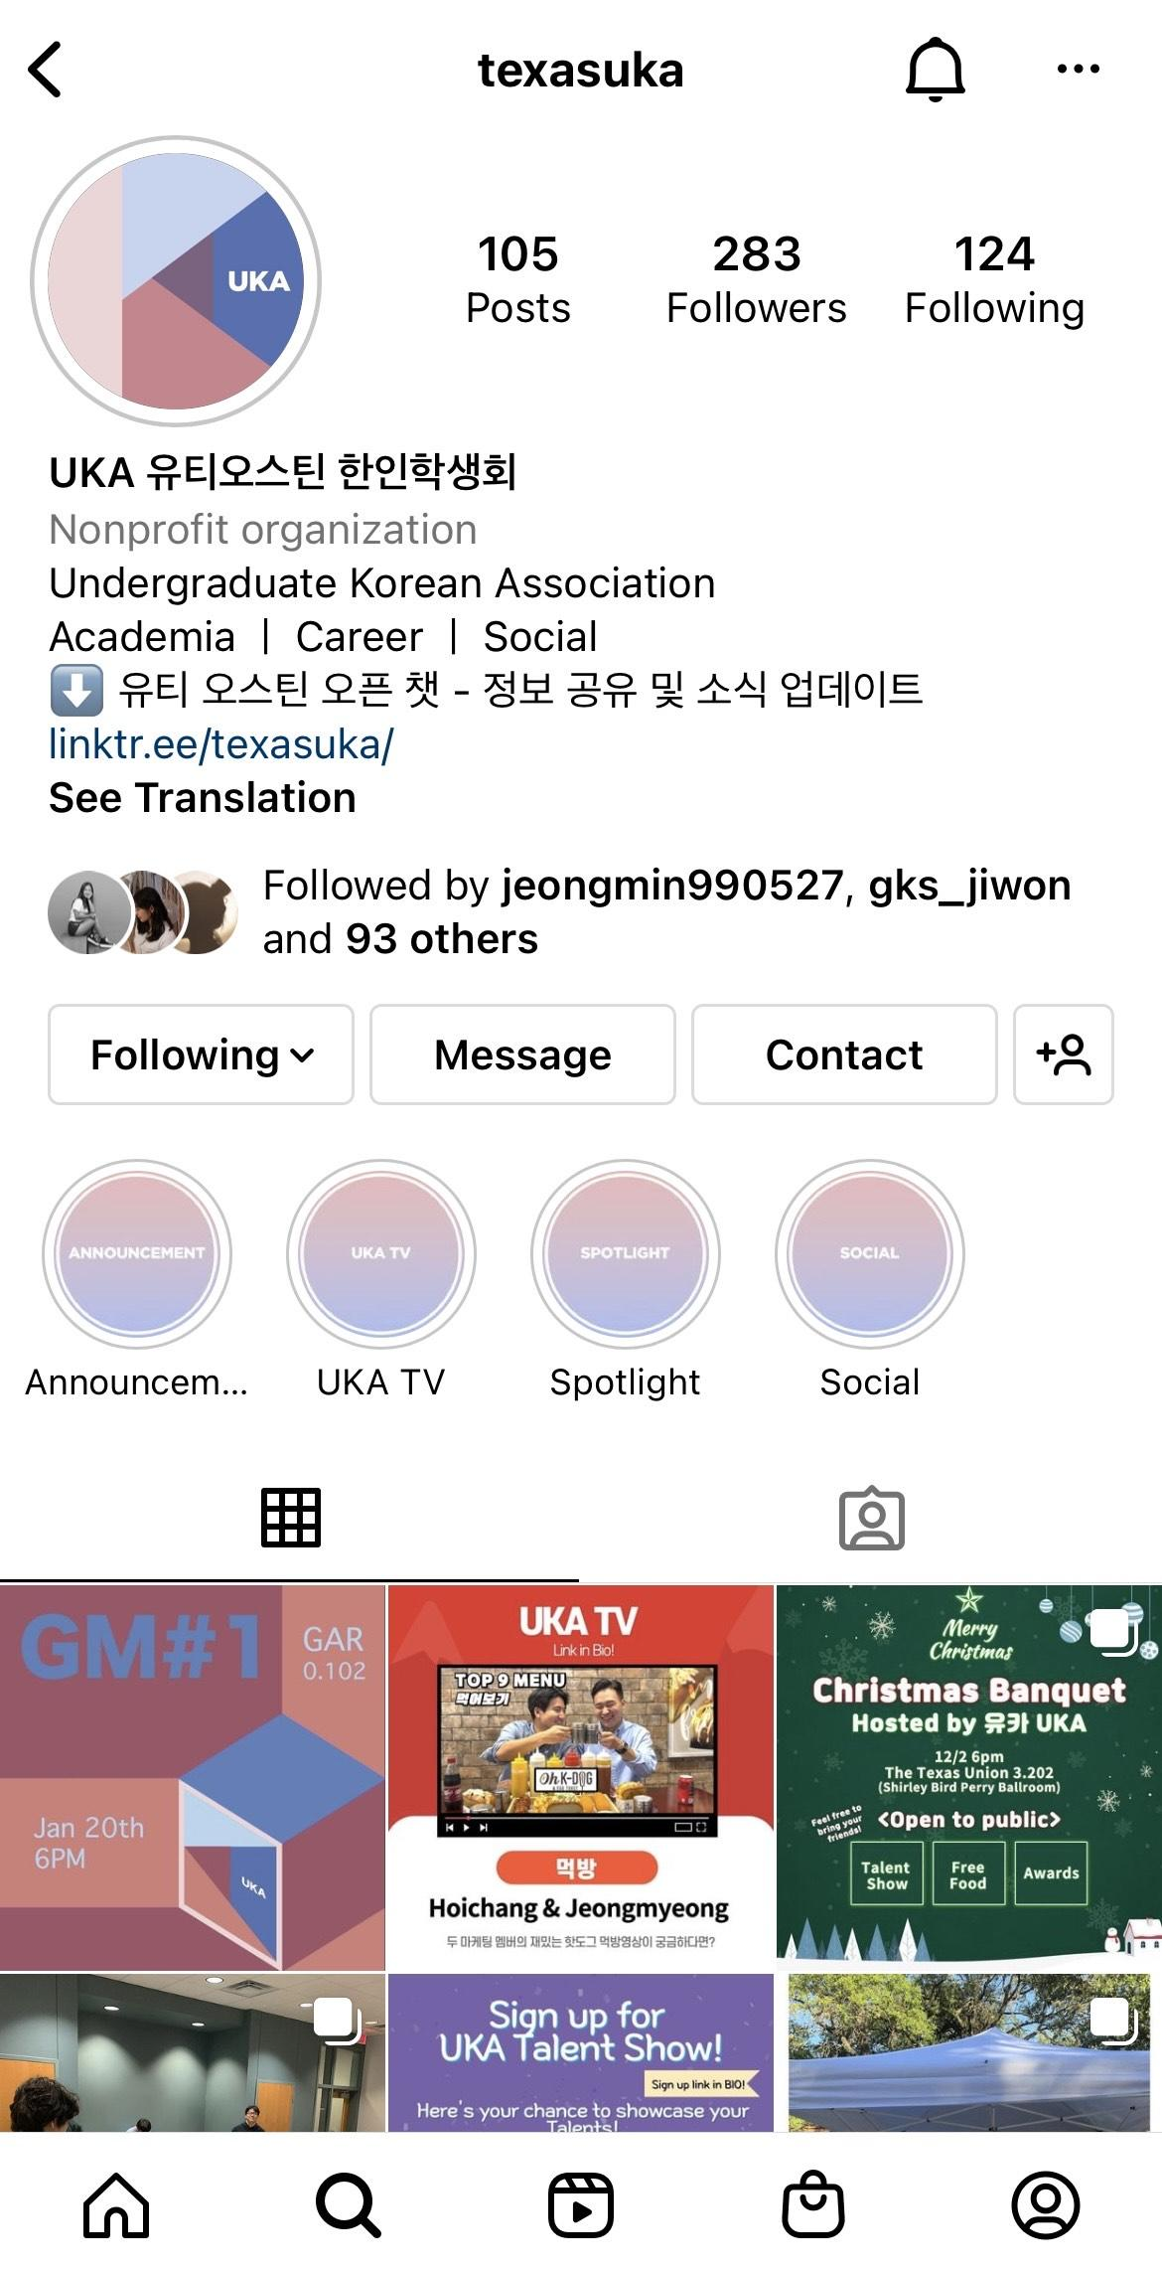
Dongari Updates
<How to Join Dongaries?>
Go to our Instagram (@texasuka) and find the linktree link!
Golf
Movie
Karaoke

Slide 7
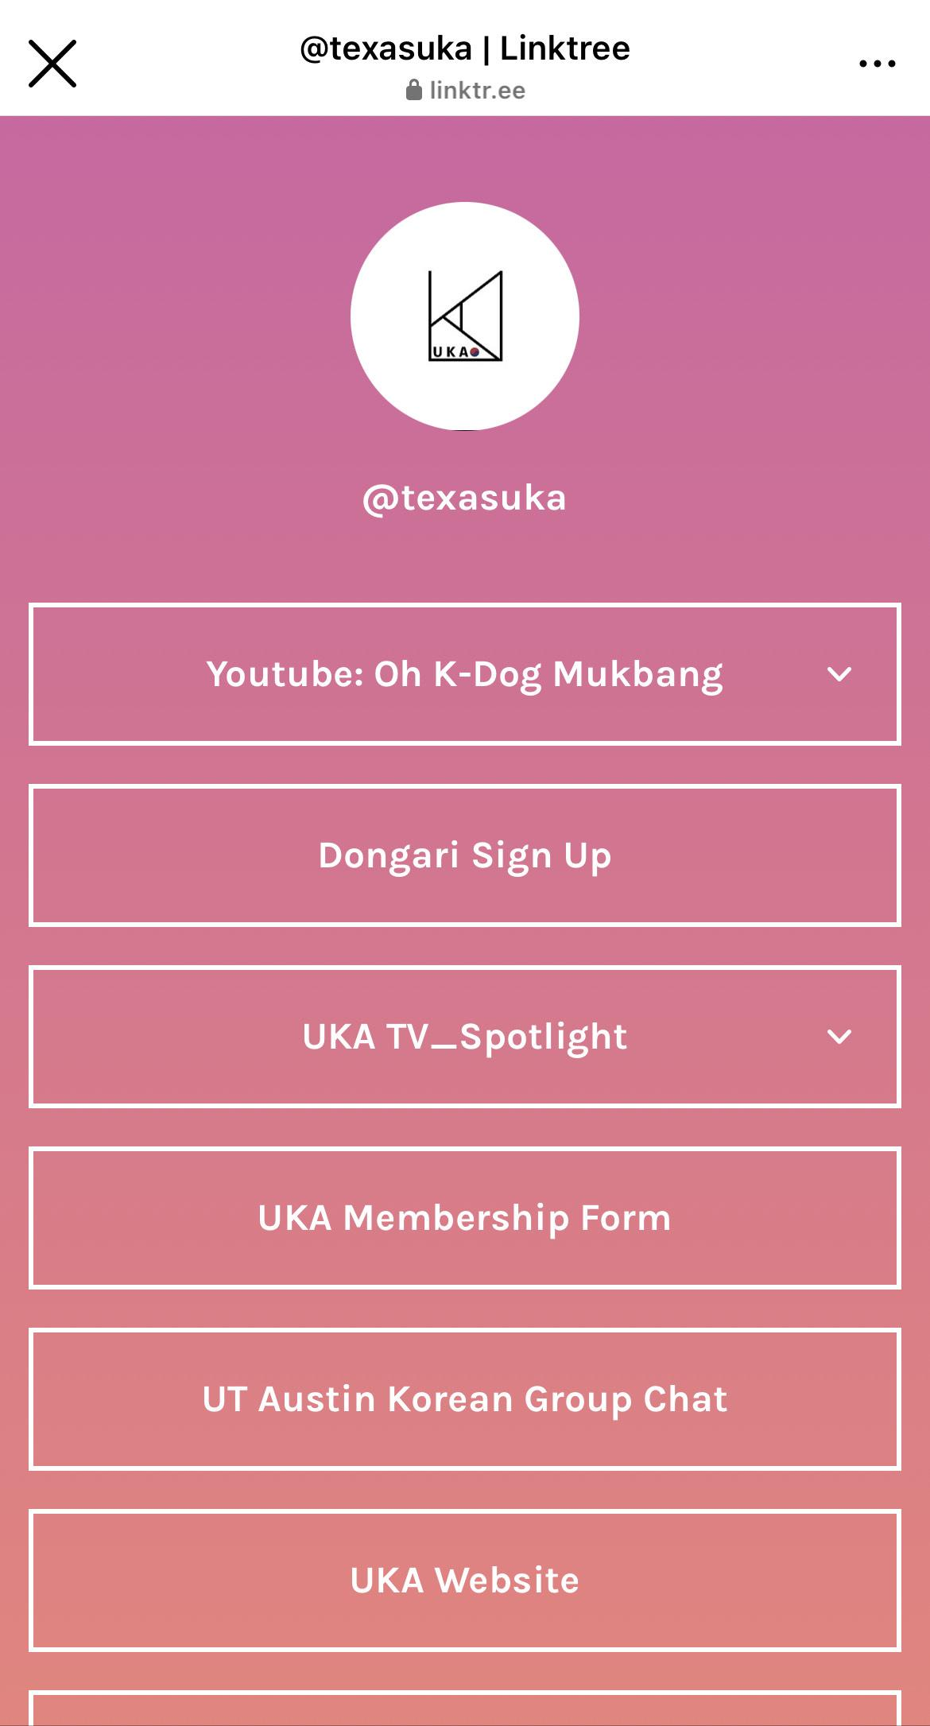
Dongari Updates
<How to Join Dongaries?>
Find “Dongari Sign Up”, and it will direct you to Google form page.

Slide 8
Dongari Fair
We are going to hold Dongari Fair in GM2!
Current Dongari Leaders will present or table to discuss and PR their plan for this semester
Popular New Dongaries based on the Dongari Sign Up form will also have a table to discuss the plan and who’s going to be a leader

Slide 9
Workshop Plans
Our first Workshop is coming soon!
Workshop #1: Resume / Career fair
1/27 (Next week!)
Guest speaker will be presenting

Slide 10
Volunteering Plans
Our New project is providing volunteering opportunities to UKA members.

Slide 11
Finance
Dongari Funds
FAM-FAM Funds
UKA X Grace Realty Scholarship

Slide 12
Finance
Tabling Fundraiser
UKA T-shirt
Our Sponsors

Slide 13
Dongari Funds
Each Dongari will be provided funds based on events, content, and other benefits it generates for UKA and its members!

Slide 14
Dongari Updates
The amount of funds will be negotiated between the Dongari leader and the executive board

Slide 15
Dongari Updates
Examples:
UKA Band 🡪 Perform on Hmart stage
UKA Game 🡪 Host UKA LOL Championship
UKA Basketball 🡪 Win Spring 2022 IM Basketball

Slide 16
FAM-FAM Funds
FAM-FAMs will be awarded specific amounts of awards based on their performances in FAM-FAM events prepared by UKA

Slide 17
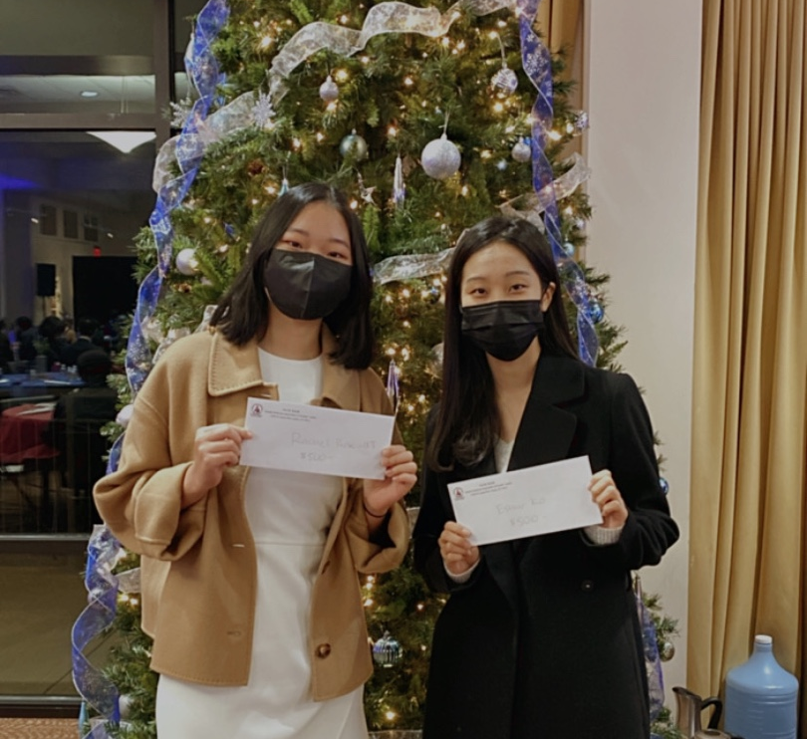
UKA X Grace Realty Scholarship
Provided by Grace Realty based in Austin!

Slide 18
UKA X Grace Realty Scholarship
TWO winners will each be awarded $500
Must submit an application form and essay by the deadline to be considered

Slide 19
Tabling Fundraiser
Two Fundraisers this semester
Theme and concept of the fundraisers will be related to Korean culture and eatery

Slide 20
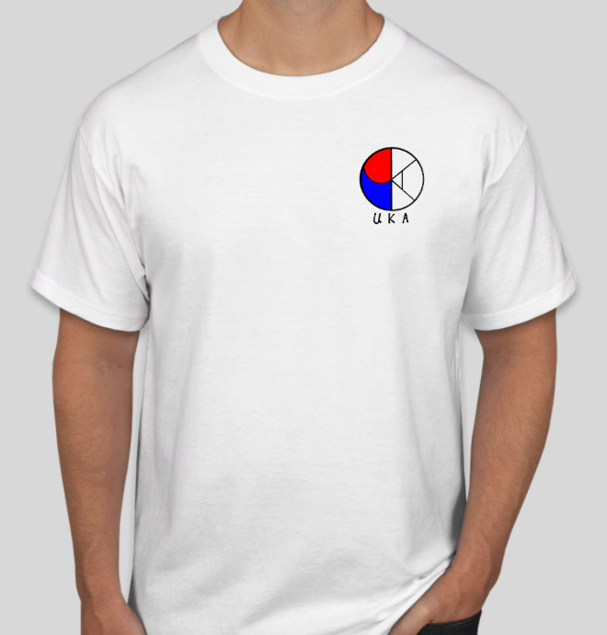
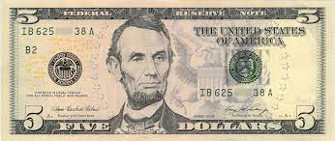
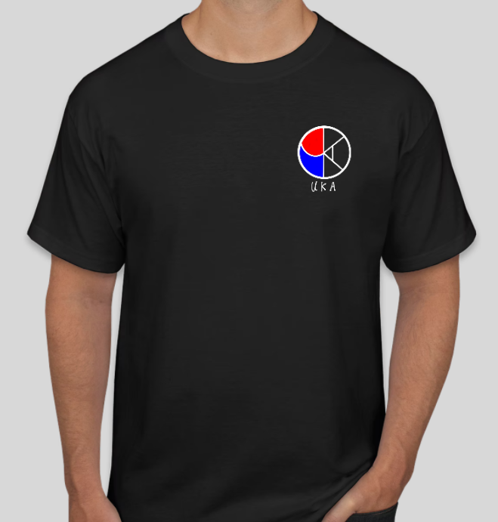
UKA T-Shirt
$5 per T-shirt

Slide 21
Our Sponsors

Slide 22
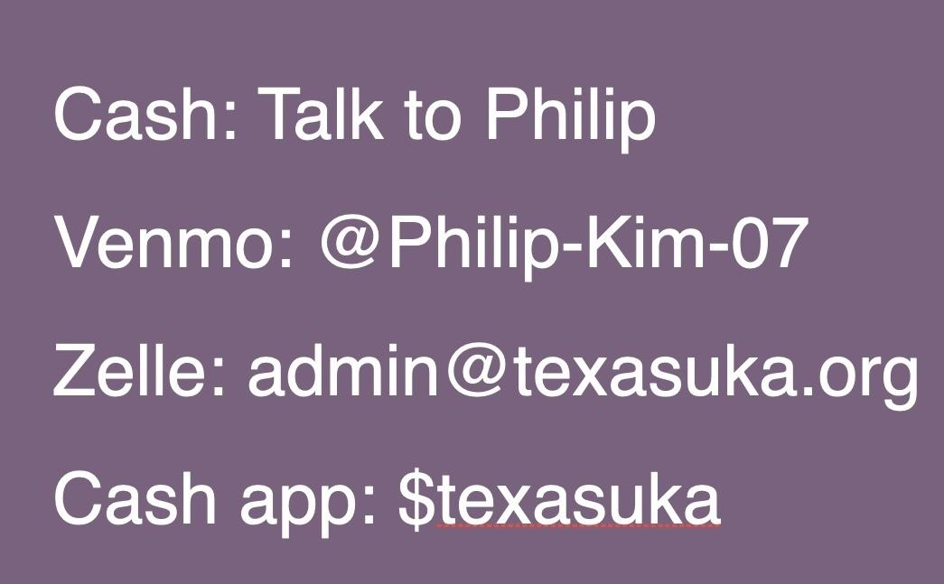
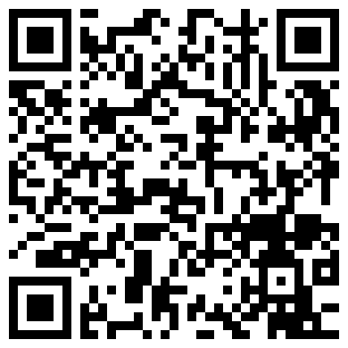
Dues for the semester
$30 for the Spring Semester

Slide 23
Operations
FAM-FAM Regrouping
Brown Bags

Slide 24
Operations
UKA Field Trip
K-Festival
UKA Mini Olympics

Slide 25
FAM-FAM Regrouping
Updated Fam-Fams!
New members can join Fam-Fams! Just reach out to us:)
New FAM-FAM Kakaotalk room will be created with updated FAM-FAM members.

Slide 26
Brown Bags
Get to know other members! Discover your potential future bestie:>
A group of 5-6 will be matched based on the Brown bag survey (will be sent in the UKA group chat tomorrow after the GM)

Slide 27
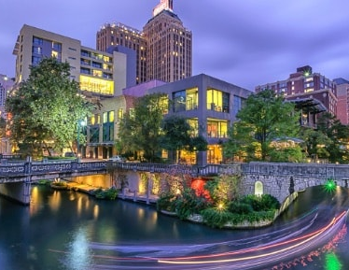
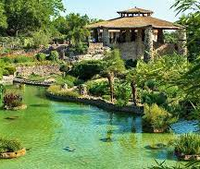
UKA Field Trip
There will be a UKA Field Trip to San Antonio!
Planned 2/12-2/13
More member interaction and member bonding!

Slide 28
K-Festival
Promote UKA & Korean Culture
Performances, booths, Korean food, and more!
Volunteers accepted for those who also want to help execute this event along with the other directors!

Slide 29
UKA Mini Olympics
Compete in mini, enjoyable games for your superiority <3
Prizes for winners!
Do not worry, it's not sports based ;)

Slide 30
Informatics
Informative Content
Website Update

Slide 31
Informative Content
We plan to publish more informative content like dorm/apartment tours, major Q&A, etc!

Slide 32
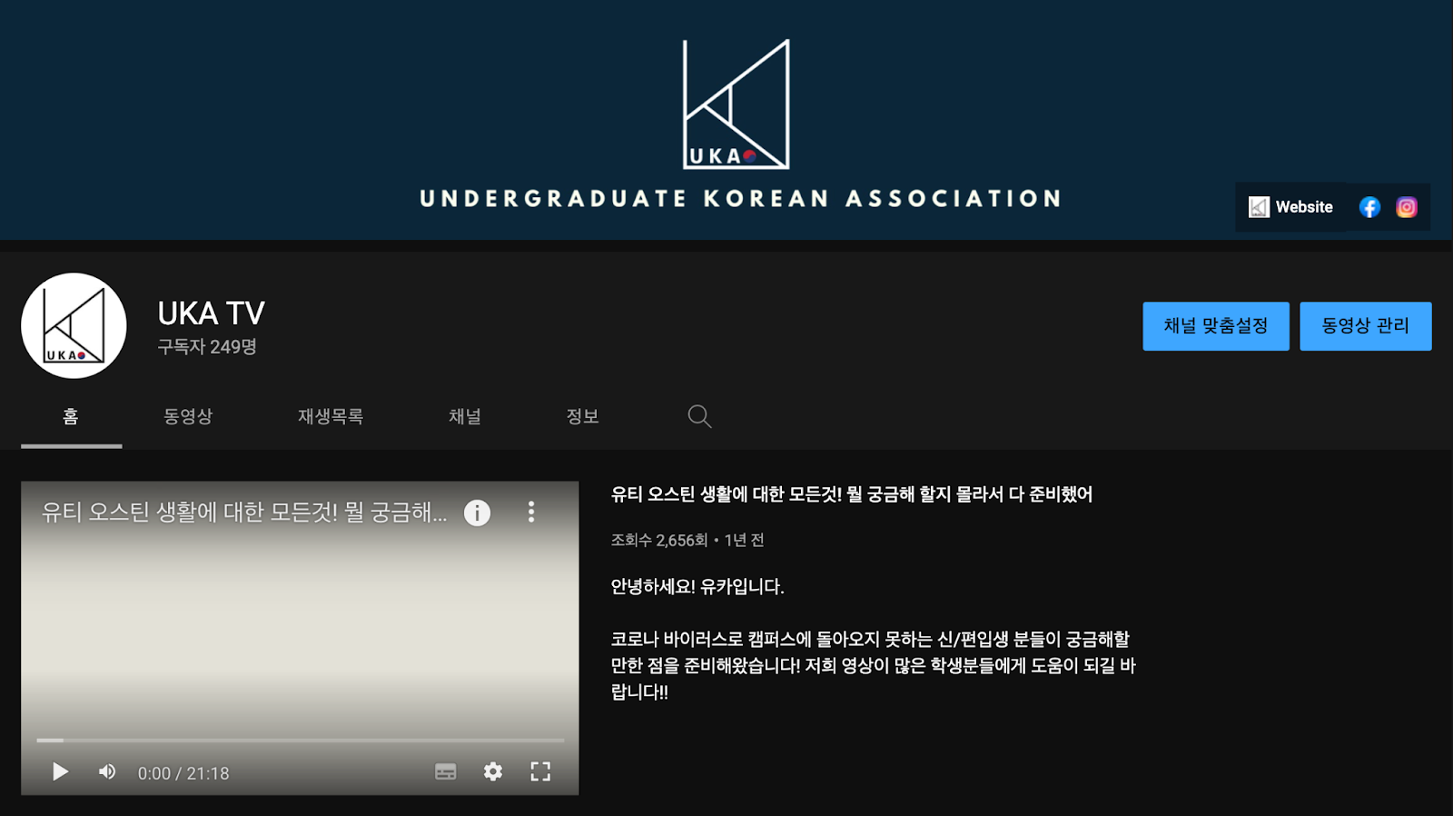
YouTube Update
Thanks for Applying!!
YouTube Crew
Seah Chae
Dayeong Kang
Minjae Kwon
Haelynn
We will be working with our YouTube Crew for frequent publishes!

Slide 33
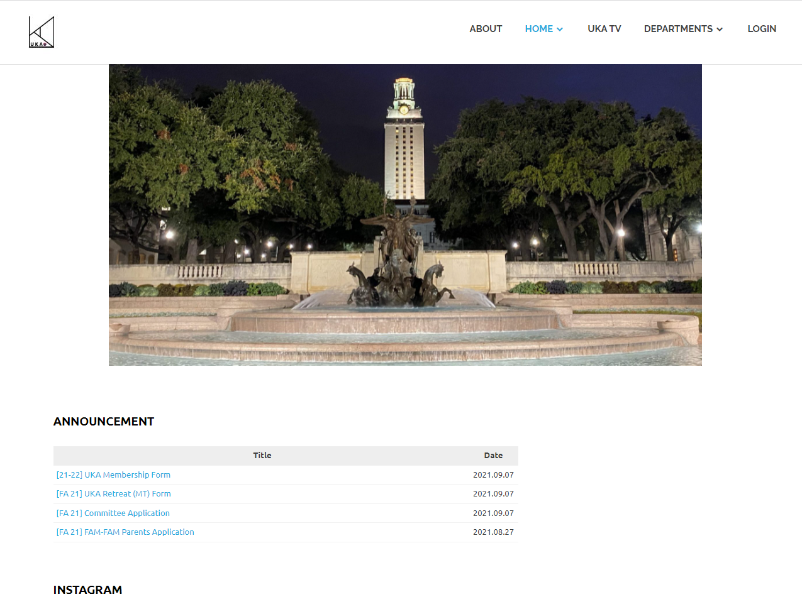
Website Update
Completely re-developed website coming soon!
texasuka.org

Slide 34
Marketing
Instagram Update
UKA Calendar
Social Media Plans

Slide 35
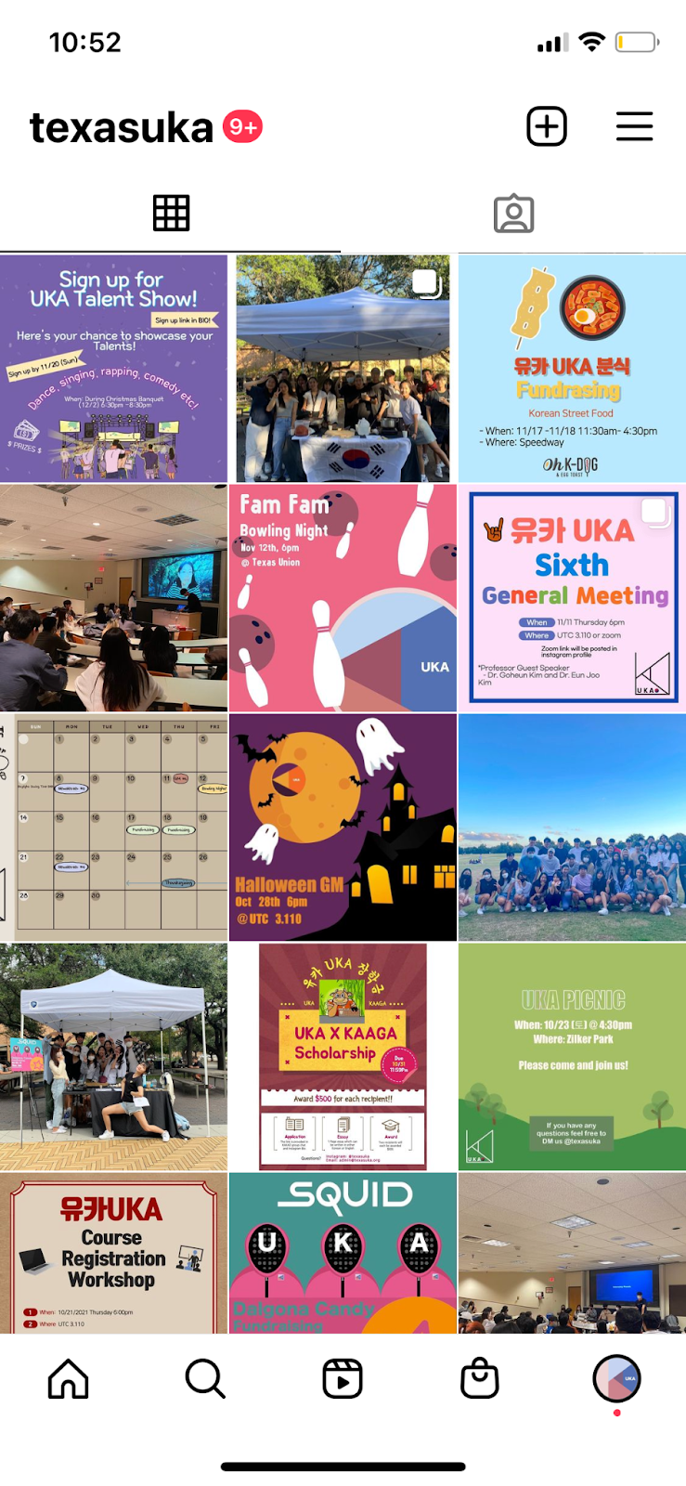
Instagram Update
Please Follow!!
We will be updating our Instagram more frequently this semester!

Slide 36
Instagram Update
Please check the Linktree website in our bio for more information!
(sign ups, GM links, etc.)

Slide 37
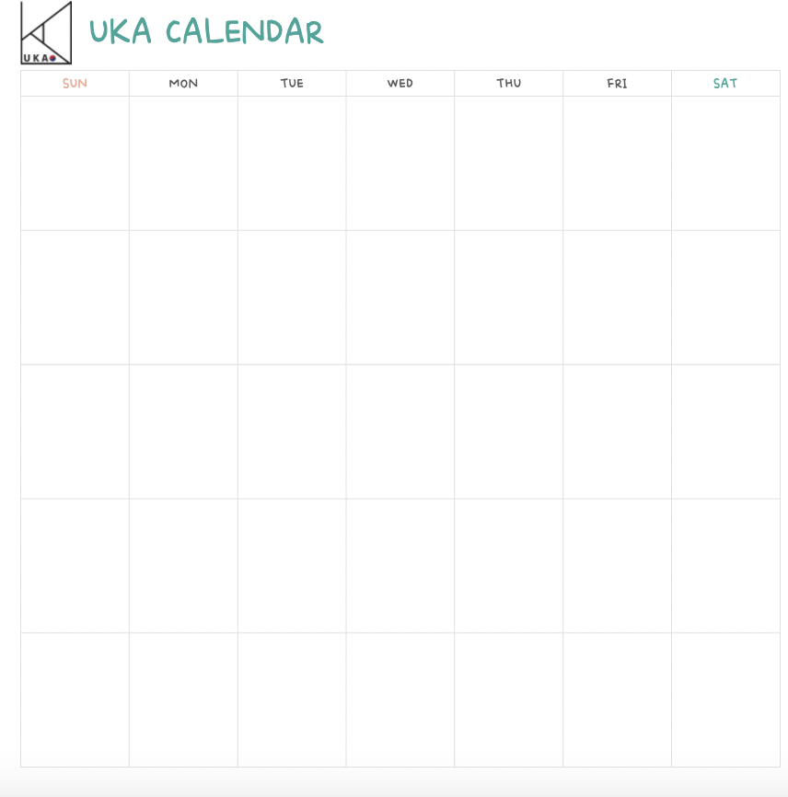
UKA Calendar & Card News
UKA Calendar and Card News are coming soon!

Slide 38
Social Media Plans
Plan to create more content like:
YouTube Shorts
Instagram IGTV/Reels
TikToks

Slide 39
Quiz Time!!

Slide 40
When do we hold Dongari Fair?

Slide 41
How much is our UKA T-shirt?

Slide 42
Name Three of our Sponsors

Slide 43
Where do we go for the Field Trip?

Slide 44
Where can you find our linktree page?

Slide 45
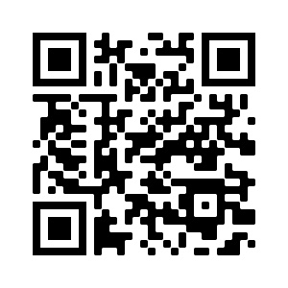
KESA Open Kakaotalk

Slide 46
Q&A
Slido code: #431792

