Slide 1
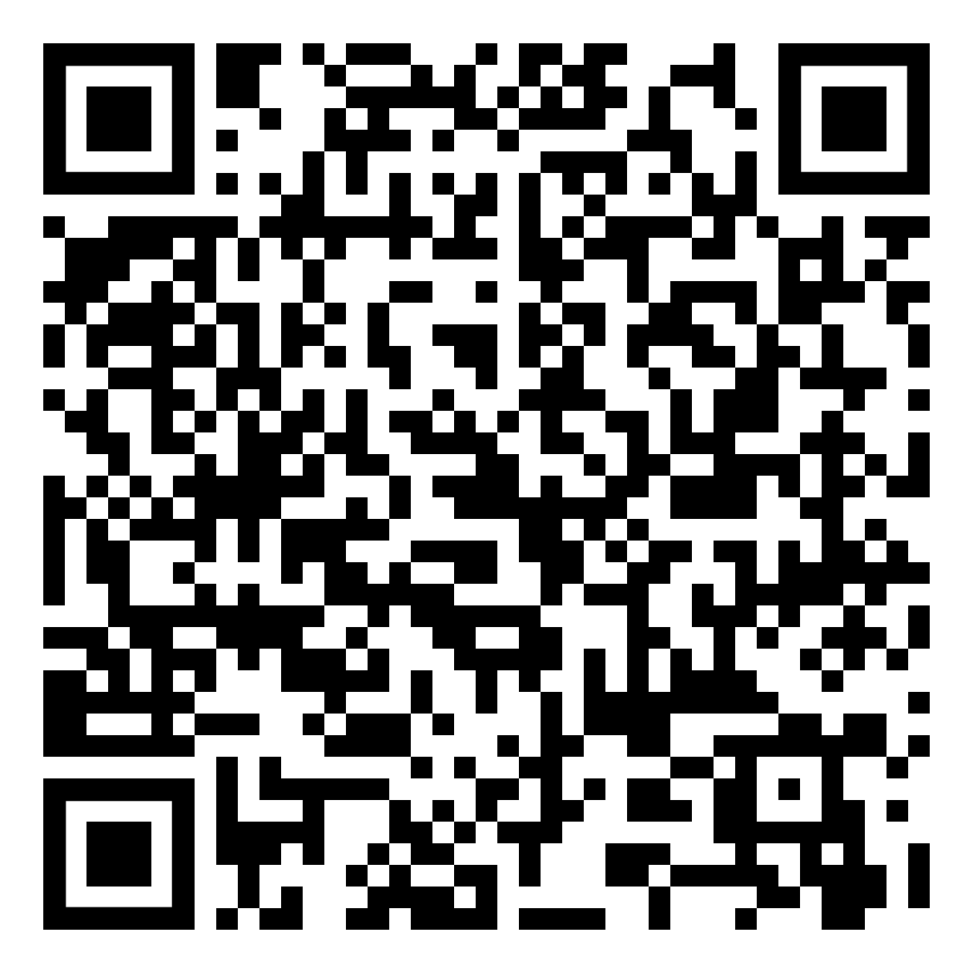
Sign-In

Slide 3
Contents
About UKA
Committee Application
Committee Overview
FAM FAM plans
Dongari Application
Upcoming Events

Slide 4
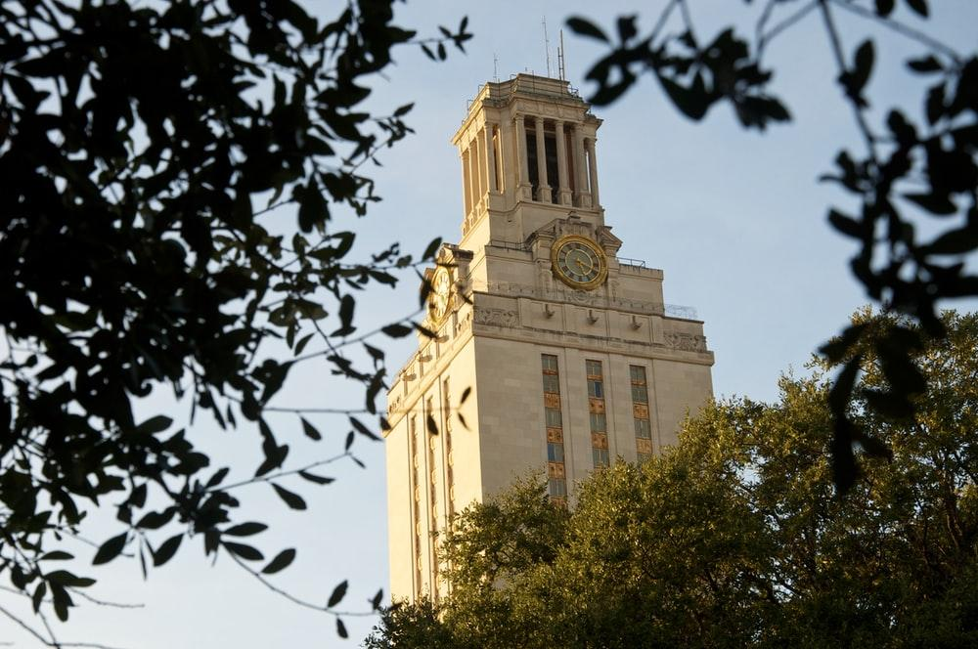
About UKA
Founded in 2019, UKA stands for SOCIAL and PROFESSIONAL development of Korean students in UT.

Slide 5
Committee Application
Due date: 9/12 11:59PM

Slide 6
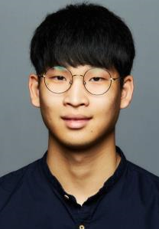
Administration
Name: Chris Yeom (염승철)
Grade: Senior
Major: Computational Biology
Fun Fact: I lost 12kg in 6 months

Slide 7
Director Roles
Workshop
GM
Dongari

Slide 8
Director Roles
Workshop
GM
Dongari

Slide 9
Director Roles
Workshop
GM
Dongari

Slide 10
Workshop Director
Plan for Workshop Contents
Invite Workshop Hosts
Create Workshop Slide deck
Notes:
Sounds boring but it will definitely help you in professional way
예를 들어서

Slide 11
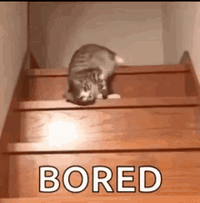
Workshop Director
Plan for Workshop Contents
Invite Workshop Hosts
Create Workshop Slide deck
Notes:
Sounds boring but it will definitely help you in professional way

Slide 12
Workshop Director
Plan for Workshop Contents
Invite Workshop Hosts
Create Workshop Slide deck
Notes:
Sounds boring but it will definitely help you in professional way
사진 바꾸고
인맥을 쌓을수 있음 benefit
말할때 서로 도우면서

Slide 13
GM Director
Design GM slide deck
Reach-out for Guest Speakers
Plan for GM contents
Facilitate Members’ Sign-in

Slide 14
Dongari Director
Conduct Dongari leaders’ meeting
Manage financial support
Examine Group Activities
Notes:
동아리 리더 미팅 더 설명

Slide 15
Finance
Name: Philip Kim (김성순)
Grade: Junior
Major: Finance / Math
Fun Fact: 울 아빠 대머리

Slide 16
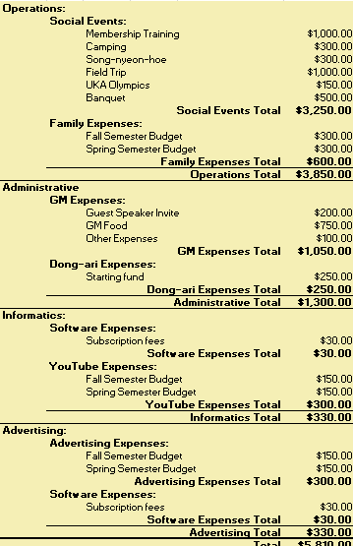
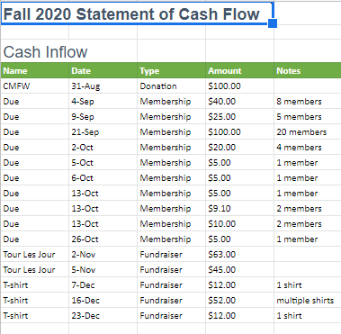
Finance Director
Functions
Budgeting
Accounting
Financing
Notes:
1번째 스켈레톤 처럼 해달라
Finance 물음표

Slide 17
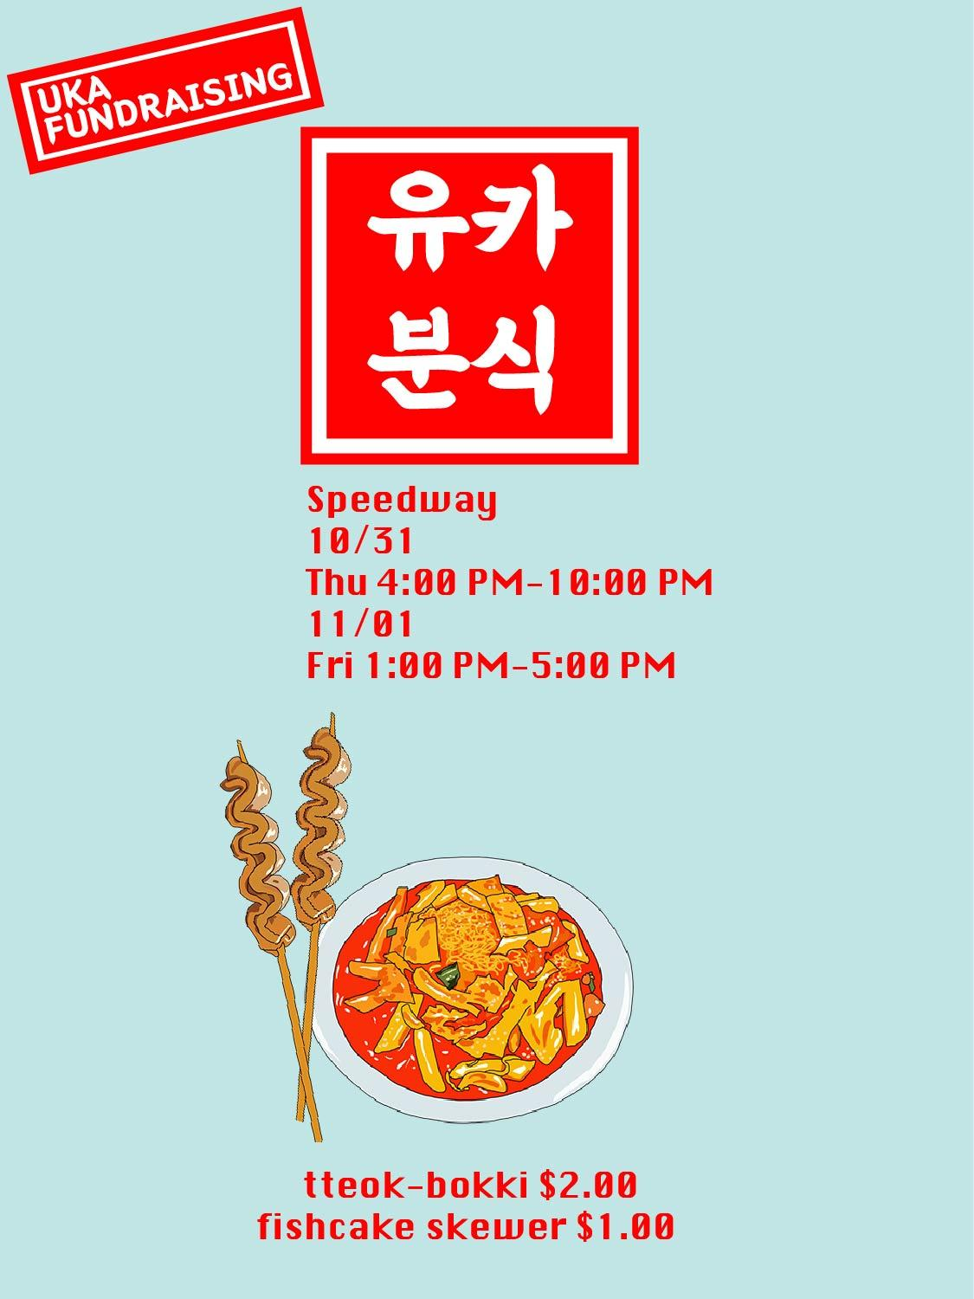
Fundraising
Fundraising such as tabling fundraiser, merchandise, and profit-share, etc.

Slide 18
Sponsorships
On-Campus
Pitching/giving a presentation for on-campus sponsorships

Slide 19
Sponsorships
Off-Campus
Research and analysis for potential business partnership/off-campus sponsorship opportunities

Slide 20
Workshop
Active participation in workshops (personal finance, college fund, and career development)

Slide 21
Scholarship
Research and report on scholarship opportunities

Slide 22
What We Look For?
Positive Attitude
Punctuality
Dedication
Responsibility
Sociability
Notes:
이거 다 합쳐서 성순이 되는 조크 어떤가?

Slide 23
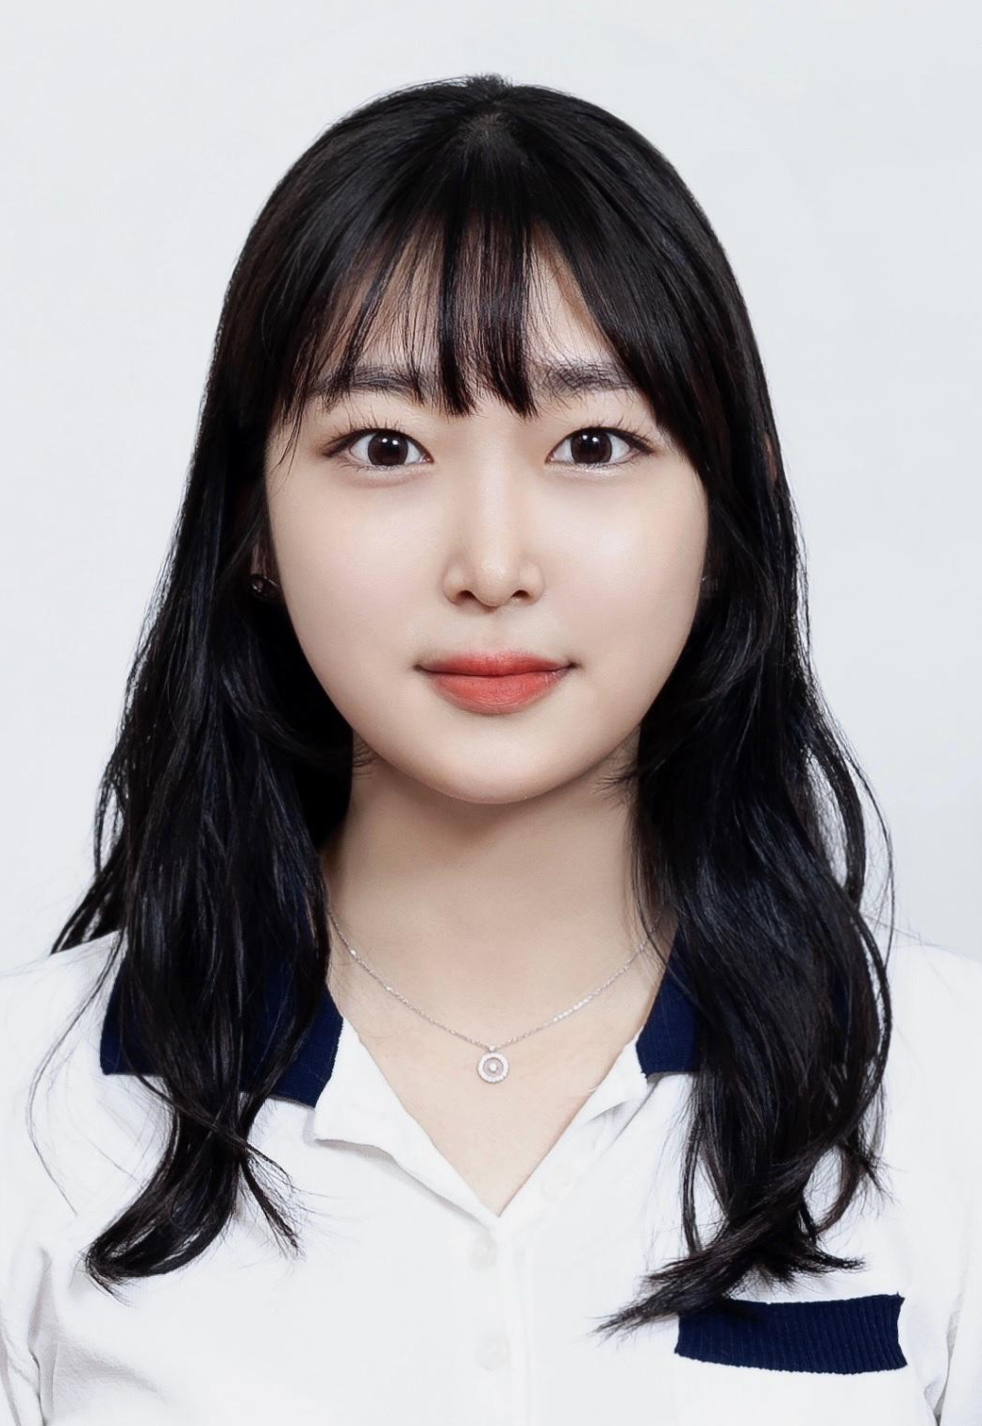
Informatics
Name: Jiwon Han (한지원)
Grade: Senior
Major: Journalism
Fun Fact: Cannot swallow pills well

Slide 24
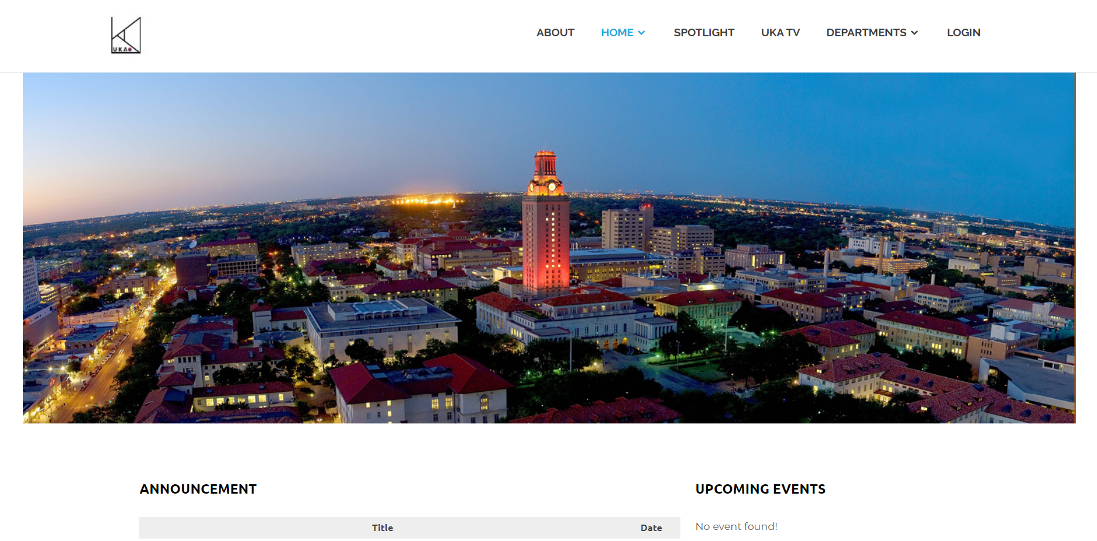
Informatics Director
YouTube
Software
Communication

Slide 25
Informatics Director
Youtube
Software
Communication

Slide 26
Informatics Director
Youtube
Software
Communication

Slide 27
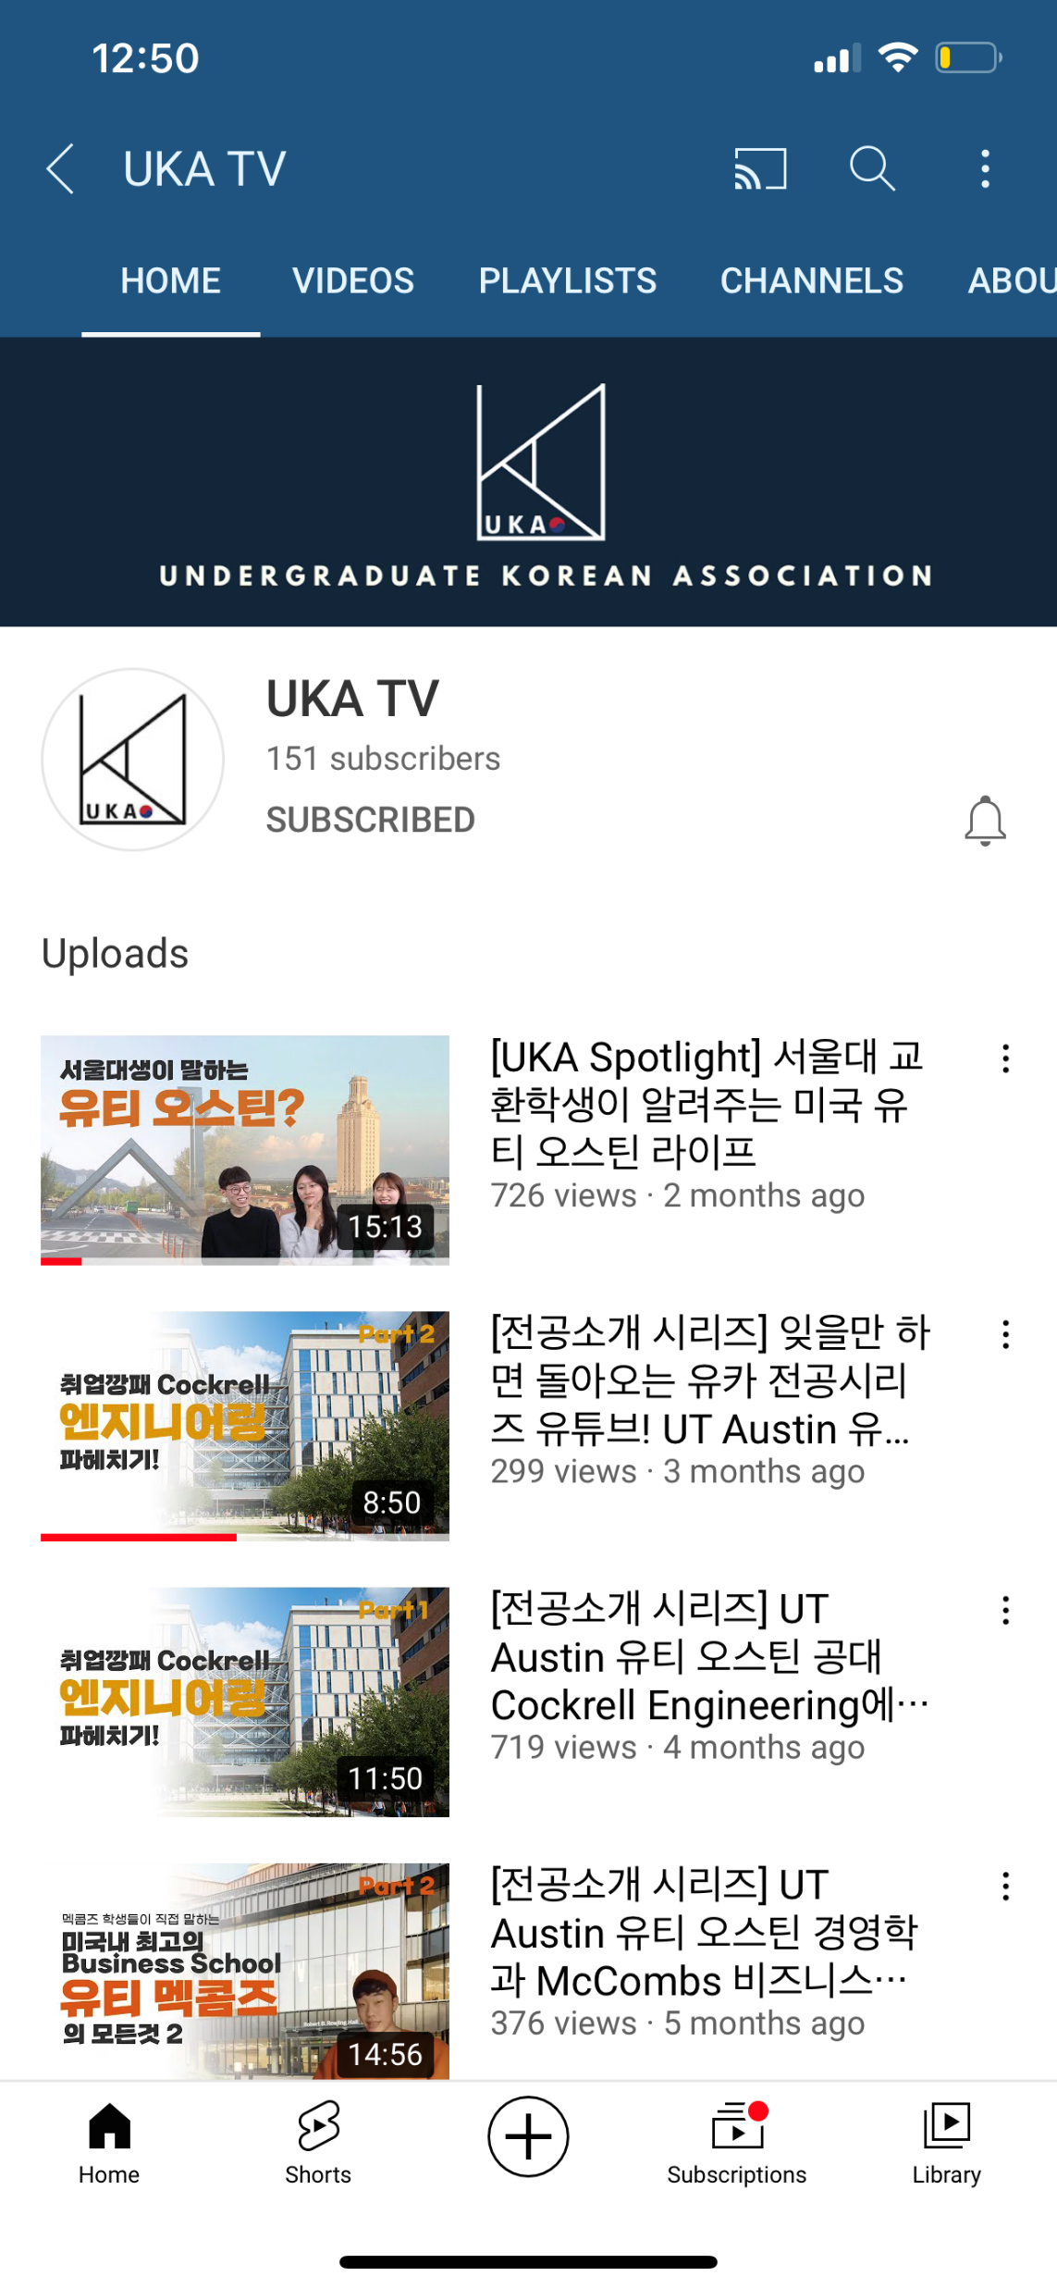
YouTube
Produce contents, direct, film, edit, and publish on UKA TV

Slide 28
YouTube
Monthly ‘SPOTLIGHT’
Interviewing UT students in an entertaining setting
Notes:
그림 바꾸기

Slide 29
Software
Re-develop UKA official WEBSITE
Maintain GCP SERVER and update any information needed on website
Perform any TECHNICAL assistance
Notes:
2,3 바꾸기

Slide 30
Communication
Administer UT Bamboo/UT 자유게시판 Facebook page
Create bi-monthly NEWSLETTER via email
HANU (한우)

Slide 31
Marketing
Name: Jeongmin Park (박정민)
Grade: Junior
Major: Education
Fun Fact: Taking ballet class this semester

Slide 32
Marketing Director
Creative Content
Create designs for POSTERS and FLYERS

Slide 33
Marketing Director
Creative Content
Public Relation
Create designs for POSTERS and FLYERS
Manage SOCIAL MEDIA
Direct EMAIL communication

Slide 34
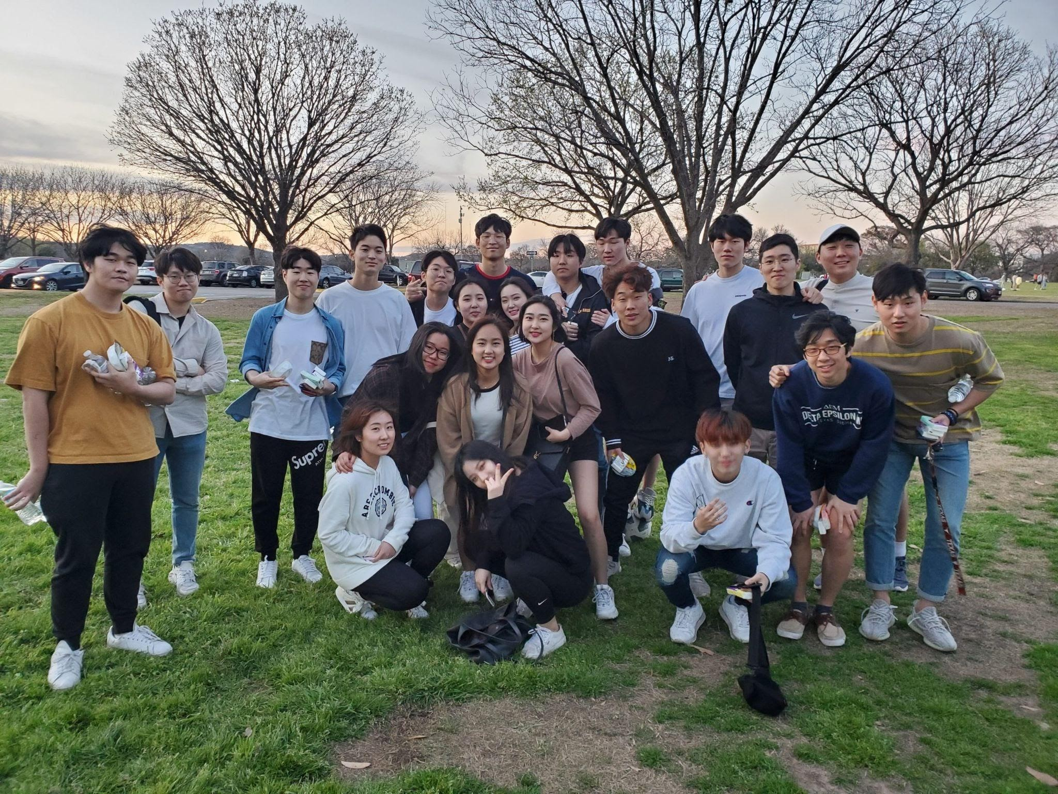
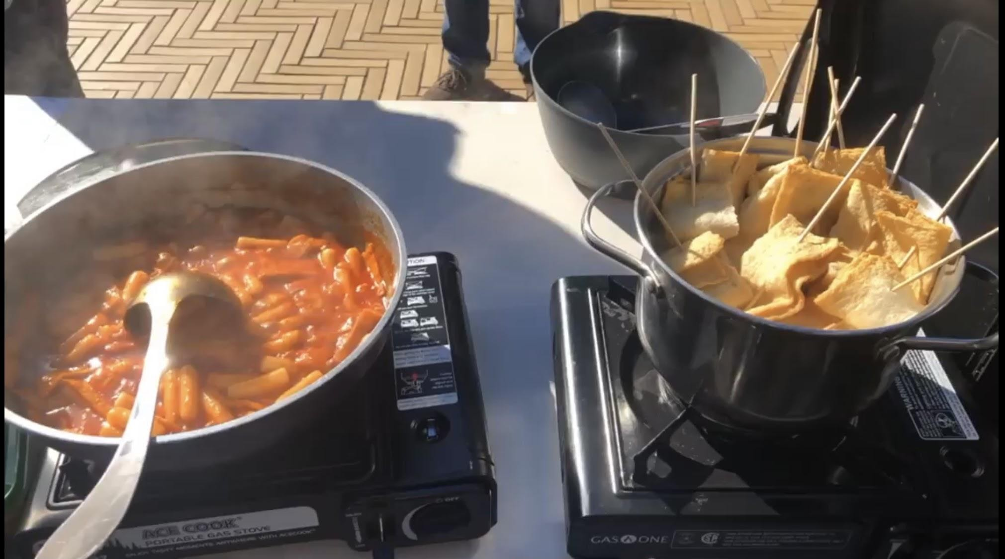
Marketing Director
Creative Content
Public Relation
Media
Outreach
Create designs for POSTERS and FLYERS
Manage SOCIAL MEDIA
Direct EMAIL communication
Take PHOTOS/VIDEOS during UKA events
Help promote fundraising sales
COLLABORATE with other communities to promote UKA

Slide 35
Marketing Director
Creative Content
Public Relation
Media
Outreach
Create designs for POSTERS and FLYERS
Manage SOCIAL MEDIA
Direct EMAIL communication
Take PHOTOS/VIDEOS during UKA events
Help promote fundraising sales
COLLABORATE with other communities to promote UKA
Notes:
Overall responsibility

Slide 36
Marketing Director
Creative Content
Public Relation
Media
Outreach
Create designs for POSTERS and FLYERS
Manage SOCIAL MEDIA
Direct EMAIL communication
Take PHOTOS/VIDEOS during UKA events
Help promote fundraising sales
COLLABORATE with other communities to promote UKA
Notes:
Overall

Slide 37
Operation
Name: Elizabeth Yun (윤다희)
Grade: Graduate School
Major: M.S. Marketing
Fun Fact: I like Mint Chocolate

Slide 38
Operation
Social Events
2-3 Events per semester

Slide 39
Operation
Brown Bag
Delegate Brown bags and Schedule

Slide 40
End-of-Semester Events
Spring
Banquet
Christmas
Party

Slide 41
Committee Office Hours
SEP
SEP
8
9
Operation – 10am to 12pm
By Elizabeth Yun
Administration – 5pm to 7pm
By Chris Yeom
Informatics – 5pm to 7pm
By Jiwon Han
Finance – 5pm to 7pm
By Philip Kim
Marketing – 5pm to 7pm
By Jeongmin Park

Slide 42
Committee Interview
SEP
SEP
SEP
13
14
15

Slide 43
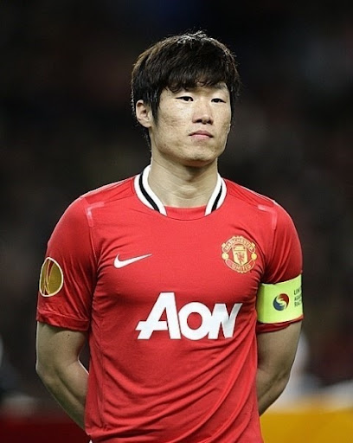
Dongari Leader

Slide 44
Dongari Leader
A group must have a LEADER, and we create a Dongari as soon as it obtains a LEADER.
Some Dongaries are POPULAR but cannot be created without a LEADER.
Notes:
리더랑 얘기한후에 제대로 ㄱ
동아리 리더하에

Slide 45
Dongari Qualification
5 Members
1 Leader
Notes:
기존에 개설된 동아리들이 있기때문에
축구나 댄스는 따로 개설 ㄴ
소개 해드리겠습니다
Step 을 적어서 정리해주고 몇주정도 걸리는지 말해주고

Slide 46
Current Situation
Dongari WITH a leader
Gaming
Basketball
Golf
Volleyball
Stock Discussion

Slide 47
Current Situation
Popular Dongari WITHOUT a leader
UKA Foodies
Movie
Board Game
Tennis

Slide 48
Current Situation
KAMU
Red Devil FC
Dance
Soccer
Notes:
기존에 개설된 동아리들이 있기때문에
축구나 댄스는 따로 개설 ㄴ
소개 해드리겠습니다
Step 을 적어서 정리해주고 몇주정도 걸리는지 말해주고

Slide 49
Process of Dongari
1
2
3
4
Notes:
기존에 개설된 동아리들이 있기때문에
축구나 댄스는 따로 개설 ㄴ
소개 해드리겠습니다
Step 을 적어서 정리해주고 몇주정도 걸리는지 말해주고

Slide 50
Process of Dongari
Application Form
1
2
3
4
Notes:
기존에 개설된 동아리들이 있기때문에
축구나 댄스는 따로 개설 ㄴ
소개 해드리겠습니다
Step 을 적어서 정리해주고 몇주정도 걸리는지 말해주고

Slide 51
Process of Dongari
Application Form
Leader Interview
1
2
3
4
Notes:
기존에 개설된 동아리들이 있기때문에
축구나 댄스는 따로 개설 ㄴ
소개 해드리겠습니다
Step 을 적어서 정리해주고 몇주정도 걸리는지 말해주고

Slide 52
Process of Dongari
Application Form
Leader Interview
Kakao Groupchat
1
2
3
4
Notes:
기존에 개설된 동아리들이 있기때문에
축구나 댄스는 따로 개설 ㄴ
소개 해드리겠습니다
Step 을 적어서 정리해주고 몇주정도 걸리는지 말해주고

Slide 53
Process of Dongari
Application Form
Leader Interview
Kakao Groupchat
Dongari
Group!!
1
2
3
4
It will usually take A WEEK to form Dongari Group.
Notes:
기존에 개설된 동아리들이 있기때문에
축구나 댄스는 따로 개설 ㄴ
소개 해드리겠습니다
Step 을 적어서 정리해주고 몇주정도 걸리는지 말해주고

Slide 54
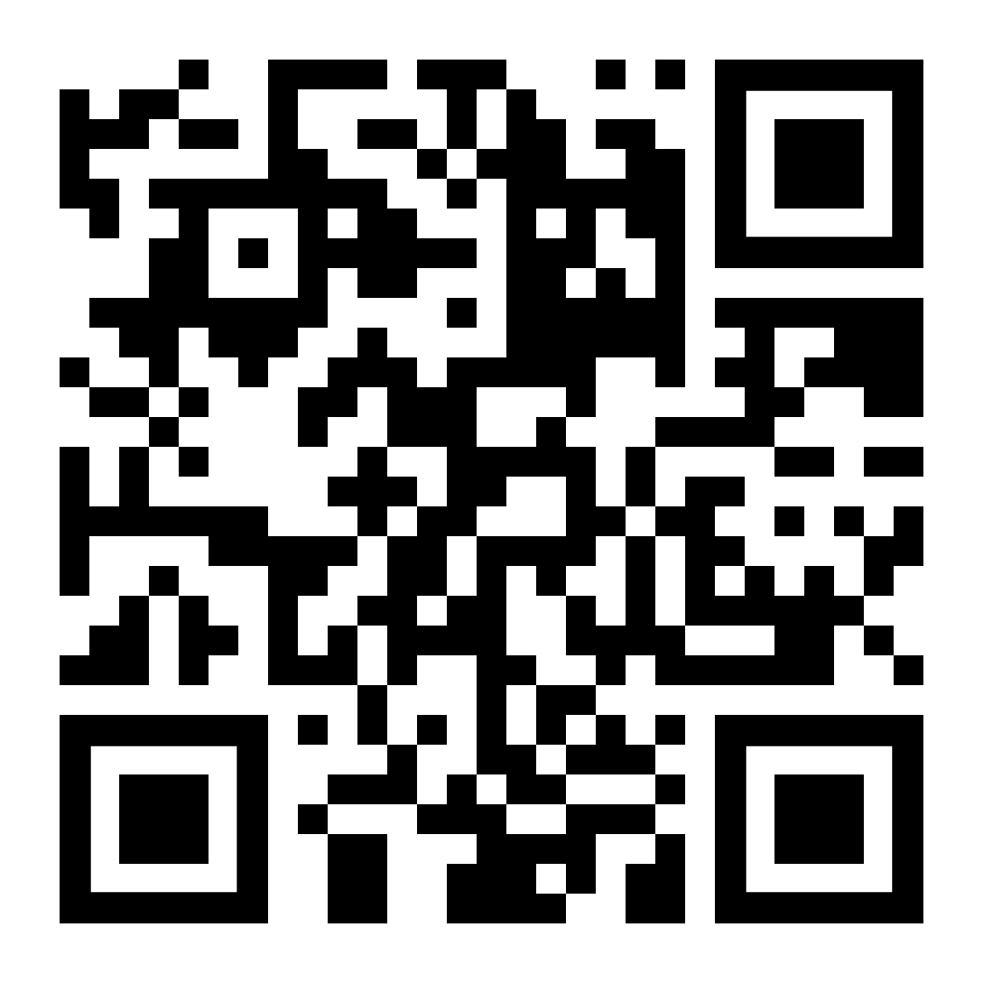
FAM-FAMS
FAM-FAM PARENT application due September 2, 11:59 PM
Parent Application Form

Slide 55
FAM-FAMS
Socialization
& Bonding
Mentoring
@texasuka.fams

Slide 56
FAM-FAMS
Socialization
& Bonding
Mentoring
@texasuka.fams

Slide 57
FAM-FAM Events
Bowling Night
UKA Mini Olympic

Slide 58
UKA Fall Retreat (MT)
When?
Where?

Slide 59
UKA Fall Retreat (MT)
9/10 – 9/11
Friday to Saturday
Where?

Slide 60
UKA Fall Retreat (MT)
Highland Lakes Camp & Conference Center
9/10 – 9/11
Friday to Saturday

Slide 61
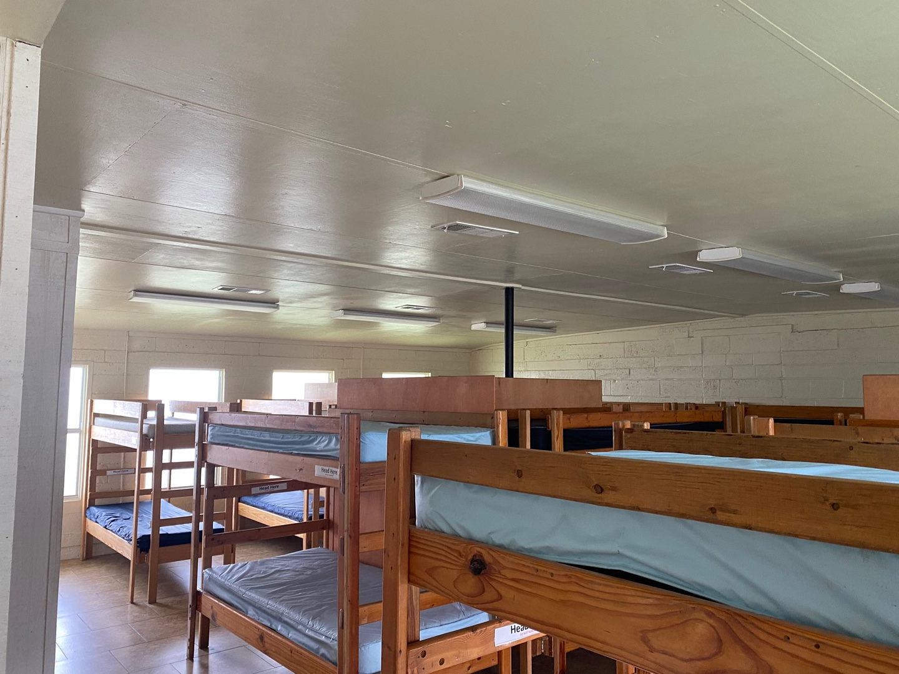
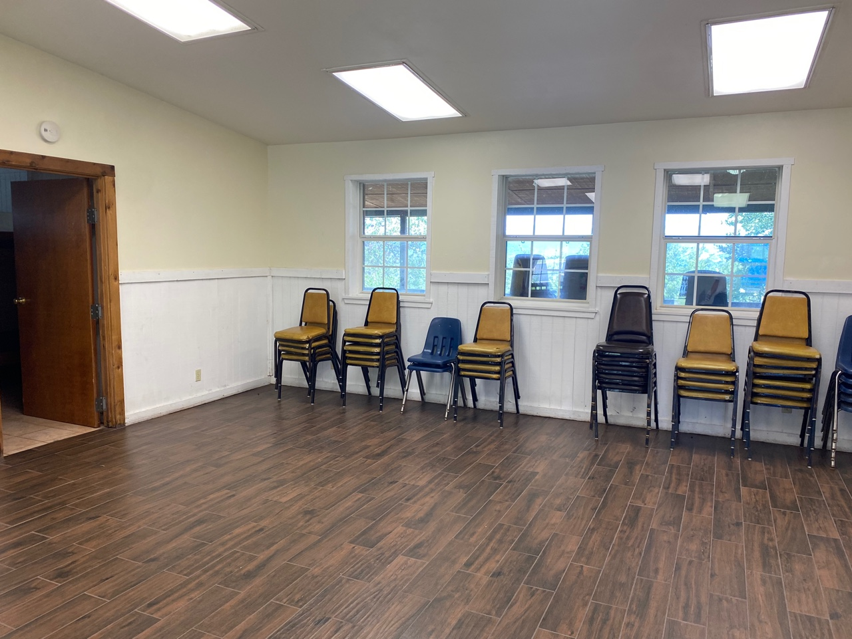
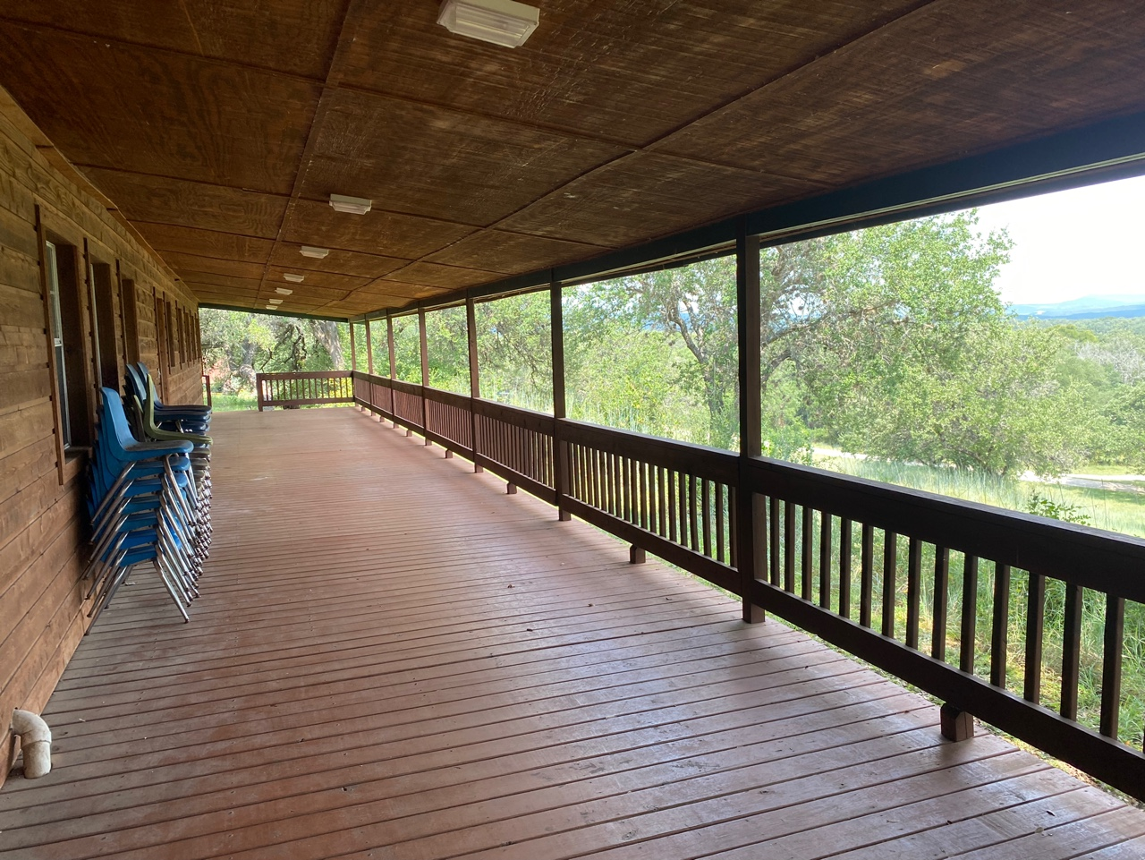
Preview
Bring your own BEDDINGS and TOILETRY!!

Slide 62
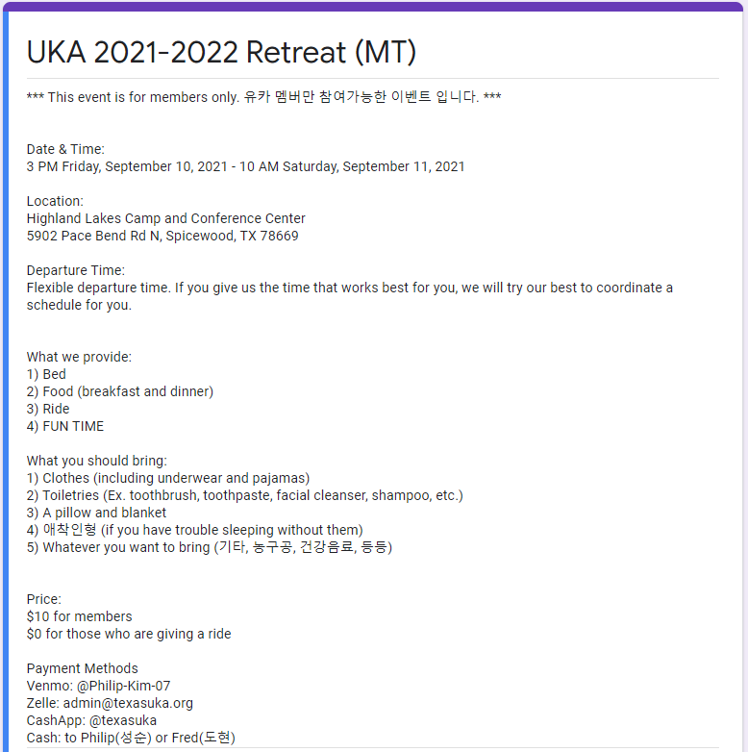
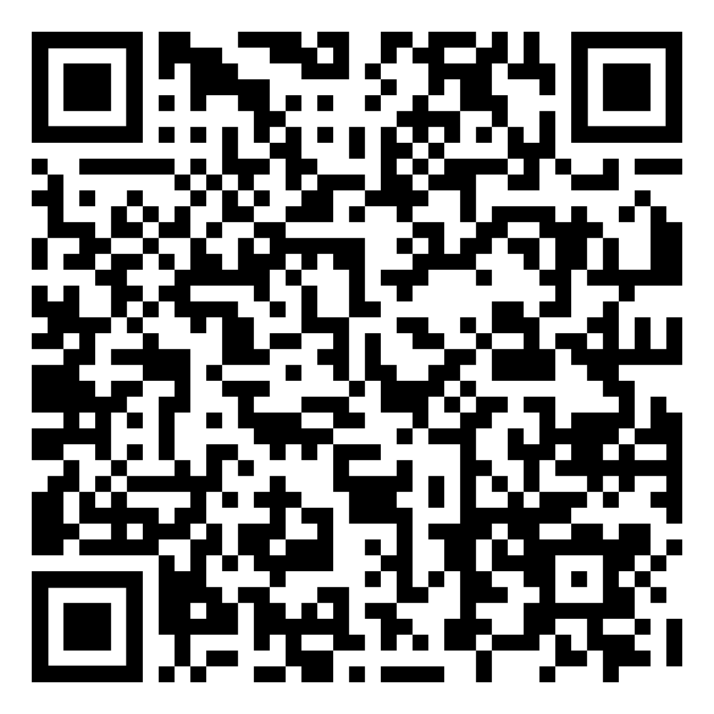
Sign-Up
Sign-up form link will be uploaded
on Instagram and Website

Slide 63
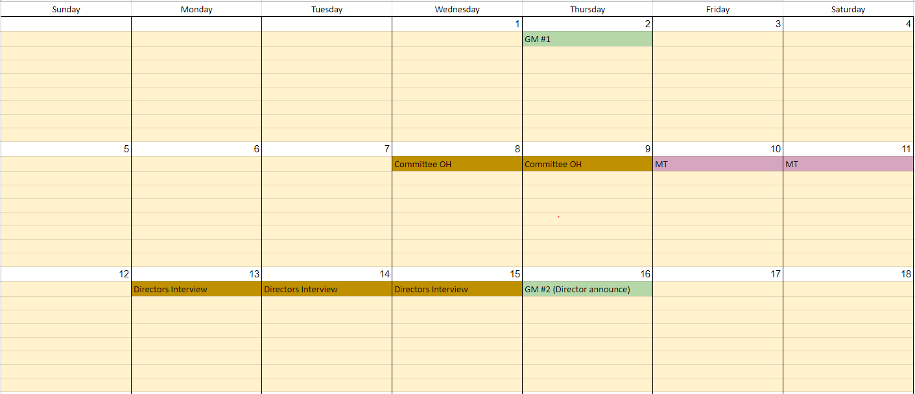
Upcoming Events

Slide 64
Dues
$30
Semester
$50
Year
Early Bird Discount $45 per year by TODAY!! ($5 Discount)

Slide 65
The End?

Slide 66
Quiz Time!!

Slide 67
What is the qualification for Dongari to be formed?

Slide 68
When is the due for FAM-FAM parents application form?

Slide 69
What is the name of the retreat place?

Slide 70
What is the name of the UKA’s mascot?

Slide 71
GAME

Slide 72
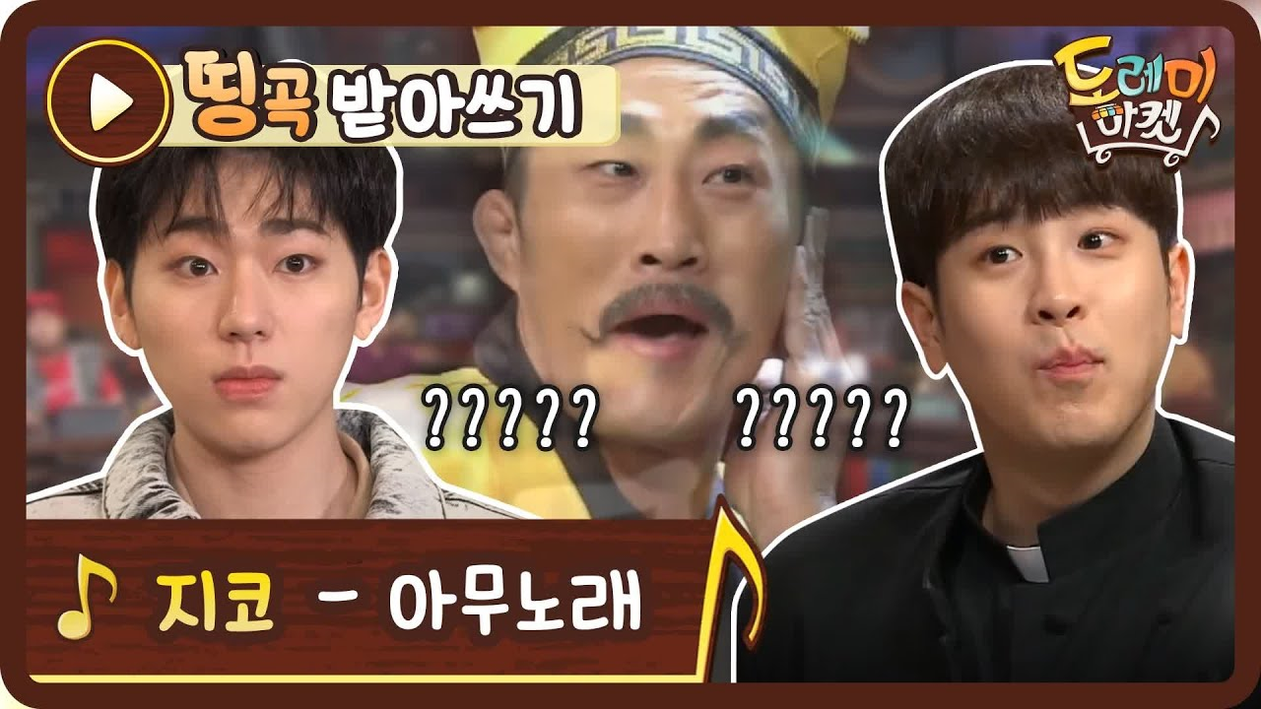
Lyrics Dictation

Slide 73
Lyrics Dictation
Twice – Likey

Slide 74
Lyrics Dictation
Britney Spears – Baby One

Slide 75
Contact Us
President 조도현
fredjdh@gmail.com | KaKaoTalk ID: fredjdh
VP Marketing 박정민
jeongminpark@utexas.edu | Kakao Talk ID: pjm990527
VP of Informatics 한지원
(915) 637 - 5310 | jhan0406@utexas.edu | KaKaoTalk ID: gksjiwon
VP of Finance 김성순(Philip Kim)
(718) 926-2622 | sungsoon.philip_kim@utexas.edu | KakaoTalk ID: soonie508
VP of Administration 염승철 (Chris Yeom)
(469) 500-9089 | christopheryeom@gmail.com | Kakao Talk ID: foy99
VP of Operations 윤다희
(512) 944-8966 | elizabethyun@utexas.edu | Kakao Talk ID: elizabethpink

Slide 76
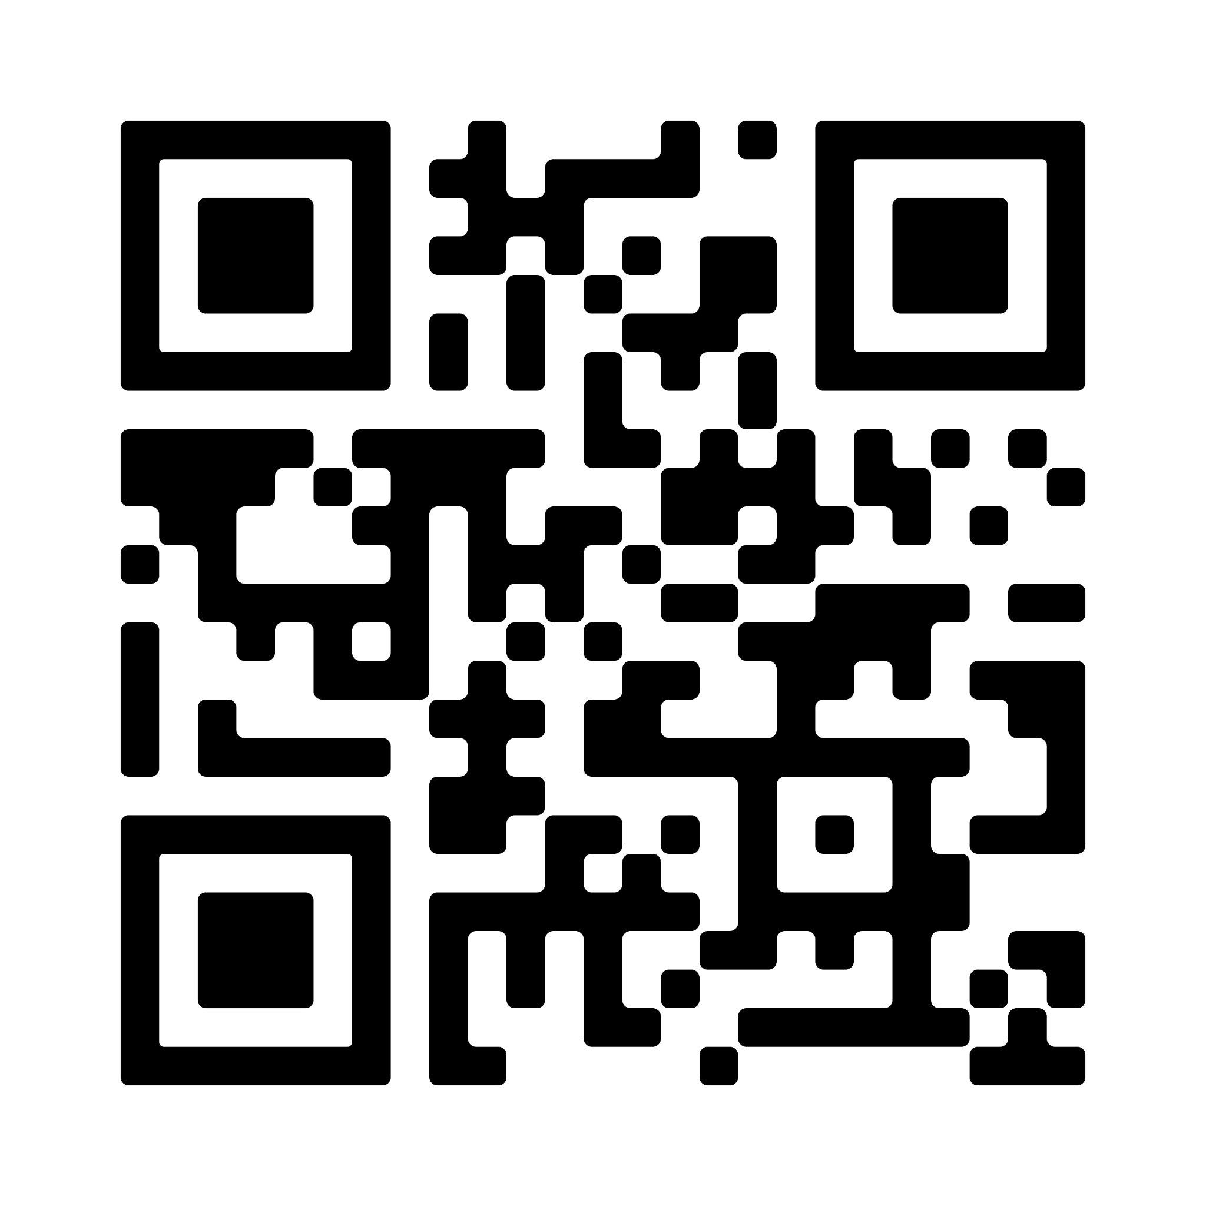
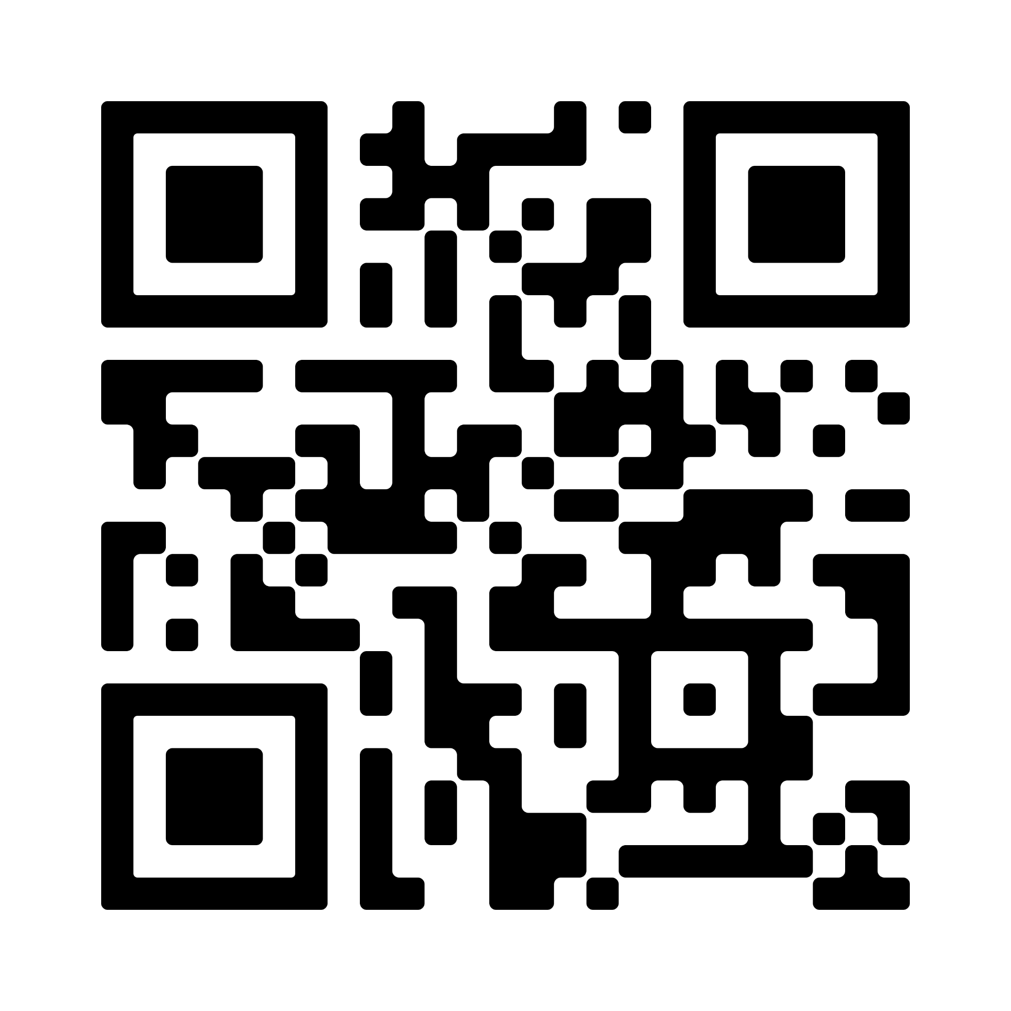
QR Codes
UT 자유게시판
UT Open Kakao

