Slide 1
GM2

Slide 2
Table of Contents
Announcements
Dongari
FAM-FAM
MT
Partnership
Committee Member Announcements
Guest Speaker (Yoonsup Lee)

Slide 3
Covid-19 Updates
GM through Zoom

Slide 4
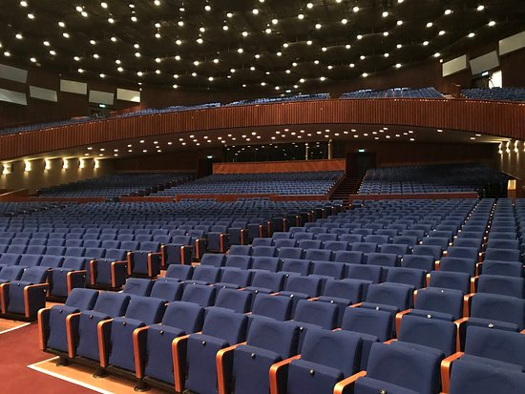
Covid-19 Updates
GM through Zoom
Bigger Room

Slide 5
Covid-19 Updates
GM through Zoom
Bigger Room
Every attendant Must Sign-in

Slide 6
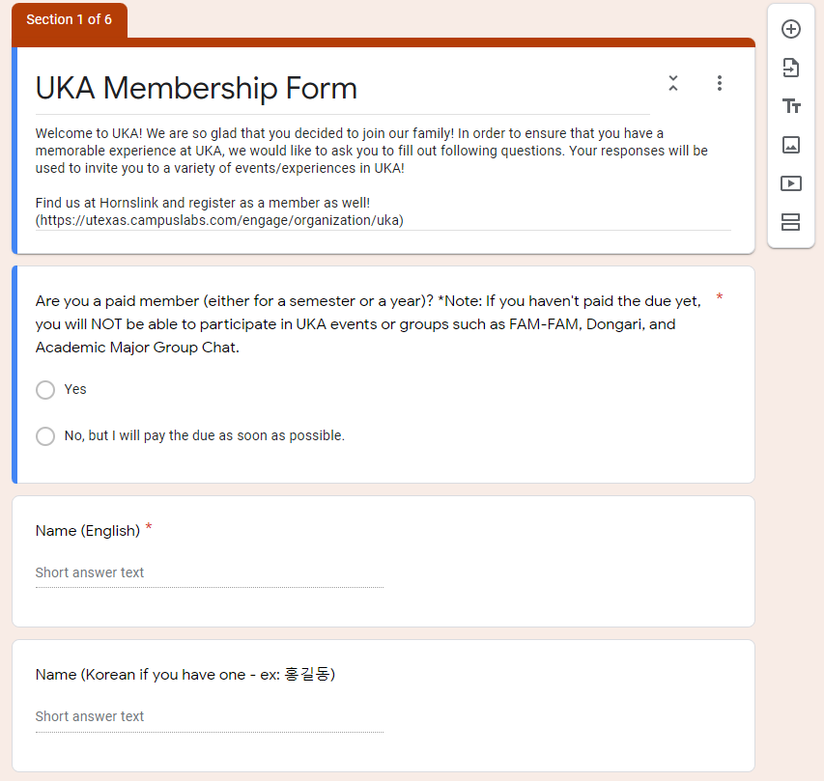
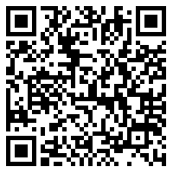
Membership Form
Please fill out!! It’s crucial for creating member roster and event purposes

Slide 7
Dongari Updates
Basketball
Movie
Golf
Volleyball
Stock Discussion
Tennis
Gaming

Slide 8
Dongari Updates
KAMU Dance Team
Red Devil FC

Slide 9
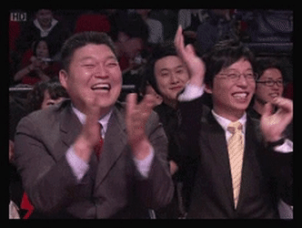
Thank You for Being a Leader!!

Slide 10
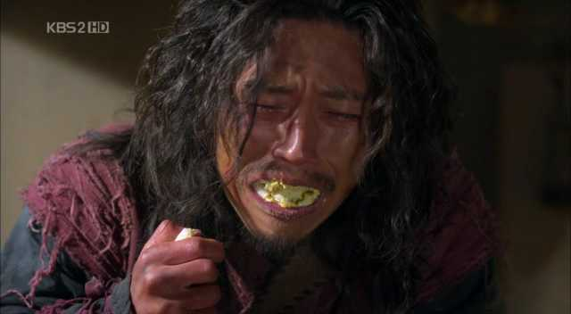
Dongari without Leaders
Need multiple Leaders!!
UKA Foodies
Board Game
43 members
17 members
Please apply for the LEADER position!!

Slide 11
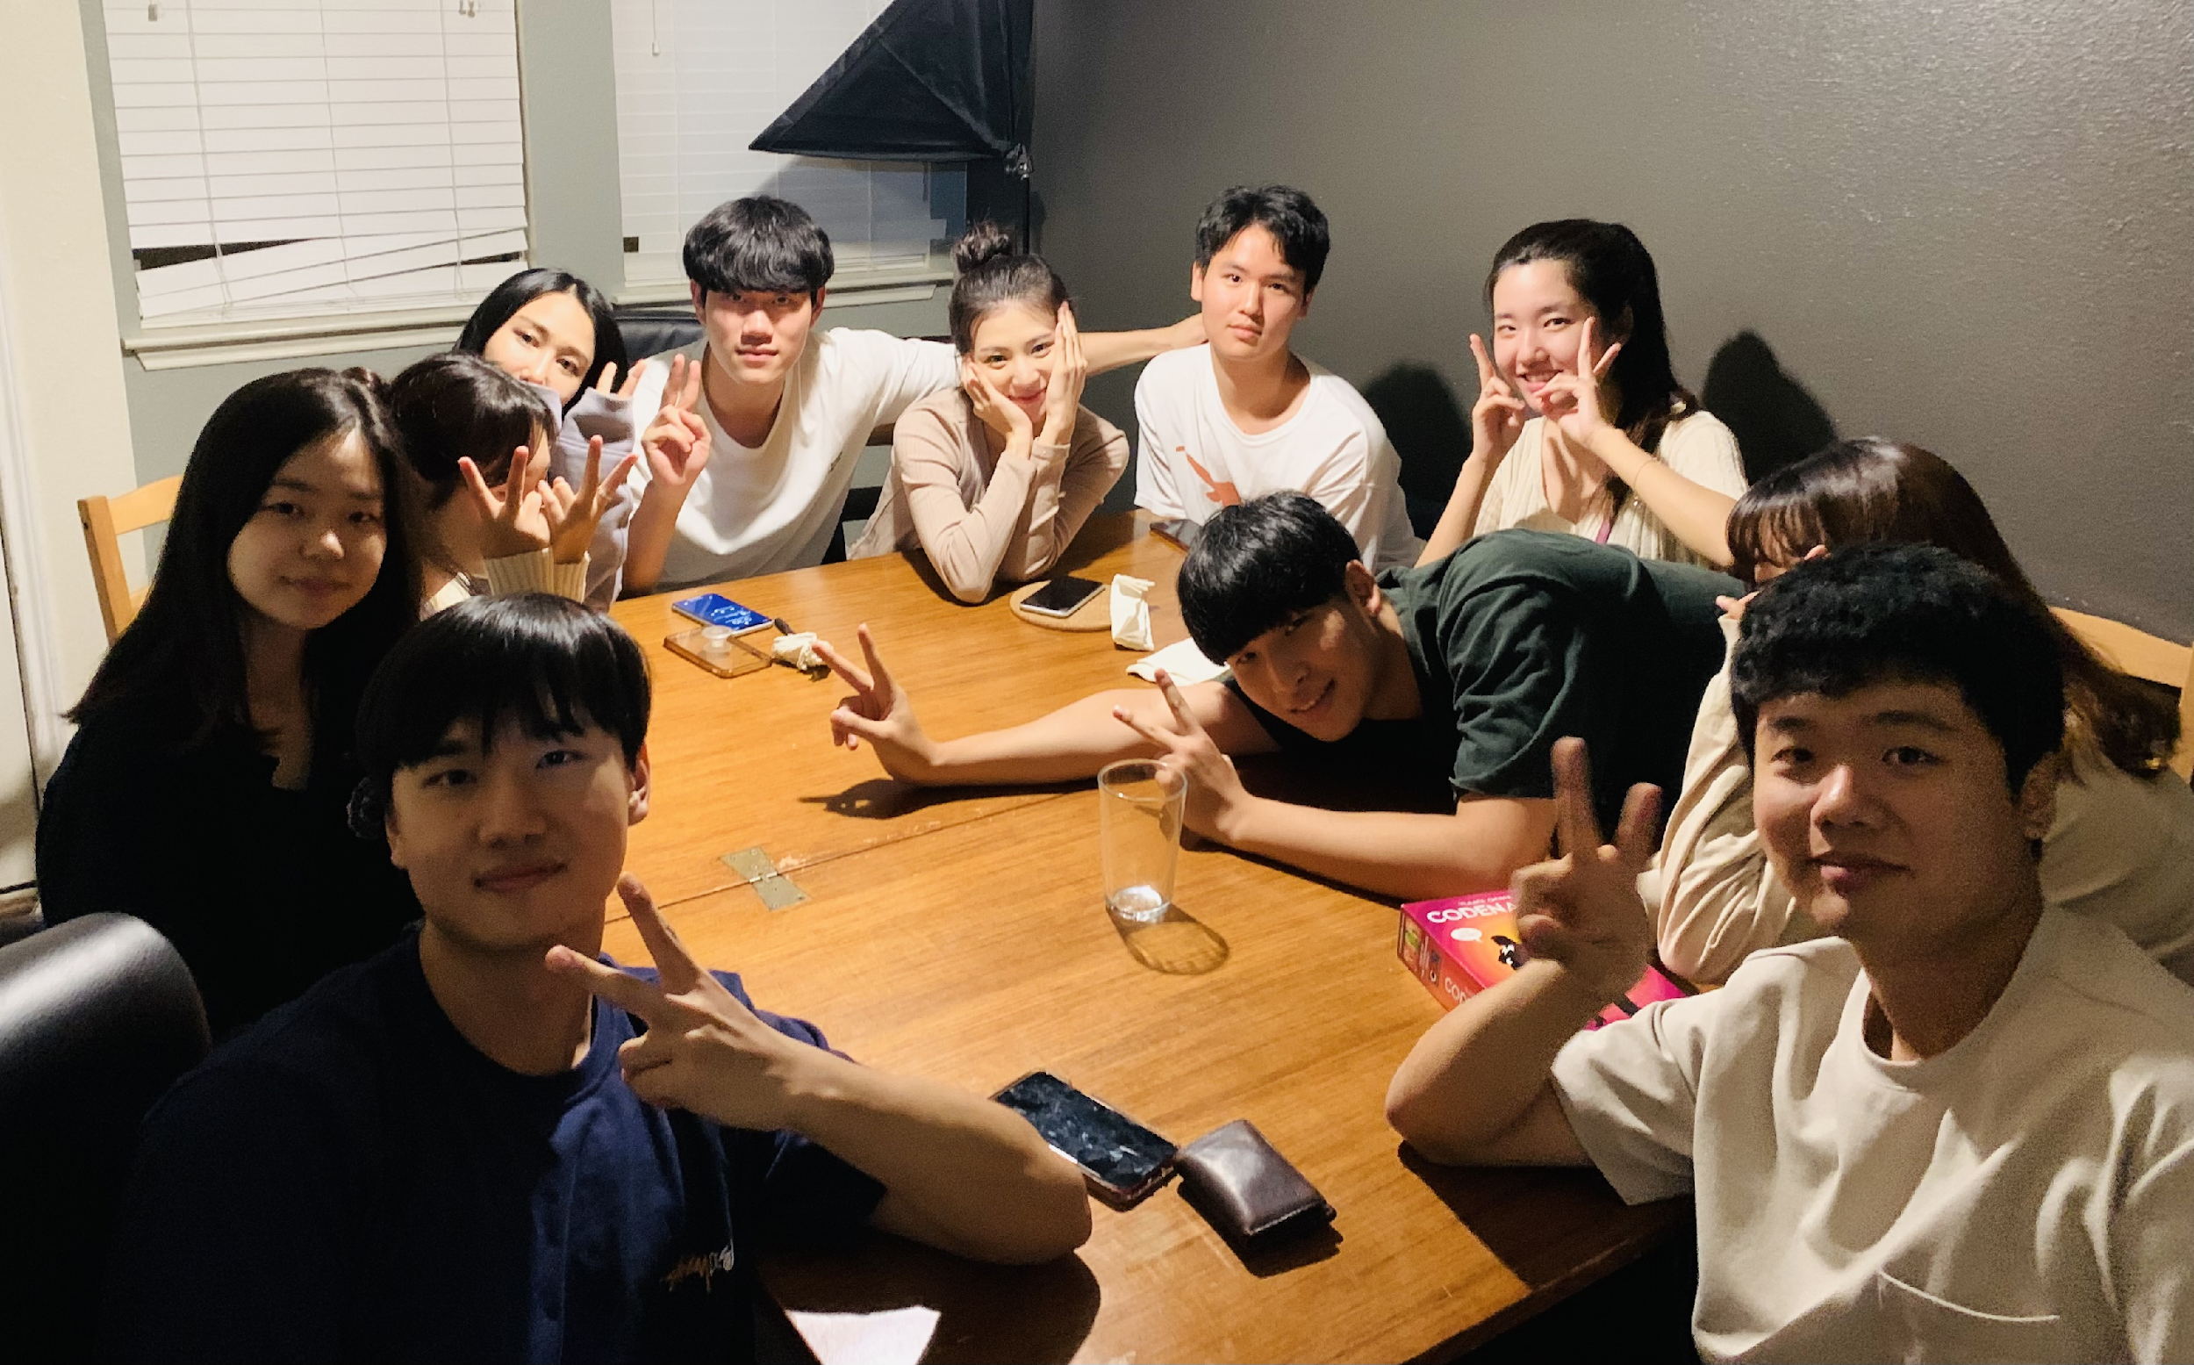
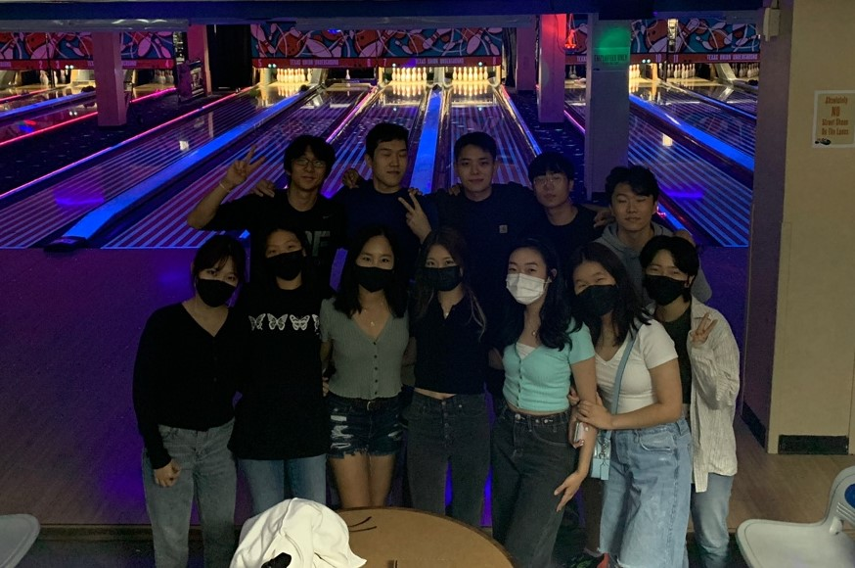
FAM-FAM Updates
Please take a picture and send it to us!!

Slide 12
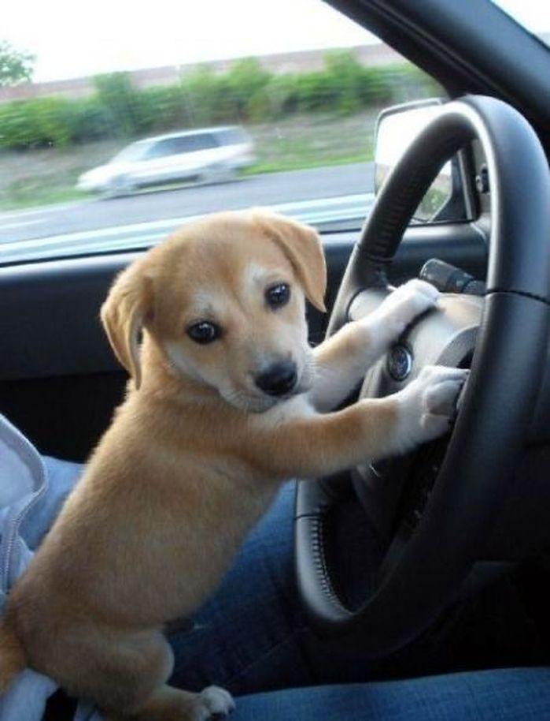
Retreat (MT) Announcement
오빠 달려~!
3PM Departing Teams
4PM Departing Teams
You can check your fellow passengers in MT group chat!

Slide 13
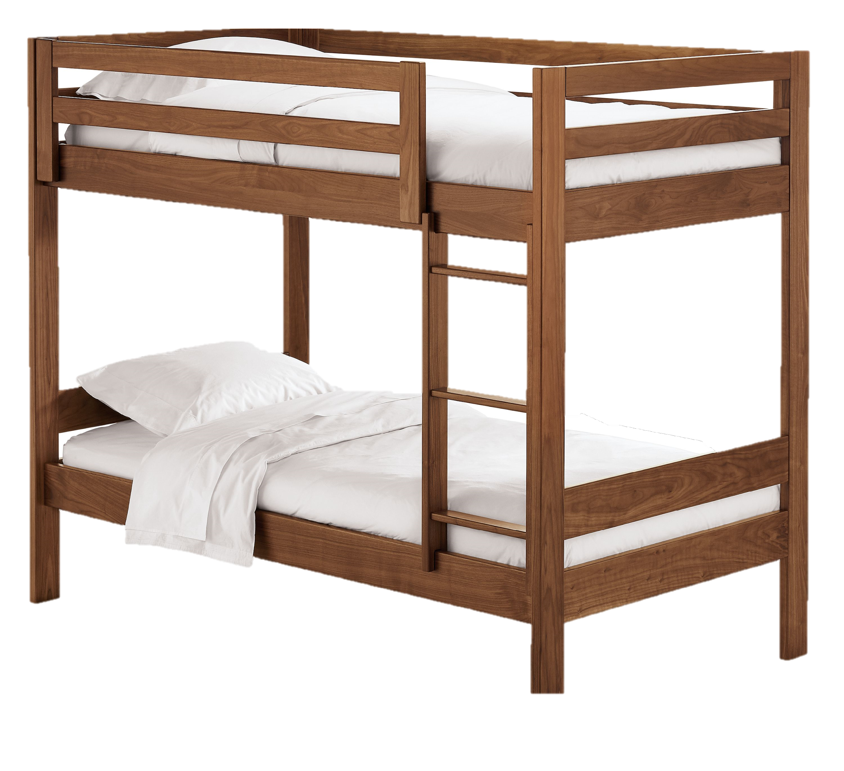
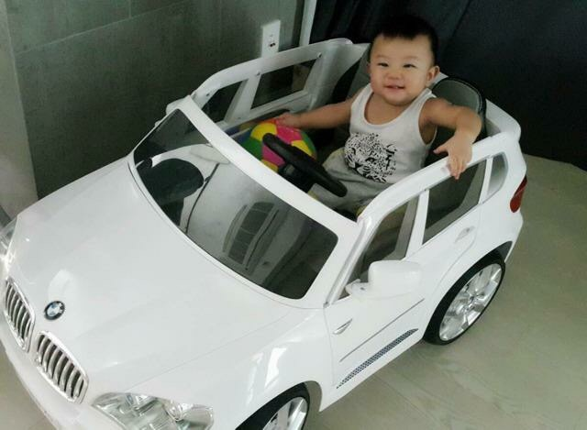
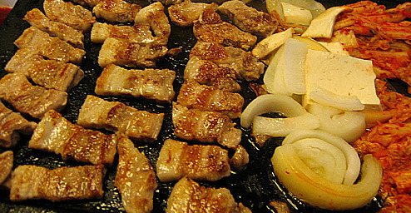
We Provide:
Bunk Beds
Food
(Dinner and Breakfast)
Ride
AND FUN TIME!!

Slide 14
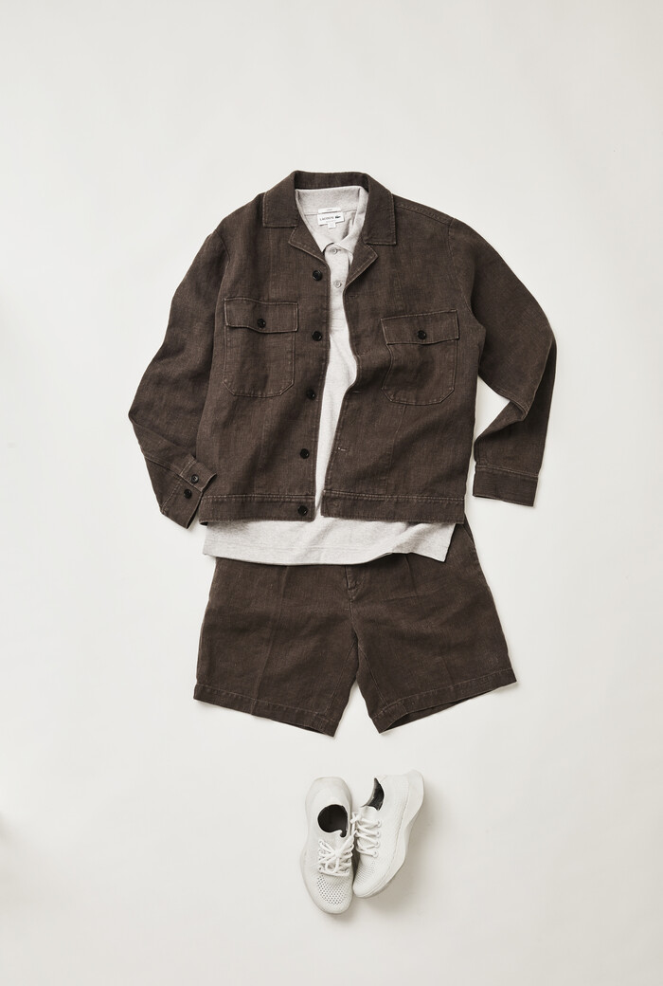
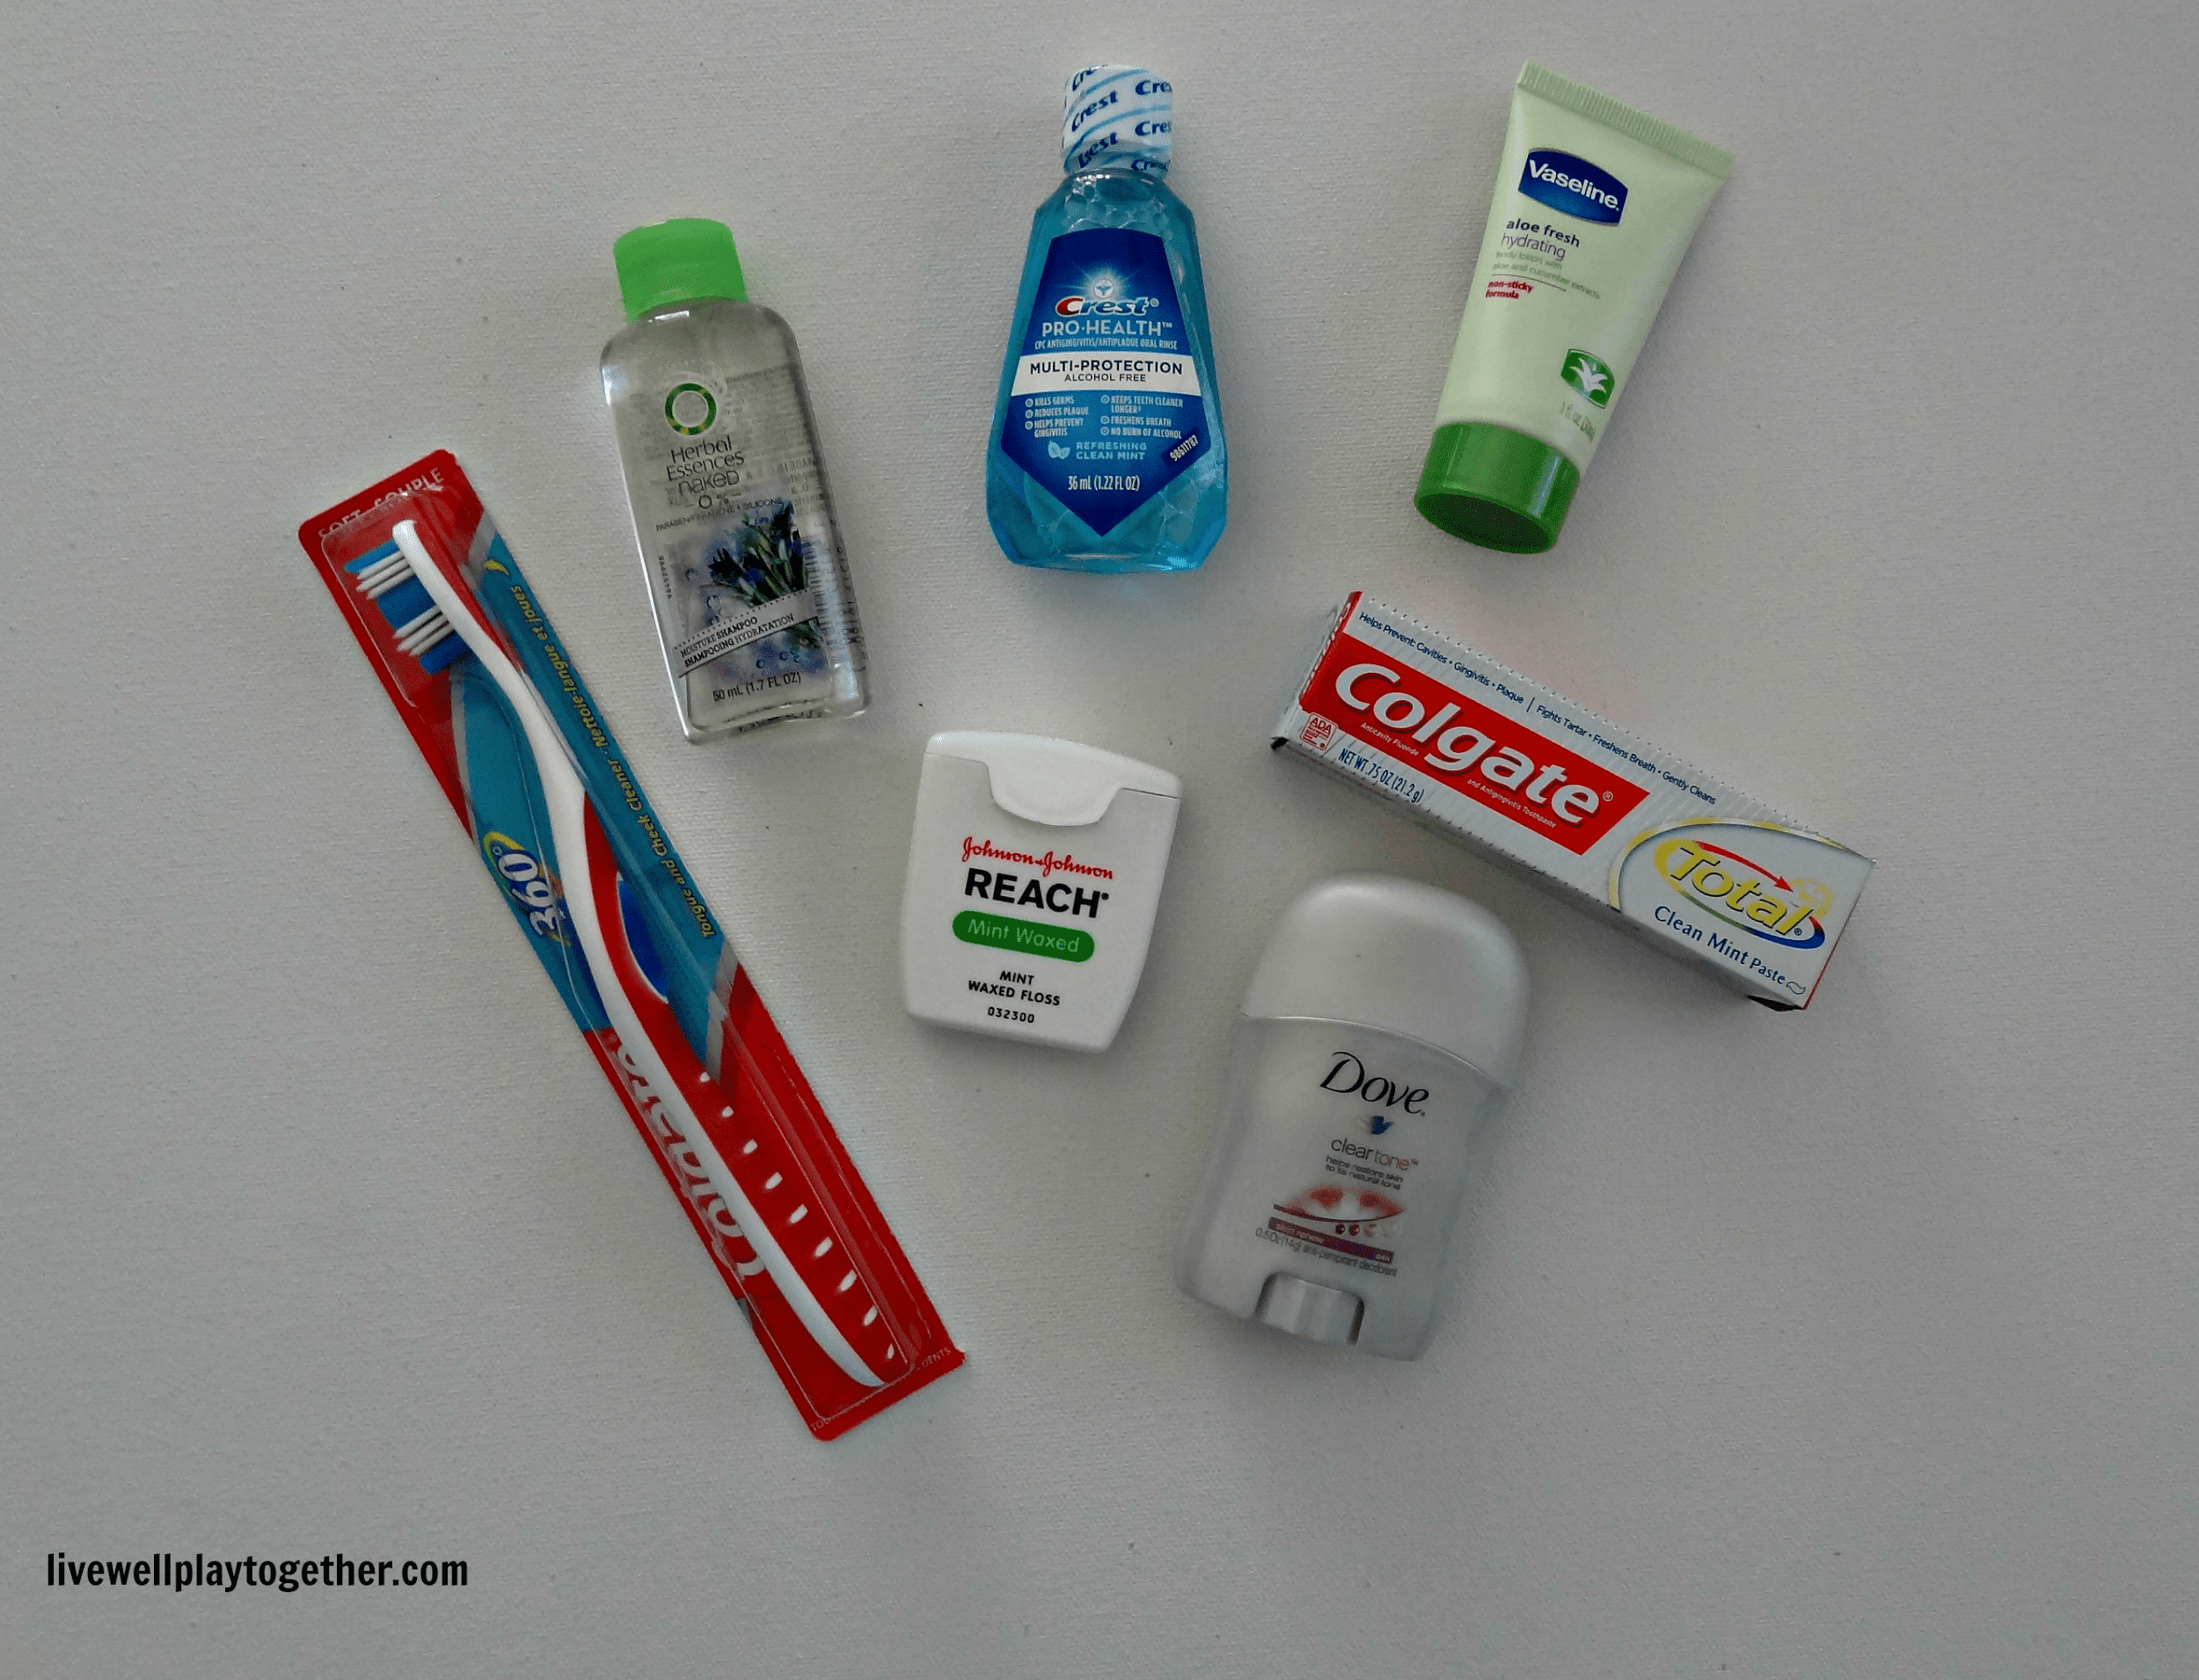
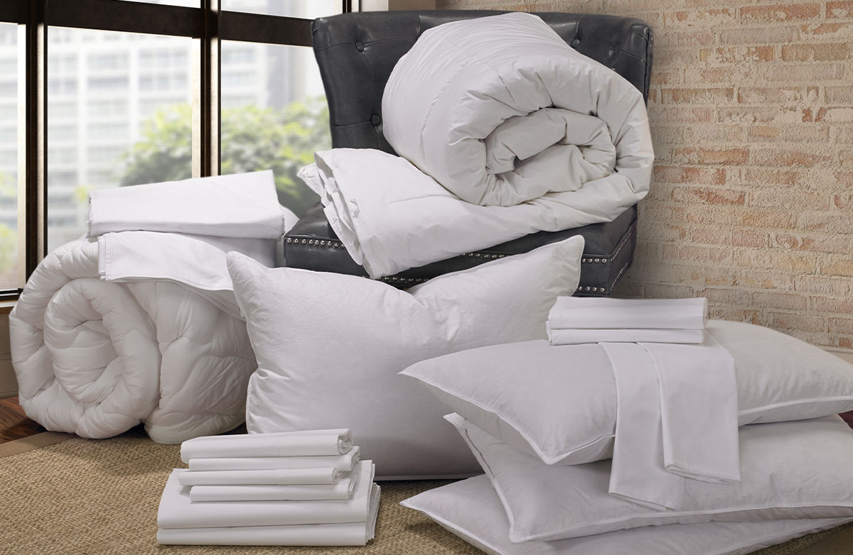
You Should Bring:
Clothes
Toiletry
(Including Towels)
Bedding
(Blanket and Pillow)
Anything you want
(ex. Basketball, guitar)

Slide 15
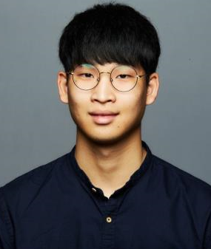
Administration Members
송재윤
Grace Park
Rachael Park
이상민
유동연
천예진
박상민
이도은

Slide 16
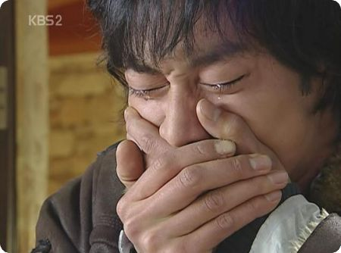
Administration Members
송재윤
Grace Park
Rachael Park
이상민
유동연
천예진
박상민
이도은

Slide 17
Operation Members
Abby Woo
강혜원
김선우
정나원
윤지연
최아연

Slide 18
Marketing Members
노회창
Sarah Lee
이채원
신희빈
홍영찬
천정명

Slide 19
Finance Members
신수민
문나영
최연서
임준영
김수빈
정혁주
이유리

Slide 20
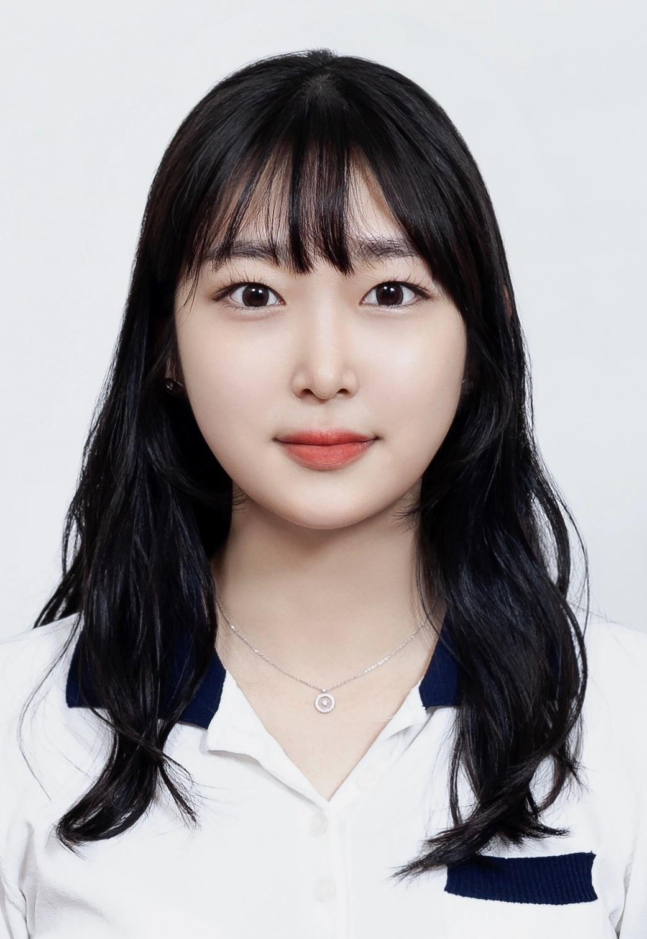
Informatics Members
윤태균
고은하
하태민
이민호
이수경
오진우

Slide 21
Partnership

Slide 22
Longhorns.kr

Slide 23
Longhorns.kr

Slide 24
Longhorns.kr
Local News and Information Updates
Used Goods Buy/Sell (+Local Delivery Service)
Korean Vendors Coupon Event
Job Postings
AUSTIN Korean Community Website

Slide 25
Coupon Event

Slide 26
Coupon Event
Event Period: 9/16 – 9/30
First come, First served for only 100 people

Slide 27
How to Participate?
1. Leave a “UKA” comment on the discount coupon post on longhorns.kr (롱혼)
2. Send screenshots of comments on KakaoTalk (@longhorns)

Slide 28
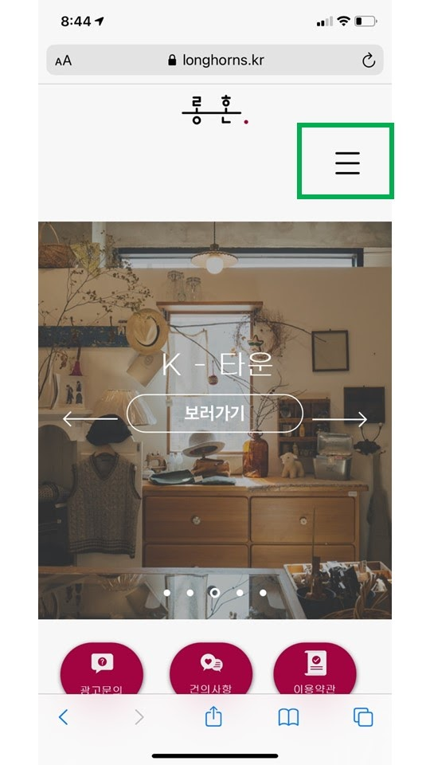
How to Participate?

Slide 29
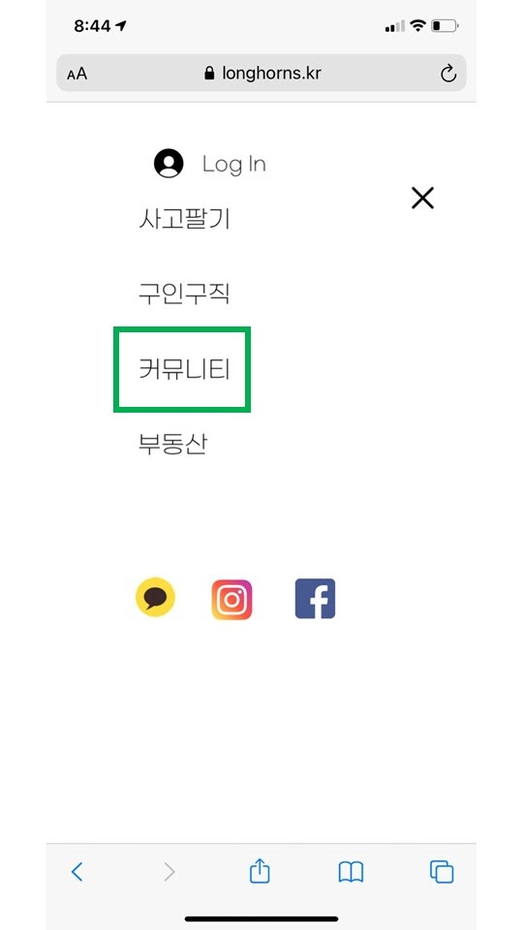
How to Participate?

Slide 30
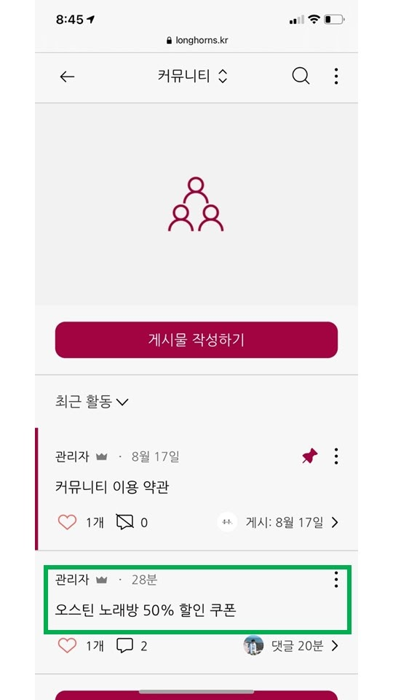
How to Participate?

Slide 31
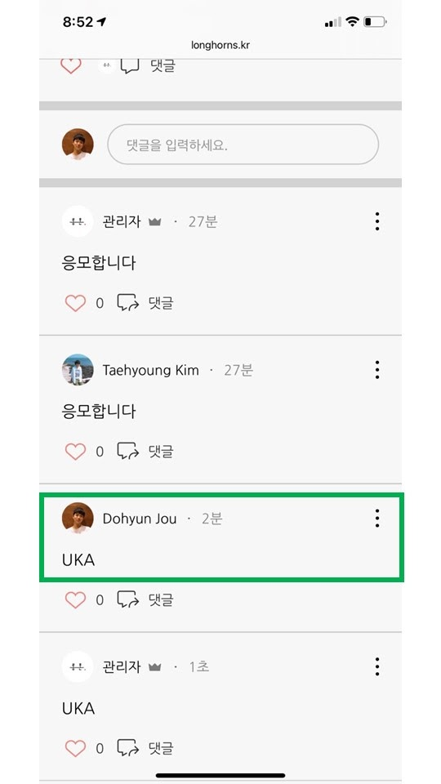
How to Participate?

Slide 32
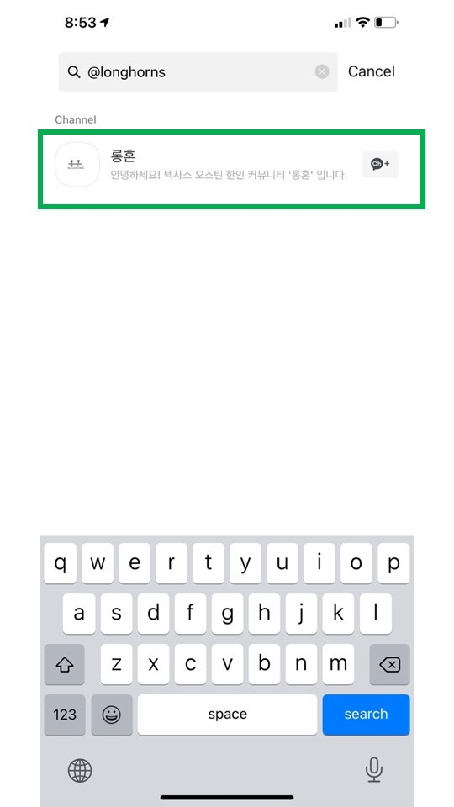
How to Participate?

Slide 33
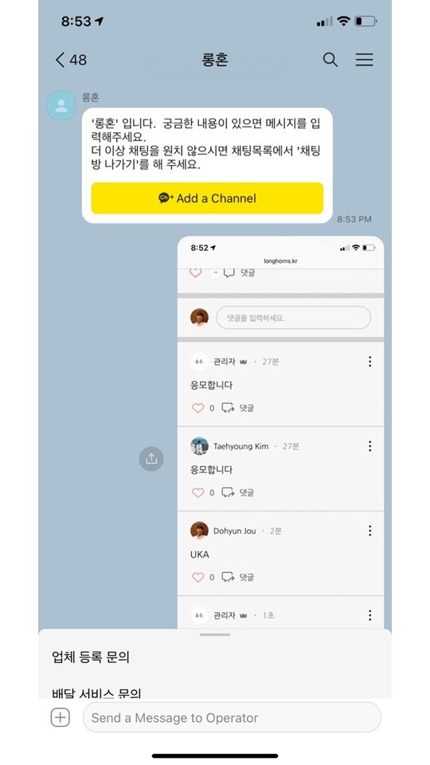
How to Participate?

Slide 34
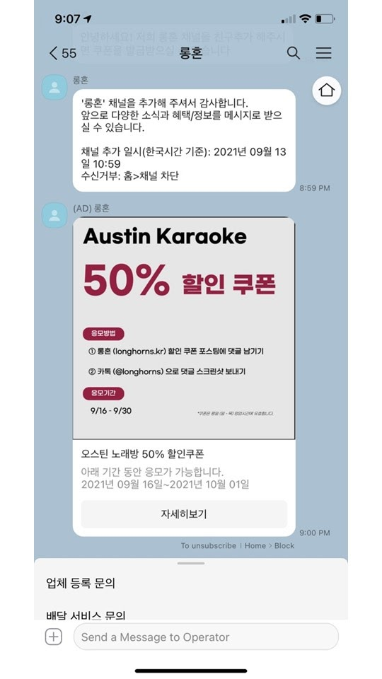
How to Participate?

Slide 35
Contact Info
Website: longhorns.kr
Instagram: @klonghorns
KakaoTalk: @longhorns

Slide 36
Guest Speaker

Slide 37
Yoonsup Lee

