Slide 1
GM #5

Slide 2
Finance

Slide 3
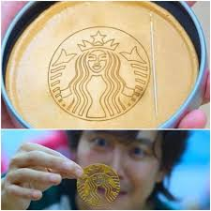
Finance
Fundraising
Scholarship

Slide 4
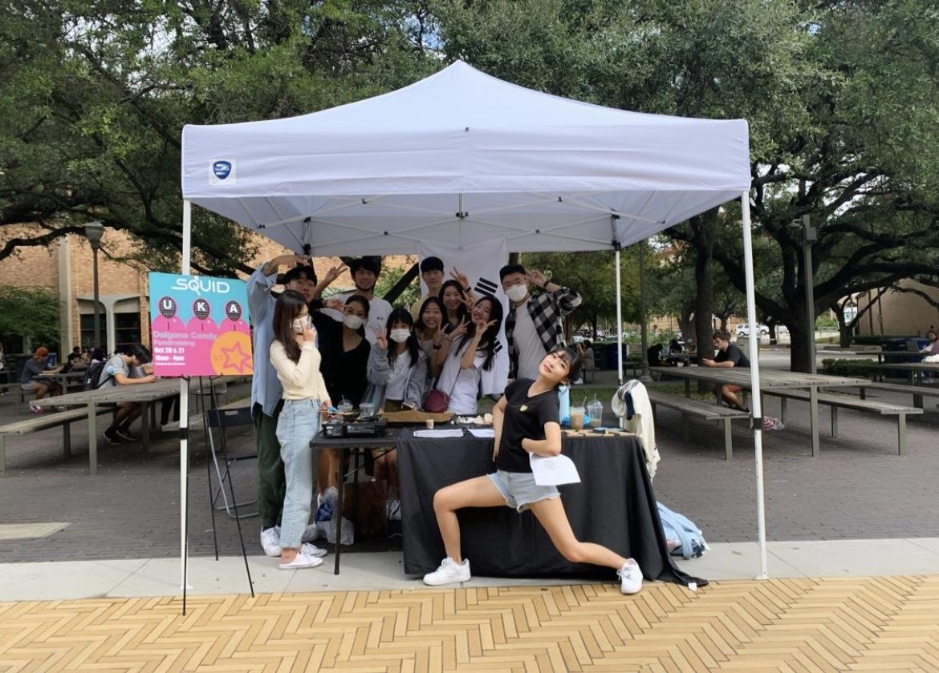
Fundraising
Thank you to everyone who visited our booth!

Slide 5
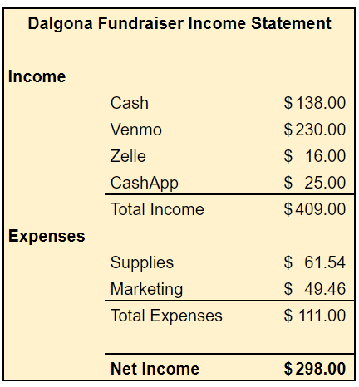
Fundraising
We raised a total of $ 298 !!

Slide 6
Scholarship
The UKA X KAAGA Scholarship is due THIS SUNDAY (10/31) at 11:59 PM!

Slide 7
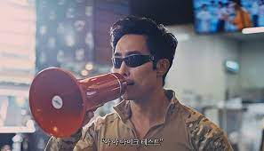
Marketing

Slide 8
Marketing
Posters
UKA T-shirts

Slide 9
Marketing
Past posters made by Jung myung Chun!!

Slide 10
Marketing
UKA T-shirts on sale for $5

Slide 11
Marketing
Thanks Emily and Ho Young for the designs!!

Slide 12
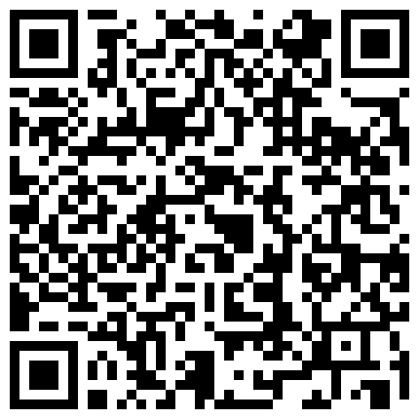
Marketing
You may get your orders in now
Or
You may wait until the design is finalized

Slide 13
Informatics

Slide 14
Informatics
Newsletter
YouTube

Slide 15
Informatics
Newsletter sent out on Oct. 25 (Mon)

Slide 16
Informatics
A new video will be uploaded soon!!

Slide 17
Informatics
Please subscribe UKA TV!!

Slide 18
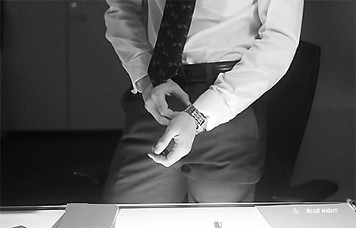
Administration

Slide 19
Administration
Dongari
Workshop

Slide 20
Administration
New DONGARIES were registered by the leaders!

Slide 21
Administration
UKAraoke
Band

Slide 22
Administration
Please Sign Up!!
These Dongaries are not yet created because they need at least 5 people to join!

Slide 23
Administration
Course Registration Workshop Recap

Slide 24
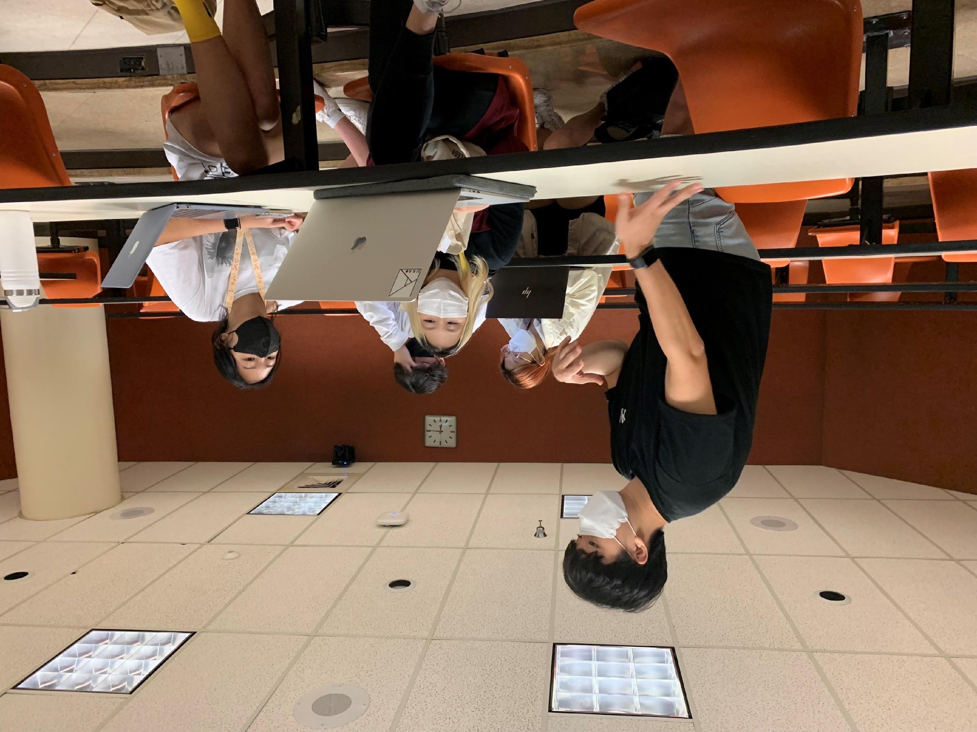
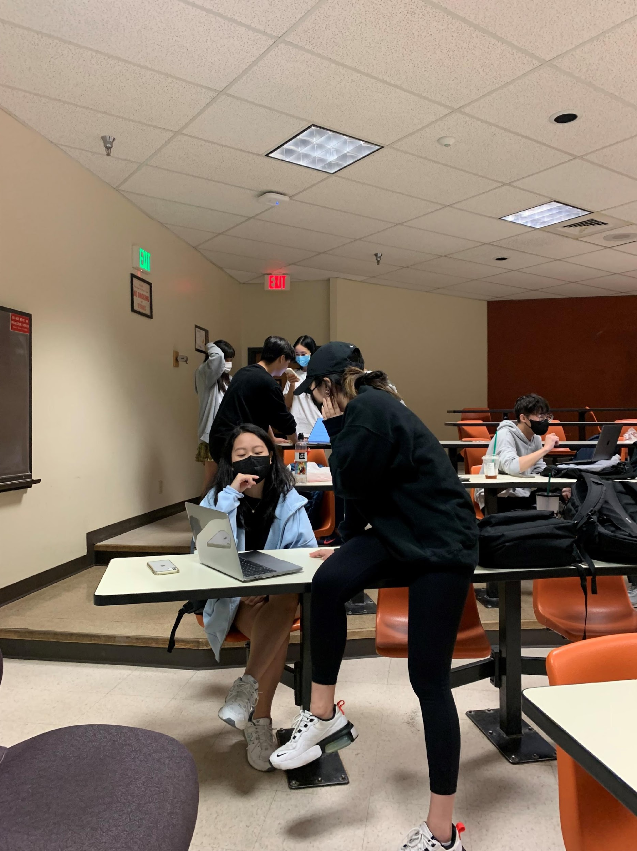
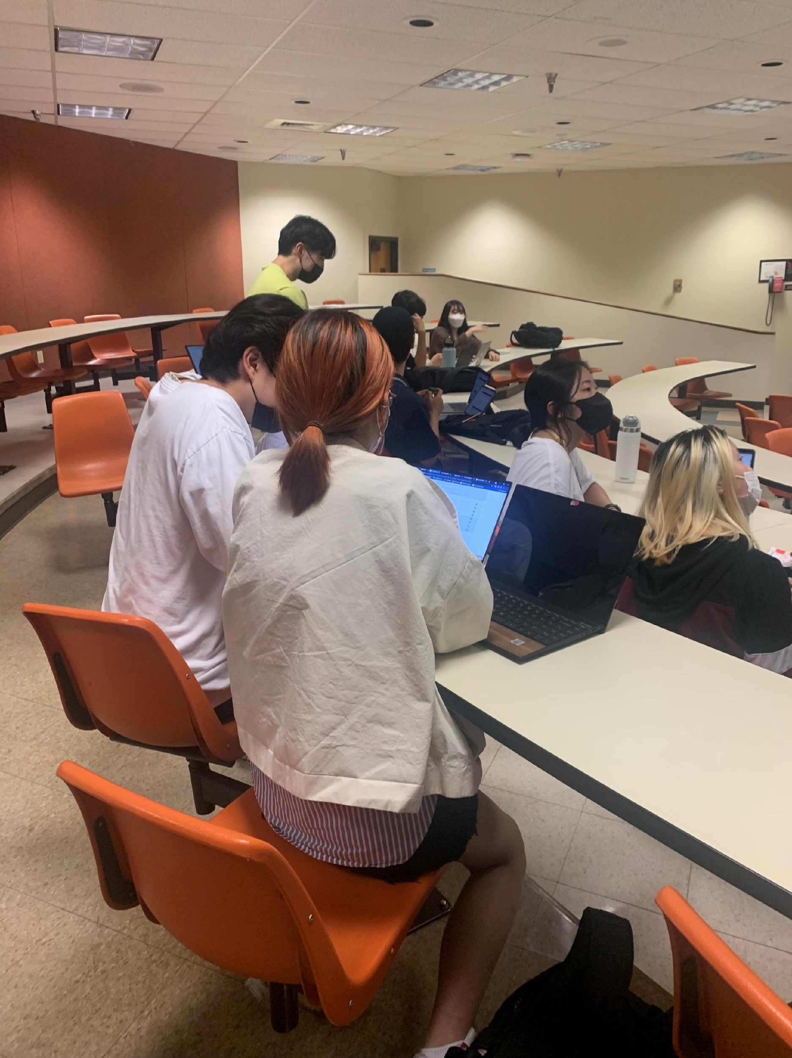
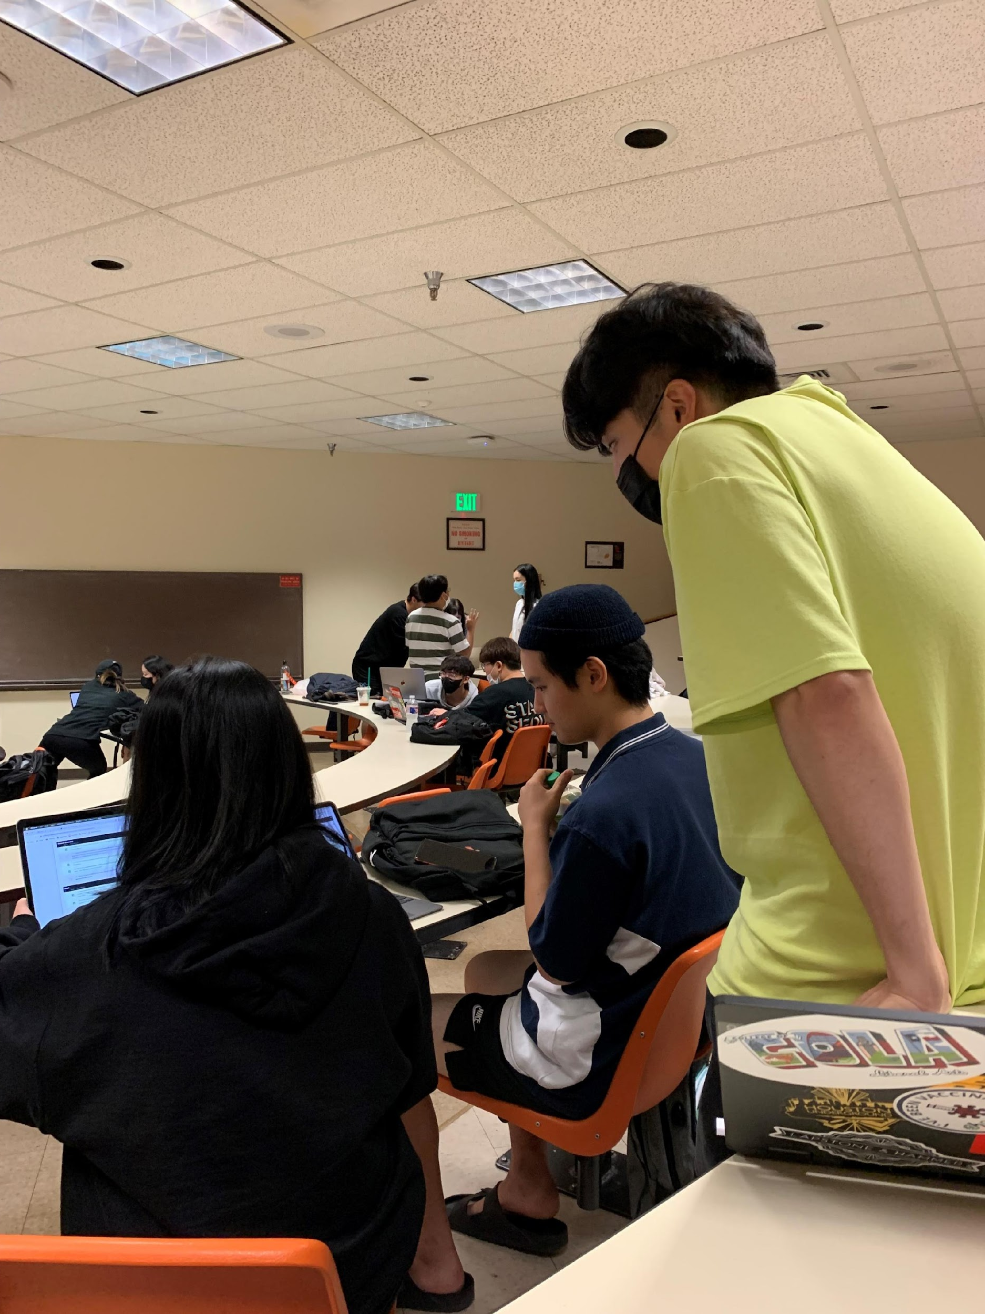
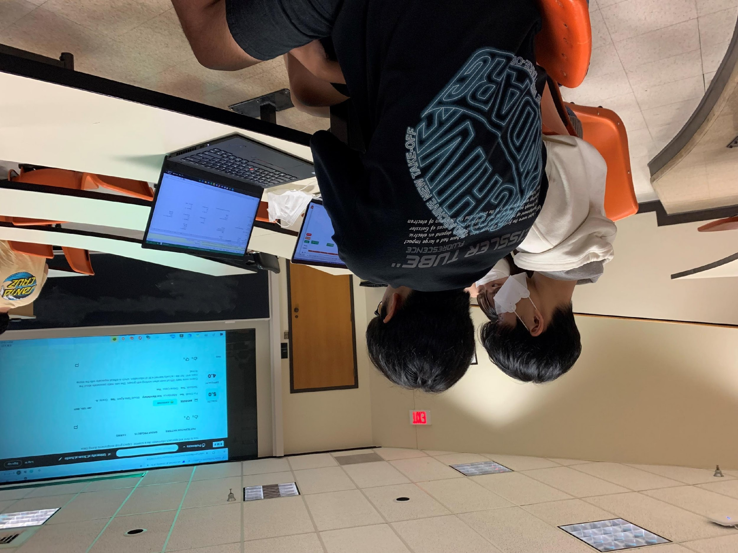
Course Registration Workshop Recap

Slide 25
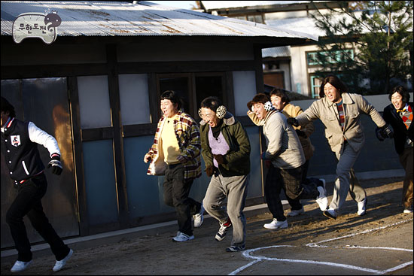
Operation

Slide 26
Operation
Fall Picnic
Bowling Night

Slide 27
Operation
Fall Picnic Recap

Slide 28
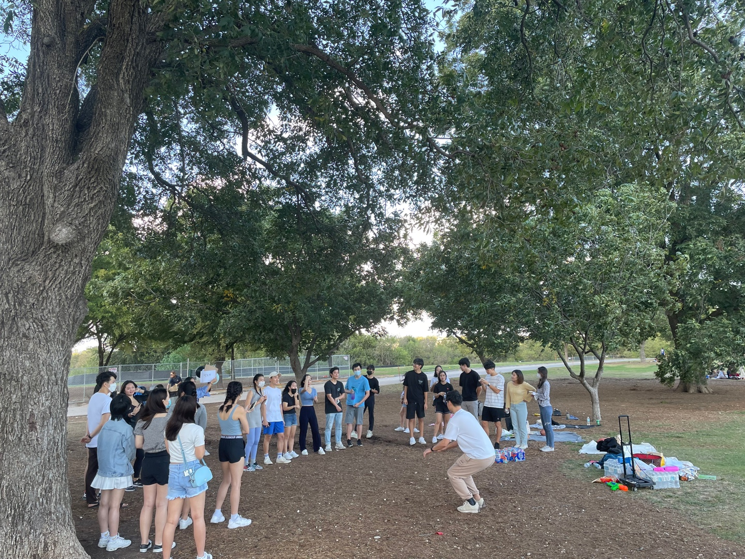
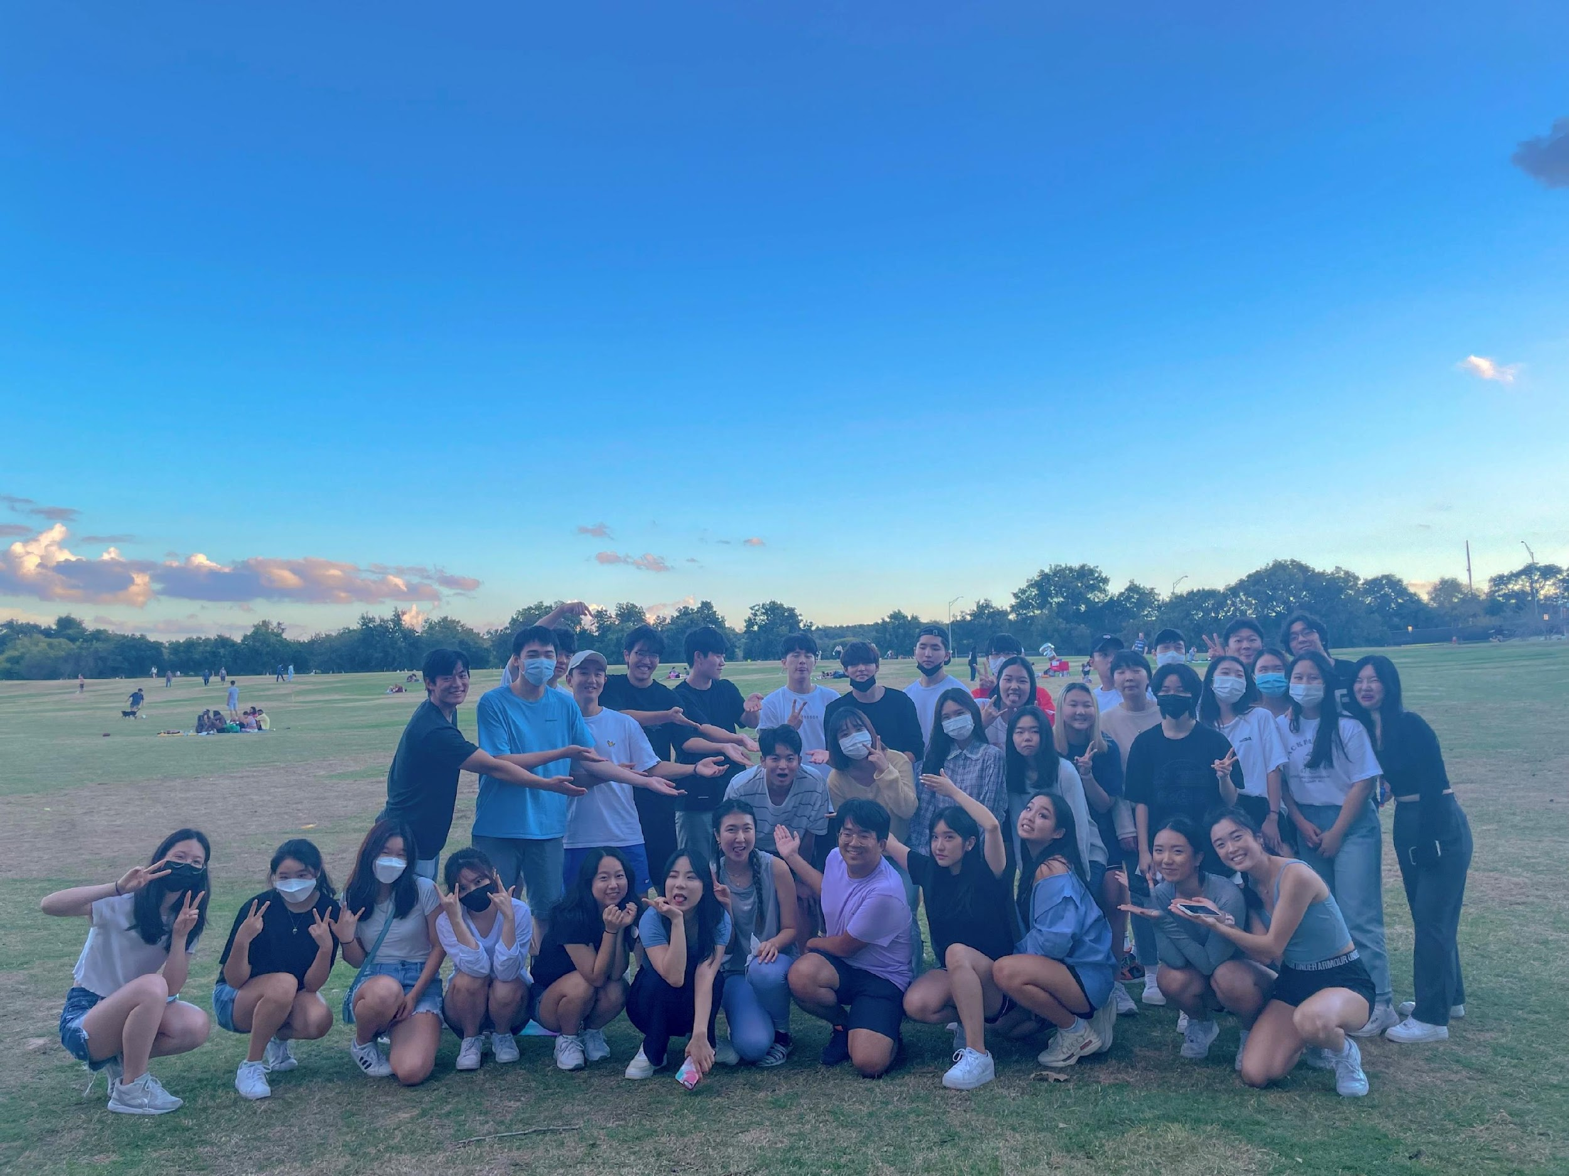
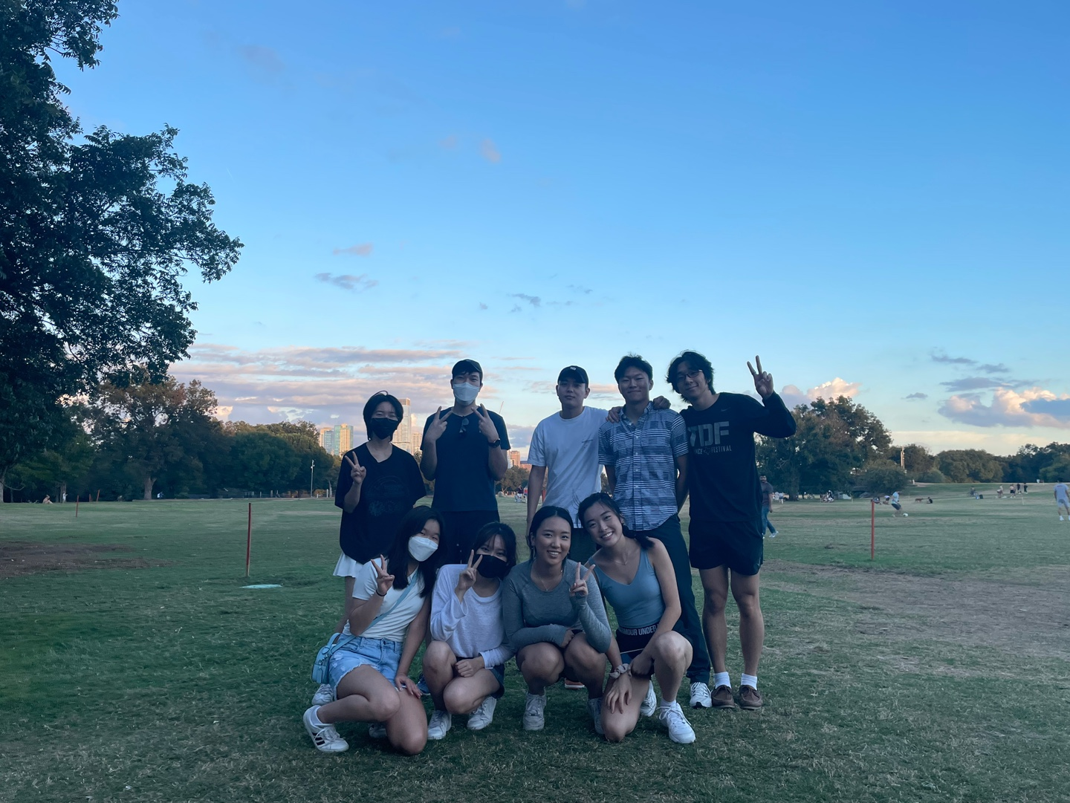
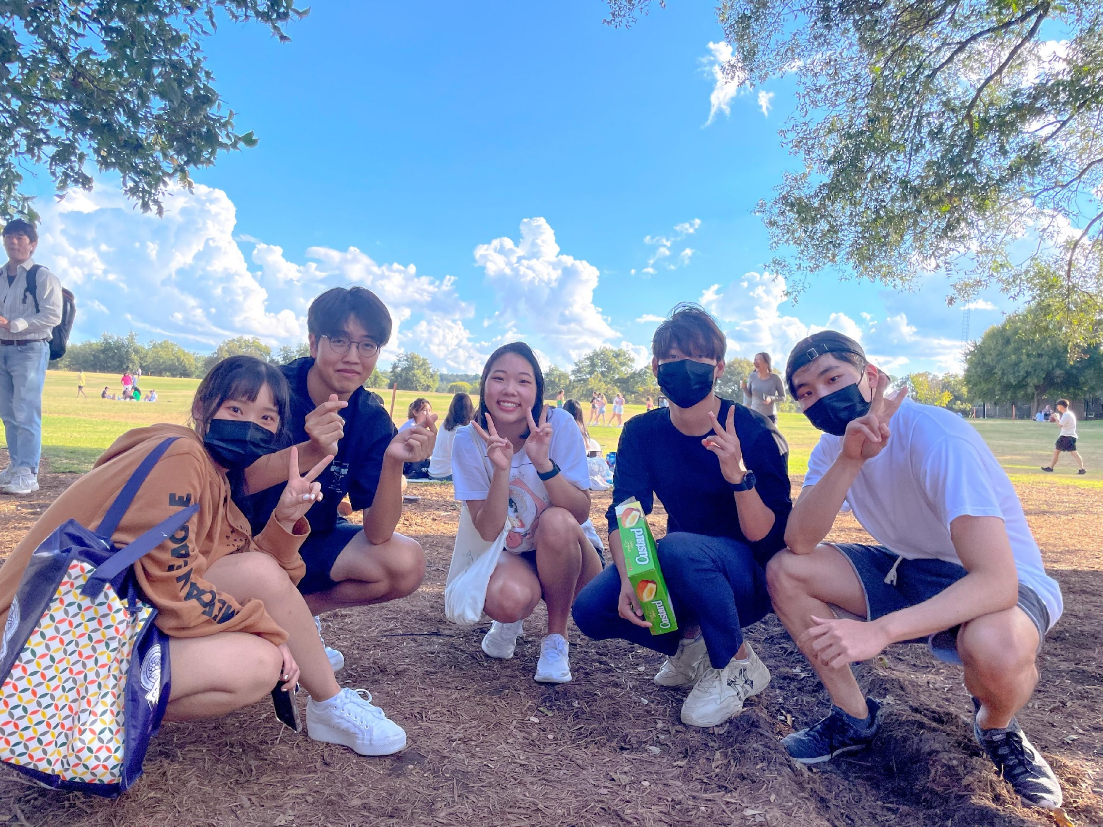
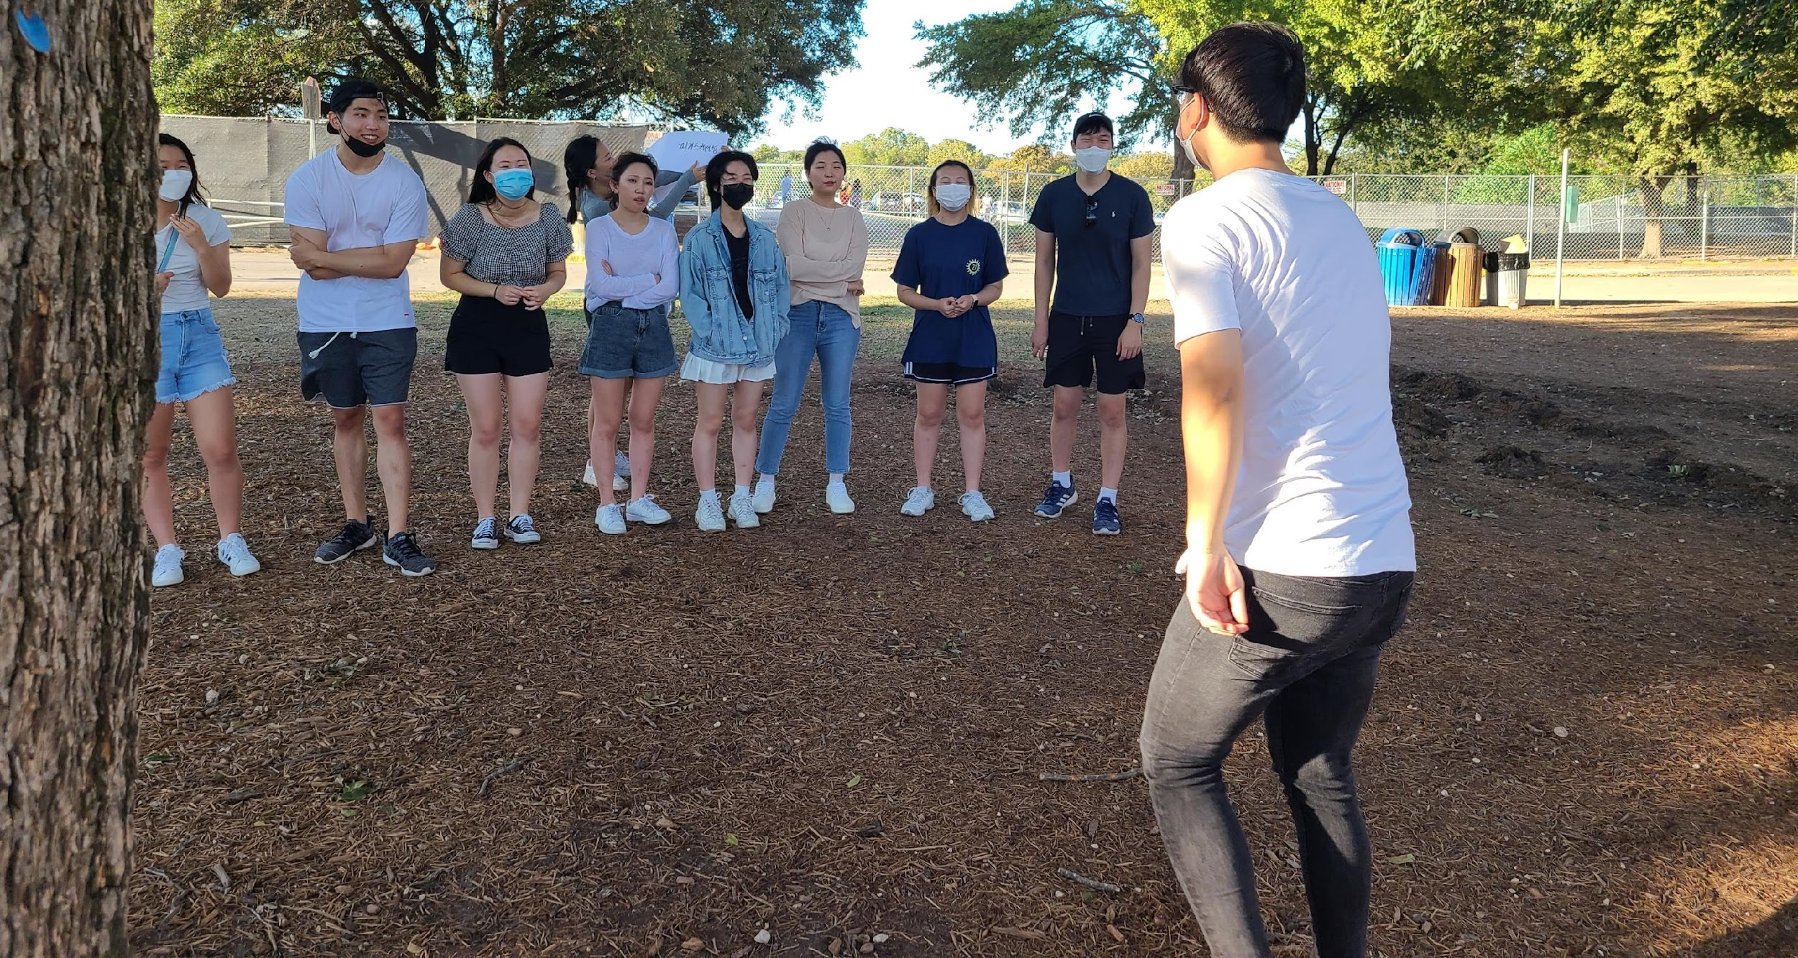
Fall Picnic Recap

Slide 29
Bowling Night
11/12
FAM-FAM Competition!

Slide 30
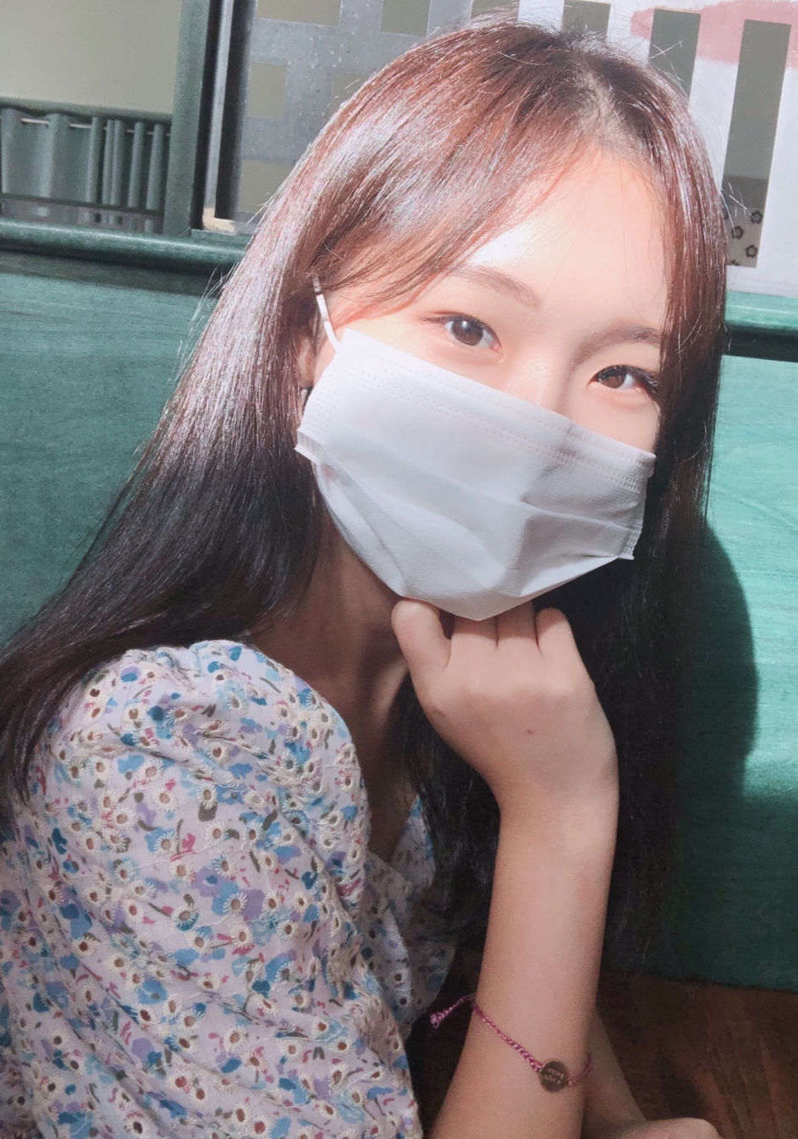
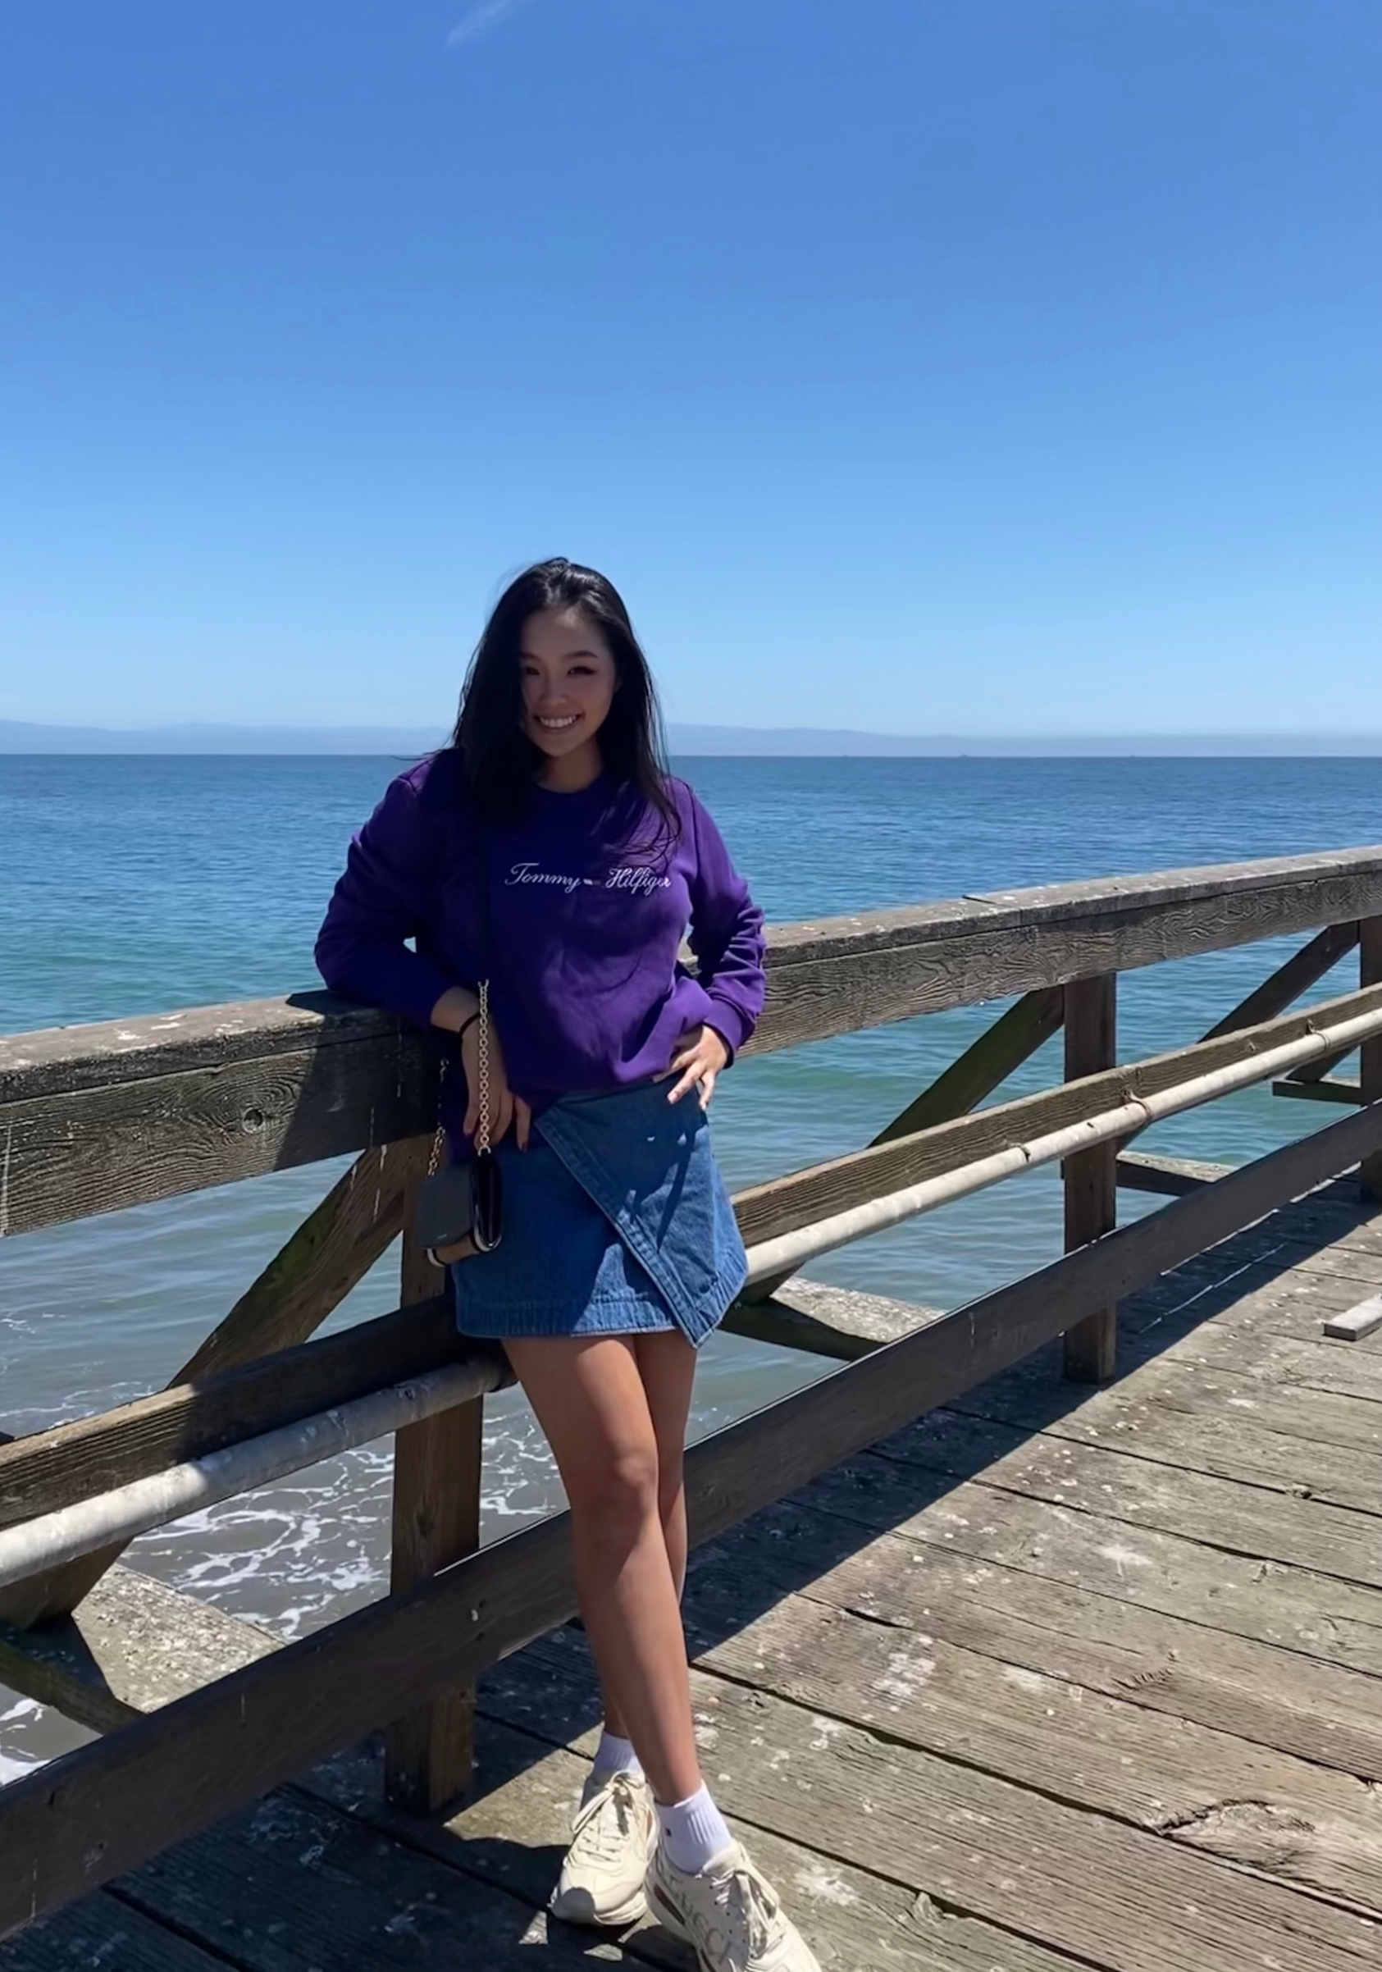
Director of the Month
Yeonseo Choi
(Master of Dalgona)
Jiyeon Yoon
(Picnic Lover)

Slide 31
Gingerbread House
Build your dream house with your FAM-FAM members

Slide 32
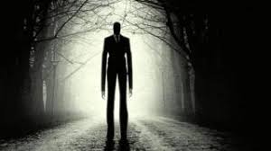
Theme: Halloween
Only one FAM-FAM group who satisfies Slenderman will get the prize!

Slide 33
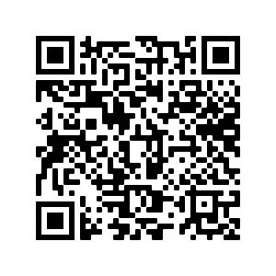
Costume Constest
Please vote the best costume you think!

